Slide 1
JOINS

Slide 2
Joins
Relational databases create relationships between any two tables
Consider this:
We want to store information about product and our supplier
We could create a table that stores a product name, a qty and a supplier
CREATE TABLE product(
id INTEGER NOT NULL AUTO_INCREMENT PRIMARY KEY,
prod_name VARCHAR(30) NOT NULL,
qty SMALLINT NOT NULL,
supplier VARCHAR(10)
)ENGINE=INNODB;

Slide 3
Joins
But what if we wanted to store more than that – what if we wanted to store all the contact information for a supplier as well?
CREATE TABLE product(
id INTEGER NOT NULL AUTO_INCREMENT PRIMARY KEY,
prod_name VARCHAR(30) NOT NULL,
qty SMALLINT NOT NULL,
supplier VARCHAR(10),
contactName VARCHAR(50),
contactPhone CHAR(10),
contactEmail VARCHAR(30),
contactPosition VARCHAR(15)
)ENGINE=INNODB;

Slide 4
Joins
We start inserting information into our new table:
INSERT INTO product (prod_name,qty, supplier, contactName, contactPhone, contactEmail, contactPosition)
VALUES
('Chicken', 2, 'Farm Chicken Supplier', 'John Doe', '555-6656','jdoe@email.com','Buyer'),
('Turkey',14,'Farm Chicken Supplier', 'John Doe','555-6666','jdoe@email.com','Buyer'),
('Beef',22, 'Cow Farms','Mike Smith', '666-9656', 'msmith@email.com', 'manager');
As this information grows it becomes more and more cumbersome….
Repeating information – waste of storage space
If the vendor changes – multiple records need to be updated
When repeated data is used, the higher the chance of errors

Slide 5
Joins
Relational databases help with these issues
CREATE TABLE supplier(
id INTEGER NOT NULL AUTO_INCREMENT PRIMARY KEY,
supplierName VARCHAR(30),
contactName VARCHAR(50),
contactPhone CHAR(10),
contactEmail VARCHAR(30),
contactPosition VARCHAR(15)
);
CREATE TABLE product(
id INTEGER NOT NULL AUTO_INCREMENT PRIMARY KEY,
prod_name VARCHAR(30) NOT NULL,
qty SMALLINT NOT NULL,
supplier INTEGER,
FOREIGN KEY(supplier)
REFERENCES supplier(id)
);

Slide 6
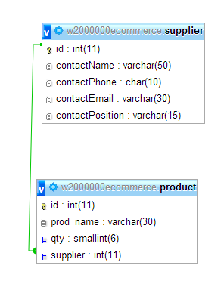
Joins
Relational Database

Slide 7
Joins
Add information to the Supplier table
INSERT INTO supplier
(supplierName,contactName, contactPhone, contactEmail, contactPosition)
VALUES
('Farm Chicken Supplier', 'John Doe', '555-6656','jdoe@email.com','Buyer'),
('Cow Farms','Mike Smith', '666-9656', 'msmith@email.com', 'manager');
INSERT INTO product
(prod_name, qty, supplier)
VALUES
('Chicken', 2, 1),
('Turkey',14,1),
('Beef',22,2);

Slide 8
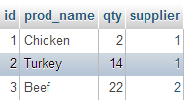

Joins
Retrieving Information
SELECT *
FROM product;
SELECT *
FROM supplier;

Slide 9
Joins
You can use this relationship to query information from more than one table
A JOIN relates or associates two tables producing a single table
There are several types of JOINS:
INNER JOIN
OUTER JOIN
LEFT OUTER JOIN
RIGHT OUTER JOIN

Slide 10
Characteristics of a Join
Tables are joined, row by row and side by side, by satisfying whatever JOIN conditions are imposed
Non-matching rows are included or excluded based on the join type
A typical join condition specifies a foreign key in one table and the associated primary key in another
If a join’s connecting columns contain nulls the nulls will never join (remember a null is unknown – so an unknown cannot equal another unknown)

Slide 11
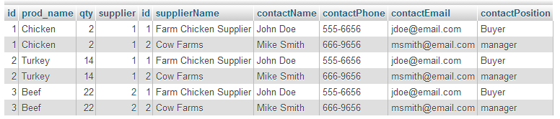
Joining the two tables
Get all the results from the two table joined on the ids
SELECT *
FROM product, supplier
This result set is called a Cartesian Product – the number of rows retrieved will be the number of rows in the first table (product) multiplied by the number of rows in the second table (supplier)

Slide 12
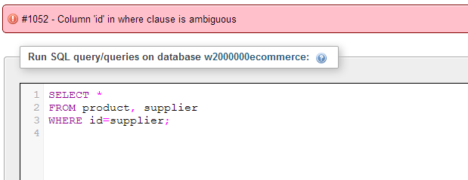
Joining the two tables
The WHERE clause is required to tell the database how to associate the information
Acts as a filter
SELECT *
FROM product, supplier
WHERE id=supplier;

Slide 13
INNER JOIN

Slide 14
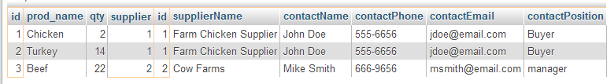
Qualifying Columns
Qualifying column names is mandatory when there is more than one instance
SELECT *
FROM product, supplier
WHERE product.supplier=supplier.id;

Slide 15
Explicit Declarations
Use the keyword INNER JOIN and the ON clause
Only the rows that satisfy the condition in the ON clause are returned
SELECT column1, column2, column3
FROM table_a INNER JOIN table_b
ON column_x=column_y

Slide 16
Explicit Declarations
SELECT *
FROM product INNER JOIN supplier
ON product.supplier=supplier.id;

Slide 17
Qualifying Column Names
Table Aliases
An alternate name assigned to a table in the query (often shorter than the table name)
Aliases are temporary and are only valid for the duration of the query
SELECT t.title_name, t.type, p.pub_name
FROM titles AS t INNER JOIN publishers AS p
ON t.pub_id=p.pub_id;

Slide 18
Qualifying Column Names
You can mix qualified and unqualified names
It is not required – but helps to improve system performance to qualify all columns AND helps makes the query self-documenting (you know what it is doing and where the columns come from)
Helps to prevent any disruptions to your query caused by additions later (where a column is added to a table that now makes your query require qualification)

Slide 19
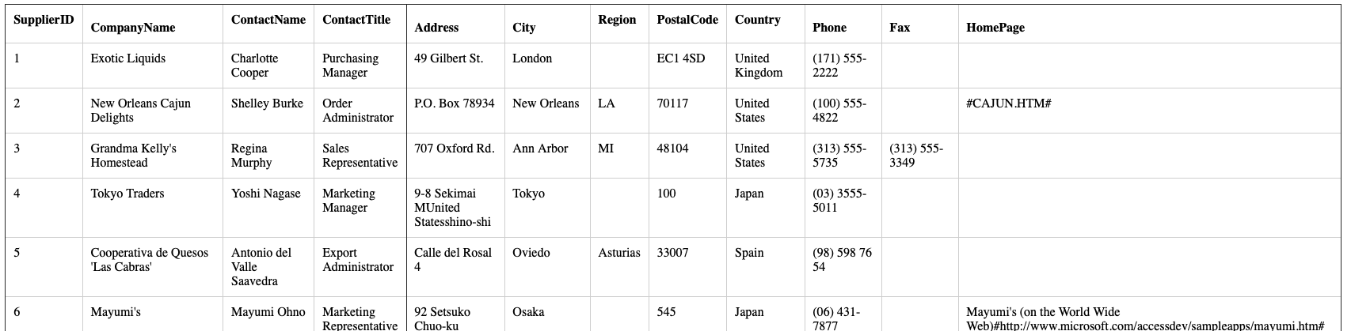
Inner Join
Suppliers table:

Slide 20
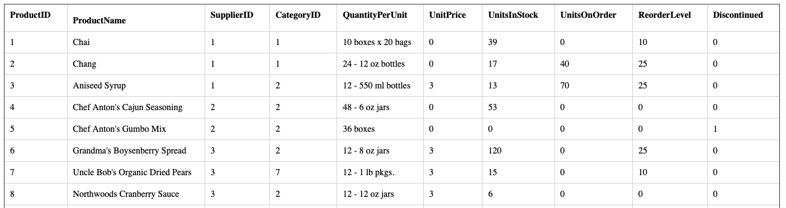
Products table

Slide 21
Joining the two tables
SELECT p.productName, s.companyName
FROM products AS p INNER JOIN suppliers AS s
ON p.SupplierID = s.SupplierID;
OR
SELECT products.productName, suppliers.companyName
FROM products INNER JOIN suppliers
ON products.SupplierID = suppliers.SupplierID;

Slide 22
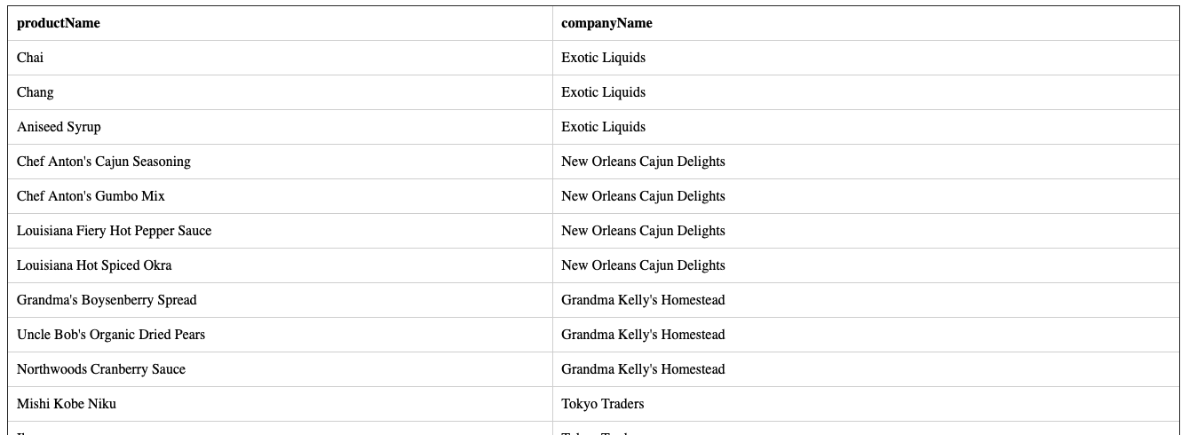
Query Result

Slide 23
Organize by supplier
SELECT products.productName, suppliers.companyName
FROM suppliers INNER JOIN products
ON products.SupplierID = suppliers.SupplierID
ORDER BY suppliers.companyName;

Slide 24
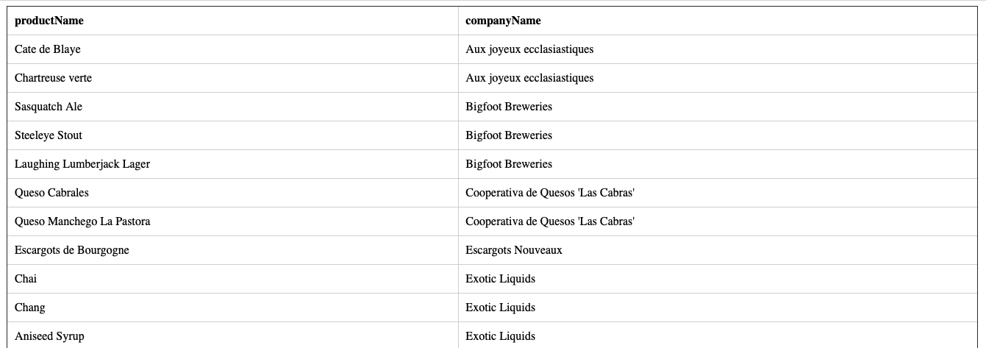
Query Result

Slide 25
Filter the result
SELECT products.productName, suppliers.companyName, suppliers.country
FROM suppliers INNER JOIN products
ON products.SupplierID = suppliers.SupplierID
WHERE country = 'United States'
ORDER BY suppliers.companyName;

Slide 26
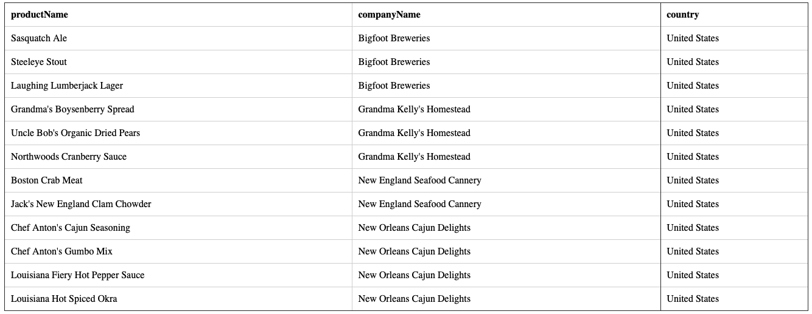
Query Results

Slide 27
Aggregate
List the number of products that each supplier provides
SELECT s.companyName, COUNT(p.productName) AS numberOfProducts
FROM suppliers AS s INNER JOIN products as p
ON s.SupplierID = p.SupplierID
GROUP BY s.companyName
ORDER BY numberOfProducts;

Slide 28
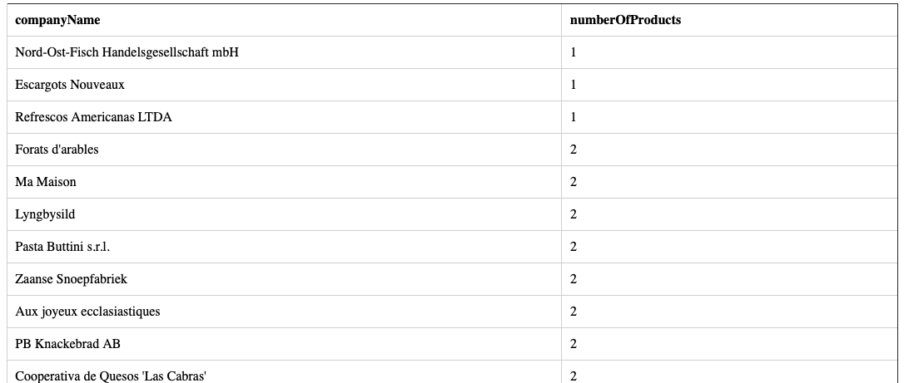
Query Result

Slide 29
JOIN more than one table
SELECT s.companyName, p.ProductName, c.CategoryName
FROM suppliers AS s INNER JOIN products as p
ON s.SupplierID = p.SupplierID
INNER JOIN categories as c
ON p.CategoryID = c.CategoryID;

Slide 30
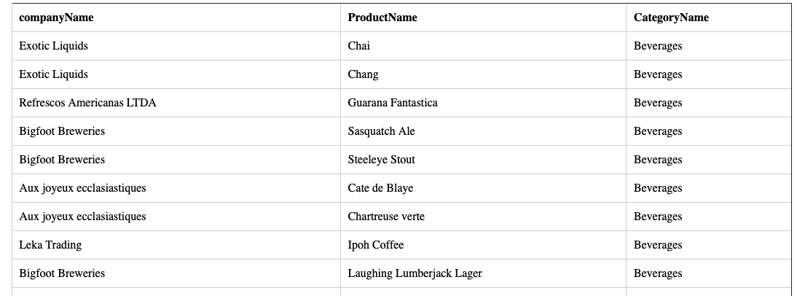
Query Result

Slide 31
OUTER JOINS
INNER JOINS do NOT return rows that do not match with a row from the other table
OUTER JOINS return all rows from at least one of the tables
Useful for answering questions about missing quantities
Authors who have written no books
Or reports that want all information from one table and matching rows from another

Slide 32
Outer Joins
The order in which you specify the tables in an outer join are important
Left outer join includes all the rows from the left table
If a row in the left table has no matching rows in the right, the associated row in the result contains NULLS
Right outer join includes all the rows from the right table
Full outer join returns all rows in the left and right tables

Slide 33
Sample information
SELECT au_fname, au_lname, city
FROM authors ;
Sarah | Buchman | Bronx
Wendy | Heydemark | Boulder
Hallie | Hull | San Francisco
Klee | Hull | San Francisco
Christian | Kells | New York
 | Kellsey | Palo Alto
Paddy | O'Furniture | Sarasota

Slide 34
Sample Information
SELECT pub_name, city FROM publishers
Abatis Publishers | New York
Core Dump Books | San Francisco
Schadenfreude Press | Hamburg
Tenterhooks Press | Berkeley

Slide 35
Comparison
List the authors that live in cities which have a publisher…
SELECT a.au_fname, a.au_lname,p.pub_name
FROM authors AS a
INNER JOIN publishers AS p
ON a.city=p.city;

Slide 36
Query Results
au_fname | au_lname | pub_name
Hallie | Hull | Core Dump Books
Klee | Hull | Core Dump Books
Christian | Kells | Abatis Publishers

Slide 37
Left Outer Join
SELECT a.au_fname, a.au_lname, p.pub_name
FROM authors AS a LEFT OUTER JOIN publishers AS p
ON a.city = p.city;
au_fname | au_lname | pub_name
Sarah | Buchman | NULL
Wendy | Heydemark | NULL
Hallie | Hull | Core Dump Books
Klee | Hull | Core Dump Books
Christian | Kells | Abatis Publishers
 | Kellsey | NULL
Paddy | O'Furniture | NULL

Slide 38
Right Outer Join
SELECT a.au_fname, a.au_lname, p.pub_name
FROM authors AS a RIGHT OUTER JOIN publishers AS p
ON a.city = p.city
au_fname | au_lname | pub_name
Christian | Kells | Abatis Publishers
Hallie | Hull | Core Dump Books
Klee | Hull | Core Dump Books
NULL | NULL | Schadenfreude Press
NULL | NULL | Tenterhooks Press

Slide 39
Outer joins
Left and right outer joins are equivalent, its just a matter of what table is the outer table
SELECT a.au_fname, a.au_lname, p.pub_name
FROM authors AS a RIGHT OUTER JOIN publishers AS p
ON a.city = p.city
SELECT a.au_fname, a.au_lname, p.pub_name
FROM publishers AS p LEFT OUTER JOIN authors AS a
ON p.city = a.city
au_fname | au_lname | pub_name
Klee | Hull | Core Dump Books
Christian | Kells | Abatis Publishers
NULL | NULL | Schadenfreude Press
NULL | NULL | Tenterhooks Press
au_fname | au_lname | pub_name
Klee | Hull | Core Dump Books
Christian | Kells | Abatis Publishers
NULL | NULL | Schadenfreude Press
NULL | NULL | Tenterhooks Press

