Slide 1
Entity Relationship Diagrams
MAD 202

Slide 2
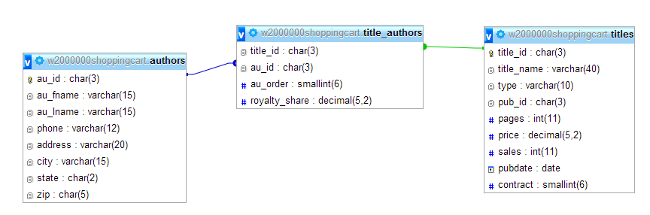
ERD diagrams
Entity Relationship Diagrams (ERD) are diagrams that detail the relationships between tables (entities).

Slide 3
Three types of relationships
One to One
Where one entity has a relationship with a single other entity
Student and Student ID
One to Many
Where one entity has a relationship with several other entities, but each of those still has a single relationship with each entity
Customer has many orders, but each order has a single customer
Many to Many
Each entity has a relationship with many entities and the reverse is true
Students and classes
A student has many classes and each class has many students

Slide 4
ERD Diagrams
Different Diagram methods
One method involves drawing entities as rectangles and relationships as diamonds
For example:
What is the relationship between a doctor and a patient?
TREATS
Doctor
Patient

Slide 5
ERD Diagrams
Other relationships
INSTRUCTS
Teacher
Students
ASSIGNED
Student Number
Student

Slide 6
ERD Diagrams
There are three kinds of relationships – they are modelled after cardinality
A doctor can treat many patients
M
TREATS
N
Doctor
Patient
A patient can be treated by many doctors

Slide 7
ERD Diagrams
Many to Many require a Junction Table
DoctorPatients
M
TREATS
N
Doctor
Patient

Slide 8
ERD Diagrams
What is the type of relationship here?
A Student Number is assigned to a student
ASSIGNED
Student Number
1
1
Student
A Student is assigned a single student number

Slide 9
ERD Diagrams
What is the relationship here?
A customer places several orders
PLACES
Customer
1
M
ORDER
Each order is placed by a single customer

Slide 10
ERD Diagrams
What is the relationship here?
A coordinator advises many students
ADVISES
Coordinator
1
M
Student
A student is advised by a single coordinator

Slide 11
ERD Diagrams
What is the relationship here?
A passenger reserves many flights
RESERVES
Passenger
M
N
Flight
A flight is reserved by many passengers
PassengerFlights

Slide 12
Cardinality
Cardinality describes the numeric relationship between two entities and shows how instance of one entity relate to instances of another entity
The interaction is modelled using cardinality notation which uses special symbols to represent the relationship
A common method of notation is called crow’s foot notation – due to the shapes

Slide 13
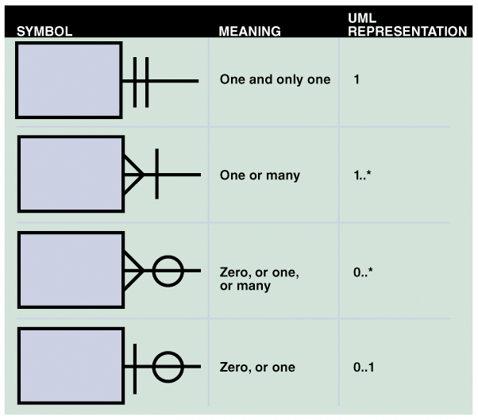
Cardinality
Crow’s Foot Notation

Slide 14
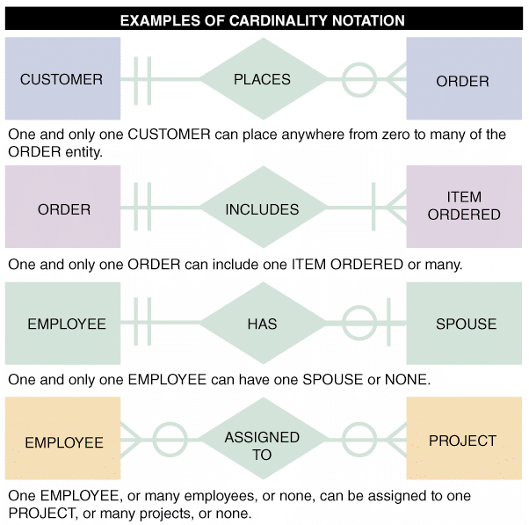
Cardinality

