Slide 1
Database Design

Slide 2
The relational model
We have been utilizing the relational model this semester. This model is based on the idea of relations
REVIEW
A table is:
Database structure that holds data
Contains data about a specific entity type
A two-dimensional grid characterized by rows and columns
Holds a data item (value) at each row-column intersection
Has at least one column and zero or more rows (no rows = empty table)
Has a unique name within a database
An entity type is a class of real world objects – a patient, movie, invoice… etc.

Slide 3
The relational model
A column :
Represents a specific attribute (property) of the table’s entity type
Each column has a domain (defined using data types) that restricts the set of values allowed in that column
Entries in columns are single-valued
Order (left to right) is unimportant
Each column has a name that identifies it uniquely within a table
A row:
Each row describes a fact about an entity
Each row contains a value or null
Order (top to bottom) is unimportant
No two rows in a table can be identical
Each row in a table is uniquely identified by its primary key

Slide 4
Relationships
A relationship is an association between common columns in two tables
The foundation of a relational database
Established how tables are related (linked) to each other
Cardinality indicates the number of instances (none, one, or many) of an entity in relation to another entity.
This can be expressed as:
One-to-one
One-to-many
Many-to-many

Slide 5
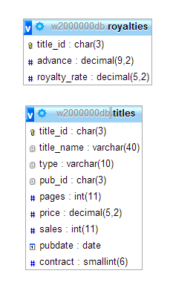
One-to-one
In a one-to-one relationship, each row in table A can have AT MOST ONE matching row in the table B – and each row in table B can have AT MOST ONE matching row in table A
A primary key of one table is also the foreign key referencing the primary key of another table
The relationship between the royalties table and the titles table is a one to one relationship.

Slide 6
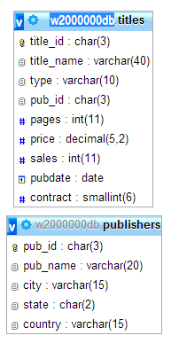
One-to-many
In a one-to-many relationship, each row in Table A can have many (zero or more matching rows in table B, but each row in table B has only one matching row in table A.
A primary key of one table appears as a foreign key in the many table
The relationship between the titles table and the publishers table is a one to many relationship.

Slide 7
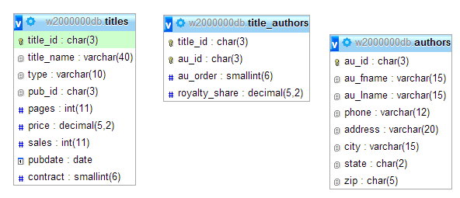
Many-to-many
In a many-to-many relations, each row in table A can have many (zero or more) matching rows in table B, and each row in table B can have many (zero or more) matching rows in table A.
A many to many relationship is established only by creating a third (junction) table that house the primary keys from both tables
One-to-many
One-to-many
Many-to-many

Slide 8
First Normal Form

Slide 9
Creating Tables and Relationships
It is possible to store all the information in a single table
It would be very large and would contain duplicate data
Redundancy causes systems to slow down, require additional effort to maintain
Updates would require significantly more attempts
Vehicle | Company | Color
Equinox | GM | Blue
Gulf | Volkswagen | Red
Wrangler | Chrysler | Black
Jetta | VW | Silver
Passat | VW | Grey

Slide 10
Creating tables and relationships
When creating a database or reviewing an existing database, you will undergo a process called Normalization
Normalization is a process that helps to ensure that your database design is free of potential update, redundancy and consistency problems.
It involves converting tables into various types of normal forms
First Normal Form (1NF)
Second Normal Form (2NF)
Third Normal Form (3NF)
better
better
This an approach that requires repeated splitting of tables and refining

Slide 11
First Normal Form
A table that contains a repeating group or multiple entries for a single row is called an unnormalized table.
Removal of repeating groups is required – most database systems do NOT allow tables to contain repeating groups
If a table does not contain repeating groups is considered to be in the first normal form (1NF)
A table in first normal form:
Has columns that contain atomic values (single values that cannot be subdivided)
Has no repeating groups

Slide 12
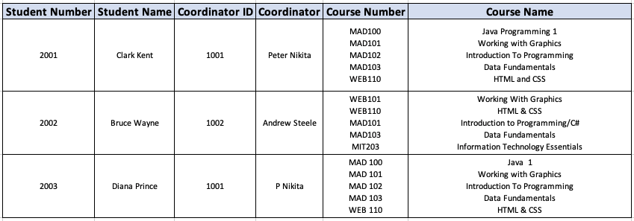
FIRST NORMAL FORM EXAMPLE
STUDENT(Student Number, Student Name, Co-ordinator ID, Co-ordinator Name, Course Number, Course Name)

Slide 13
Conversion to first normal form
To bring a table to 1NF – store the repeating values in different rows.

Slide 14
Conversion to first normal form
To bring a table to 1NF – store the repeating values in different rows.
No longer repeating – but problems may still exist

Slide 15
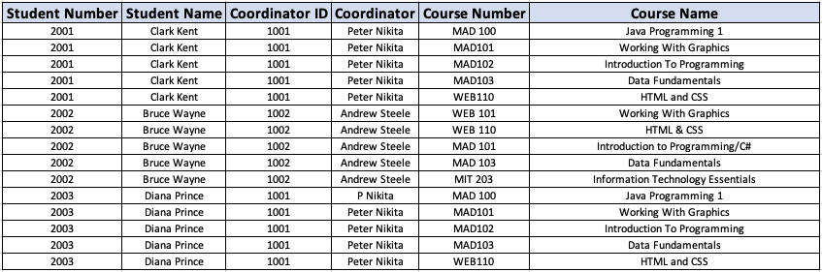
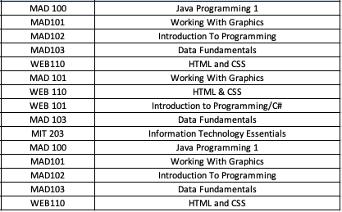
Conversion to first normal form

Slide 16
Why is this a problem?
A database that does not conform to 1NF:
Queries become increasingly complex
Multiple values in a row-column intersection mean that table name, column name, and key are insufficient to address every value in the database
Difficult to update, retrieve, insert or delete a single value because you must rely on the order of the values

Slide 17
Second Normal Form

Slide 18
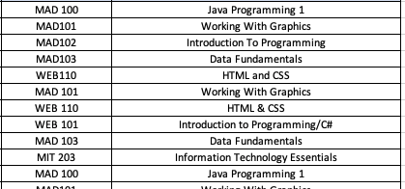
Second Normal form
Redundancy in the table which cause what is called update anomalies
Update – change in name requires multiple updates
Inconsistent Data- nothing to prevent the course names from being different

Slide 19
Second Normal Form
Additions – cumbersome due to absence of unique identifier
Deletions – will remove customer information when deleting a course

Slide 20
Conversion to Second Norm
A table is in second normal form (2NF) if it is in the first normal form and no nonkey field is dependent on only a portion of the primary key.
If the primary key of a table contains only a single field, the table is automatically in the second normal form.

Slide 21
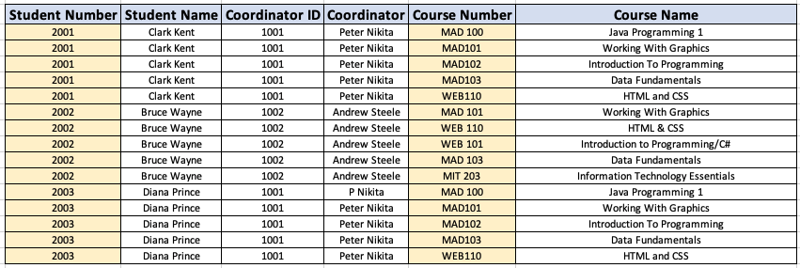
Solution
Create tables that house the Student and Courses

Slide 22
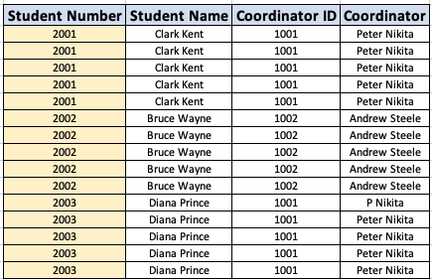

Convert to 2NF
… and no nonkey field is dependent on only a portion of the primary key
Key to each record is a combination of the Student Number and Course Code

Slide 23

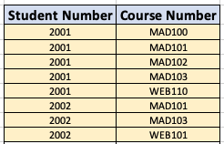

Convert to 2NF

Slide 24
Third Normal Form

Slide 25

Third Normal Form
Problems can still exist in a 2NF table - not the primary key
Repetition

Slide 26
Third normal form
Determinant – any field or collection of fields that determines another field. Primary key is a determinant field
Candidate key – a field or collection of fields that could function as primary keys
A table is consider in Third Normal Form if it is in second normal form and if the only determinants it contains are candidate keys

Slide 27
Convert to 3NF

Slide 28
Convert to 3NF

Slide 29


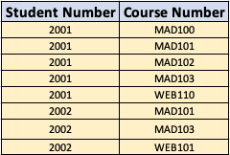

3NF
Coordinator Table
Student Table
Course Table
Junction Table

