Slide 1
Can We Use Google Trends Search Data to Find Patterns in Bitcoin Trading?
April 4, 2018

Slide 2
Building a Bitcoin Negative Sentiment Indicator Using Google Trends Data
Our hypothesis is that a spike in Google searches for “Bitcoin” combined with negative terms might indicate rising negative sentiment for Bitcoin
Negative search terms data was pulled from Google Trends using “Bitcoin” + the following terms: banned, scam, collapse, crash, fall, fraud, illegal, Ponzi, tulip, worst.
The total volume of these negative searches was then divided by general searches for “bitcoin” alone to arrive at our theoretical bitcoin negative sentiment indicator (somewhat analogous to vadersentiment for text)

Slide 3
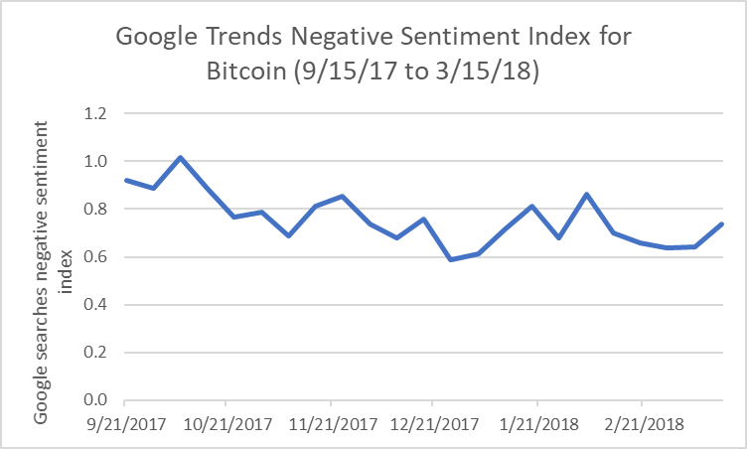
Google Trends Negative Sentiment Index -- Results

Slide 4
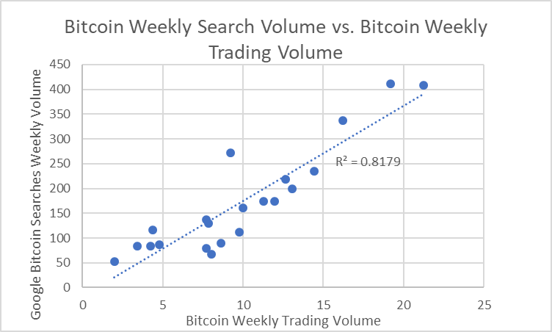
We found a very strong correlation between weekly search volumes for bitcoin and weekly trading volumes of bitcoin

Slide 5
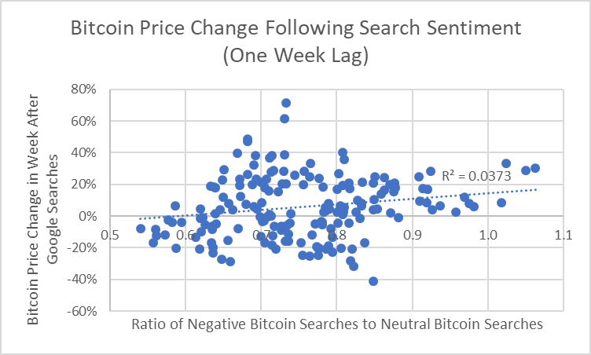
We found a weak correlation between our negative sentiment indicator and subsequent change in bitcoin price

Slide 6
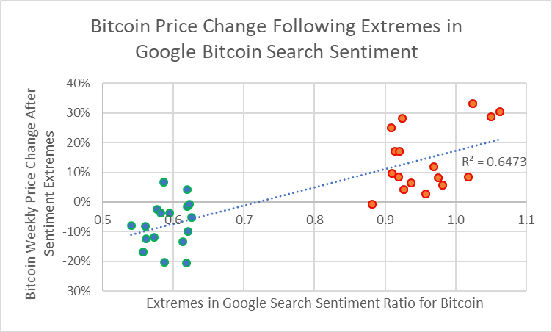
When we focused in only on extremes in our in negative sentiment indicator (top and bottom 10% of sentiment extremes), the predictive power of our indicator improved

Slide 7
Negative sentiment in Google searches appears to be inversely correlated with subsequent price moves in bitcoin. “Be Fearful When Others Are Greedy and Greedy When Others Are Fearful” -- Warren Buffet

