Slide 1
Thanks a Plot!
January 2018

Slide 2
Today’s Class

Slide 3
Objectives
In today’s class we’ll be covering:
Introduction to Plotly.js, charting, and customizing charts
Understand Charting, Interactivity, and Figure Hierarchy
Build Basic Chart types including Scatter, Line, Bar, and Pie
Customize Chart layouts
More JavaScript practice!

Slide 4
How to Learn JavaScript

Slide 5
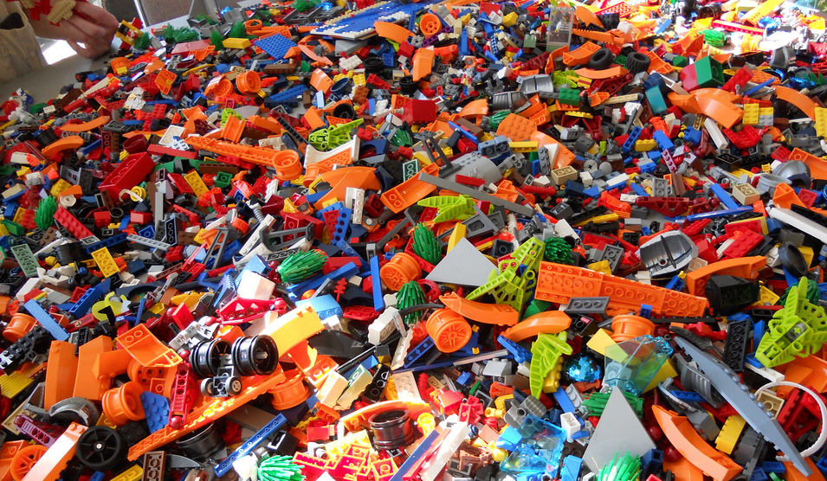
Your Brain on JavaScript…

Slide 6
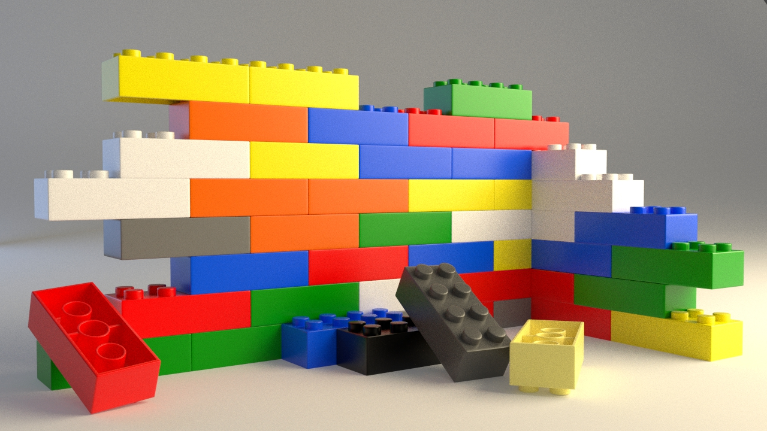
Start slow...

Slide 7
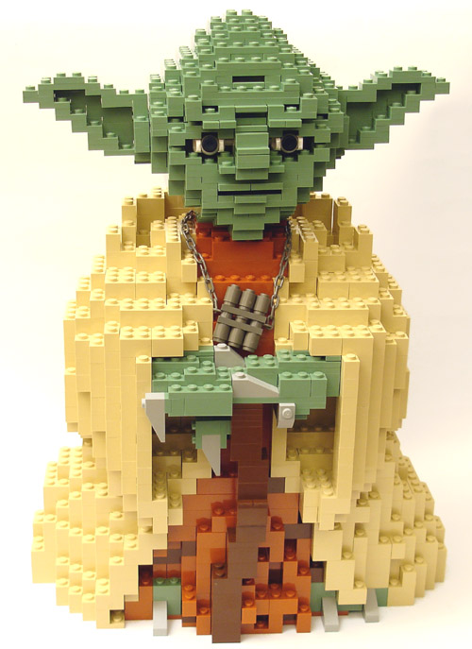
Eventually, this will be you...

Slide 8
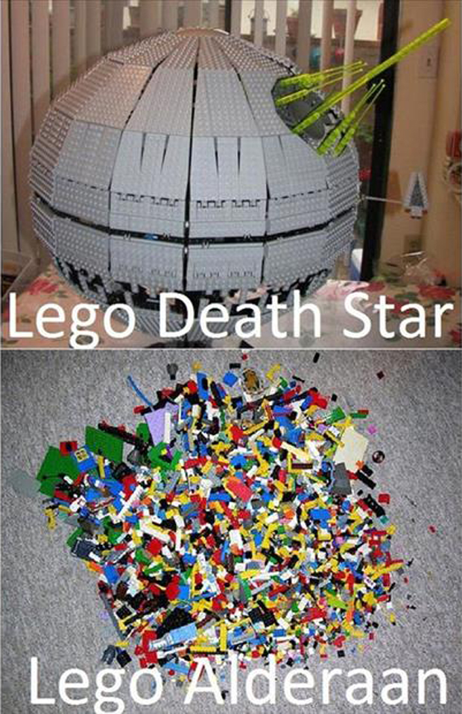
Just don’t become Lego Alderaan... Talk to us if you need extra help!

Slide 9
Overall Tips
Review Immediately: We’ll be building upon these concepts quickly. The firmer your grasp now, the better off you’ll be.
Re-do the exercises in class: Don’t just re-read! Actually spend the time to re-do them from scratch on your own.
Get Help: Come to office hours. Ask conceptual questions. Ask specific questions. Just keep asking questions!
Don’t be Afraid: You will get this. It will take time, but you will get this. Just keep at it. Patience will pay off.

