Slide 1
Big Data
The Data Bootcamp |
<Date goes here>

Slide 2
Big Data
What is Big Data?

Slide 3
What is Big Data?
Stock exchange data, emails, Social media posts like facebook statuses and tweets.
Lesser known things like, supply chains, barcodes, cell towers
There was always big data, just no way to keep it and analyze it.

Slide 4
Four Vs of Big Data
Volume - Size of the data
Terabytes of stock data
Velocity - How quickly data is coming in
Car sensors sending information every second
Variety - Different forms of data.
Social media posts, comments, photos etc.
Veracity - Uncertainty of data.
Again social media data may not be precise, come from bots, etc.

Slide 5
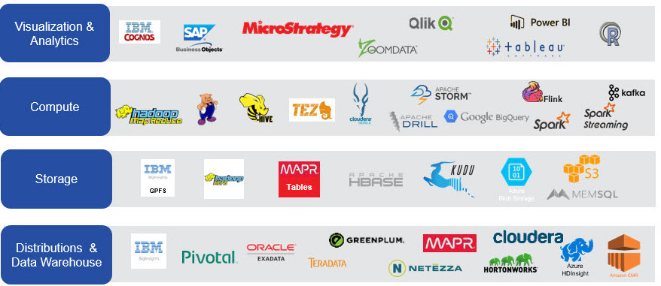
Big Data Overview

Slide 6
Big Data Problems
What are some issues that you might encounter when dealing with extremely large data sets?

Slide 7
Issues
Place to store massive amounts of data
Way to access data quickly
Back-ups for Hardware failure.
Ways to analyze data quickly

Slide 8
Hadoop Overview

Slide 9
What is Hadoop?
"The Apache Hadoop software library is a framework that allows for the distributed processing of large data sets across clusters of computers using simple programming models. It is designed to scale up from single servers to thousands of machines, each offering local computation and storage. Rather than rely on hardware to deliver high-availability, the library itself is designed to detect and handle failures at the application layer, so delivering a highly-available service on top of a cluster of computers, each of which may be prone to failures.”
- As defined on Hadoop website
Named after the creator’s, Doug Cutting, kid’s stuffed yellow elephant.

Slide 10
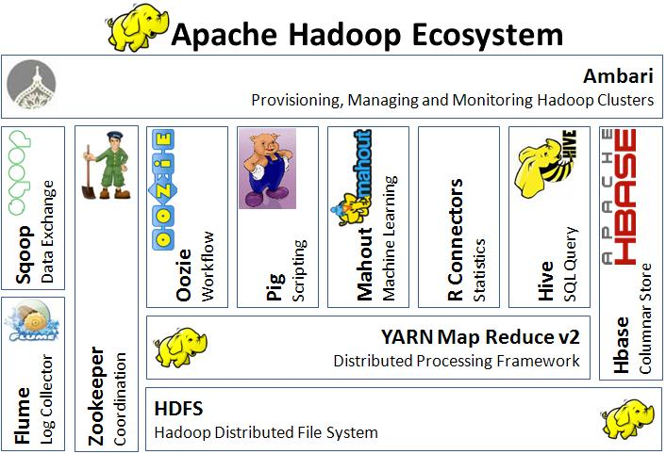
Hadoop Ecosystem

Slide 11
Fundamentals
MapReduce
The Hadoop Distributed Filesystem (HDFS)
Yet Another Resource Negotiator (YARN)

Slide 12
MapReduce

Slide 13

MapReduce History
It was originally created out of research at Google.
Designed to solve a single problem, how to index all the information on the internet.

Slide 14
Example: Counting The Number Of Books In A Library
Map: You count up the odd-numbered shelves. I count up the even numbered shelves. The more people we get the better.
Reduce: We get together and add up our counts.

Slide 15
The Map part of MapReduce
Execute the Map() function on data.
Execute on each node.
Output <key, value> pairs on each node.

Slide 16
The Reduce part of MapReduce
Execute the Reduce() function on data.
Execute on some node.
Aggregate sets of <key, value> pairs on some nodes.
Output a combined list.

Slide 17
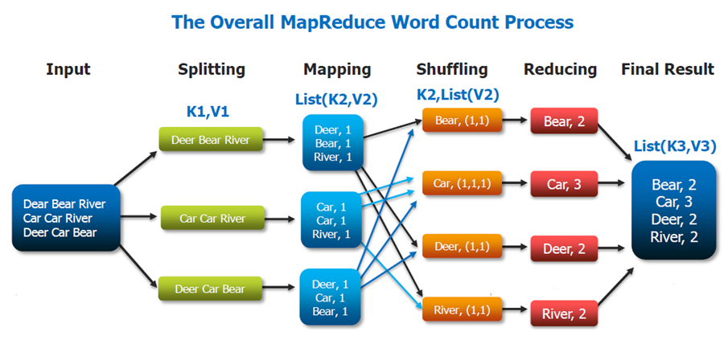
Classic Word Count Example

Slide 18
Hadoop Distributed Filesystem

Slide 19
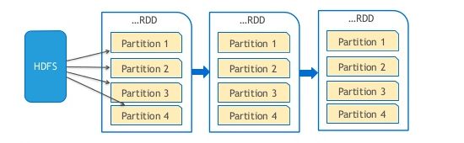
HDFS
Partitioned large datasets
Store files across a network of machines.
Evolved from the GFS or Google File system
Pros
Handles Terabytes of data
Write once - read many times
Uses Commodity hardware
Cons
Not good to low latency access
Bad for lots of small files
Not for multiple writers

Slide 20
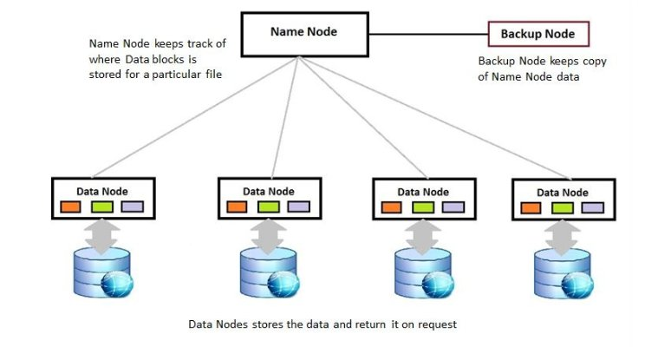
Node
Client will request data through the name node.
The name node will then locate that data across it’s data node.
Then return data back to the client.

Slide 21
Yet Another Resource Manager

Slide 22
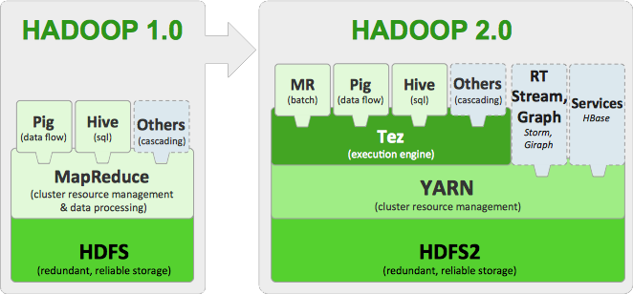
YARN Overview
Apache Hadoop YARN (Yet Another Resource Negotiator) is a cluster management technology.
YARN is one of the key features in the second-generation Hadoop 2 version of the Apache Software Foundation's open source distributed processing framework.

Slide 23
MRjob

Slide 24

What is MRjob?
MRjob is a Python library built by Yelp.
It lets you write MapReduce jobs in Python and run them on different platforms.
It lets you stay in Python land while making it easier to process and analyze big data.

Slide 25
What will we use MRjob for?
Writing MapReduce jobs in pure Python.
Running jobs on our Hadoop cluster.
Running jobs in the cloud using Google Cloud Dataproc. (we will cover this shortly)

Slide 26
MRjob fundamentals

Slide 27
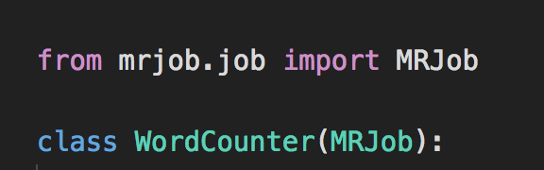
What is a job?
A job is defined by a class that inherits from Mrjob.
This class contains methods that define the steps of your job.

Slide 28
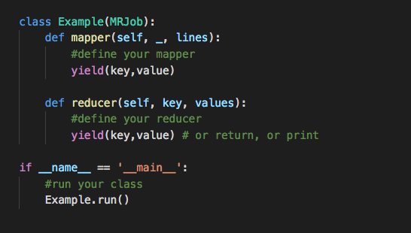
Basic Example

Slide 29
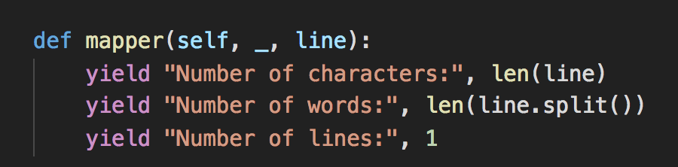
The mapper() method
The mapper() method takes a key and a value as arguments and yields as many key-value pairs as it likes.
In this example we are ignoring the key by using _

Slide 30
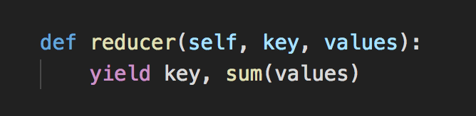
The reducer() method
The reduce() method takes a key and an iterator of values and also yields as many key-value pairs as it likes.

Slide 31
Spark (PySpark)

Slide 32
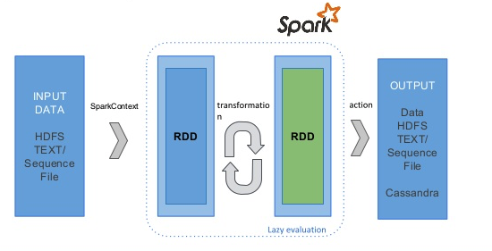
What is Spark?
In memory distributed data analysis.
Its goal is to make jobs faster.

Slide 33
Spark vs Hadoop
Parameters | Spark | Hadoop
Fault Tolerance | Spark RDD guarantees fault tolerance | Uses replication for fault tolerance
Speed | Faster due to in-memory computation | Relatively slower than Spark
OS Support | Linux, Windows, Mac OS | Linux
High Level Language | Python, Scala, Java, R | Java
Machine Learning | Has its own set of ML libraries | Requires interfacing with other libraries

Slide 34
Resilient Distributed Dataset
A Resilient Distributed Dataset (RDD), the basic abstraction in Spark.
It represents an immutable, partitioned collection of elements that can be operated on in parallel.

Slide 35
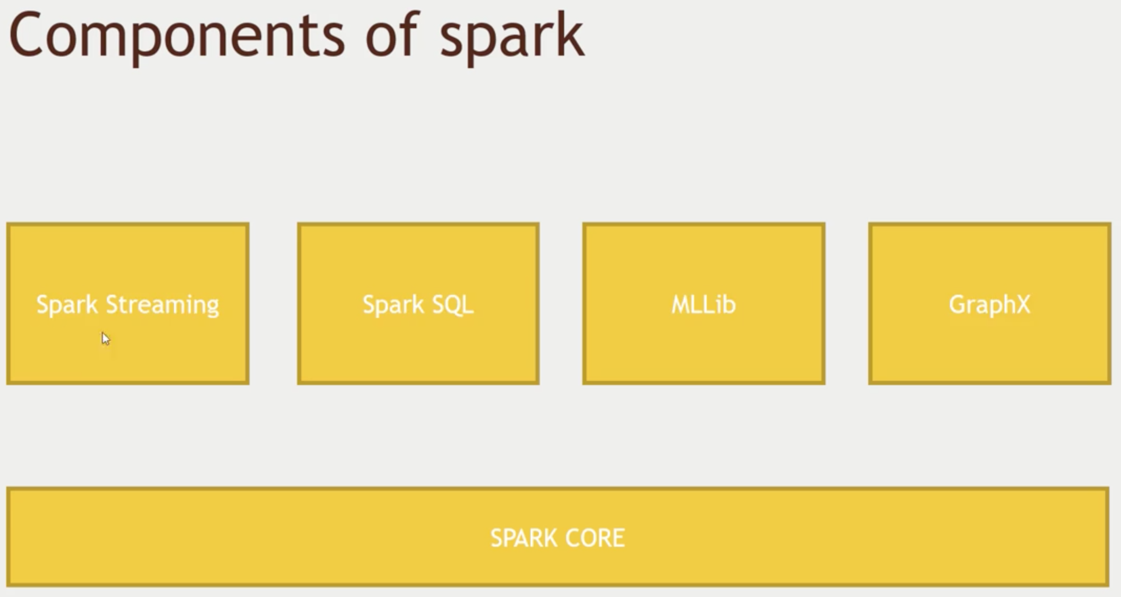
Components of spark

Slide 36
Spark Dataframes
Similar to Pandas
Hold data in a column and row format.
Each column represents a variable or feature.
Each row represents one data point.

