Slide 1
Support Vector Machine
The Data Bootcamp |
<DATE GOES HERE>

Slide 2
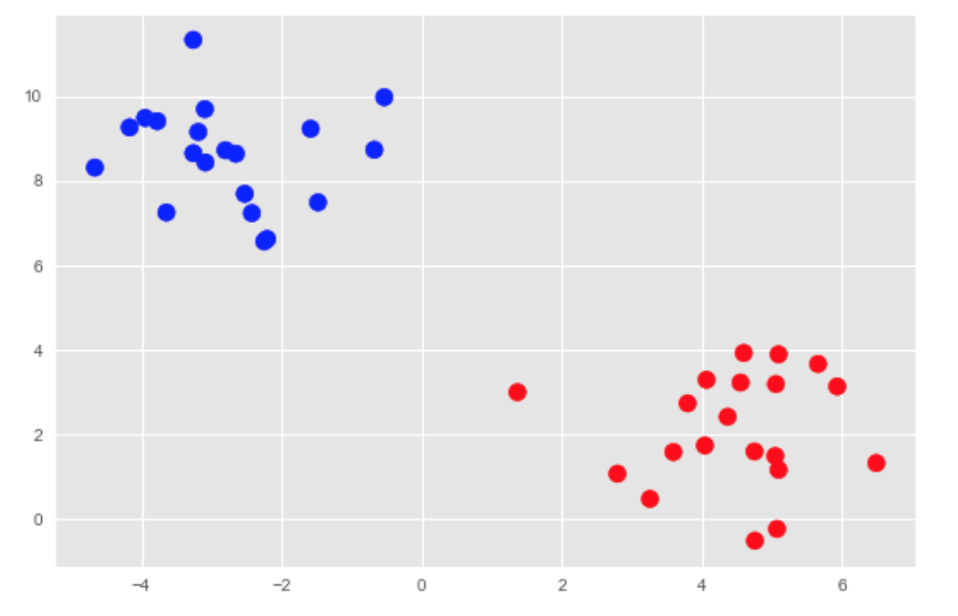
Linear Classifiers
Linear Classifiers attempt to draw a line that separates the data, but the issue is which line best separates the groups?
Which Class am I?

Slide 3
Linear Classifiers
Linear Classifiers attempt to draw a line that separates the data, but the issue is which line best separates the groups?
Yay! Red!

Slide 4
Linear Classifiers
Linear Classifiers attempt to draw a line that separates the data, but the issue is which line best separates the groups?
Yay! Blue!

Slide 5
Linear Classifiers
Linear Classifiers attempt to draw a line that separates the data, but the issue is which line best separates the groups?
Yay! Red!

Slide 6
Linear Classifiers
Linear Classifiers attempt to draw a line that separates the data, but the issue is which line best separates the groups?
I’m so confused

Slide 7
Support Vector Machines
The SVM Algorithm finds the optimal hyperplane that separates the data points with the largest margin possible.
Optimal Hyperplane
Ok, red it is!
Max Margin

Slide 8
Questions / Discussion
Notes:
It’s important to keep in mind why you joined this class. Let’s talk about your goals.

