Slide 1
Activation Functions
The Data Bootcamp |
<DATE>

Slide 2
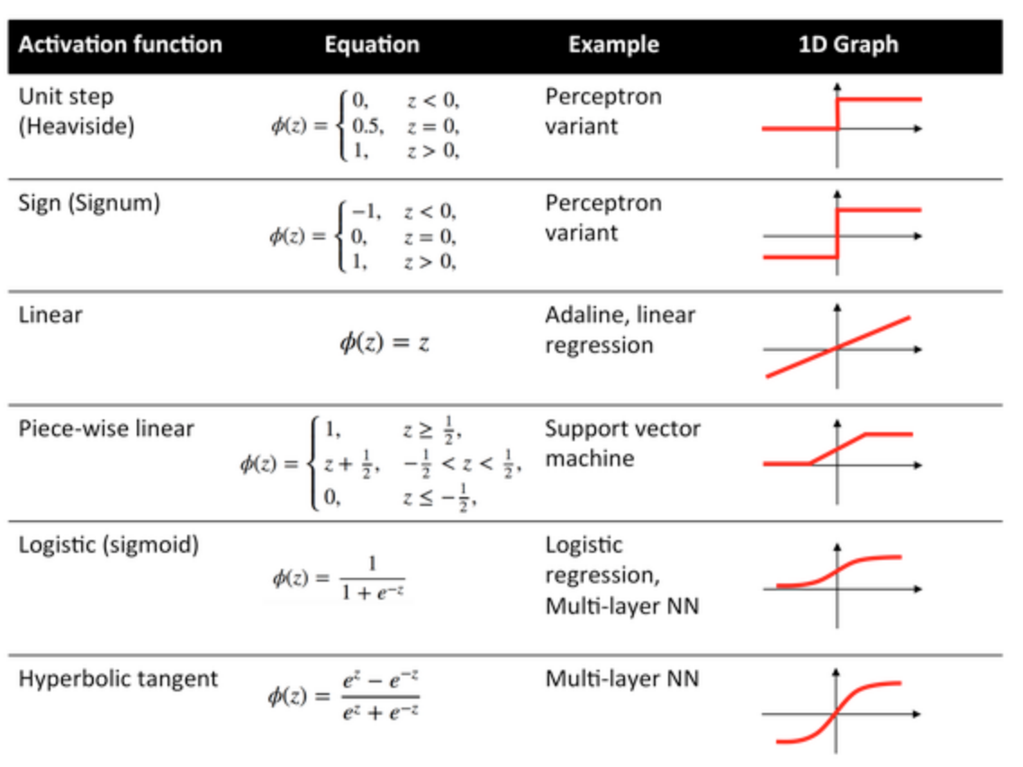
Activation Functions
Activation Functions are applied to every node in a neural network.
These functions decide whether or not a neuron should be activated.

Slide 3
Sigmoid Functions
Predicts the probability as an output.
Outputs range between 0 and 1.
Common for Logistic Regression

Slide 4
Rectified Linear Units (relu)
Extremely popular activation function for deep learning and neural networks.
Defined as f(x) = max(0, x)
Has output of 0 if input in less than 0, otherwise will have a raw output for a positive input.

Slide 5
Softmax
Another popular choice for the output layer of a neural network
It’s used for multiple-logistic regression (more than one class)
Can’t just put yes or no.
Details:
All of the output probabilities will be a range between 0 and 1, but all of the probabilities will also sum to 1

