Slide 1
Container and provisioning
Why is everyone talking about Docker?

Slide 2
Agenda
Container vs. virtualization
Linux containers
LXC vs. Docker
History of Docker
Docker CLI
Docker images
Dockerfile
Docker-Compose

Slide 3
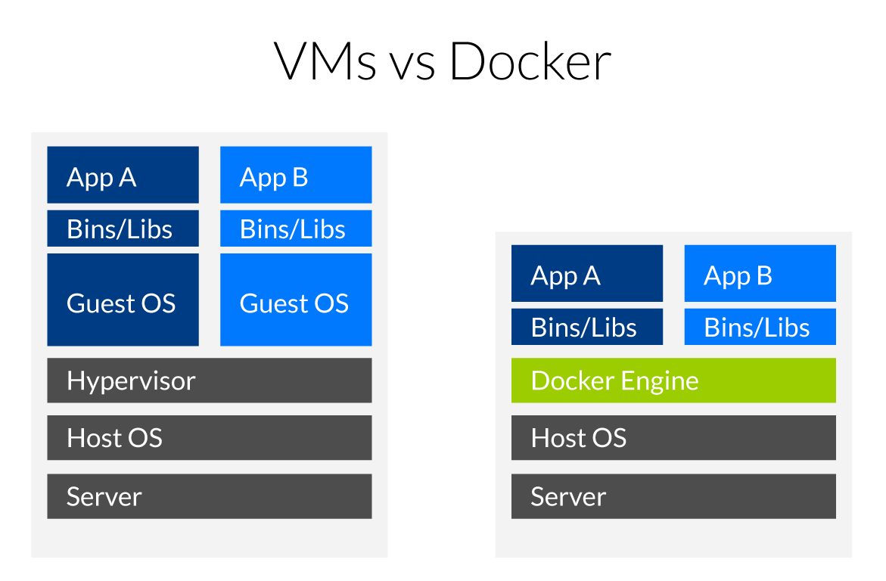
Virtualization vs. container
Quelle: https://www.inovex.de/blog/docker-an-introduction-to-easy-containerization/

Slide 4
Virtualization vs. container
Pros
Many excellent hypervisors available
Feels like „regular“ systems for administrators and devs
No special knowledge needed
Cons
Resource overhead for every virtual machine
Takes longer to setup if no special tools are used (Puppet, Chef, etc.)
Pros
Lower resource overhead
Very fast setup when container are prebuilt
Isolation of every container
Stable environment
Cons
Training of devs and admins required
Getting complex if cluster is required (Kubernetes, DC/OS, Swarm)
Backup

Slide 5
Linux containers (LXC)
Based on Linux cgroups (kernel feature to manage resources and application isolation)
Initial release 2008
Docker uses the same concepts as LXC! (in fact LXC is one of the available drivers for the Docker engine)

Slide 6
History of Docker
Rebranding of dotCloud to Docker Inc.
Native Docker support with Hyper-V on Windows
10/29/2013
Microsoft announces Docker support in Windows Server 2016
Initial Commit
1/19/2013
10/15/2014
6/8/2016
2013
Jan
Jul
2014
Jul
2015
Jul
2016
2016
Heute
3/1/2013
7/21/2015
6/20/2016
First announcement
First Kubernetes version
Docker Swarm is built in with Docker 1.12
7/1/2014
Microsoft, Red Hat, IBM, Docker,... joined the Kubernetes Project

