Slide 1
Container and provisioning
Why is everyone talking about Docker?

Slide 2
Agenda
Container vs. virtualization
Linux containers
LXC vs. Docker
History of Docker
Why Docker?
Docker CLI
Docker images
Dockerfile
Docker-Compose

Slide 3
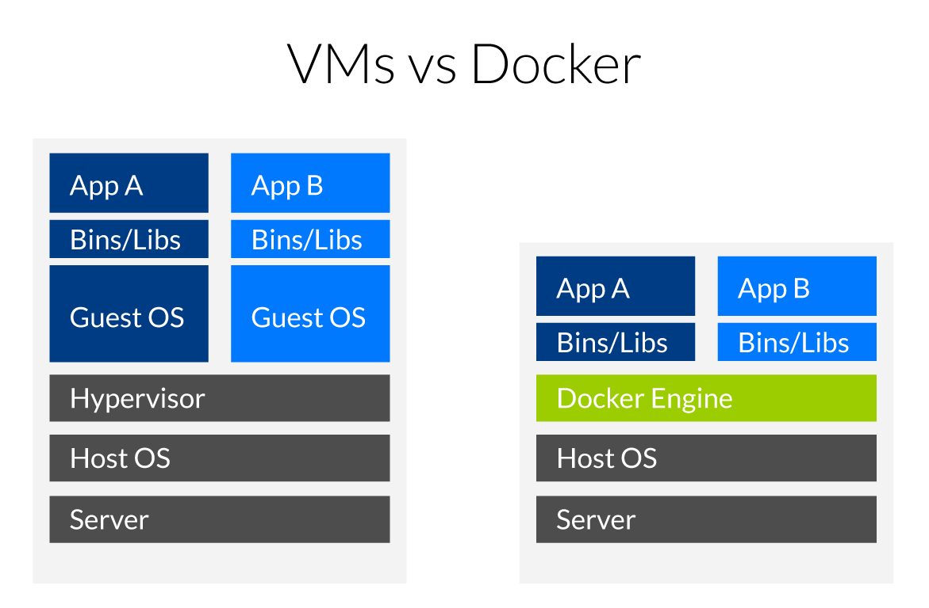
Virtualization vs. container
Quelle: https://www.inovex.de/blog/docker-an-introduction-to-easy-containerization/

Slide 4
Virtualization vs. container
Pros
Many excellent hypervisors available
Feels like „regular“ systems for administrators and devs
No special knowledge needed
Cons
Resource overhead for every virtual machine
Takes longer to setup if no special tools are used (Puppet, Chef, etc.)
Pros
Lower resource overhead
Very fast setup when container are prebuilt
Isolation of every container
Stable environment
Cons
Training of devs and admins required
Getting complex if cluster is required (Kubernetes, DC/OS, Swarm)
Backup

Slide 5
Linux containers (LXC)
Based on Linux cgroups (kernel feature to manage resources and application isolation)
Initial release 2008
Docker uses the same concepts as LXC! (in fact LXC is one of the available drivers for the Docker engine)

Slide 6
History of Docker
Rebranding of dotCloud to Docker Inc.
Native Docker support with Hyper-V on Windows
10/29/2013
Microsoft announces Docker support in Windows Server 2016
Initial Commit
1/19/2013
10/15/2014
6/8/2016
2013
Jan
Jul
2014
Jul
2015
Jul
2016
2016
Heute
3/1/2013
7/21/2015
6/20/2016
First announcement
First Kubernetes version
Docker Swarm is built in with Docker 1.12
7/1/2014
Microsoft, Red Hat, IBM, Docker,... joined the Kubernetes Project

Slide 7
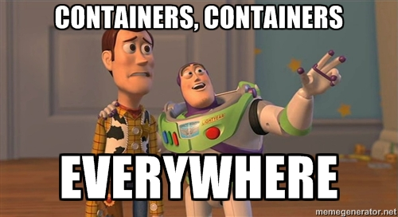

Slide 8
Why Docker?
So after talking about pros and cons, alternative products and the history…why is Docker “the new shit”?
No more time consuming setup of servers:
Dependencies
Configurations
Documentation for administrators
Every application/component can be packed in a container
Upgrades of containers are fast (if done right)
Developers do not need to setup a heavy development environment but just start a view containers (Docker-Compose!)
Administrators “just” pull the containers for production
Containers can easily scale out (think of 5 containers of the same service instead of just 1)
Rollback of an entire application/a single component is possible by switching the container version

Slide 9
Why Docker in Microservices?
Create a container per service
Scale out a single service instead of the whole application by deploying more containers
Continuous integration & continuous delivery
E.g. automatically build new containers
Deploy new containers to testing, staging (and production) environments depending on which branch you‘re building
Existing eco system for service discovery and distributed configuration (see chapter 4)
Clustering solutions available (Docker Swarm, Kubernetes, DC/OS Mesos,…)

Slide 10
Docker CLI – Basics
CMDlet | Explanation
docker --help | You already guess it
docker ps | Show running docker containers
docker ps -a | Show all existing containers (including stopped)
docker images | Show all local images
docker run –ti <image[:version]> | Start a new interactive container
docker run –d <image[:version]> | Start a new container in deamon mode (in background)
docker rm <container id/name> | Removes an existing container if it is stopped
docker rm –f <container id/name> | Removes an existing container even it is still running
docker exec –ti <container id/name> /bin/bash | Attaches a Bash instance to a running container

Slide 11
Docker CLI – Basics
CMDlet | Explanation
docker rmi <image id> | Removes a local container image
docker stop <container id/name> | Stops a running container
docker commit <container id/name> [repository[:tag]]

Slide 12
Docker CLI – Build u. Registry
CMDlet | Explanation
docker build [[registry/]user/image name] | Create a new container based on a Dockerfile in the same directory
docker build [[registry/]user/image name:tag] | Create a new container based on a Dockerfile and add a tag to it
docker push [[registry/]user/image name] | Push a built image to a registry (default is Docker Hub)
docker login [registry url] | Login to a private Docker registry

Slide 13
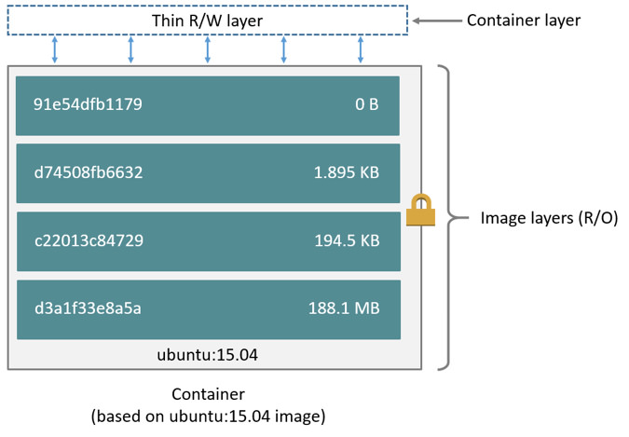
Docker Images
Quelle

Slide 14
Docker Images
Images consist of (more or less) layers
Every layer is a kind of a snapshot and can be removed
It’s possible to inspect how a specific layer was created (more on that later)
At last each layer isn’t more than a .tar.gz archive which will be applied to the base image when a container is created
If a image has to be rebuilt, Docker recognizes which layers aren‘t affected and is keeping them as they are to speed up the build process

Slide 15
Creating new Docker images
There are two ways to create new Docker images:
Create a new container, do all required changes on your own by installing the via bash and commit this changes
Create a Dockerfile, describe all changes which have to be made to the base image and build it with the Docker CLI
Most containers are built with Dockerfiles because it‘s easier to make small changes and recreate an image, building containers manually is only acceptable for proof-of-concepts

Slide 16
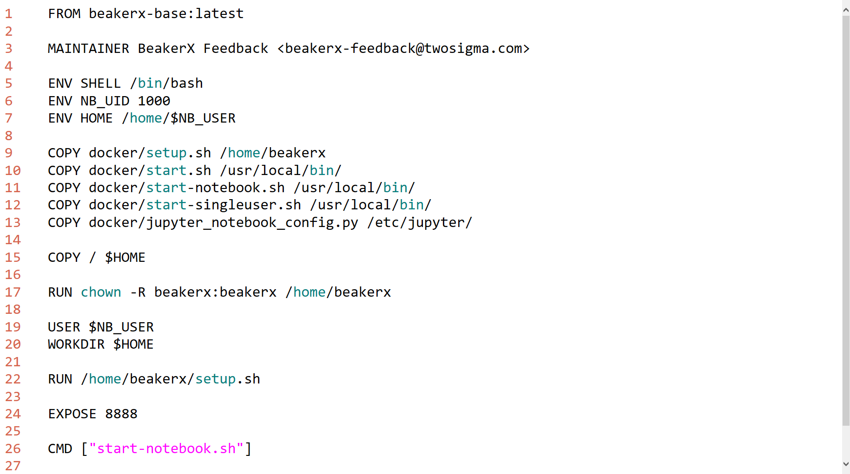
Dockerfile – Beispiel BeakerX

Slide 17
Dockerfile – Basics
Directive | Explanation
FROM <image>[:tag] | Declares base image which will be used
RUN <command> | Command to run while building the container (creates a new layer)
CMD [ „executable“, „param1“, „param2“ ] | Provide a default command when a new container is started
EXPOSE | Declare a port which will be exposed by the container (e.g. 80 for Nginx)
ENV <key> <value> | Declare an environment variable for the container
ADD <src> <dest> | Copy files or directories from local or remote URLs into the container
COPY | Copy files or directories from local URLs into the container
ENTRYPOINT [ „executable“, „param1“, „param2“ ] | Declare the entrypoint of the container when it’s started

Slide 18
Dockerfile – Basics
Directive | Explanation
VOLUME [ “/data” ] | Create a mount point to share data between the host and a container or between containers (persistence!)
USER <user>[:group] | Set the user context (and optionally the group) for all following RUN, CMD and ENTRYPOINT in the Dockerfile
WORKDIR /path/to/workdir | Sets the working directory for every following RUN, CMD, ENTRYPOINT, ADD or COPY command, can be used multiple times in one Dockerfile, the directory will be created if it does not exist, the path can also be relative
Quelle: https://docs.docker.com/engine/reference/builder/

Slide 19
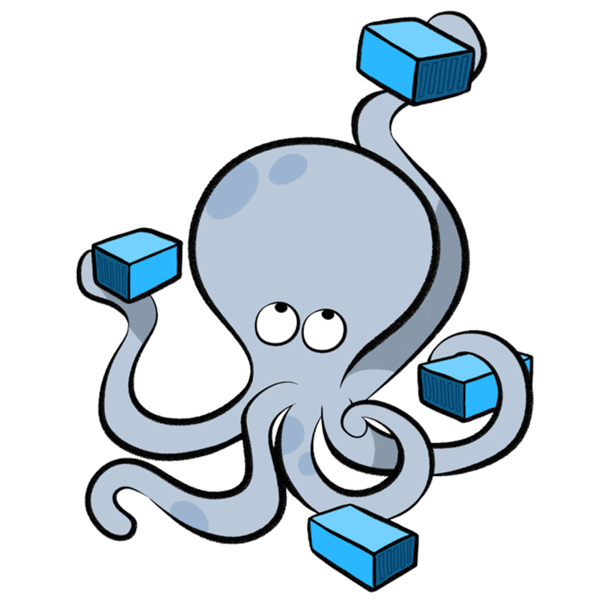
Docker-Compose

Slide 20
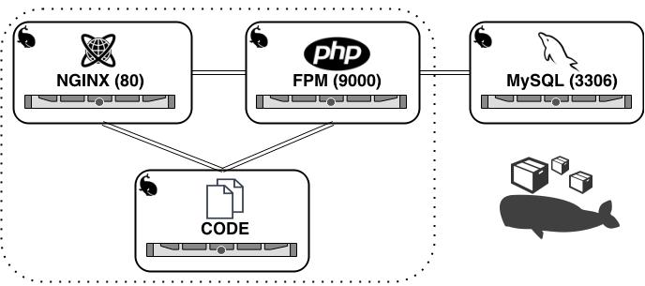
Docker-Compose
Quelle

Slide 21
Docker-Compose
Tool to create multi-container applications
Define all services the application consists of
Separate services optionally in multiple networks
Configure services (set environment variables, expose ports, mount volumes and so on)
Start and stop a multi-container application by running a single command (docker-compose up/down)
An extended version is used to deploy multi-container applications to Docker Swarm
Other Docker cluster systems use similar formats (e.g. Pod definition in Kubernetes)
Docs: https://docs.docker.com/compose/compose-file/compose-file-v2/
Cheatsheet: https://devhints.io/docker-compose

Slide 22
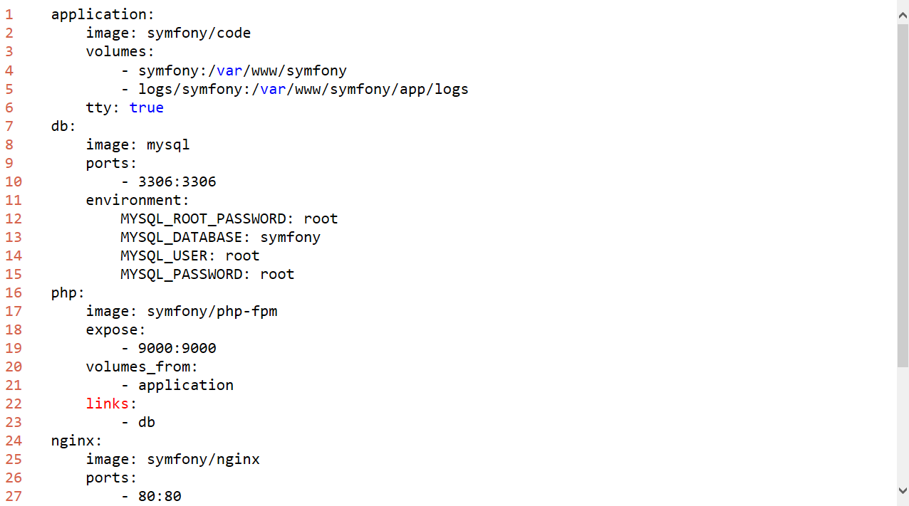
Docker-Compose – Example Symfony

