Slide 1
Container and provisioning
Why is everyone talking about Docker?

Slide 2
Agenda
Container vs. virtualization
Linux containers
LXC vs. Docker
History of Docker
Why Docker?
Docker CLI
Docker images
Dockerfile
Docker-Compose

Slide 3
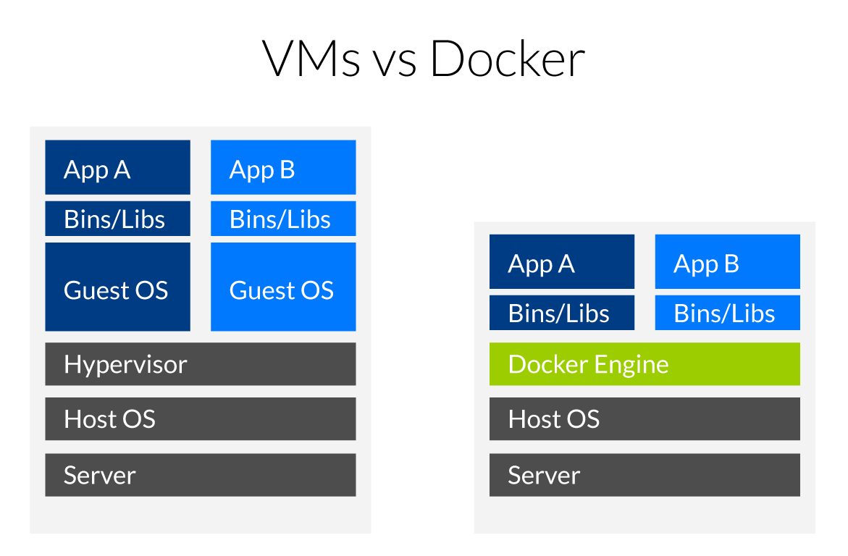
Virtualization vs. container
Quelle: https://www.inovex.de/blog/docker-an-introduction-to-easy-containerization/

Slide 4
Virtualization vs. container
Pros
Many excellent hypervisors available
Feels like „regular“ systems for administrators and devs
No special knowledge needed
Cons
Resource overhead for every virtual machine
Takes longer to setup if no special tools are used (Puppet, Chef, etc.)
Pros
Lower resource overhead
Very fast setup when container are prebuilt
Isolation of every container
Stable environment
Cons
Training of devs and admins required
Getting complex if cluster is required (Kubernetes, DC/OS, Swarm)
Backup

Slide 5
Linux containers (LXC)
Based on Linux cgroups (kernel feature to manage resources and application isolation)
Initial release 2008
Docker uses the same concepts as LXC! (in fact LXC is one of the available drivers for the Docker engine)

Slide 6
History of Docker
Rebranding of dotCloud to Docker Inc.
Native Docker support with Hyper-V on Windows
10/29/2013
Microsoft announces Docker support in Windows Server 2016
Initial Commit
1/19/2013
10/15/2014
6/8/2016
2013
Jan
Jul
2014
Jul
2015
Jul
2016
2016
Heute
3/1/2013
7/21/2015
6/20/2016
First announcement
First Kubernetes version
Docker Swarm is built in with Docker 1.12
7/1/2014
Microsoft, Red Hat, IBM, Docker,... joined the Kubernetes Project

Slide 7
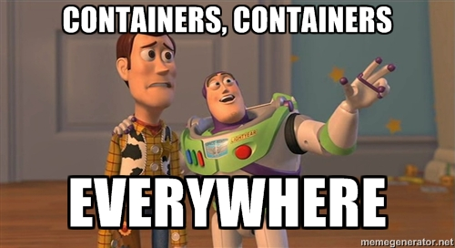

Slide 8
Why Docker?
So after talking about pros and cons, alternative products and the history…why is Docker “the new shit”?
No more time consuming setup of servers:
Dependencies
Configurations
Documentation for administrators
Every application/component can be packed in a container
Upgrades of containers are fast (if done right)
Developers do not need to setup a heavy development environment but just start a view containers (Docker-Compose!)
Administrators “just” pull the containers for production
Containers can easily scale out (think of 5 containers of the same service instead of just 1)
Rollback of an entire application/a single component is possible by switching the container version

Slide 9
Why Docker in Microservices?
Create a container per service
Scale out a single service instead of the whole application by deploying more containers
Continuous integration & continuous delivery
E.g. automatically build new containers
Deploy new containers to testing, staging (and production) environments depending on which branch you‘re building
Existing eco system for service discovery and distributed configuration (see chapter 4)
Clustering solutions available (Docker Swarm, Kubernetes, DC/OS Mesos,…)

Slide 10
Docker CLI - Basics
CMDlet | Explanation
docker --help | You already guess it
docker ps | Show running docker containers
docker ps -a | Show all existing containers (including stopped)
docker images | Show all local images
docker run –ti [image[:version]] | Start a new interactive container
docker run –d [image[:version]] | Start a new container in deamon mode (in background)
docker rm [container id/name] | Removes an existing container if it is stopped
docker rm –f [container id/name] | Removes an existing container even it is still running
docker exec –ti [container id/name] /bin/bash | Attaches a Bash instance to a running container

Slide 11
Docker CLI
CMDlet | Explanation
docker rmi [image id] | Removes a local container image
docker stop [container id/name] | Stops a running container

Slide 12
Docker CLI – Build u. Registry
CMDlet | Explanation
docker build [[registry/]user/image name] | Create a new container based on a Dockerfile in the same directory
docker build [[registry/]user/image name:tag] | Create a new container based on a Dockerfile and add a tag to it
docker push [[registry/]user/image name] | Push a built image to a registry (default is Docker Hub)
docker login [registry url] | Login to a private Docker registry

