Slide 1

Airport Slot allocation processes
By: Hanchen, Annalee Watts, Connor Tyrell, Likitha Shatdarsanam, and Uday

Slide 2
Background info
We researched the slot allocation process at Level 3 airports. Airlines request a slot to land/take off in airports and all requests are organized by an airport coordinator. In our presentation we are going to break down the process starting at initial requests by airlines to the allocation of slots from the airport. We are going to use functional, structural, and behavioral diagrams to represent each phase of the slot allocation process
Notes:
Likitha
Our topic for today’s presentation is level 3 airport slot allocation system
The prime objective of airport slot coordination is to ensure the most efficient
declaration, allocation and use of available airport capacity in order to optimize
benefits to consumers, taking into account the interests of airports and airlines.
Airports are categorized into three levels of congestion for coordination purposes:
- Level 1: Airports with sufficient capacity to meet user demands at all times.
- Level 2: Airports with potential for congestion during certain periods, manageable by adjusting schedules agreed upon by airlines and a facilitator.
- Level 3: Airports lacking sufficient infrastructure or facing government-imposed constraints, requiring a coordinator to allocate slots to manage capacity.
Airport slot allocation involves allocating limited capacity to airlines and operators to ensure a functional airport and efficient use of infrastructure, serving as an interim solution until airport capacity can be expanded.

Slide 3
System requirements
Airlines submit slot requests, with the coordinator reviewing and classifying them as new, existing, or historical, and evaluating feasibility against airport parameters.
Historical slot requests are assessed for adherence to the 80/20 rule, and changes to such slots are checked for compliance with coordination parameters.
A slot pool is formed from returned and optimized slots, divided 50/50 between new and existing airlines, with the coordinator matching and confirming allocations.
Unallocated and unchanged historical slots are reallocated or managed, ensuring airlines comply with the "use it or lose it" policy through ongoing monitoring.
The coordinator adjusts slots as needed for operations and regulations, while the airport body regularly reports on capacity and slot misuse.
Notes:
Likitha
Slot Request Submission: Airlines submit requests for slots to the coordinator.
Coordinator Review: The coordinator reviews these submissions to verify whether they are for new entrants, existing airlines, or historical slot requests.
Evaluate Request Against Coordination Parameters: The coordinator evaluates the requests based on the airport’s coordination parameters to determine feasibility.
Historical Slot Analysis: For historical slot requests, an analysis is conducted to confirm whether the airline has met the requirements for historic precedence (typically the 80/20 rule).
Changes to Historical Slots: If changes are requested to historical slots, the coordinator checks whether these changes are acceptable within the coordination parameters.
Slot Pool Creation: The coordinator creates a slot pool, which may include slots returned from airlines or additional slots created through capacity optimization.
Division of Slot Pool: The slot pool is divided, often with a portion reserved for new entrants and the remainder for other airlines.
Slot Request Evaluation: Slot requests are then evaluated for availability within the designated pools (new entrants vs. existing airlines).
Waitlist Management: If requests can't be accommodated, they are added to a waitlist.
Confirmation of Slot Requests: Upon successful matching of requests with available slots, the coordinator confirms the slots to the requesting airlines.
Slot Allocation Communication: The coordinator communicates the results of the slot requb est process to the airlines.
Reallocation of Unchanged Historical Slots: If unchanged historical slots are not allocated due to changes not being accepted, these slots are reallocated.
Handling Slots that Fail to Allocate: Failed slots are sent back to the slot pool for reallocation.
Monitor Slot Utilization: Ongoing monitoring of how airlines utilize their allocated slots is conducted
Reporting and Documentation: Detailed records of the slot allocation process, including requests, evaluations, and confirmations, are maintained for transparency and audit purposes.
Adjustments and Updates: Throughout the slot allocation cycle, the coordinator may need to make adjustments and updates based on operational needs, capacity changes, or regulatory requirements.
Stakeholder Communication and Engagement: The coordinator engages with various stakeholders, including airlines, airport authorities, and regulatory bodies, to ensure a fair and efficient slot allocation process.
This sequence of activities ensures a fair, transparent, and effective allocation of airport slots, as per the standardized guidelines provided by the Worldwide Slot Management Standards.
The airport managing body regularly reports on the capacity of the airport & generates misuse reports

Slide 4
Slot Reservation regulations
Slot Pool:
Establishing a Slot Pool: After allocating unchanged historic slots, a slot pool is created for new and changing requests.
50/50 Rule: 50% of the initial allocation in the slot pool should go to new entrants, and the remaining 50% to returning entrants. If a 50/50 balance isn't achievable in one season due to limited slots, it should be corrected in subsequent seasons.
New Entrants:
Eligibility and Allocation: Only airlines can attain new entrant status. New entrants offered slots within one hour of their requested time must accept by the end of the first day of the scheduling conference to retain their status.
Dispute Resolution: Dissatisfied new entrants can request a Coordination Committee meeting to resolve issues.
Historic Slots:
Priority to Historic Slots: Slots that airlines request that remain unchanged or with minor changes that do not affect coordination parameters are given first priority.
Flexibility in Changes: For changes that affect coordination parameters, airlines must indicate their flexibility using industry-standard codes. If requested changes cannot be accommodated, the coordinator sends the unchanged historic slots back to the requesting airline.
Year-Round Operations:
Priority Over New Requests: Requests to extend operations to year-round are prioritized over new slot requests.
Flexibility for Different Operations: When evaluating year-round operations, coordinators should allow timing flexibility to accommodate varying needs of short- and long-haul services.
The additional criteria take into account aspects that require more subjective judgment from a variety of sources including: Effective Period of Operation, Operational Factors, Time Spent on Waitlist, Type of Consumer Service and Market, Connectivity, Competition, Environment, Local Guidelines
Notes:
annalee

Slide 5
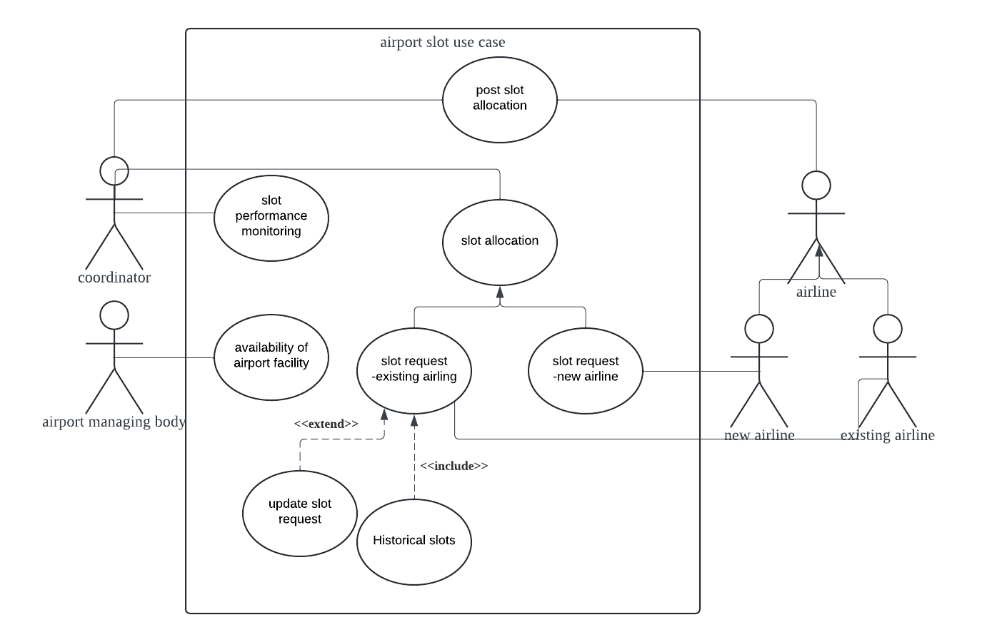
Use case diagram
This use case outlines the process of allocating landing and take-off slots to airlines after they have submitted their requests. It involves the Slot Coordinator reviewing historical and new entrance requests, assessing them against predefined criteria, and making decisions to ensure optimal airport operation and fair access to slots.
Notes:
annalee
This is our use case diagram. the primary actor is the slot coordinator so the slot coordinator does various things like monitoring slot performance, posting slot allocations, and more. This is a detail essential use case so the descriptions are detailed because it’s essential in understanding the required functionality

Slide 6
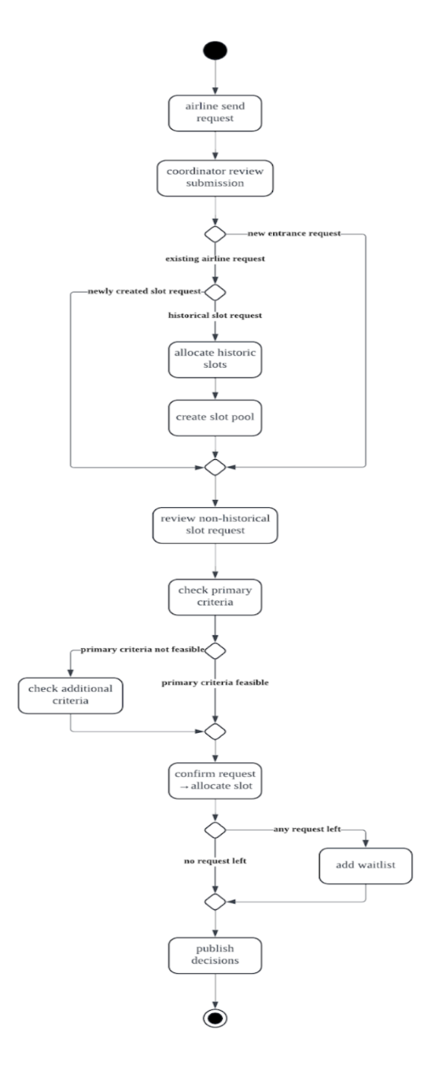
Activity diagram
Highlights the process flow from slot request to final allocation.
Notes:
Uday

Slide 7
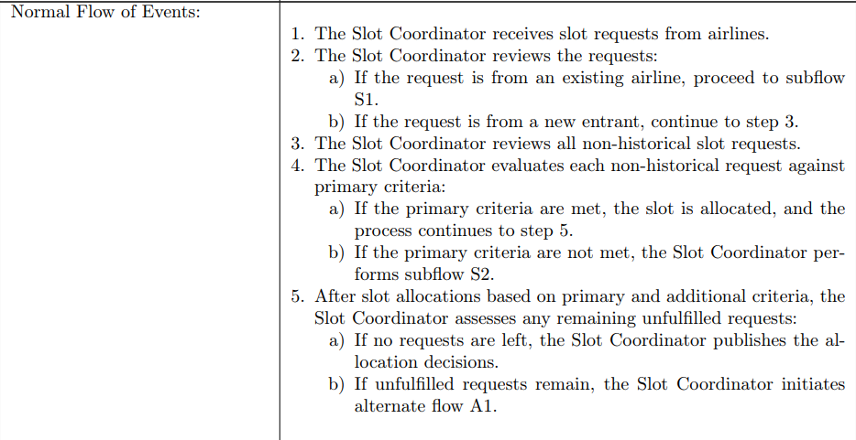
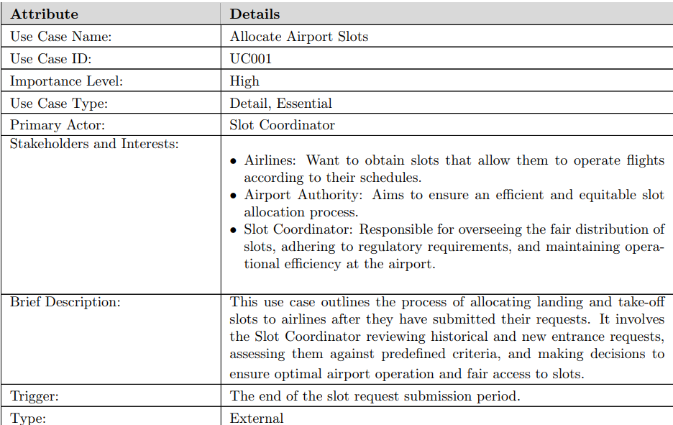
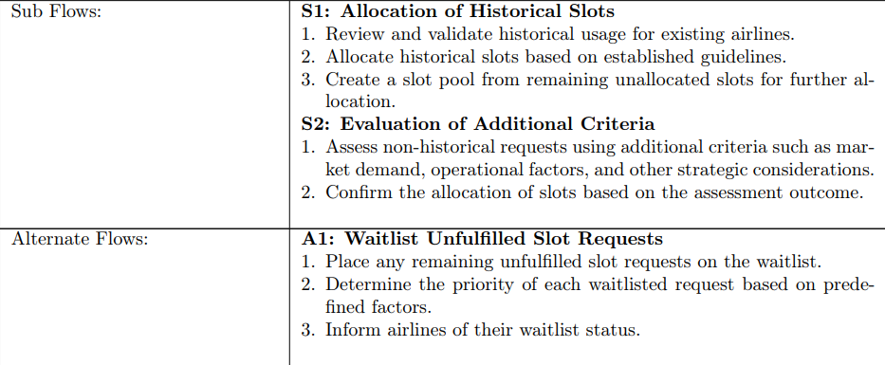
Use Case description
Notes:
Uday

Slide 8
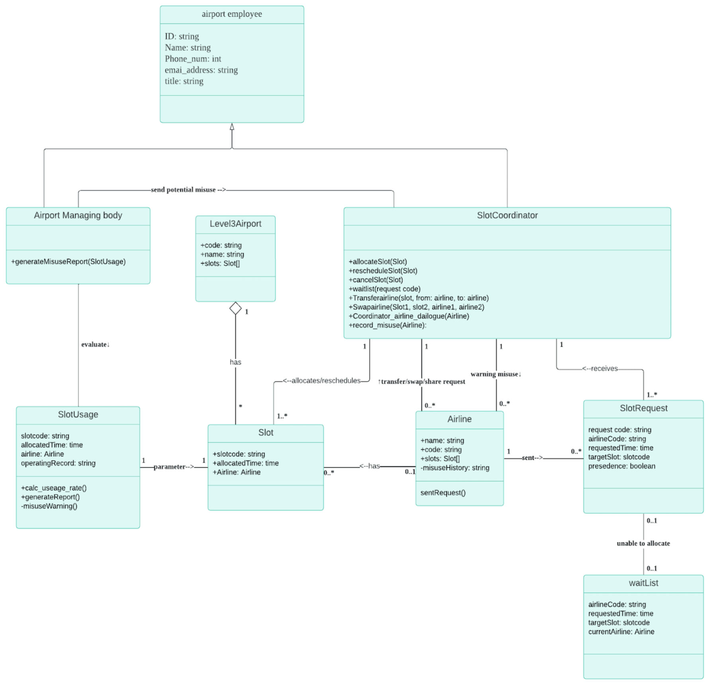
Class diagram
A structural model that identifies objects and their classes.
Notes:
hanchen

Slide 9
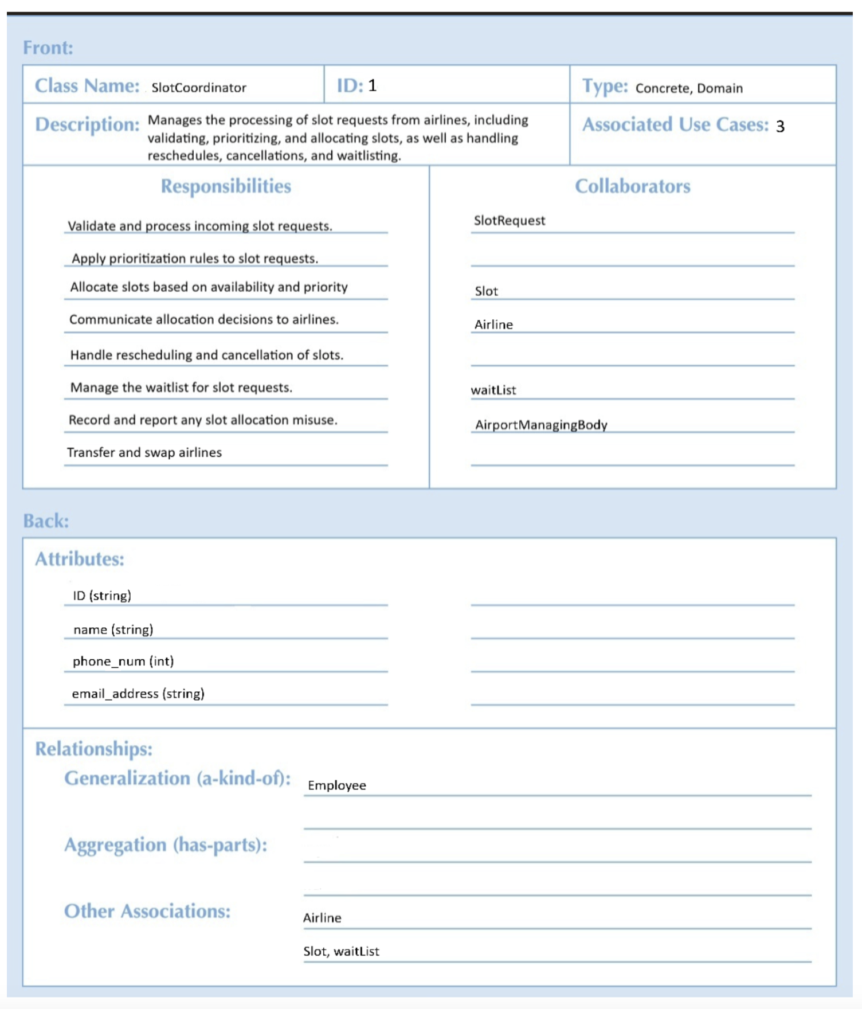
Crc card
A structural model to highlight all essential properties of a class.
Notes:
Hanchen

Slide 10
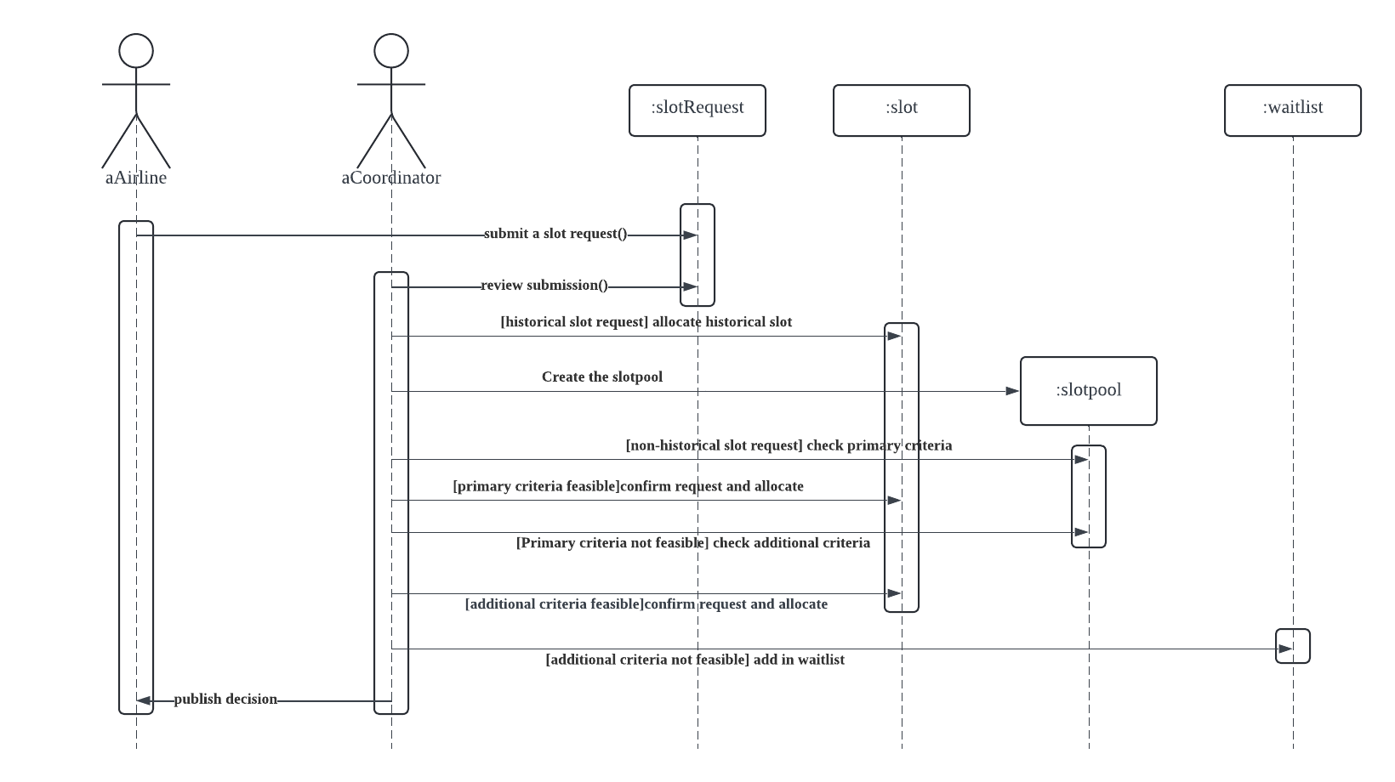
Sequence diagram
A behavioral model that emphasizes message sequence. This is a generic sequence diagram.
Notes:
Connor
Behavioral models describe the internal behavior of the system
Sequence diagram shows all of the messages in a sequence for a given use case
This is an generic sequence diagram because it shows all possible scenarios of the use case
The frame is of the slot allocation/request use case, shown in activity diagram
Two actors and four objects.
The initiator of this use case and sequence diagram is the airline actor submitting the request
Execution sequence limited for the waitlist object
Guard conditions: to ensure that this is a generic instead of an instance sequence diagram
Once again, this sequence diagram runs through slot allocation use case in the sequence/order that it will be carried out in by the actors and objects

Slide 11
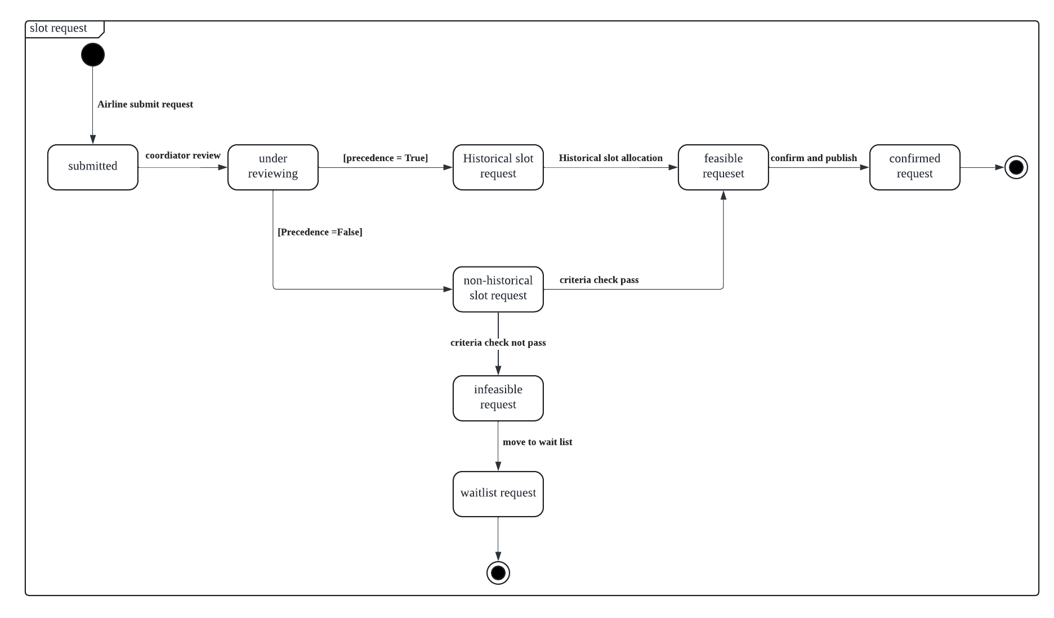
Behavioral state machine
Behavioral model that sets values of an object’s attributes and relationships with other objects.
Notes:
Connor
Represents a change in the state (data) of an object
The frame is still the slot request
Similarly to the sequence diagram, the initial state occurs when airline submits request
The state changes through events that happen in the system.
We ensure no “black hole states” or “miracle states”; has initial and final states that make sense
Guard conditions are mutually exclusive and all states are reachable
Events & transitions

