Slide 1
Jackal Hunt Rabbits
EE 5900: Introduction to Robotics
Final Project Presentation

Slide 2
Team Members
Sabari Manohar
Haden Wasserbaech
Deep Doshi

Slide 3
Project Summary
This project is based on Easter Egg hunting theme which involves rabbit as the robot used by us is Clearpath Jackal robot.
Here the rabbits sitting on baskets with colored eggs were supposed to be hunted out by the jackal robot. Once the task was achieved, it had to return back with the egg count. The entire task had to be performed autonomously.

Slide 4
Task for the Project
Mapping an enclosed area
Hunting bunnies associated with an ALVAR tag, in the map
Selecting bunny location as waypoints
Returning back at Starting point and pose; finding an ALVAR tag for bunny to hunt for
Counting the number of Easter eggs in the specified basket using image processing
Returning back to start point to give out visual display or pop-up for number of egg along with the location(i.e. ALVAR marker number)

Slide 5
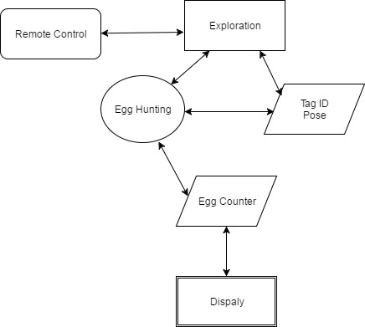
Flowchart

Slide 6
Approach
We focused on generalized solution and so decided to go with frontier exploration.
And done with that, we started working on Alvar tracker and waypoint extractor along with image processing

Slide 7
Exploration Package
For exploration we focused on coming to a generalized solution as the arena was unknown.
To get the best and optimal exploration, we narrowed down our choice on Frontier Exploration because
Given the boundary, it explores with greedy search for goals which is known as Frontiers(means open space)

Slide 8
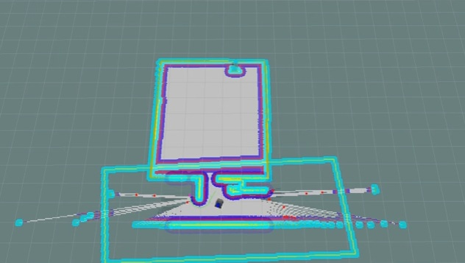
Frontier Exploration Package
What encouraged us to use this package is that it was already implemented on Clearpath Husky, and ROS.
So we thought of reverse engineer Husky stuff with Jackal and based upon over map enhance it.
The frontier_exploration package provides a costmap_2d layer plugin BoundedExploreLayer, and actionlib client/server nodes explore_client and explore_server.

Slide 9


Alvar tags
Alvar features
adaptive thresholding to handle a variety of lighting conditions,
optical flow based tracking for more stable pose estimation
an improved tag identification method
Tag 1 Tag 2 Tag 3

Slide 10
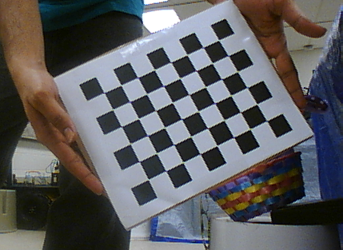
Alvar tag detector
For this we used ROS wrapper ar_track_alvar with functionalities like
Generating AR tags,
Identifying and tracking the pose of individual AR tags and bundles,
Using camera images to automatically calculate spatial relationships
For using it effectively we had to calibrate camera and for that we used camera ‘calibrator.py’ API.

Slide 11
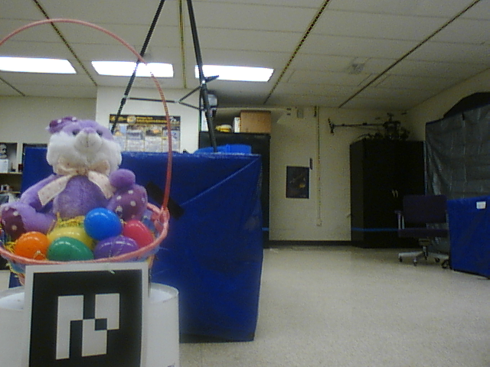
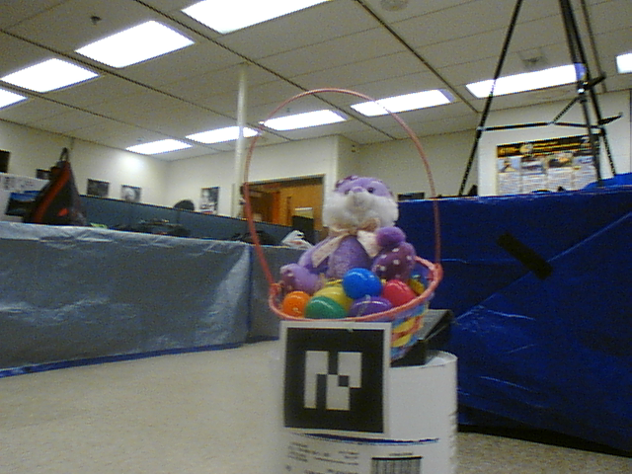
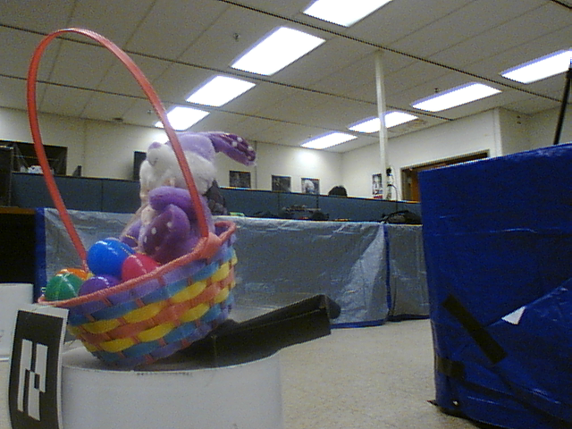
Rabbit Image Database

Slide 12
Egg Hunter & Counter
Based upon the alvar ID, we took the image based on threshold distance, into consideration
We developed the image parameters calibration and using the image database we trained it for colored based egg extractor

Slide 13
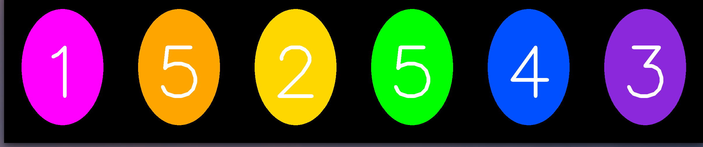
Egg Hunter & Counter (cont)

Slide 14
State Machine
State Machine is sequential operation framework to perform complex tasks
Particularly for ROS, we have a well documented SMACH library
Using smach, we can execute sequential steps like explore, map, etc, with a better implementation

Slide 15
Block diagram
State Machine
Exploration
Mapping
Alvar Detector
Waypoint Collection
Egg Hunter

Slide 16
Challenges
Implementation for Exploration
Alvar Detector and integration
Egg Counter
State Machine
Integrating and Implementation
Charging and Deugging

Slide 17
Challeneges (cont)
Unable to visualize Rviz, ROS_HOSTNAME to Jackal5 and there we ping from both machines
For exploration, as move_base had to be used, which expected map, it failed. Again while trying to use it without map for Jackal, we had dependency issues and malfunctioned everytime.
So we settled down with “Random Basic Obstacle” exploration program.

Slide 18
Contribution
Sabari : Exploration, State Machine, Debuging
Haden: Image Processing, Egg Counter
Deep : Alvar Detector, Mapping, Documentation
Everyone were involved in Simulations and Integration

Slide 19
Thank You

