Slide 1

Gym Management Platform: Streamlining Attendance & User Management

Slide 2

Why a Gym Management Platform?
Eliminate Manual Errors
Digital Solution Needed
Manual attendance and member tracking often lead to errors, consuming valuable time and resources.
A robust digital solution is crucial for seamless management of users, attendance, and profiles.
Enhanced Interaction
Facilitates better interaction between gym administrators and members through dedicated, intuitive dashboards.

Slide 3

Technology Stack Overview
Backend: SQL database for robust data storage and retrieval, ensuring data integrity.
Connectivity: JDBC API facilitates a strong connection between the Java-based JSP frontend and the SQL database.
Frontend: JSP pages deliver a dynamic, interactive, and user-friendly web interface.
This architecture guarantees a secure, scalable, and easy-to-maintain system, future-proofing your gym operations.

Slide 4
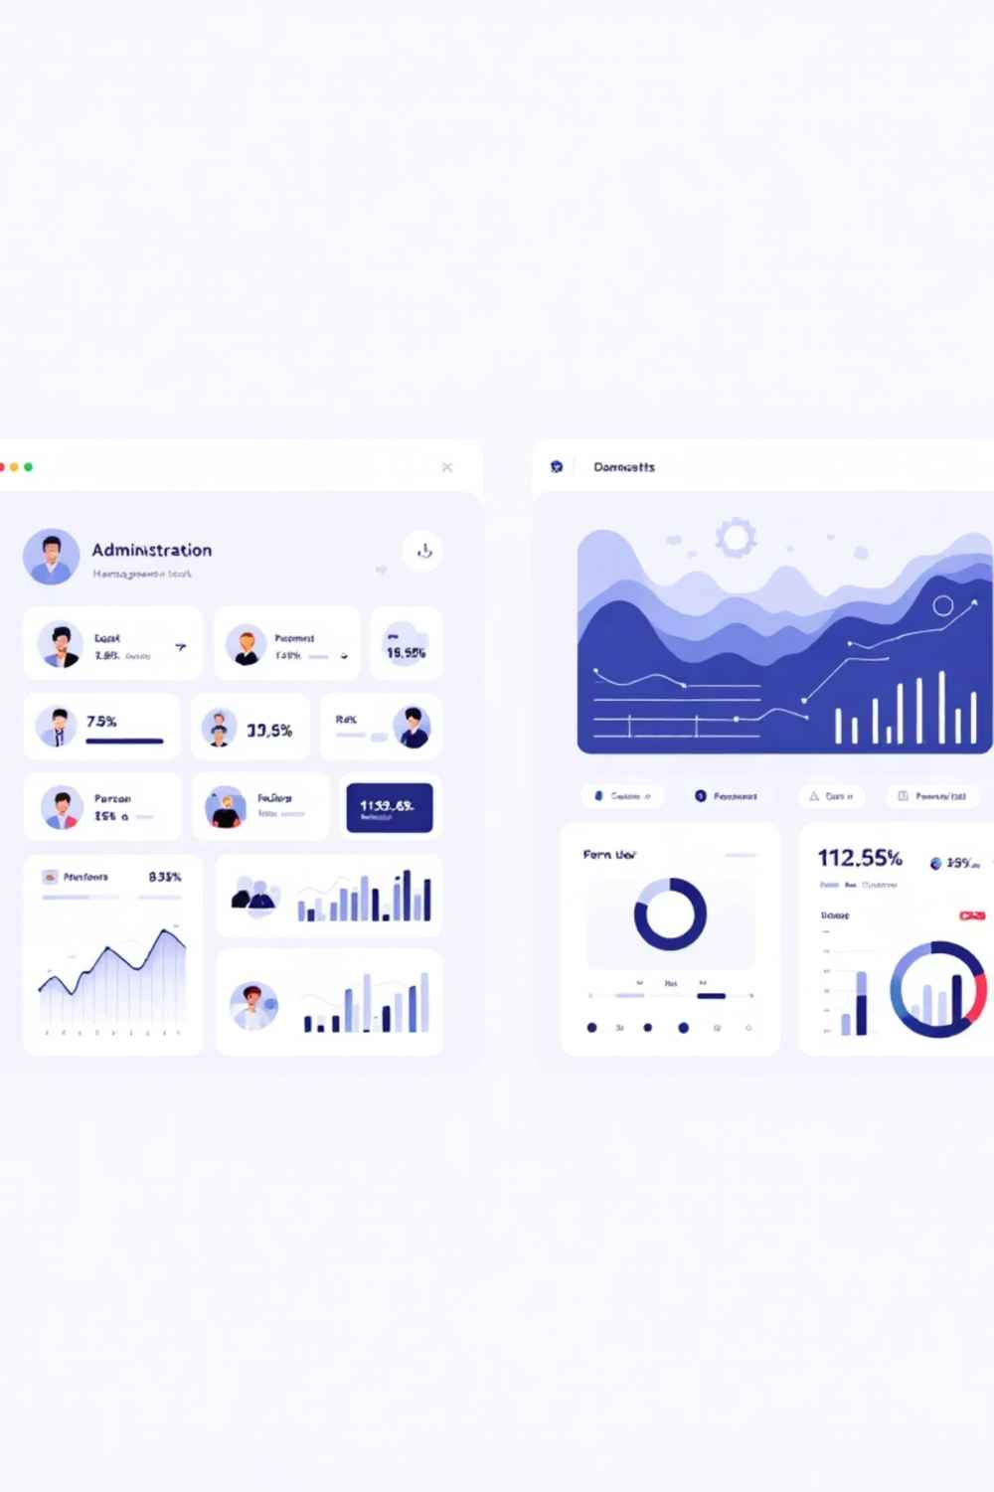

User Roles & Dashboards
Admin Dashboard
Manage user profiles: create, edit, delete members.
Mark and track attendance records efficiently.
View comprehensive reports and control system settings.
User Dashboard
View personal attendance history and progress.
Update personal profile details securely.
Access important gym notifications and updates.

Slide 5
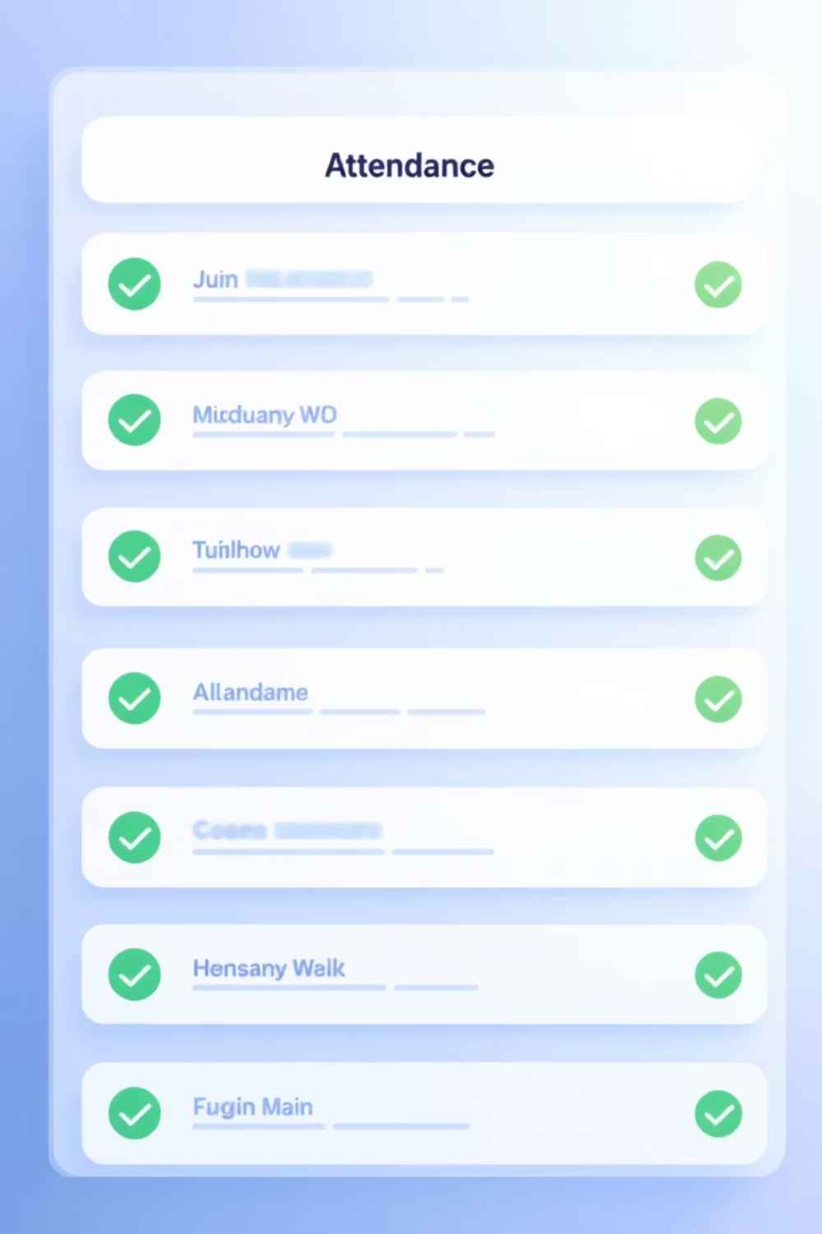
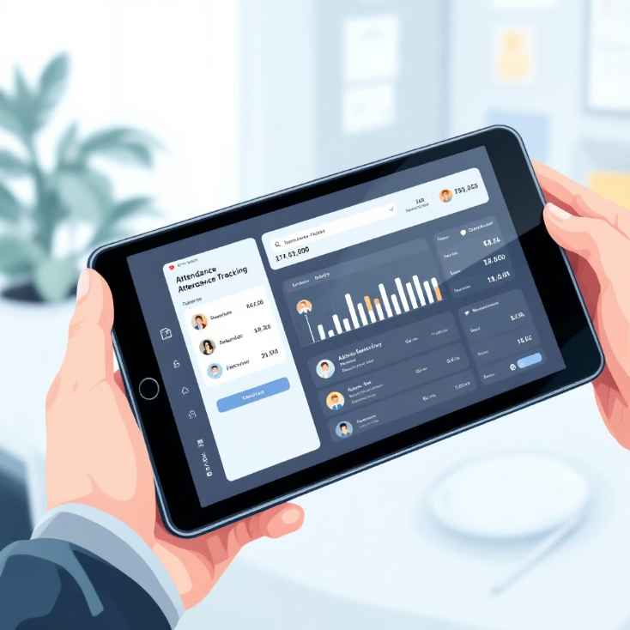
Attendance Management Feature
The platform empowers administrators to effortlessly mark daily attendance for each member, significantly boosting operational efficiency.
All attendance data is stored securely in the SQL database, providing a reliable record of member activity.
This feature enables comprehensive tracking of member gym usage patterns and engagement levels, offering valuable insights into member behaviour.
Supports the generation of detailed reports for attendance trends and member activity, aiding in better management decisions.

Slide 6
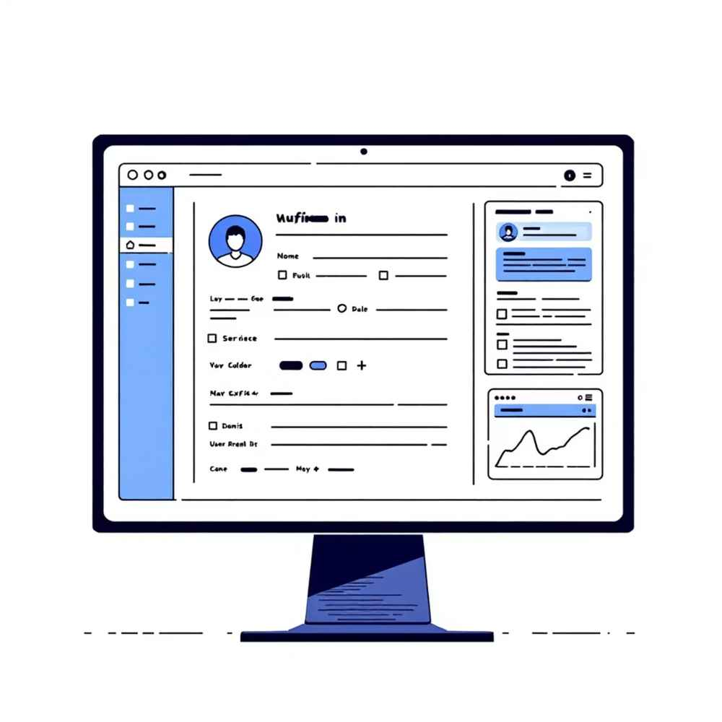
User Profile Management
Admins can seamlessly add new members with complete details, including name, contact information, and membership type.
The system allows for easy editing or deletion of existing profiles, ensuring that all data remains accurate and up-to-date.
Members have the autonomy to update their own profile details directly through their personalised dashboards.
This functionality ensures a current and accurate member information database, contributing to smooth gym operations and improved member satisfaction.

Slide 7





System Workflow & User Experience
Secure Login
Intuitive Navigation
Role-based access (Admin/User) with secure authentication protocols.
Menus are tailored to user roles for an optimal experience.
Responsive Pages
Real-time Feedback
JSP pages with user-friendly forms for data entry and updates.
Instant feedback on actions like attendance marking and profile edits.

Slide 8

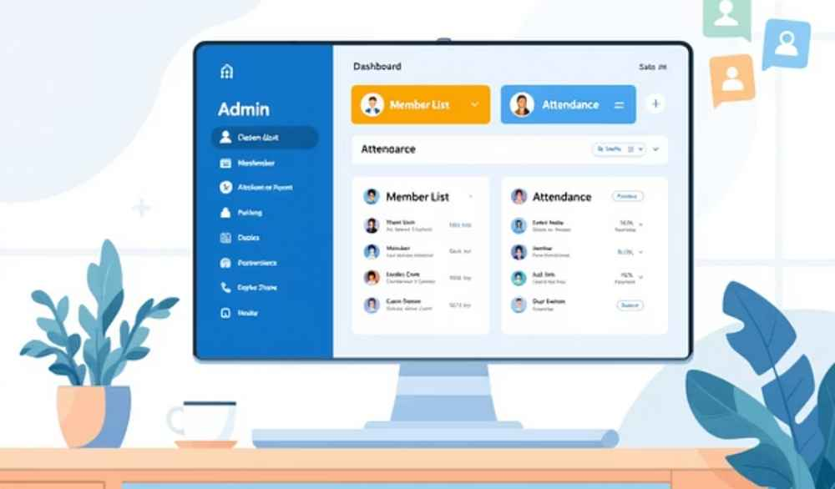
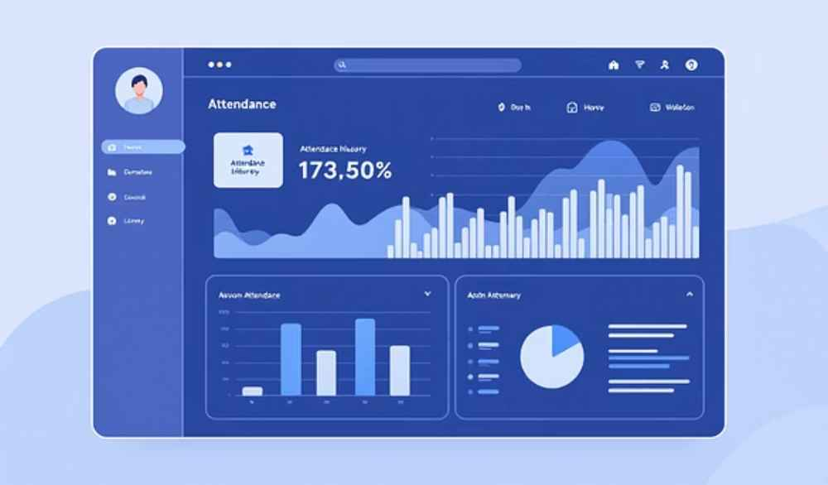

Demo Screenshots & Visuals
Visual cues provide clear feedback for success or error messages, greatly enhancing overall usability.

Slide 9

Benefits & Impact for Gyms
Time & Error Reduction
Enhanced Engagement
Significant savings in time and minimisation of errors in managing attendance and member data.
Boosts member engagement through transparent and easily accessible attendance tracking.
Simplified Admin
Scalable Solution
Centralised control simplifies complex administrative tasks, making operations smoother.
A highly adaptable and scalable solution suitable for gyms of any size, from small studios to large fitness centres.

Slide 10

Conclusion & Next Steps
This innovative platform is designed to modernise gym operations with a technology solution you can trust.
It is ready for immediate deployment and can be fully customised to meet your gym’s unique operational needs.
We invite you to discuss integration, comprehensive training, and future feature enhancements that can further optimise your gym management.
Thank You!
Questions and feedback are always welcome.

