Slide 1
TCS Innovista 2017
Private and Secure Digital Identity on a Blockchain based General Purpose Technology Platform
C&ES, Hi-Tech, CMI & ATU
Team: Nikhil Chaudari, JingJing Chen, Shalini Gupta, Shamal Lalvani, Satish Manoharan, Arunkumar Sekar, Prafull Tilwankar, Spencer Tingley
Mentor & Chief Architect: Dr. Andreas Freund
December 2016
TCS Confidential

Slide 2

Why Digital Identity will become fundamental at a global scale
1.5bn without legal identity
$10Bn+ of PII Cyberhacks
Exponential Identity Risks & Opportunities
Coherent Strategies and Solutions
Physical Danger
Global Regulations
Seamless CX

Slide 3
Secure & Private Digital Identity (DI): An Ubiquitous “Killer App”
Any Life Experience
Clients like it …
Any Ecosystem Participant & Value-Exchange
Cross-industry Impact
On top of legacy systems
Individuals
Any Asset Lifecycle
DI
Secure
Private
Self controlled
Ubiquitous
Any Industry
Assets
Things
Any Business Process
Organizations

Slide 4






Digital Identity solution Is built on TCS’ Industrial Internet Platform
Open App Ecosystem
Strategic Partners
API & Integration Layer
IIP Platform Module
Blockchain
Big Data
AI
IoT
3rd party Platforms
FS Blokchain Platform
Clients
Developer
Ecosystem
Infrastructure
IoT Ecosystem of Devices
Open Source, Modular, Loosely Coupled, Platform Ecosystem

Slide 5
Our technology & identity approach differentiates us from the rest
Technology Approach
Digital Identity Protocol
Differentiation
Key Competitors (Partners)
Established | Start-Ups
Microsoft IBM Deloitte Accenture PwC | ConsenSys ShoCard Evernym Blockstack Labs UniqueID

Slide 6
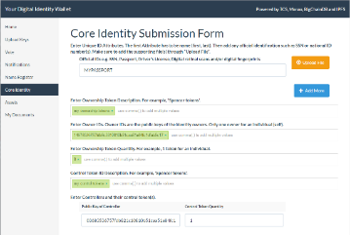
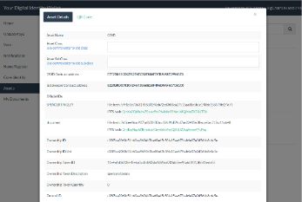
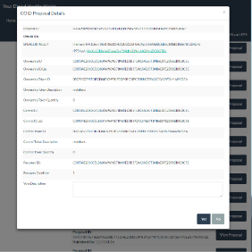
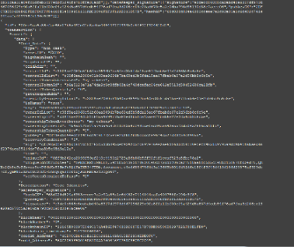
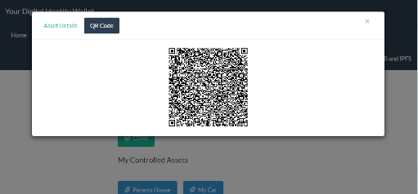
TCS Builds Digital Identity Protocol & PoC for a Large US ISP
Business Challenge
TCS Solution
Client Benefits
Significant cybersecurity risks
Data Privacy Regulations
DI POC on IIP with mobile, ZK Verification App & APIs
Secure & private DI
Multiple Blockchain, Cryptographic & Big Data technologies
Fulfill Data Privacy Regulations
DI for cyber security
Potentially new & cross-industry business models
Digital Identity Submission
Digital Identity Asset View
Digital Identity Validation
Integrating Blockchains
ID Verification: QR Code

Slide 7
TCS DI can have a global impact on people and industries alike
People
Industries
Organizations
TCS
Social:
1.5Bn people have a secure, legal identity for the 1st time
Economic:
$10Tn+ added to global GDP
Business Across Industries:
All Ecosystems Any Value Exchange
Security:
Secure, Trust Platform (People, Devices, Orgs & Assets)
New Business:
Ecosystem plays
Value-Props in adjacent industries
Security & Compliance
Better security, data privacy & compliance
Tata Group vision
$1Bn+ for every vertical
Services & Platform Play
No patent filed yet. Intent to Open Source

Slide 9
Our technology and identity approach differentiates us from the rest
Technology Approach
Digital Identity Protocol
Differentiation
Key Competitors (Partners):
Established:
Microsoft
IBM
Deloitte
Accenture
PwC
Start-ups:
ConsenSys
ShoCard
Evernym
Blockstack Labs
UniqueID
…
Ecosystem of Partners
Open Source
Multiple Technologies
Security from the ground up
Scalable & Interoperable
Quasi Zero-Knowledge
Universally Applicable
Modular & Multi-dimensional
Private & User Controlled (Identity + Data)
Trustless Verification
Use Case Agnostic Core Identity
Blockchain Agnostic
Secure Self-Recovery

