Slide 1






PredictX · TEAM PITCH DECK
Jack Schneider
PROJECT
THEME
Smart Energy Guardian
Energy Intelligence & Sustainability
AI-based IoT system that finds and stops electricity wasted in empty campus rooms
Software prototype: working
Hardware build: in progress
BRANCH
TEAM SIZE
FACULTY MENTOR
Electrical & Electronics Engineering (EEE)
3 Members — Suyash · Arjun · Arya
Ravichandra Halagatti
Powering Predictive Intelligence — A PredictX Campus Hackathon Submission
Jack Schneider · PredictX Campus Hackathon
1
Notes:
ARYA (opening, ~30 s): Good morning. We are team Jack Schneider from EEE. Our project is Smart Energy Guardian — an AI-based IoT system that finds electricity being wasted in empty classrooms, labs and hostels and switches it off safely. Our mentor is Prof. Ravichandra Halagatti. Today: Arya explains the problem and idea, Suyash explains how the system works, Arjun shows the working software and our status. Quick status up front: the software is complete and working; the hardware build is in progress and will be shown in the final review.

Slide 2

Smart Energy Guardian
What real-world problem are you solving, and for whom?
Institutional buildings (classrooms, labs, hostels) waste huge amounts of electricity because lights, fans and ACs keep running in empty rooms. Nobody notices until the bill arrives — facility teams have no room-level visibility, causing financial loss, extra carbon emissions and structural inefficiency.
OUR SOLUTION
INTELLIGENCE ENGINE
TECH STACK
A low-cost IoT + AI system that detects, analyzes and eliminates electrical energy wastage in institutional campuses.
An ESP32 in each room collects real-time data from PIR/mmWave occupancy sensors, SCT-013/PZEM current & power sensors and temperature modules every 5 seconds.
If a room is vacant but appliances keep drawing power, the system passes a set of safety checks, executes an automated relay shut-off and sends real-time alerts to a centralized React.js web dashboard.
Output: live power, kWh used and wasted, cumulative kWh savings, ₹ cost reduction and estimated CO₂ offset — per room and campus-wide.
Edge-AI Intelligence Engine: an Isolation Forest anomaly detection model flags abnormal electrical behaviour — spikes, over-consumption, voltage faults, low power factor and phantom loads.
A deterministic decision engine combines occupancy, vacancy time, class schedules, manual overrides and appliance rules, so necessary loads are separated from outright waste — no false positives or blind shut-offs like binary motion sensors.
Hybrid edge-cloud: the ESP32 acts locally (relay, fail-safe), the server runs analytics, and the dashboard updates live over WebSocket.
ESP32 microcontroller
PIR / mmWave occupancy
SCT-013 / PZEM-004T power sensing
Temperature modules
Relay-based shut-off
Isolation Forest ML (scikit-learn)
Python FastAPI backend
SQLite / PostgreSQL
React.js + TypeScript dashboard
Jack Schneider · PredictX Campus Hackathon
2
Notes:
ARYA (~1.5 min): The problem — in classrooms, labs and hostels, lights, fans, projectors and ACs are often left on after people leave. Nobody tracks it room by room, so the waste only shows up in the electricity bill. Our solution has three parts. (1) Sensing: an ESP32 in every room reads occupancy (is anyone there?) and electrical values (how much power is each appliance using?). (2) Intelligence: a decision engine checks — is the room empty for long enough, is no class scheduled, is it not an essential load like a server — and an ML model watches for abnormal electrical behaviour. (3) Action: if it is real waste, a relay switches the appliance off and the dashboard shows the alert and the money and CO2 saved. The tech stack is on the right: ESP32 and sensors for hardware, Python FastAPI and scikit-learn for backend and ML, and React for the dashboard.

Slide 3



Why It Matters
PROBLEM & IMPACT
The cost of one forgotten classroom — and of a whole campus
ONE TYPICAL CLASSROOM
6 tube lights × 40 W = 240 W
4 ceiling fans × 75 W = 300 W
1 split AC ≈ 1,500 W
Total ≈ 2.04 kW left running
Empty but ON ~3 h per day
220 working days per year
Tariff ₹8/kWh · grid 0.71 kg CO₂/kWh
1,346 kWh
₹10,771
956 kg
wasted per room / year
lost per room / year
CO₂ per room / year
SCALE IT TO 100 ROOMS
≈ 1.35 lakh kWh · ≈ ₹10.8 lakh · ≈ 96 tonnes CO₂
every single year — from rooms where nobody is even present. In our 7-day simulated demo campus, 15.9% of all energy was drawn in vacant rooms.
Illustrative estimate based on these assumptions — the exact figure depends on each campus.
Jack Schneider · PredictX Campus Hackathon
3
Notes:
ARYA (~1 min): To show why this matters, take one ordinary classroom: 6 tube lights, 4 fans and one AC — about 2 kilowatts. If it stays on in an empty room for just 3 hours a day, over 220 working days that is about 1,350 units, around ₹10,800 and almost a tonne of CO2 per room per year. For 100 rooms that becomes about 1.35 lakh units and ₹10.8 lakh every year. These are our own illustrative assumptions, not measured data. In our simulated demo campus, about 16% of energy was used in empty rooms. So even small savings per room add up to a lot across a campus.

Slide 4
Innovation & Differentiation
INNOVATION & ORIGINALITY · 25%
What makes your approach genuinely new?
TODAY'S APPROACH
YOUR APPROACH
Appliances are switched off manually by occupants or staff, or run on fixed timers — so empty rooms keep drawing power.
Conventional binary motion sensors trigger false positives or blind shut-offs (e.g. a lab cut off mid-experiment) and cannot tell necessary loads from waste.
No room-level visibility: savings are never measured, and faults like a stuck relay or phantom load go unnoticed.
Commercial building-management systems are costly and built for large offices, not classrooms and hostels.
1. Edge-AI Intelligence Engine: ML anomaly detection on electrical features catches spikes, over-consumption, voltage faults and phantom loads.
2. Multi-signal sensing: occupancy (PIR/mmWave), current & power (SCT-013/PZEM) and temperature fused on a low-cost ESP32.
3. Explainable, safety-first decisions: 20 checks (data freshness, schedules, overrides, essential loads) — every decision is shown check-by-check.
4. Closed loop: relay shut-off with acknowledgement & timeout, real-time alerts and a dashboard tracking kWh, ₹ and CO₂ savings.
5. Hardware-ready, deploy-anywhere: a simulator and ESP32 emulator use the exact device protocol, so the software is tested before a single wire is connected.
Jack Schneider · PredictX Campus Hackathon
4
Notes:
ARYA (~1.5 min): Today, rooms are switched off manually or with timers, and simple motion sensors either switch things off when someone is sitting still or never switch off at all. Nobody can see per-room waste. What is new in our approach: (1) an ML model that watches the electrical signal itself and flags faults; (2) several sensors combined on one cheap ESP32 instead of one motion sensor; (3) every decision is explainable — the dashboard shows all 20 checks, like 'is a class scheduled?', 'is it an essential load?'; (4) it is closed-loop — the relay must confirm the switch-off, and savings are tracked in kWh, rupees and CO2; (5) the software is already proven with a simulator and an ESP32 emulator, so when hardware is connected, the software does not change. Now Suyash will explain how the system works inside.

Slide 5





How It Works — System Architecture
TECHNICAL DESIGN
Four layers, one data path from sensor to screen
1. Room Node (Edge)
2. Backend (Python · FastAPI)
3. Database
4. Dashboard (React · TS)
ESP32 + PIR + PZEM/SCT-013 + relay board
Sends readings every 5 s over Wi-Fi (HTTPS JSON)
Switches relay ON/OFF and confirms with the power meter
Telemetry pipeline: kWh, waste, cost, CO₂
ML anomaly scoring of every reading
Decision engine + command service
Monitor loop every 3 s (offline, timeouts)
SQLite (local) or PostgreSQL / Supabase (cloud)
Rooms, appliances, readings, 15-min energy buckets, alerts, commands, audit log
Live updates over WebSocket
12 pages: rooms, alerts, history, ML, simulation, settings
Secure login: viewer / operator / admin
Tested today without hardware: a built-in simulator (5 virtual rooms, 7 scenarios) and an ESP32 emulator talk to the backend using the exact same protocol as the real ESP32 — so when our hardware is ready, the software needs no changes.
Jack Schneider · PredictX Campus Hackathon
5
Notes:
SUYASH (~1.5 min): Our system has four layers. Layer 1, the room node: an ESP32 with an occupancy sensor, a power meter and a relay board. Every 5 seconds it sends a small JSON message: is the room occupied, and how many watts each appliance is drawing. Layer 2, the backend in Python FastAPI: it converts power into energy (kWh), works out how much was wasted in empty rooms, scores each reading with the ML model, and every 3 seconds a monitor loop runs the decision engine. Layer 3, the database: SQLite on a laptop or PostgreSQL in the cloud — it stores rooms, readings, alerts and every command for auditing. Layer 4, the React dashboard, which updates live through WebSocket. Important point: because we do not have the hardware yet, we built a simulator and an ESP32 emulator that send exactly the same messages a real ESP32 will send. So the whole software path is already tested end-to-end.

Slide 6


Safety-First Decision Engine
TECHNICAL DESIGN
An appliance is switched off only when every check passes
1
Data Quality
2
Wastage
3
Safety Policy
4
Mode
Is the data fresh and trustworthy?
Power reading < 45 s old, occupancy known, sensor OK, ESP32 online.
Is energy really being wasted?
Appliance above standby power AND room vacant for the minimum time (10 min).
Is it safe to switch off?
Not an essential load, no manual override, no class scheduled now or in 10 min, no recent manual switch-on.
What are we allowed to do?
Recommend → alert only. Dry-run (default) → log only. Auto → send OFF command.
If not → do nothing
If not → no action
If not → only recommend
Relay must acknowledge in 20 s
Real relay switching needs 3 keys: Auto mode + hardware switching enabled on the server + that ESP32 validated by an admin.
AI advises, rules decide: an ML anomaly never switches anything off on its own — it raises an alert for a human to inspect.
Jack Schneider · PredictX Campus Hackathon
6
Notes:
SUYASH (~1.5 min): Switching off electricity in a room where people might be is risky, so our decision engine is safety-first. It runs 4 stages. Stage 1, data quality: if the reading is old, the occupancy sensor has failed or the ESP32 is offline, we do nothing at all. Stage 2, wastage: the appliance must be ON and the room must have been empty for a minimum time, 10 minutes by default, so someone stepping out briefly is not affected. Stage 3, safety policy: we never touch essential loads like servers or fridges, we respect manual overrides, and we do not switch off if a class is scheduled now or in the next 10 minutes — in those cases we only send a recommendation. Stage 4, mode: recommend, dry-run (the default, which only logs what it would do) or auto. Real hardware switching needs three keys at once. And the ML model only advises — it can raise an alert but can never switch something off by itself.

Slide 7
ML Anomaly Detection
AI / ML
Isolation Forest — learns what normal electrical behaviour looks like and flags what doesn't
WHAT IT CATCHES
0.995
86.7%
70.1%
1.1%
Over-consumption (load far above its rating)
Sudden power spikes
Voltage faults
Low power factor (inefficient load)
Phantom load — power flowing while the relay says OFF
ROC-AUC
Recall
Precision
False alarms
HOW IT WORKS
5 input features: power ratio, step change, voltage deviation, power factor, relay mismatch
200 trees, trained on 16,000 readings, tested on 8,000 unseen readings
Alert only after 2 flagged readings in a row (no one-off noise)
Rule-based fallback if no model is loaded
Measured on synthetic data from our own simulator — it proves the pipeline works. Real accuracy will be measured once hardware data is collected.
Jack Schneider · PredictX Campus Hackathon
7
Notes:
SUYASH (~1.5 min): For AI we use Isolation Forest from scikit-learn. In simple words, it learns what normal electrical readings look like, and readings that are easy to 'isolate' from the rest are unusual — those are anomalies. It catches five kinds of problem: over-consumption, spikes, voltage faults, low power factor, and phantom load, where power is still flowing even though the relay says OFF — that usually means a faulty relay. The model uses five features, has 200 trees, and was trained on 16,000 readings and tested on 8,000 readings it had never seen. Results: ROC-AUC 0.995, recall 86.7% (it catches about 87 out of 100 anomalies), precision 70%, and only 1.1% false alarms. Voltage faults are the weakest at 59%. To be honest with the panel: this data is generated by our simulator, so it proves the pipeline works; real accuracy will be measured after hardware data comes in. Now I'll show the end-to-end flow of the prototype.

Slide 8


Prototype & Demo
PRESENTATION & PROTOTYPE · 20%
Show, don't just tell — this is your proof of feasibility
Sensing
PIR / mmWave occupancy · SCT-013 / PZEM current & power · Temperature
DEMO NOTES
Stage: working software demo (simulator + ESP32 emulator). Hardware node: in progress.
Detects vacant rooms with abnormal power draw, cuts power via relay (simulated) and alerts the dashboard in real time.
Demo scenarios: vacant-room waste, anomaly, sensor failure, offline device, failed and timed-out commands.
127 automated tests passing (105 backend, 18 frontend, 4 end-to-end).
Next: wider rollout across labs and hostels, deeper per-room analytics and mobile alerts.
Edge Node
ESP32 aggregates real-time telemetry every 5 s and drives the relays
Intelligence
Decision engine (20 safety checks) + ML anomaly detection (Isolation Forest)
Action & Insight
Automated relay shut-off · live React.js dashboard, alerts & savings
Jack Schneider · PredictX Campus Hackathon
8
Notes:
SUYASH (~1 min): This is the complete flow. Sensors measure the room, the ESP32 collects and sends the data, the intelligence layer decides, and the action layer switches the relay and updates the dashboard. Our current stage: the software is a working demo, driven by the simulator and the ESP32 emulator; the physical hardware node is in progress. We can demonstrate scenarios like a room left on while empty, an electrical anomaly, a failed sensor, an offline device, and a relay that fails or does not respond. All of this is covered by 127 automated tests. Now Arjun will show you the actual software screens.

Slide 9
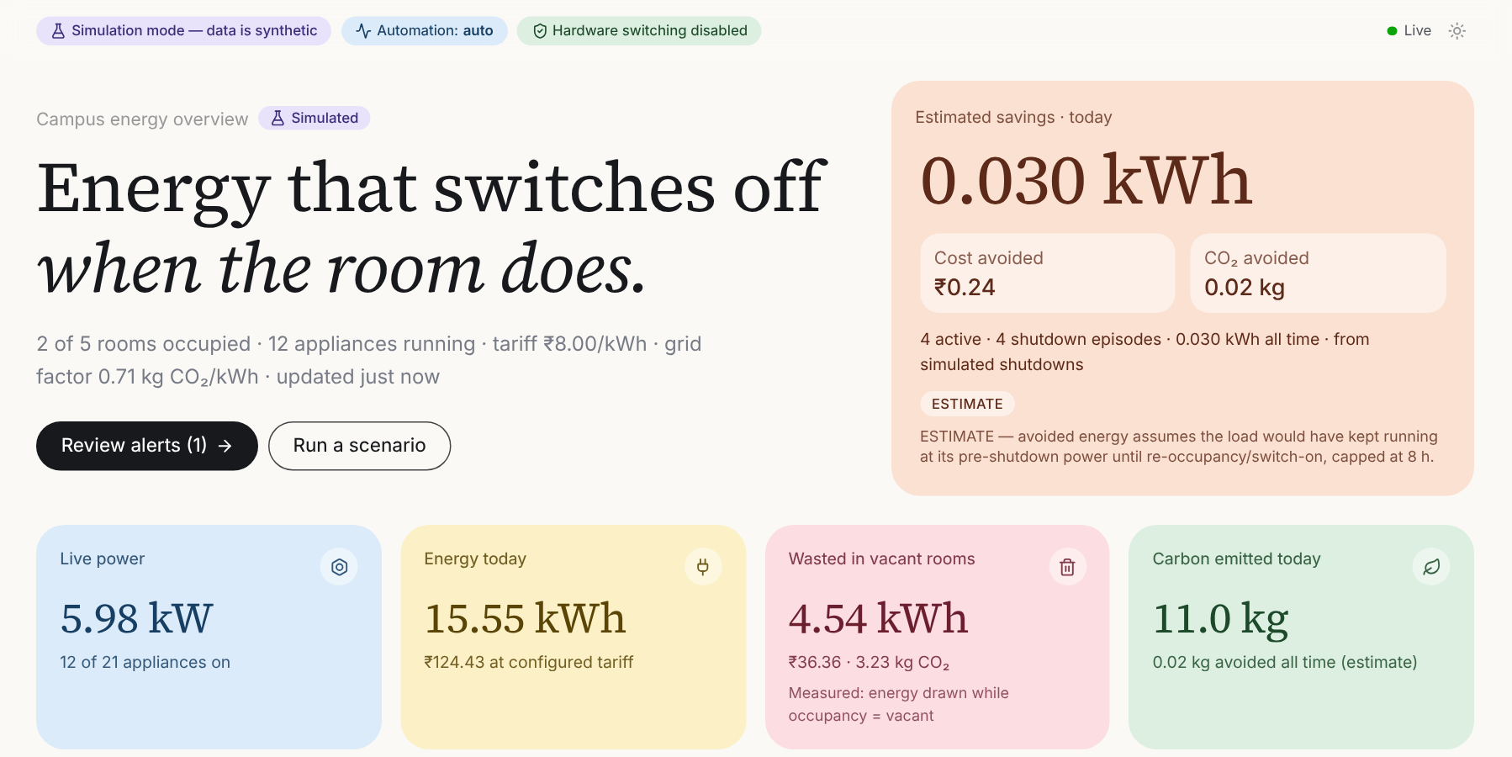
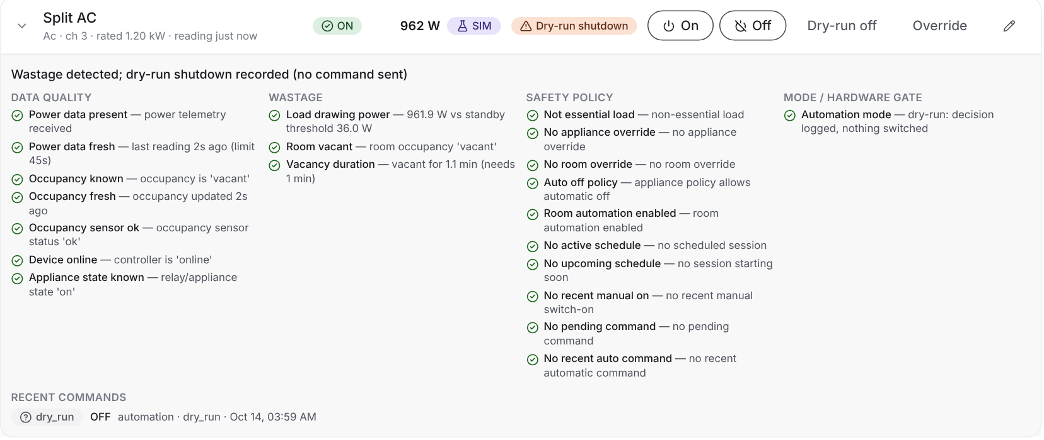
Software Prototype — Live Dashboard
WORKING SOFTWARE
Real screens from our running software (simulated campus data)
Room view: every decision explained check-by-check (here: Split AC in an empty seminar room)
WHAT THE DASHBOARD GIVES
Campus overview: live power, energy today, energy wasted in vacant rooms, CO₂ and estimated savings
Live kW, kWh, ₹ cost and CO₂ — per room and campus
Energy wasted while rooms were empty
Alerts with recommendations · manual ON/OFF & overrides
Schedules, devices, users & roles, settings
Labelled honestly: every screen shows whether data is Simulated, Emulated ESP32 or Hardware, and savings are always marked as estimates.
Jack Schneider · PredictX Campus Hackathon
9
Notes:
ARJUN (~1.5 min): This is our working dashboard. On the left, the campus overview: live power in kilowatts, energy used today, energy wasted in empty rooms — in red — carbon emitted, and in the top-right the estimated savings in kWh, rupees and CO2 after automatic shutdowns. On the right is a room page. Here the seminar room is empty but the lights, fans, projector and AC are still on. If you open the Split AC, you can see every check the decision engine ran — data quality, wastage, safety policy and mode — each with a green tick and the reason. So the operator always knows WHY the system wants to switch something off. Every screen also clearly says whether the data is simulated or from real hardware, and savings are labelled as estimates.

Slide 10
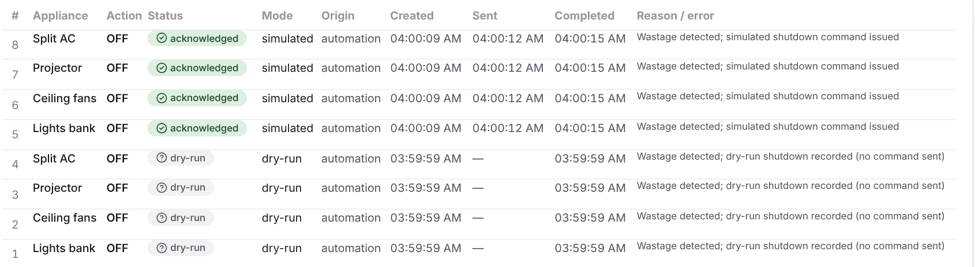
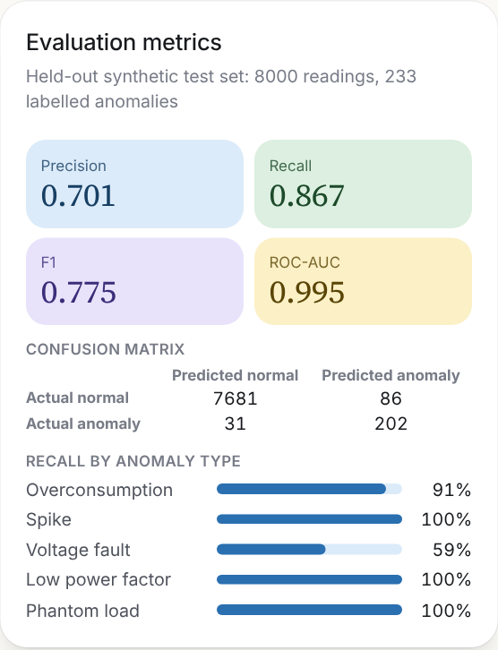
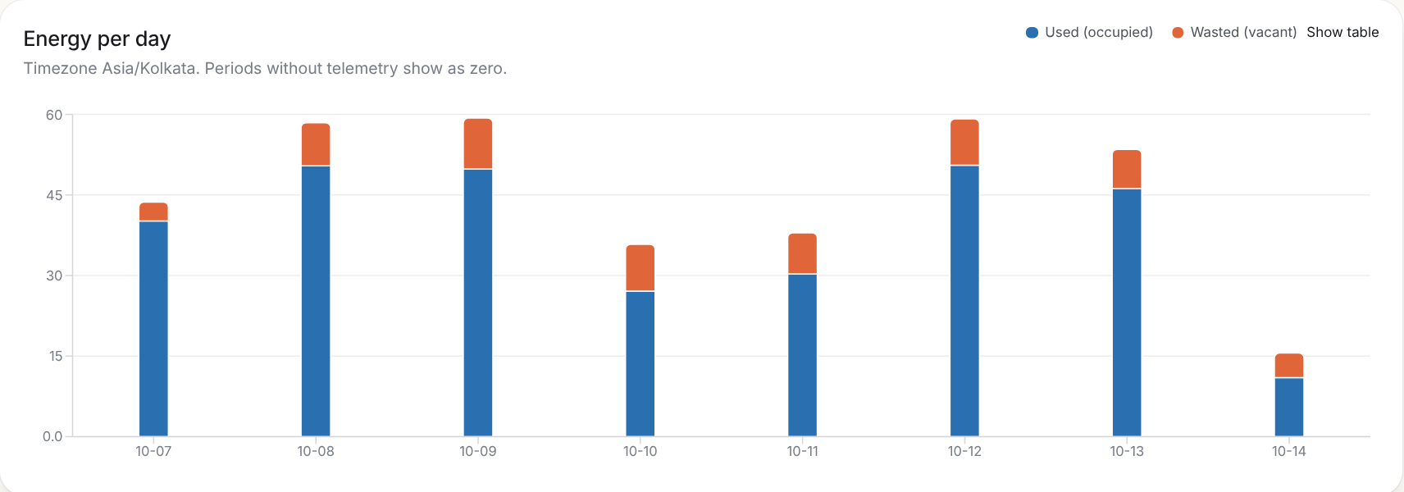
Software Prototype — Automation & History
WORKING SOFTWARE
From detection to shutdown to savings — all tracked
DEMO IN 4 STEPS
1
Room left ON while empty → waste alert appears
Command log: dry-run decisions, then automatic OFF commands acknowledged by the controller
2
Dry-run shows what would be switched off
3
Switch to Auto → OFF commands sent & acknowledged
ML page: metrics, confusion matrix, recall by type
4
Savings counter starts; history shows waste dropping
Energy history: used (blue) vs wasted in vacant rooms (orange), 7 days
Jack Schneider · PredictX Campus Hackathon
10
Notes:
ARJUN (~1.5 min): Here is the automation in action. The command log at the top shows two stages: first, in dry-run mode, the system only recorded 'I would switch these 4 appliances off'. Then we switched the mode to Auto, and it sent real OFF commands to the controller, which acknowledged each one within about 3 seconds. If a relay fails or does not reply within 20 seconds, it is marked failed or timeout and an alert is raised. Below is the energy history for 7 days: blue is energy used while the room was occupied, orange is energy wasted while it was empty. On the right is the ML page with the model's metrics and recall per anomaly type. In the live demo we can show these 4 steps in about two minutes.

Slide 11
Project Status — Where We Stand
PROGRESS
Software complete for this review · hardware build planned for the final review
SOFTWARE COMPLETED
HARDWARE IN PROGRESS
Backend: data pipeline, energy & cost maths, alerts, commands
Safety-first decision engine with explanations
ML anomaly model trained, evaluated, versioned
React dashboard — 12 pages, live updates, dark mode
Simulator (7 scenarios) + ESP32 emulator
Docker, cloud deployment setup, CI pipeline
READY
Components selected & bill of materials
Wiring / pin plan for the ESP32 node
ESP32 firmware code drafted
Device protocol tested end-to-end via emulator
NEXT — FOR FINAL REVIEW
Procure parts, assemble and bench-test one room node
Connect to dashboard in dry-run, then live relay demo
Collect real readings to re-check the ML model
57
12
127
REST APIs
UI pages
tests passing
Jack Schneider · PredictX Campus Hackathon
11
Notes:
ARJUN (~1 min): Where we stand. The software is complete: backend, decision engine, ML model, dashboard, simulator and emulator, with 57 REST APIs, 12 dashboard pages and 127 automated tests passing. The hardware is in progress: we have finalised the components, the wiring plan and drafted the ESP32 firmware, and the communication protocol has already been tested using the emulator. The physical build has not started yet — for the final review we will procure the parts, assemble and test one room node, connect it to this same dashboard, and show a live relay shutdown with real readings.

Slide 12

Hardware Plan — Toward the Final Review
HARDWARE ROADMAP
One low-cost room node, designed to fail safe
Component | Role in the node
ESP32 DevKit (WROOM-32) | Brain of the node + Wi-Fi
PIR HC-SR501 / mmWave | Occupancy — is anyone in the room?
PZEM-004T + CT clamp / SCT-013 | Voltage, current and power per appliance
4-channel opto-isolated relay | Switches loads (normally-closed = fail-safe)
HLK-PM01 5 V supply | Powers the node from mains
DHT22 / DS18B20 | Room temperature (add-on for AC logic)
BUILD PLAN
1
Procure
Buy ESP32, sensors, relay board and power supply
2
Assemble & flash
Wire one node; flash firmware; bench-test boot, Wi-Fi loss, relay check
3
Connect
Register the ESP32 on the dashboard; run in dry-run mode
Safety by design: if the node crashes or loses power, the relay's normally-closed contact keeps lights and fans ON; OFF is confirmed with the power meter; mains wiring done under lab supervision.
4
Live demo
Real room: vacant → alert → relay OFF → savings, at the Final Review
Jack Schneider · PredictX Campus Hackathon
12
Notes:
ARJUN (~1 min) — or ARYA if she leads hardware: This is our hardware plan. Each room gets one node: an ESP32 as the brain, a PIR or mmWave sensor for occupancy, a PZEM-004T power meter with a CT clamp to measure each appliance, a 4-channel relay board to switch them, a 5 V supply and an optional temperature sensor. Safety is designed in: we use the relay's normally-closed contact, so if the ESP32 crashes, the lights and fans stay ON — no one is left in the dark — and every OFF is verified with the power meter. Our build plan has four steps: procure, assemble and bench-test, connect to the dashboard in dry-run mode, and finally a live demo in a real room at the final review.

Slide 13

Meet the Team
Cross-disciplinary skills behind the idea
Suyash Tatiya
Arjun Gupta
Arya Suman
24BEE0087
24BEE0064
24BEE0032
Team Lead
Software & Testing
Research & Hardware
Backend, decision engine & ML model
React dashboard, simulation, testing & deployment
Problem research, energy analysis & hardware design
Faculty Mentor: Ravichandra Halagatti Schneider Mentor: assigned during mentoring phase
Jack Schneider · PredictX Campus Hackathon
13
Notes:
ALL (~30 s, each person says one line about themselves): Suyash — team lead, backend, decision engine and ML. Arjun — dashboard, simulation, testing and deployment. Arya — problem research, energy analysis and hardware design. Thank our mentor, Prof. Ravichandra Halagatti, for his guidance.

Slide 14


Who Did What
TEAM CONTRIBUTIONS
Specific tasks owned by each team member
Suyash Tatiya
Team Lead · Backend & ML
Arjun Gupta
Frontend, Testing & Deployment
Arya Suman
Research, Energy & Hardware
System architecture & database design
FastAPI backend and 57 REST APIs
Safety-first decision engine (20 checks)
Isolation Forest pipeline: data, training, metrics
Command flow: acknowledgement & timeouts
React + TypeScript dashboard (12 pages)
Live WebSocket updates & charts
Simulation scenarios & ESP32 emulator runs
Unit + end-to-end (Playwright) tests
Docker & cloud deployment (Vercel, Render)
Problem research & campus energy study
Energy, cost & CO₂ calculation model
Sensor selection & bill of materials
ESP32 wiring plan & firmware protocol
Leads hardware build for Final Review
Presents Part 2: How it works
Presents Part 3: Software & status
Presents Part 1: The pitch
Jack Schneider · PredictX Campus Hackathon
14
Notes:
ALL: Each member reads their own column in 15–20 seconds. This shows the panel that work was divided clearly: Suyash on backend and ML, Arjun on frontend, testing and deployment, Arya on research, energy calculations and hardware.

Slide 15

Roadmap & Next Steps
Where this goes beyond the hackathon
If Shortlisted
Build and bench-test the ESP32 room node, calibrate the anomaly model on real room-level consumption data, harden the relay and alert logic, and polish the dashboard for the final pitch.
1
If Selected as Winner
Use the Schneider internship to pilot Smart Energy Guardian in live campus buildings and align it with professional energy-management practice.
2
Long-Term Vision
Scale into a deployable blueprint for smart campuses, hostels and commercial buildings — with mobile alerts, people counting and multi-building reports — to achieve measurable net-zero goals.
3
Jack Schneider · PredictX Campus Hackathon
15
Notes:
ARJUN or SUYASH (~45 s): Next steps. Immediately: build the hardware node, calibrate the model on real data and polish the dashboard for the final review. If we win, we would like to pilot it in real campus buildings with Schneider's guidance. Long term, this can become a blueprint for smart campuses, hostels and commercial buildings, with mobile alerts and multi-building reports.

Slide 16

Thank You
Jack Schneider · Questions Welcome
Suyash Tatiya · Arjun Gupta · Arya Suman | Faculty Mentor: Ravichandra Halagatti
suyash.tatiya2024@vitstudent.ac.in
Jack Schneider · PredictX Campus Hackathon
16
Notes:
ARJUN: Thank you. We are happy to take questions. (Answer questions according to ownership: architecture/backend/ML → Suyash; dashboard/testing/deployment → Arjun; problem, energy numbers, hardware → Arya.)

