Slide 1


C3I Summer Internship (June-July 2025)
“Analyzing job posting trends, skill gaps, and recommend reskilling programs in employment sectors”
Intern Name: Suhas Venkata Karamalaputti (PES2UG22CS590)
Mentor Name: Dr. Richa Sharma (Associate Professor)

Slide 2
Problem Statement
The skills gap is a significant challenge for job seekers. Many individuals lack the specific skills required for available positions, leading to unemployment and underemployment, so our model aims to solve this issue by analyzes a user's resume and recommends relevant online courses to bridge their skill gaps and improve their career prospects.

Slide 3
Research Gap
We noticed that in the conference and journal papers we came across, they used traditional methods like tf-idf and word2vec. But the drawback with such methodologies is that, methodologies like tf-idf miss the context and they completely rely on token frequency and word2vec struggle with out of vocabulary words.

Slide 4
Objective
Develop a model that extracts skills from user resumes and identifies gaps between current capabilities and target job requirements.
Create a deep learning-based recommendation system using DSSM that suggests relevant courses based on identified skill gaps and job requirements.
Build a robust system that can extract skills from various resume formats (PDF, DOCX, images) using OCR and NLP techniques, filtering out irrelevant content.
Develop an interactive Streamlit application that provides instant career guidance, skill analysis, and course recommendations with a user-friendly interface.

Slide 5
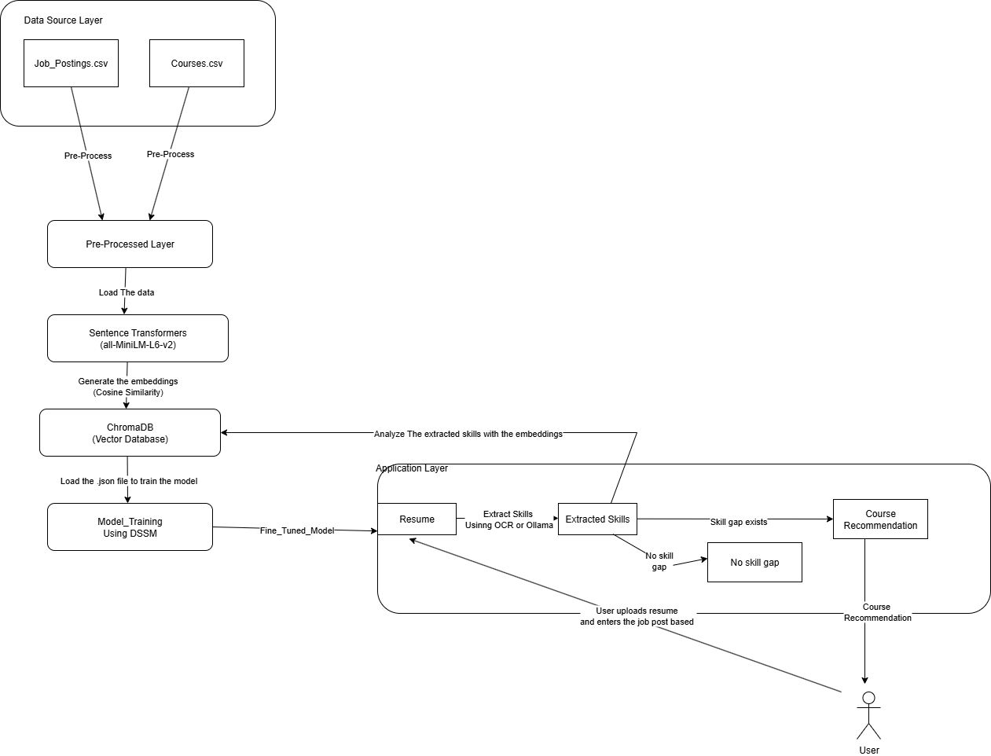
Architecture Diagram

Slide 6
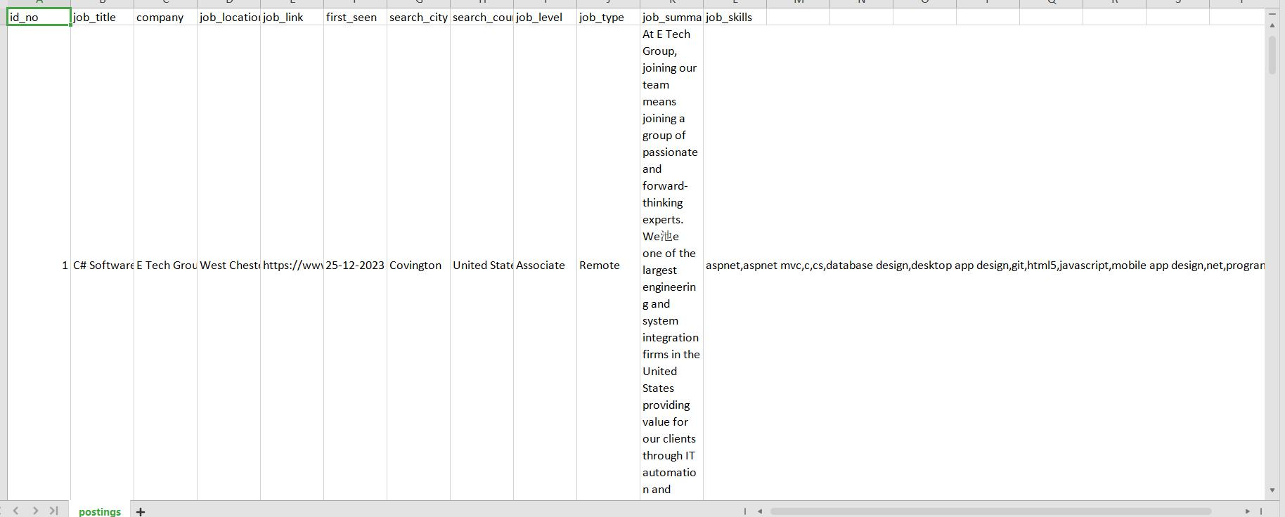
Dataset Details & Preprocessing Steps
1. Job_Dataset
1.1 Postings.csv( 6680 job_postings)

Slide 7
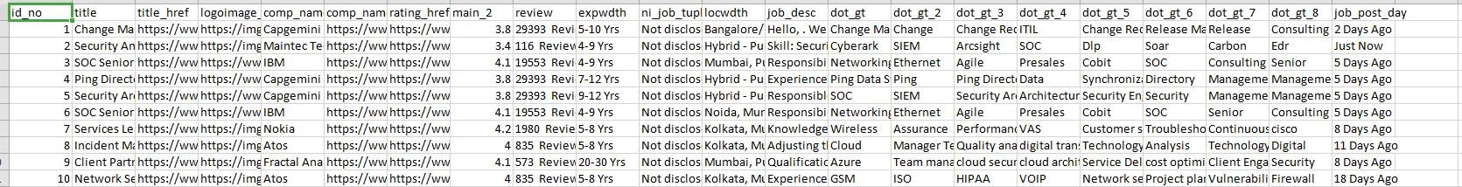
Dataset Details & Preprocessing Steps
1.2.data_science_analytics.csv","engineering_hardware_networks.csv","engineering_software_qa.csv","it_information_security.csv","project_program_management.csv", "product_management.csv", "research_development.csv", "ux_design_architecture.csv
- Aggregate around 70,000 job_postings

Slide 8
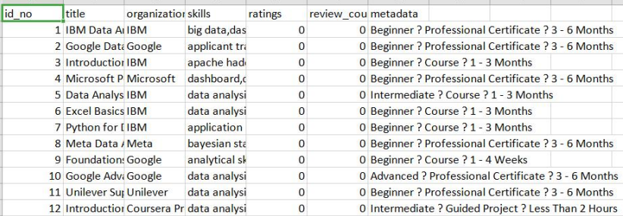
Dataset Details & Preprocessing Steps
2. Courses Dataset
2.1 coursera_data_analyst.csv", "coursera_hardware.csv", "coursera_info_sec.csv", "coursera_product.csv","coursera_project.csv","coursera_software.csv", "coursera_cyber_security.csv", "coursera_ui_ux.csv","coursera_web_developer.csv"
- Aggregate 6000 courses

Slide 9
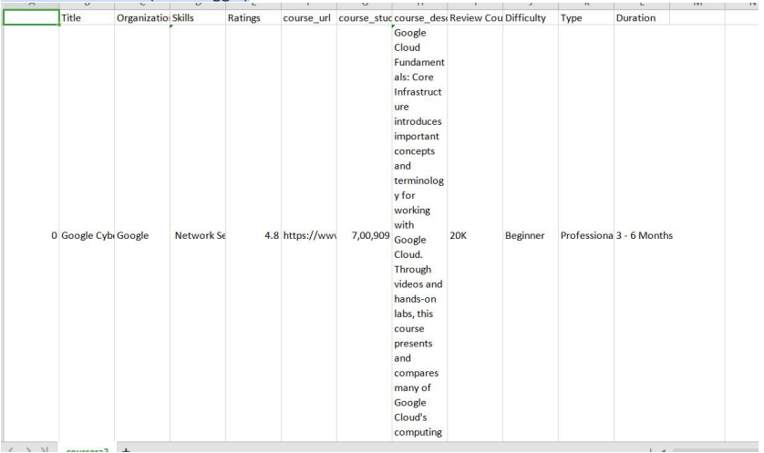
Dataset Details & Preprocessing Steps
2.2 Coursera dataset (from Kaggle)
-Around 6600 courses

Slide 10
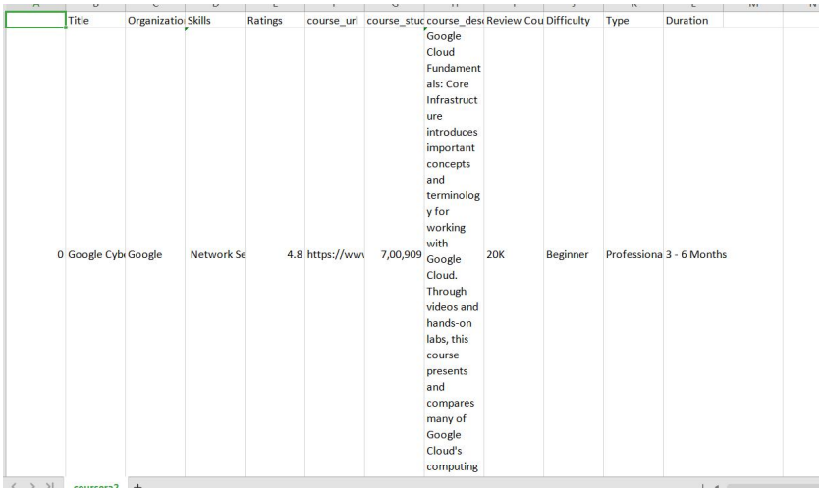
Dataset Details & Preprocessing Steps
2.3. Udemy Course dataset (From Kaggle)
- Around 83,000 courses

Slide 11
Dataset Details & Preprocessing Steps
Preprocessing Steps
All CSV datasets are loaded with robust encoding handling (UTF-8, latin1, etc.).
Column names are standardized to lowercase and underscores for consistency.
Duplicate rows are removed to ensure data integrity.
Rows with more than 50% missing values are dropped.
Remaining missing values are filled with appropriate defaults (e.g., 'Unknown' for categorical, median for numerics).
Skill columns are split, lowercased, deduplicated, and standardized.
Cleaned datasets are saved as new CSV files in the preprocessed/ directory for modeling and analysis.
Before pre-processing there was around 80,000 job_postings and 96000 courses, and after the eda_analysis and data_preprocessings I have reduced job_postings to 31,000 and retained the the amount of courses to 96000 for better mapping of job to relevant courses

Slide 12
Feature Extraction
In our project we have extracted four main features for creating vectors embeddings which are course_embeddings, job_embeddings, job_skill_embeddings, course_skill_embeddings.
The other crucial feature extraction is relevant skills from the resume that user uploads using OCR(Optical Character Recognition) and based on the job title we enter it recommends the relevant courses in case of skill gap

Slide 13
Pre-training and Training setup
The training setup dynamically generates positive job-course pairs by computing cosine similarity between initial embeddings, while also creating negative pairs at a 2:1 ratio for contrastive learning. These combined pairs form a `TripletDataset`, which is split into training and validation sets for batch processing by `DataLoader`s.
The DSSM model, comprising job and course towers, is trained using `Adam` optimizer and `CosineEmbeddingLoss`. It employs EMA on validation loss for stable monitoring, and includes early stopping if the smoothed validation loss doesn't improve for three epochs, preventing overfitting and saving the best performing model.

Slide 14
Hyperparameter Finetuning
Hyperparameter | Value
Batch size | 32
LEARNING RATE | 10^{-4}
Epochs | 100
query_dim | 384
doc_dim | 384
margin | 0.2

Slide 15
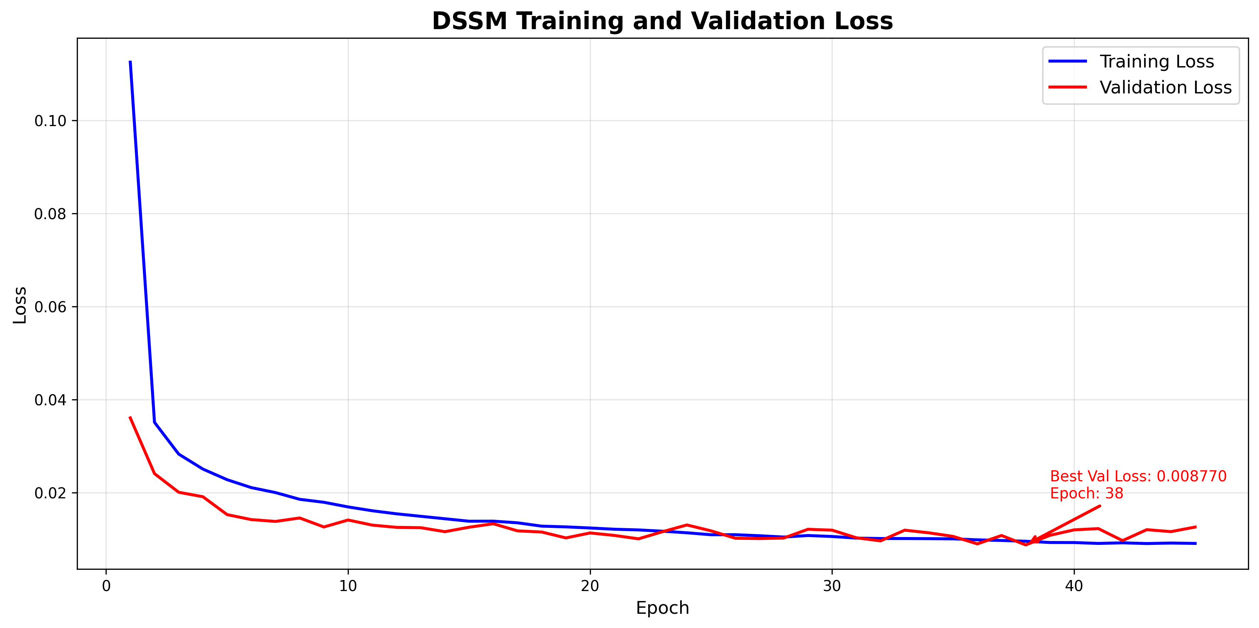
Results and Graphs

Slide 16
Evaluation Metrics and Tools used for it
The metrics used in our project is training and validation loss which is done with the help of Pytorch.
We used cosine_similarity as another metric for mapping the relevant courses and job embeddings.
The tools used are:
Pytorch for loss vales
Matplotlib for plotting the visualizations of training and validation loss

Slide 17
Implementation
eda_analysis: Analyzes raw job/course data, identifying missing values, performing dataset-specific insights, and conducting initial skill gap analysis via exact matching to inform preprocessing.
data_processing: Cleans and standardizes raw data, handling missing values robustly and performing advanced skill normalization. It creates `combined_text` fields for embeddings and saves preprocessed files for later stages.
populate_chromadb: Generates `all-MiniLM-L6-v2` embeddings for preprocessed jobs, courses, and individual skills, storing them in ChromaDB. It also creates initial job-to-course similarity mappings.

Slide 18
Implementation
model_training: Trains a Deep Structured Semantic Model (DSSM) using ChromaDB embeddings, generating positive/negative pairs for contrastive learning. It employs CosineEmbeddingLoss, EMA(Exponential Moving Averaage) for validation, and early stopping to optimize and save the best model.
model_testing: A Streamlit web application that integrates the trained DSSM and ChromaDB. It analyzes user resumes, identifies skill gaps for desired jobs, and recommends relevant courses, leveraging both pre-computed mappings and DSSM insights.

Slide 19
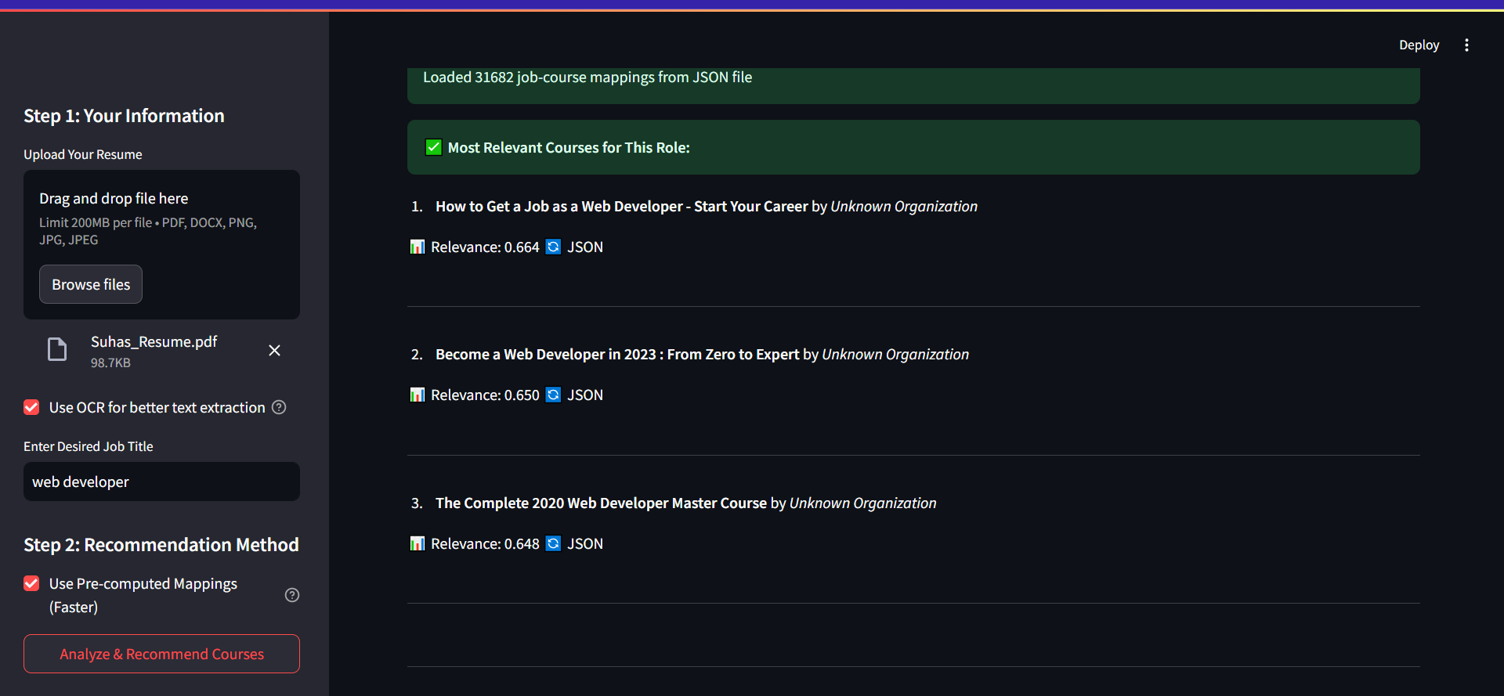
Results

Slide 20
Conclusion
Successfully developed an AI-powered career guidance system using DSSM architecture
Implemented robust skill extraction from various resume formats (PDF, DOCX, images) with OCR capabilities
Created intelligent job-course matching using deep learning and semantic similarity
Built an interactive Streamlit application providing real-time career assessment and course recommendations

Slide 21
Future Work
Real-Time Job Market Integration
Accessibility Improvements like Voice-based interaction, Multi-language interface

Slide 22
Inferences
The architecture succes balances computational efficiency with semantic understanding, making it suitable for real-time career guidance applications while maintaining high recommendation quality.
The market requires comprehensive career guidance that addresses both technical proficiency and business acumen, indicating a shift toward interdisciplinary skill sets in modern workplaces.

Slide 23
References
https://doi.org/10.1108/JWAM-08-2024-0111
https://www.researchgate.net/publication/387087506_Survey_on_Resume_Parsing_Models_for_JOBCONNECT_Enhancing_Recruitment_Efficiency_using_Natural_language_processing_and_Machine_Learning
https://arxiv.org/abs/2410.12052v1

