Slide 1

9th International Conference on Inventive Computation Technologies
Paper ID : ICICT-1214
Paper Title : Detection And Mitigation of Replay Attacks in CCTV Systems
Authors : Shreyas Suresh, Soumya Ranjan Mishra, Suhas Venkata Karmalaputti, Mohit Prasad Singh, Dr. Manju
Affiliation : Department of Computer Science and Engineering, PES University
Presenting Author : Suhas Venkata Karmalaputti

Slide 2
Problem Statement
CCTV systems are vital for surveillance across sectors like banking, transportation, healthcare, and public safety. However, they face growing cyber threats, especially replay attacks, where intercepted video or data streams are retransmitted to deceive the system. This leads to unauthorized access, footage tampering, and compromised surveillance integrity, exposing the need for robust security enhancements. This project proposes an AI-based detection and response system to mitigate replay attacks by integrating machine learning and cryptographic security measures. Key components include:
Secure Communication Protocols: Encrypting data and verifying stream authenticity.
AI-Powered Anomaly Detection: Identifying timestamp and frame inconsistencies in video streams.
Real-Time Automated Response: Alerting admins, isolating compromised devices, and blocking threats.
Modular Design: Seamlessly integrating with existing infrastructures. The system undergoes vulnerability assessments, machine learning model training, and rigorous testing to ensure effectiveness, scalability, and ease of use. Expected outcomes include improved replay attack detection, enhanced CCTV security, and greater trust in surveillance technologies, making this a significant step towards adaptive, secure surveillance solutions.

Slide 3
Proposed Approach
This project adopts a hybrid detection framework combining Hierarchical Temporal Memory (HTM) for motion anomaly detection and percepetual hashing for content verification in CCTV footage.
The pipeline begins with optical flow extraction to capture motion between frames.
These motion vectors are encoded into Sparse Distributed Representations (SDRs) and processed by HTM, which learns temporal patterns and flags deviations as anomalies.
Simultaneously, perpetual hashing generates consistent hash values for each frame, enabling the detection of repeated or tampered content even under minor visual changes.
An alert logic module fuses HTM scores and hash matches using adaptive thresholds and persistence logic to trigger reliable alerts.

Slide 4
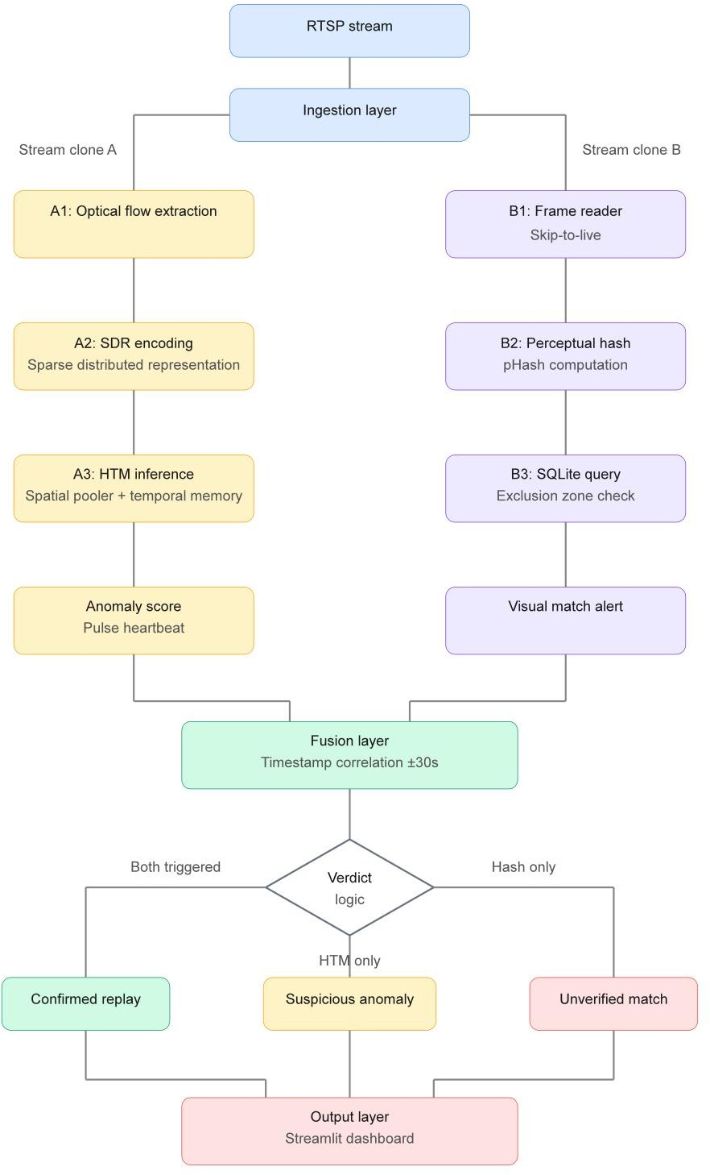
Workflow Diagram

Slide 5
Results & Conclusion
The proposed system demonstrated high efficacy during validation in a simulated CCTV environment.
The HTM detection module successfully identified attacks by distinguishing between normal temporal patterns and artificial replay loops, flagging threats as anomalies.
Concurrently, the "Gatekeeper" mitigation logic functioned as an effective firewall, immediately blocking detected threats and ensuring only authenticated footage was committed to the trusted ledger, while the dashboard provided administrators with immediate, actionable alerts.

