Slide 1
UE22CS320B – Capstone Project Phase – 2 ESA
Detection And Mitigation Of Replay Attacks
Project Guide: Dr Sarasvathi V
Project ID: 49
Project Team:
Mohit Prasad Singh (PES2UG22CS320)
Shreyas S (PES2UG22CS540)
Soumya Ranjan Mishra (PES2UG22CS571)
Suhas Venkata (PES2UG22CS590)

Slide 2
Outline
1.
Abstract
Suggestions from Review – 1
Suggestions from Review – 2
Analysis and Critique of Research/Relevance –Application in Real world
High Level Design
Design Methodology
Project Progress (Minimum 20% implementation)
Data Preprocessing and Base Model Implementation
Individual Contribution
References
2.
3.
4.
5.
6.
7.
8.
9.
10.

Slide 3
Problem Statement
“Replay Attacks on CCTV Systems: A Significant Threat”
CCTV systems are essential for modern surveillance, yet they are vulnerable to replay attacks, where attackers intercept and resend legitimate data, leading to unauthorized actions. These attacks exploit the lack of robust security measures, particularly in communication protocols that fail to implement strong authentication and encryption​.
The consequences can be severe, including unauthorized access, manipulation of recorded footage, and compromised integrity of surveillance data. Industries such as banking and transportation face significant risks, as compromised CCTV can undermine public safety and trust​.
Despite existing security measures, there remains a gap in addressing replay attack vulnerabilities. This project aims to develop an AI-based detection and response system to enhance the security of CCTV networks against these specific threats, ensuring a more reliable surveillance infrastructure

Slide 4
Abstract And Scope
CCTV systems are vital for surveillance across sectors like banking, transportation, healthcare, and public safety. However, they face growing cyber threats, especially replay attacks, where intercepted video or data streams are retransmitted to deceive the system. This leads to unauthorized access, footage tampering, and compromised surveillance integrity, exposing the need for robust security enhancements. This project proposes an AI-based detection and response system to mitigate replay attacks by integrating machine learning and cryptographic security measures. Key components include:
Secure Communication Protocols: Encrypting data and verifying stream authenticity.
AI-Powered Anomaly Detection: Identifying timestamp and frame inconsistencies in video streams.
Real-Time Automated Response: Alerting admins, isolating compromised devices, and blocking threats.
Modular Design: Seamlessly integrating with existing infrastructures. The system undergoes vulnerability assessments, machine learning model training, and rigorous testing to ensure effectiveness, scalability, and ease of use. Expected outcomes include improved replay attack detection, enhanced CCTV security, and greater trust in surveillance technologies, making this a significant step towards adaptive, secure surveillance solutions.

Slide 5
Suggestions from Review – 1
Fix the high-level diagram

Slide 6
Suggestions from Review – 2
Find a better way to simulate replay attack
Make a better presentation

Slide 7
Analysis and Critique of Research
Analysis and Critique of Research: Strengths of Discussed Methods:
  Watermarking: Proposed as an active defense for CPS, injecting hidden signals to authenticate data flow and detect stealthy attacks/replays.
  Observer-Based Detection: Kalman Filters (or similar) used for detecting attacks in CPS like DC microgrids, aiming for low computational load.
  Identified Weaknesses/Challenges:
  Stealthy Attacks: Replay attacks specifically leverage valid past data, making them difficult for standard model-based detectors to identify.
  CPS Vulnerability: Networked nature makes systems susceptible to various attacks, including replay, that can destabilize physical processes.
  Gaps/Potential Improvements:
  Resilient Architectures: Need for holistic CPS design focused on stability and resilience against attacks.
  Resource Management: Balancing security mechanism requirements with system resources is an ongoing challenge.

Slide 8
Relevance And Real-World Application
Relevance
  Current Challenges
  Research directly addresses the critical need to secure increasingly digitized and networked infrastructure (CPS) against cyber-physical attacks.
  Industry Needs & Impact
  Effective, real-time detection mechanisms are vital to prevent system destabilization and ensure the reliability and stability of physical systems controlled by CPS, especially in critical applications.
Application in the Real World
  Implementation Contexts
  Discussed methods apply to CPS security, including industrial control and smart grids (e.g., DC Microgrids).
  Use Cases
  Physical security, critical infrastructure monitoring, traffic systems, etc.
  Scalability & Feasibility Challenges
  Integration: Security solutions must fit within complex, potentially heterogeneous CPS architectures.
  Computational Demand: Real-time systems require low-demand detection methods. (Implies complex AI/computationally heavy methods face challenges).

Slide 9
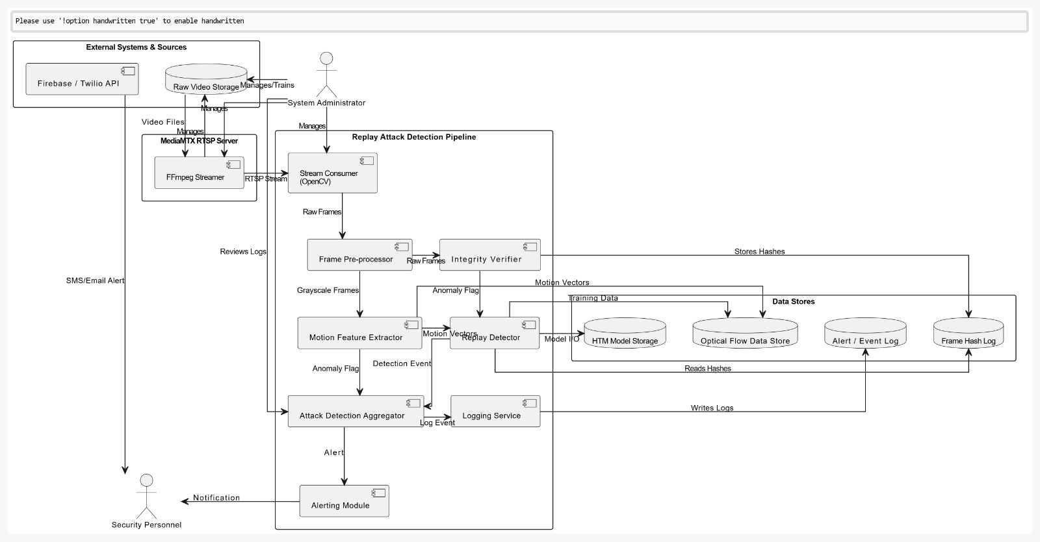
High-level design

Slide 10
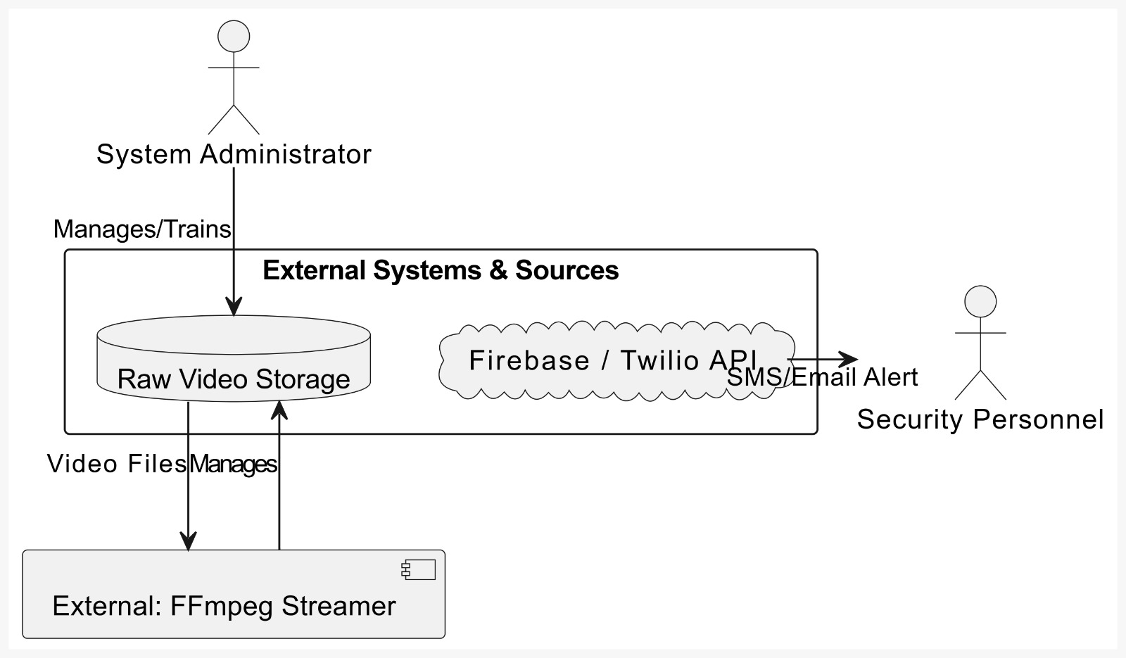
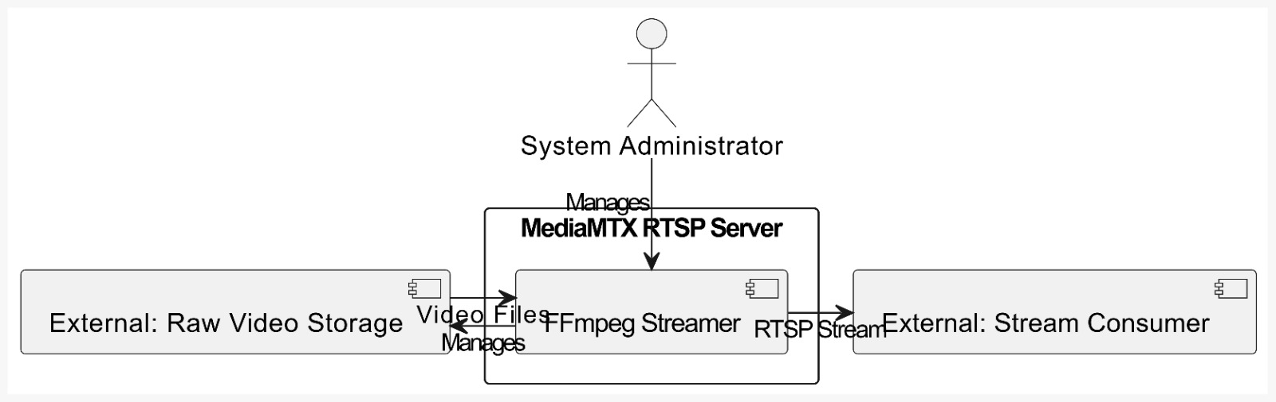
A System Administrator manages Raw Video Storage. An FFmpeg Streamer uses these video files. Firebase/Twilio APIs send SMS/Email alerts derived from the system to Security Personnel.
A System Administrator manages the MediaMTX RTSP Server and Raw Video Storage. The FFmpeg Streamer takes video files from storage and sends an RTSP stream via the MediaMTX server to an external Stream Consumer.

Slide 11
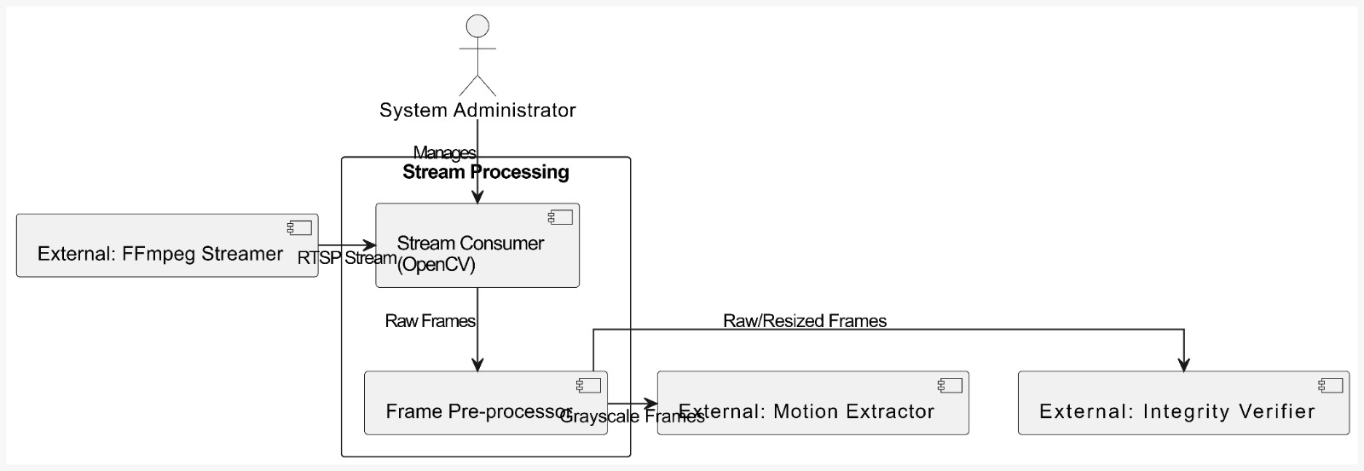
An external FFmpeg streamer sends an RTSP stream to the Stream Consumer (OpenCV). Raw frames go to the Frame Pre-processor, which outputs grayscale frames to the Motion Extractor and raw/resized frames to the Integrity Verifier. A System Administrator oversees this.
Pre-processed frames go to an Integrity Verifier (SHA-256 hash) and a Motion Feature Extractor (Optical Flow). The Verifier checks a hash log for frame reuse. The Extractor sends motion vectors to storage and a Replay Detector. Both detectors flag anomalies.

Slide 12
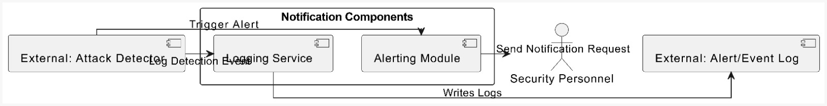
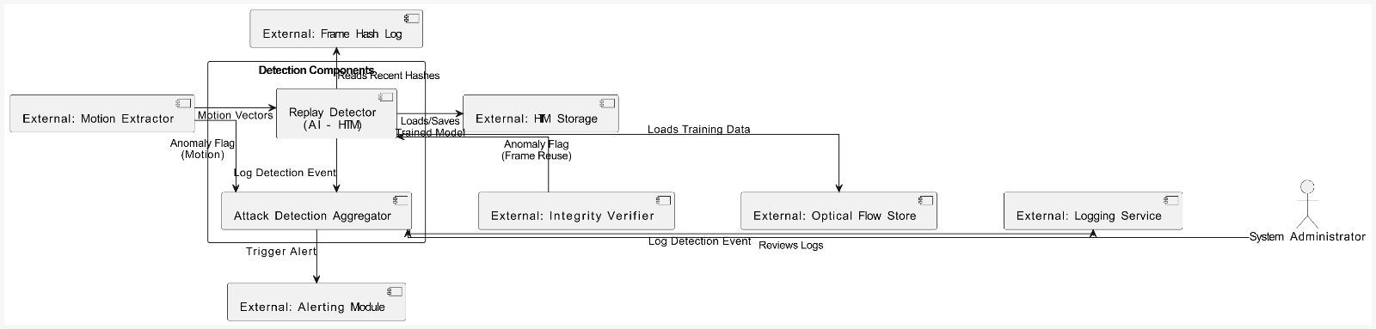
An external Attack Detector triggers an Alerting Module and a Logging Service. The Alerting Module sends notification requests to Security Personnel, while the Logging Service writes details to an external Alert/Event Log.
Motion vectors feed the Replay Detector (AI-HTM), using a model from HTM Storage. An Integrity Verifier provides a frame reuse flag. Both motion and frame reuse anomaly flags go to the Attack Detection Aggregator, which triggers logging and the alerting module.

Slide 13
The Motion Extractor feeds the Optical Flow Store, which provides training data for the HTM Model Storage. The Integrity Verifier populates the Frame Hash Log. The Logging Service writes to the Alert/Event Log. The Replay Detector utilizes the stored HTM model.

Slide 14
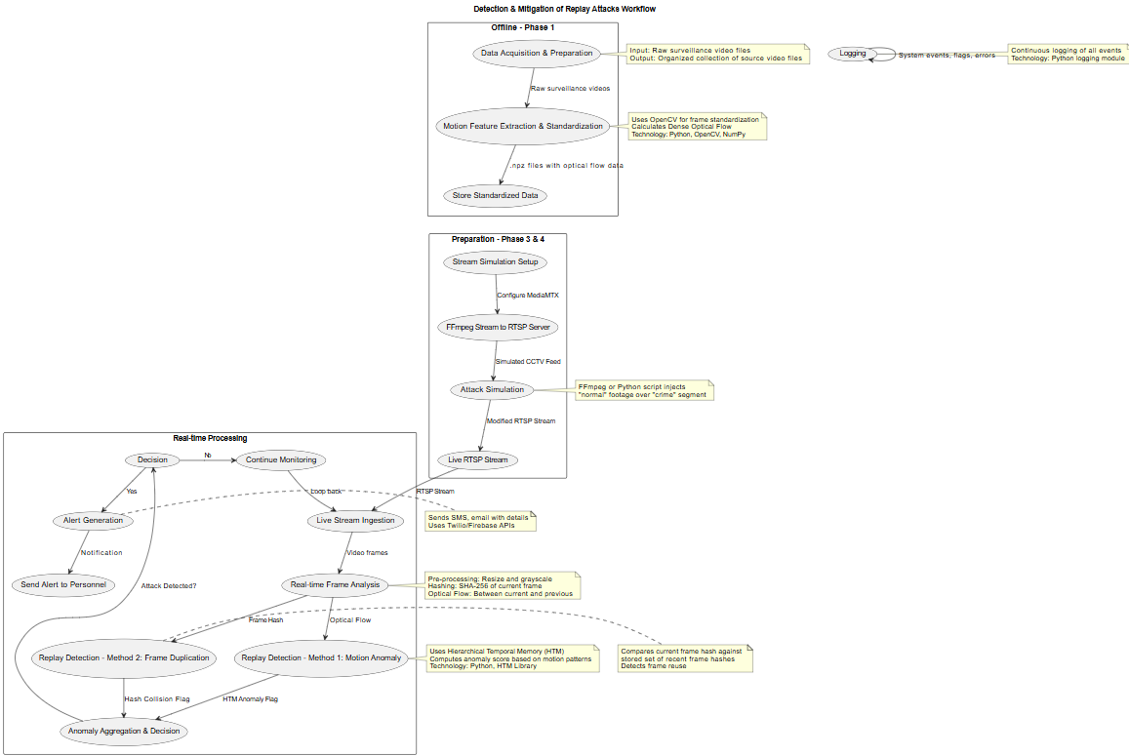
Project Workflow

Slide 15
Design methodology
Other Key Project Components:
Dataset: ~50 Crime videos (Normal + Crime segments), processed optical flow .npz files.
Simulation Setup: FFmpeg stream -> MediaMTX RTSP Server -> OpenCV consumer. Includes manual replay attack simulation methods (FFmpeg overlay/loop, Python script).
HTM Model Training: Requires training on normal optical flow patterns from video data.
Evaluation Metrics: Need definition (e.g., TPR, FPR, F1-Score) to measure detection performance.
Configuration: Management of paths, thresholds, parameters.
Technology Selection:
Language: Python
Core Libraries: OpenCV, NumPy
Streaming/Simulation: FFmpeg, MediaMTX
Detection:
  Optical Flow (Farneback via OpenCV)
  HTM (Hierarchical Temporal Memory - specific library TBD)
  SHA-256 Hashing
Alerting: Firebase / Twilio APIs (Planned)
Platform: Windows 11

Slide 16
Project Progress-Data Preprocessing
Path Initialization
Defined output directory: optical_flow_data.
Defined input directory: dataset videos.
Output Directory Creation
Ensured the output directory exists or created it if it didn’t.
Video File Discovery
Automatically discovered all video files (.mp4, .avi, .mov) in the input directory.
Video Processing Loop
Opened each video using cv2.VideoCapture.
Read video properties (FPS, resolution) for monitoring.
Resized frames to 640x480 resolution.
Converted frames to grayscale (cv2.cvtColor) for optical flow input.
Computed dense optical flow using cv2.calcOpticalFlowFarneback between consecutive frames.
Stored computed motion vectors as compressed NumPy files (.npz).

Slide 17
Project Progress-Data Visualization
Path Initialization
Defined paths for loading optical flow .npz files and original videos. Created output directory (visualized_optical_flow).
File Discovery
Listed all .npz flow files and identified corresponding original video files.
Data Loading
Opened original video (cv2.VideoCapture). Loaded motion vectors from the .npz file (np.load). Read video properties (FPS, dimensions).
Output Video Setup Initialized cv2.VideoWriter to save visualization output as .mp4.
Frame Processing & Visualization Loop
Read frames from the original video and corresponding flow data. Converted optical flow vectors (direction/magnitude) to HSV colour space (Hue=Direction, Value=Magnitude, Saturation=Max). Converted HSV visualization back to BGR format (cv2.cvtColor).Blended the BGR flow visualization onto the original frame (cv2.addWeighted, e.g., 70% video + 30% flow). Displayed the blended frame in real-time (cv2.imshow). Wrote the blended frame to the output video file.
Cleanup: Released video capture/writer resources and closed display windows.

Slide 18
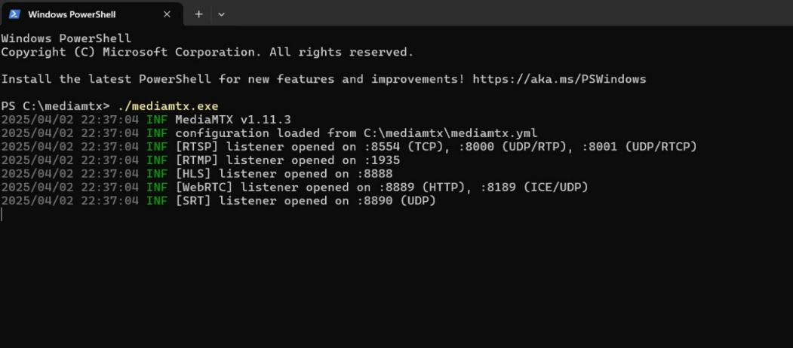
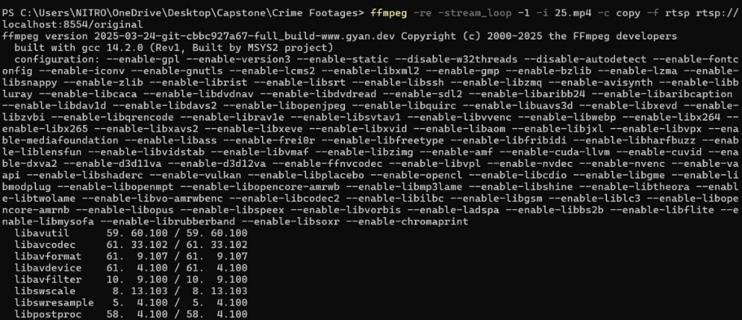
Project Progress
BASIC IMPLEMENTATION
MediaMTX:
It is a powerful and efficient media server that supports various streaming protocols, including RTSP(Real Time Streaming Protocol). By running mediamtx.exe, we establish an RTSP server that can stream our pre-processed video data. The server listens on specific ports for incoming client connections.
FFmpeg:
Core command-line tool for video processing. FFmpeg command creates a looped, real-time RTSP stream, effectively simulating a CCTV feed. This simulated feed is vital for testing the replay attack detection system in a realistic environment. The choices of -re, -c copy, and -f RTSP prioritize real-time accuracy, efficiency, and compatibility with surveillance standards.

Slide 19
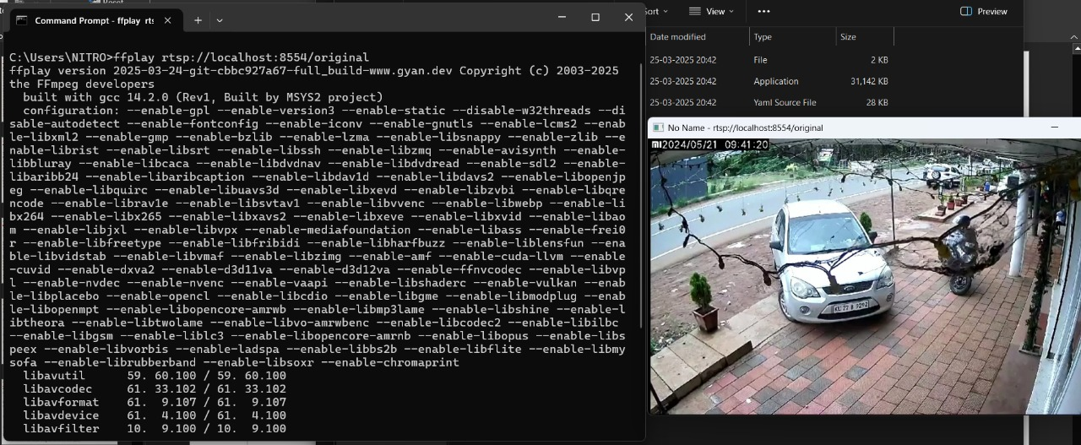
Project Progress
BASIC IMPLEMENTATION
Ffplay:
It serves as a direct, visual confirmation that the RTSP stream is accessible and playing as intended. It ensures that the video encoding and streaming process is functioning correctly. It allows for a quick visual inspection of the stream's quality and content. By using Ffplay, you can quickly identify any issues with the RTSP stream, such as:
-> Connection problems
-> Video encoding errors
-> Latency or buffering issues.

Slide 20
Any other information
User Training: Educate the personnel who will be interacting with the CCTV system about the signs of replay attacks and how to respond to alerts.
Incident Response Plan: Develop a detailed incident response plan to handle detected replay attacks efficiently. This should include steps for isolating affected systems, investigating the breach, and mitigating the damage.
Redundancy and Backup: Implement redundancy in your CCTV infrastructure to ensure there is always a backup in case one system fails. Regular backups of footage can also help verify the integrity of the data.
Detailed Documentation: Maintain comprehensive documentation of the system design, protocols, and updates. This can help in troubleshooting and training new team members.
User Feedback Loop: Incorporate a feedback mechanism where users can report any false positives or system issues, which can be used to improve the AI model.

Slide 21
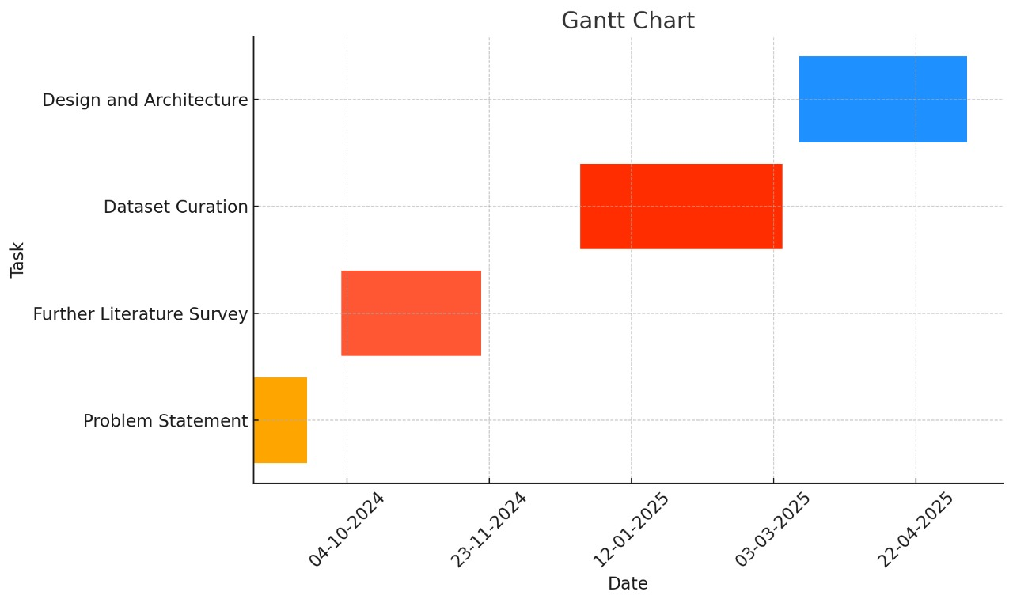
Capstone (Phase-I Phase-II and Phase III) Project Timeline

Slide 22
Capstone-1 Deliverables
Literature survey
Identification of Problem Statement
Requirements Elicitation
Feasibility Study
Setting up a project timeline using Gantt chart
Creating a summary presentation of our idea

Slide 23
Capstone-2 Deliverables
Acquiring/Creating relevant datasets
Choosing the appropriate software tools that will be used for the project
Creating a detailed workflow
Creating a prototype based on the datasets collected
High-Level Design

Slide 24
PLAN OF WORK FOR CAPSTONE 3
Creating Replay Dataset
Training the model (HTM + Optical Flow) for replay attack detection
Sending Real time alerts to users upon detection of replay attacks
Hashing of frames using SHA-256 (or similar) for enhanced security

Slide 25
EFFORT CARRIED OUT BY EACH TEAMMATE
TEAM MEMBER | TASK | LOC | TIME SPENT
Soumya Ranjan Mishra | RTSP Streaming, Automation of replay attack | 400 | 16-18 hrs
Shreyas S | Automation of Replay Attack, Replay attack script | 400 | 16-18 hrs
Suhas Venkata | Pre-Processing and Visualization | 152 | 5-6 hrs
Mohit PS | High Level Design and defining of different modules | -- | 2-3 hrs

Slide 26
TASKS COMPLETED IN CAPSTONE PHASE 2
Data Pre-Processing
Data Visualization
RTSP Streaming Setup
Simulation Of Replay Attack

Slide 27
Conclusion
The project, "Detection and Mitigation of Replay Attacks on CCTV Systems," enhances surveillance security through a hybrid approach combining AI-driven scene analysis, HTM-based temporal anomaly detection, and optical flow analysis for real-time edge processing, blockchain-based integrity verification ensures tamper-proof video data and secure evidence management. With a modular, scalable architecture, the system integrates seamlessly with existing CCTV infrastructures. Cryptographic security measures safeguard data transmission, and future work will focus on optimizing performance, reducing false positives, and expanding applicability across diverse surveillance environments to counter evolving cyber threats.

Slide 28
References
[1] D. Zhao, B. Yang, Y. Li, and H. Zhang, "Replay Attack Detection for Cyber-Physical Control Systems: A Dynamical Delay Estimation Method," IEEE Transactions on Industrial Electronics, vol. 71, no. 6, pp. 6263-6273, Jun. 2024, doi: 10.1109/TIE.2024.3406859.
[2] A. Naha, A. Teixeira, A. Ahlén, and S. Dey, "Sequential Detection of Replay Attacks," IEEE Transactions on Automatic Control, vol. 68, no. 3, pp. 1247–1258, Mar. 2023. DOI: 10.1109/TAC.2022.1234567.
[3] A. Patel and M. Z. A. Khan, "Optimal Chi-squared Detector of Replay Attacks on Cyber-Physical Systems," in Proc. 2021 9th Int. Conf. Systems and Control (ICSC), Caen, France, 2021, pp. 338–343. DOI:10.1109/ICSC50472.2021.9666502.

Slide 29
Thank You

