Slide 1
ASSIGNMENT
Finding the Global Minima of the 2D Ackley Function
Using Genetic Algorithm
Course No: CSE 4111 — Machine Learning Lab
Submitted By
Submitted To
Faisal Ahmed – 2107061
Dr. Al-Mahmud
Sumaiya Akter – 2107080
Professor
Asique Ehetasamul Haque – 2107096
Dept. of Computer Science and Engineering
Khulna University of Engineering & Technology (KUET)
Nure Alam Siddiki Prince – 2107110
Niloy Chowdhury – 2107117
1

Slide 2
The Ackley Function
Our optimization landscape — a highly multimodal 2D surface
f(x₁, x₂) = -20·exp(-0.2·√(0.5(x₁²+x₂²))) - exp(0.5(cos(2πx₁)+cos(2πx₂))) + 20 + e
Global Minimum
f(0, 0) = 0.0 — the single deepest valley at the origin
Search Space
x₁, x₂ ∈ [-5.0, 5.0] (bounded 2D continuous domain)
Challenge
Hundreds of local minima trap gradient-descent; GA searches globally
Why GA?
Population-based search explores the whole space simultaneously
Ackley Parameters
a = 20.0, b = 0.2, c = 2π (standard recommended values)
2

Slide 3
Genetic Algorithm Pipeline
8 sequential steps to evolve the global minimum
Configuration
Chromosome Init
Fitness Evaluation
Roulette Selection
1
GA_PARAMS: pop=50, gens=100, Pc=80%, Pm=5%
2
50 random [x₁,x₂] chromosomes (Generation 0)
3
Compute Ackley f(x₁,x₂) for every individual
4
Lower f → bigger slice → more likely as parent
1-Point Crossover
Gaussian Mutation
Elitism Carry-over
Loop ×100 gens
5
Swap x₂ genes between pairs (Pc = 80%)
6
Nudge each gene with ±N(0,0.5) noise (Pm = 5%)
7
Best-ever chromosome guaranteed in next generation
8
Repeat steps 3-7 until generation 100
Repeat steps 3-7 each generation until generation 100
Each step maps to one Python module in src/ -- implemented sequentially by the team.
3

Slide 4
Step 1 — Configuration | src/config.py
Single source of truth for all GA hyperparameters
src/config.py
GA_PARAMS = {
# Problem definition
"num_genes" : 2, # chromosome = [x1, x2]
"gene_bounds" : (-5.0, 5.0), # search space
# Ackley parameters (recommended)
"ackley_a" : 20.0,
"ackley_b" : 0.2,
"ackley_c" : 2 * math.pi,
# GA hyperparameters
"population_size": 50,
"num_generations": 100,
"pc" : 0.80, # crossover probability
"pm" : 0.05, # mutation prob (per gene)
"elitism" : 1, # elites carried over
}
Population = 50
Enough diversity without excessive compute time.
Generations = 100
Sufficient for full convergence on the Ackley landscape.
Pc = 80%
High crossover rate drives recombination of fit gene pairs.
Pm = 5%
Low mutation preserves good solutions while adding variation.
Elitism = 1
Best individual always survives to the next generation.
4

Slide 5
Step 2 — Chromosome Representation | src/chromosome.py
Value encoding: chromosome = [x₁, x₂] — two real floats directly
src/chromosome.py
from src.config import GA_PARAMS
def random_gene() -> float:
low, high = GA_PARAMS["gene_bounds"] # (-5.0, 5.0)
return random.uniform(low, high)
def random_chromosome() -> list:
"""Full chromosome = [x1, x2]"""
return [random_gene()
for _ in range(GA_PARAMS["num_genes"])]
def is_within_bounds(chromosome) -> bool:
"""Sanity-check all genes in [-5, 5]."""
low, high = GA_PARAMS["gene_bounds"]
return all(low <= g <= high for g in chromosome)
Chromosome
[ x₁, x₂ ] e.g. [-1.5, 3.2]
Gene
One real float in [-5.0, 5.0]
Why not binary?
Binary needs encode/decode — wasteful for continuous reals
Our choice
Direct real values — natural fit for Ackley's inputs
Mutation ready
Nudging a float: -1.5 → -1.1 (Gaussian jitter)
Population: [ [-1.5, 3.2], [0.7, -4.1], [2.2, 0.9], ... ] (50 total)
5

Slide 6
Step 3 — Population Initialization | src/population.py
Create Generation 0: 50 fully random, unbiased chromosomes
src/population.py
from src.config import GA_PARAMS
from src.chromosome import random_chromosome
def initialize_population(pop_size=None, seed=None) -> list:
"""Build Generation 0. Seed for reproducibility."""
if seed is not None:
random.seed(seed) # reproducible run
pop_size = GA_PARAMS["population_size"] \
if pop_size is None else pop_size
return [random_chromosome()
for _ in range(pop_size)]
Blind Initialization
No bias toward (0,0). Progress must come from selection + crossover + mutation.
Reproducibility
seed=42 replays the exact same run for report examples and debugging.
Dependency chain
Calls random_chromosome() → random_gene() → gene_bounds from config.py.
Output format
list of 50 chromosomes: [ [x1,x2], [x1,x2], ... ]
6

Slide 7
Step 4 — Fitness Evaluation | src/ackley.py + src/fitness.py
Plug each [x₁,x₂] into the Ackley formula — lower score = fitter
src/ackley.py
src/fitness.py
# src/ackley.py
def ackley_2d(x1, x2):
a = GA_PARAMS["ackley_a"] # 20.0
b = GA_PARAMS["ackley_b"] # 0.2
c = GA_PARAMS["ackley_c"] # 2pi
t1 = -a * exp(
-b * sqrt(0.5*(x1**2+x2**2)))
t2 = -exp(
0.5*(cos(c*x1)+cos(c*x2)))
return t1 + t2 + a + e
# ackley_2d(0, 0) == 0.0 ✓
# src/fitness.py
def evaluate_population(pop):
return [ackley_2d(c[0], c[1])
for c in pop]
def sort_population(pop, fit, ascending=True):
paired = list(zip(pop, fit))
paired.sort(key=lambda x: x[1],
reverse=not ascending)
return ([c for c,_ in paired],
[f for _,f in paired])
def get_elite(pop, fit):
sp, sf = sort_population(pop, fit)
return sp[0], sf[0]
evaluate_population()
sort_population()
get_elite()
Returns list of Ackley scores; index i in fitness always matches index i in population.
Sorts ascending (lowest f first) so population[0] is best this generation.
Returns the single best in this generation. Best-ever tracking is done in ga.py.
7

Slide 8
Step 5 — Roulette Wheel Selection | src/selection.py
Lower Ackley fitness → bigger wheel slice → higher chance of being selected as parent
src/selection.py
def roulette_wheel_selection(
pop, fit, num_parents):
max_f = max(fit)
sel = [(max_f-f)+1e-10 for f in fit]
total = sum(sel)
probs = [v/total for v in sel]
cum, cdist = 0.0, []
for p in probs:
cum += p; cdist.append(cum)
selected = []
for _ in range(num_parents):
r = random.random() # [0, 1)
for i, cp in enumerate(cdist):
if r <= cp:
selected.append(pop[i])
break
return selected
How Roulette Wheel Works
1. Find max fitness in this generation
2. sel_valᵢ = (max_f − fᵢ) + ε
3. Normalise → probabilities (sum = 1)
4. Build cumulative distribution
5. Spin: draw r ∈ [0,1), pick first i
where cum_prob ≥ r
⇒ Lower Ackley value → larger slice
8

Slide 9
Step 6 — 1-Point Crossover | src/operators.py
Swap gene segments between two parents with probability Pc = 80%
src/operators.py — one_point_crossover()
def one_point_crossover(p1, p2, pc=None):
pc = pc or GA_PARAMS["pc"] # 0.80
if len(p1) < 2 or random.random() >= pc:
return list(p1), list(p2)
pt = random.randint(1, len(p1) - 1)
child1 = p1[:pt] + p2[pt:]
child2 = p2[:pt] + p1[pt:]
return child1, child2
Probability Pc = 80%
80% of pairs undergo crossover; 20% pass unchanged.
2-gene chromosome
Only one valid point: between x₁ and x₂ — always swaps x₂.
Immutability
Parents never modified in-place — children are fresh list copies.
Why crossover?
Recombines good gene values from two fit parents into offspring.
Parent 1: [-1.5, -1.0] Parent 2: [3.2, 4.5]
crossover at point=1 (between x1 and x2)
Child 1: [-1.5, 4.5] Child 2: [3.2, -1.0]
9

Slide 10
Step 7 — Gaussian Mutation | src/operators.py
Independently perturb each gene with probability Pm = 5%
src/operators.py — mutate()
def mutate(chromosome, pm=None,
method="gaussian", sigma=0.5):
pm = pm or GA_PARAMS["pm"] # 0.05
low, high = GA_PARAMS["gene_bounds"]
mutated = list(chromosome) # copy!
for i in range(len(mutated)):
if random.random() < pm:
if method == "gaussian":
val = mutated[i] + random.gauss(0, sigma)
elif method == "uniform":
val = random.uniform(low, high)
mutated[i] = max(low, min(high, val))
return mutated # original unchanged
Mutation Details
>> Per-gene, not per-chromosome
Each of the 2 genes mutated independently. ~10% of all genes change per generation.
>> Gaussian (default, sigma=0.5)
Small N(0,0.5) jitter — good for fine-tuning near the optimum.
>> Uniform (alternative)
Resamples completely from [-5,5]. Useful to escape local minima.
>> Boundary clamping
val = max(-5, min(5, val)). is_within_bounds() always True after mutation.
>> Why mutation?
Maintains diversity; prevents premature convergence.
10

Slide 11
Step 8 — Elitism & New Population | src/operators.py
Guarantee best-ever solution never dies; assemble next generation
src/operators.py — apply_elitism()
src/operators.py — create_new_population()
def apply_elitism(old_pop, old_fit,
new_pop, new_fit, elitism=None):
elitism = elitism or GA_PARAMS["elitism"]
sp_o, sf_o = sort_population(old_pop, old_fit)
sp_n, sf_n = sort_population(new_pop, new_fit)
for k in range(elitism):
worst = -(k + 1)
if sf_o[k] < sf_n[worst]:
sp_n[worst] = list(sp_o[k])
sf_n[worst] = sf_o[k]
return sort_population(sp_n, sf_n)
def create_new_population(
parents, population_size=None, ...):
offspring = []; idx = 0
while len(offspring) < population_size:
p1 = parents[idx % len(parents)]
p2 = parents[(idx+1) % len(parents)]
idx += 2
c1, c2 = one_point_crossover(p1, p2)
c1 = mutate(c1); c2 = mutate(c2)
offspring.append(c1)
if len(offspring) < population_size:
offspring.append(c2)
return offspring
✅ Elitism Guarantees
1. Best fitness can NEVER get worse (monotonic non-increasing convergence curve).
2. Population size stays exactly 50 — elite replaces the WORST if strictly better.
3. create_new_population() generates exactly pop_size offspring in round-robin order.
11

Slide 12
Step 9 — Full GA Loop | src/ga.py
run_ga() wires all modules and runs 100 generations from one function call
src/ga.py — run_ga()
def run_ga(seed=None):
pop = initialize_population(
pop_size=GA_PARAMS["population_size"], seed=seed)
best_chr=None; best_fit=float("inf"); hist=[]
for _ in range(GA_PARAMS["num_generations"]):
fit = evaluate_population(pop)
elite, ef = get_elite(pop, fit)
if ef < best_fit:
best_chr=list(elite); best_fit=ef
hist.append(best_fit)
parents = roulette_wheel_selection(
pop, fit, num_parents=GA_PARAMS["population_size"])
offspring = create_new_population(
parents, population_size=GA_PARAMS["population_size"],...)
offit = evaluate_population(offspring)
pop, fit = apply_elitism(
pop, fit, offspring, offit,
elitism=GA_PARAMS["elitism"])
return {"best_chromosome": best_chr,
"best_fitness": best_fit,
"fitness_history": hist,
"population": pop}
"best_chromosome"
[x₁, x₂] that achieved the lowest Ackley score
"best_fitness"
Lowest Ackley f value found across all 100 gens
"fitness_history"
List[float] of length 100 — the convergence curve
"population"
Final 50 chromosomes after generation 100
12

Slide 13
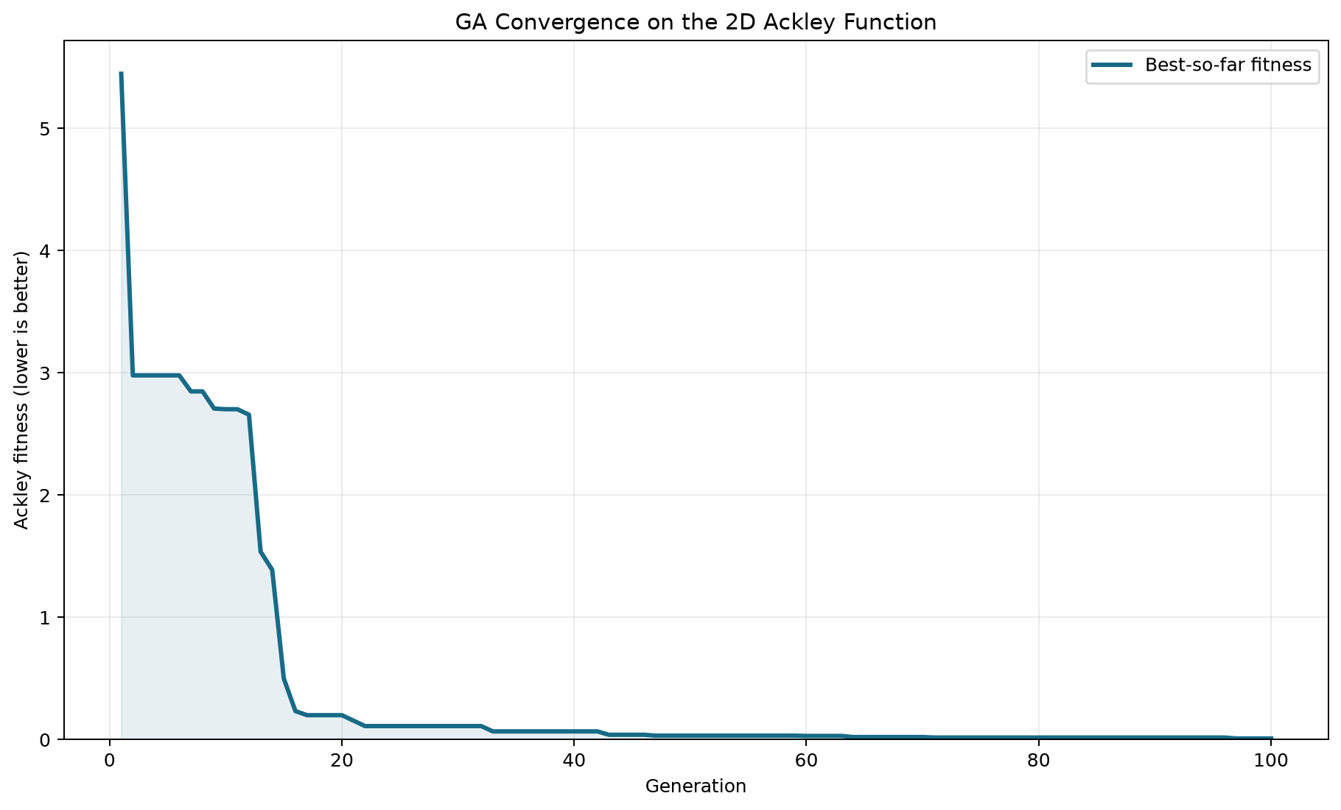
Output — Convergence Plot | analysis/output/convergence.png
Best-so-far Ackley fitness vs. generation number — monotonically non-increasing
Generation 1
Starts at ≈5.45 — random chromosomes far from origin scored poorly.
Gen 1-15: Rapid Drop
Selection + crossover quickly concentrate fit individuals; fitness plunges.
Gen 15-45: Fine-Tune
Gaussian mutation refines solutions near (0,0); curve flattens gradually.
Gen 100: Final Result
Best fitness ≈0.0098. Chromosome [-0.00081, 0.00327] — near (0,0).
Monotonic Shape
Curve NEVER rises — guaranteed by elitism in apply_elitism().
13

Slide 14
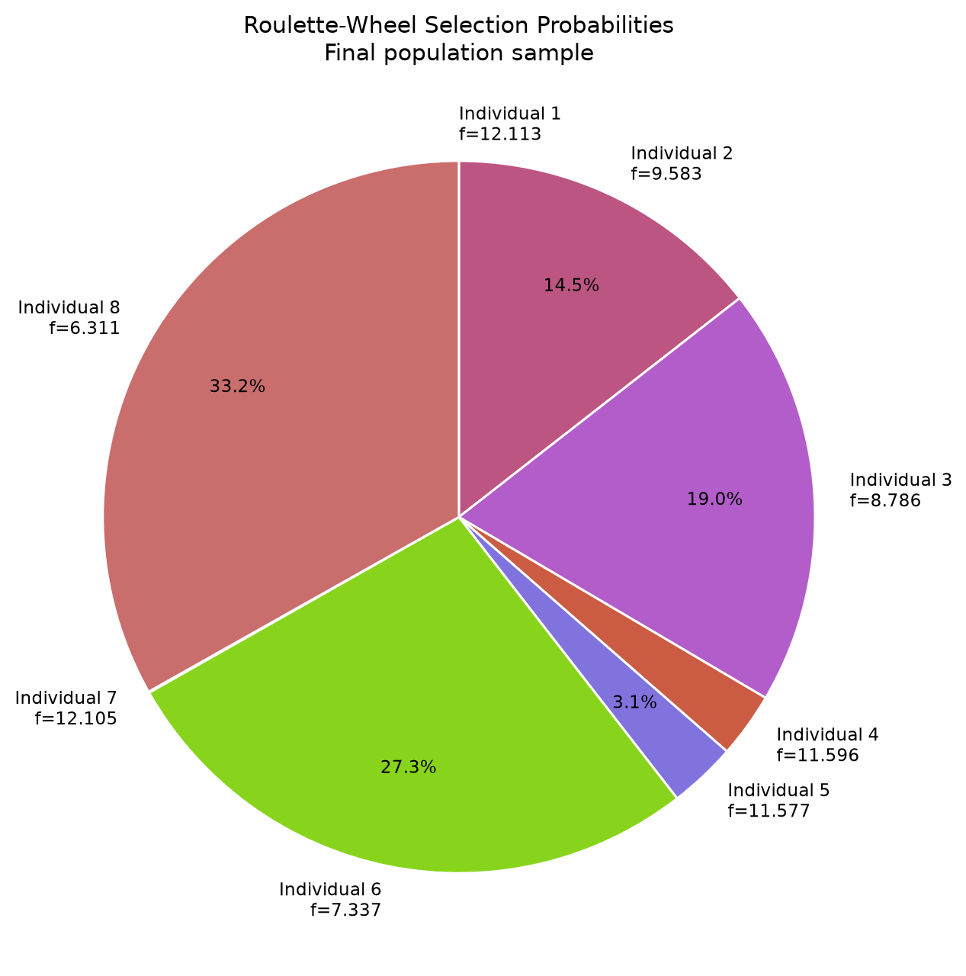
Output — Roulette-Wheel Selection | analysis/output/selection_wheel.png
Visualises how inverse-fitness weighting assigns proportional selection slices
How to Read This Chart
>> Transformation
sel_val = (max_f − fᵢ) + ε. Lower f → bigger slice.
>> Ind 8 (f=6.311): 33.2%
Lowest fitness in sample → largest slice — most likely chosen as parent.
>> Ind 6 (f=7.337): 27.3%
Second lowest fitness → second largest slice.
>> Ind 4+5 (≈11.6): 3.1%
High Ackley values → tiny slices — rarely selected.
>> ε = 1e-10
Prevents any individual having exactly zero probability.
14

Slide 15
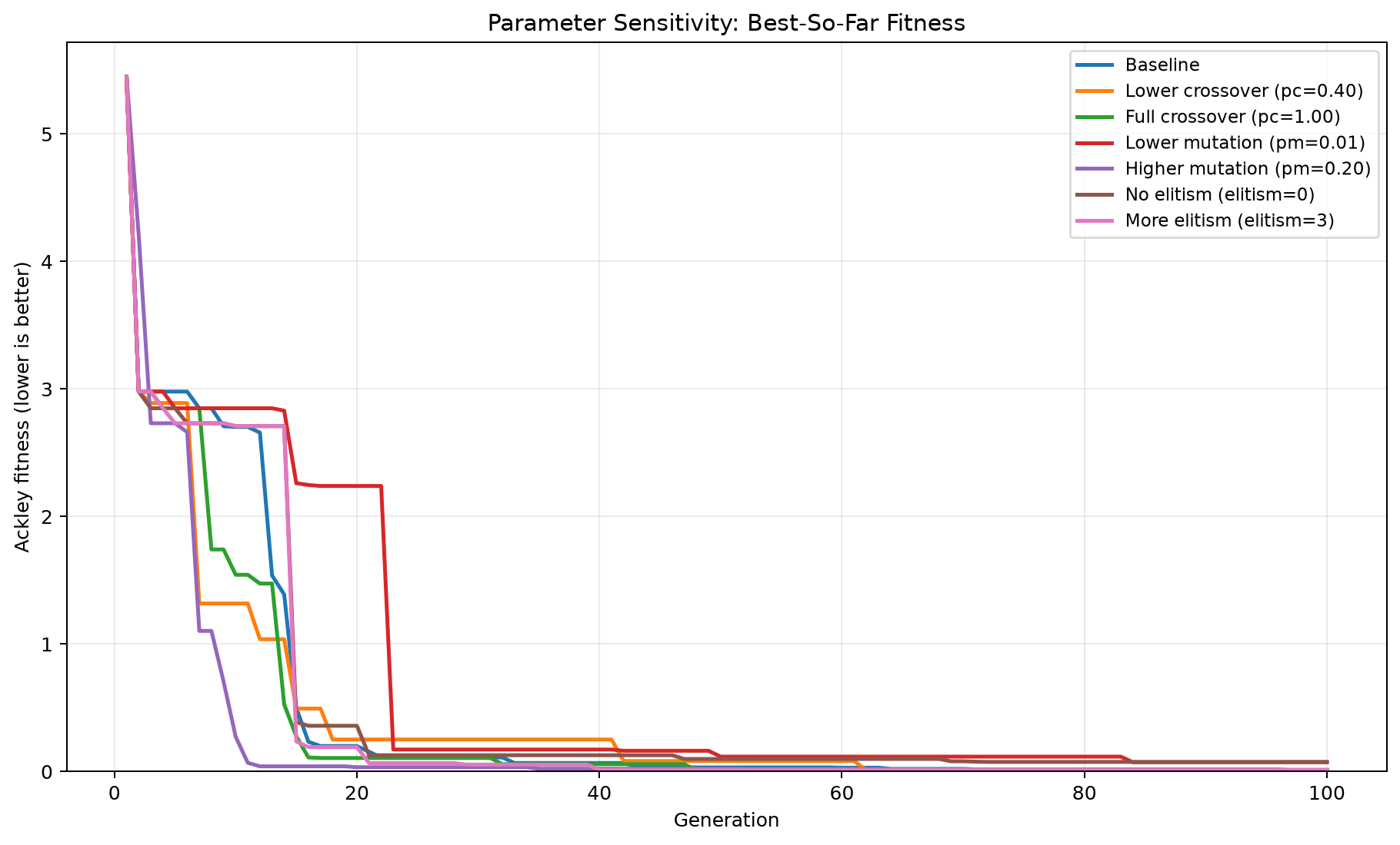
Output — Parameter Sensitivity | analysis/output/parameter_comparison.png
One-at-a-time experiments with seed=42 — isolates each parameter's effect
Variant
Final Fitness
Key Insight
Baseline (our settings)
0.009841
Best — balanced trade-off
Lower crossover pc=0.40
0.011393
Less mixing slows convergence
Full crossover pc=1.00
0.010678
More mixing, similar result
Lower mutation pm=0.01
0.073762
Premature convergence — diversity lost
Higher mutation pm=0.20
0.006645
More exploration helps
No elitism (elitism=0)
0.076158
Good solutions lost — worst
More elitism (elitism=3)
0.015357
Reduces diversity slightly
15

Slide 16
Results & Conclusion
Genetic Algorithm successfully locates the global minimum of the 2D Ackley function
Final Best Result
Best chromosome: [-0.000811, 0.003273] ≈ (0, 0) Best fitness: 0.009841 (true minimum = 0.0)
>> 99.8% fitness reduction
>> Elitism is critical
GA dropped from 5.45 → 0.0098 over 100 generations — chromosome virtually identical to (0,0).
Removing elitism degraded result 7.7× to 0.076. Elitism protects best-ever from crossover/mutation damage.
>> Mutation balance matters
>> Value encoding works well
pm=0.01 caused premature convergence at 0.074. Default pm=5% maintains diversity without disrupting good solutions.
Real-valued [x₁,x₂] enabled Gaussian mutation naturally. Binary encoding would add unnecessary quantization overhead.
>> Convergence in ~45 generations
Most improvement in gen 1-45. Generations 45-100 fine-tune near-optimal solutions with diminishing returns.
16

