Slide 1

Informatica Master Data Management (MDM)

Slide 2
Topic 1: Introduction and MDM Architecture

Slide 3
Objectives
Following are the objectives of this topic:
Understand Informatica MDM architecture
Understand different components of Informatica MDM
Understand the batch data process flow
Open and Navigate the Hub console

Slide 4
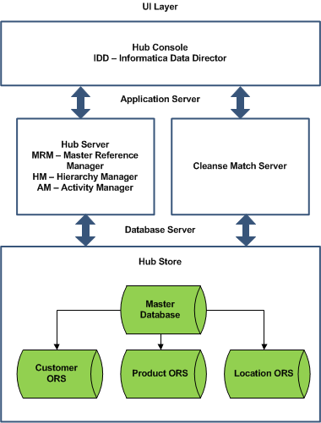
Informatica MDM Architecture
The MDM architecture is a three-tier model:
Database Server: Place where the business data and metadata resides. It is implemented on a DBMS – Oracle or DB2
Application Server: Manages security and access to the data. It is implemented on J2EE application server – Weblogic, Websphere, or JBOSS
UI Layer: Set of tools that allows users to configure the environment and perform data management activities.

Slide 5
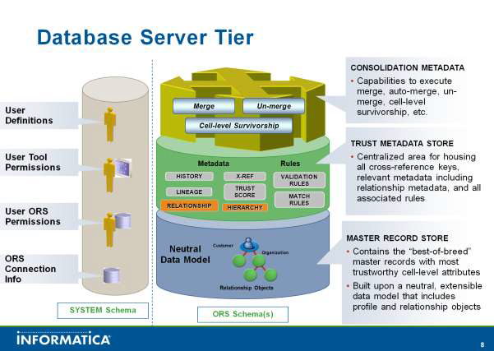
Database Server Tier
Database server layer comprises of two types of schemas:
Master Database: Contains MDM Hub environmental configuration settings
Operation Reference Store (ORS): Contains master data and content metadata

Slide 6
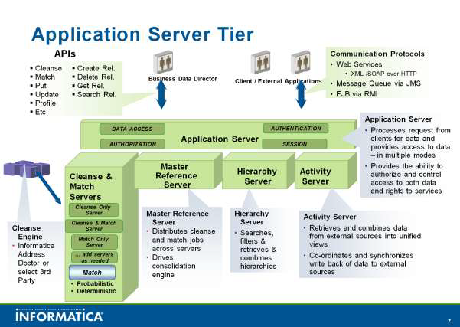
Application Server Tier
Supports data cleansing and matching activities
Enables data access and exposes various data services as APIs

Slide 7
Batch Process Flow
The batch process comprises of the processes:
Land Process
Stage Process
Load Process
Match Process
Consolidate Process
Publish Process

Slide 8
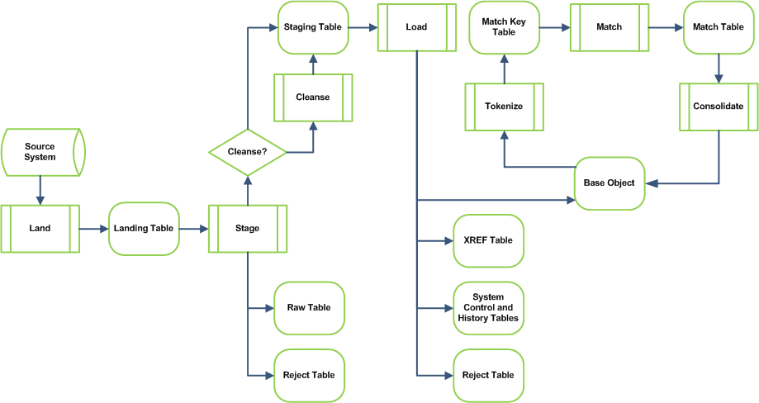
Batch Process Flow
Overall batch process flow of data in Informatica MDM

Slide 9
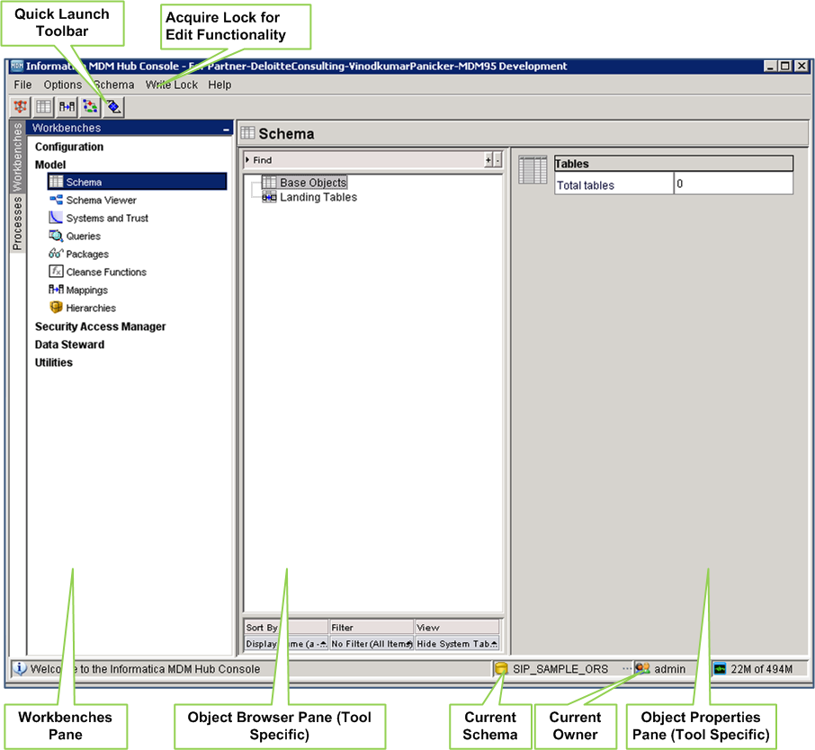
Hub Console
MDM Hub console is an UI for MDM specific administrative and configuration activities

Slide 10
Topic 2: Data Model

Slide 11
Objectives
Following are the objectives of this topic:
Understand Schema Tool functionality
Configure Source Systems
Configure Landing Tables
Configure Base Objects
Configure Stage Tables

Slide 12
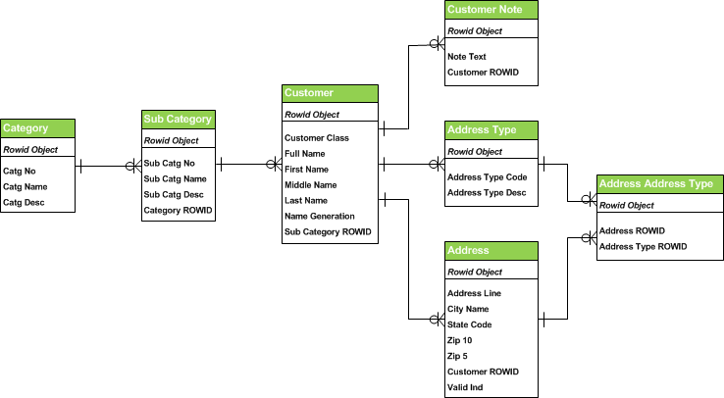
Data Model
Data Model used for this training

Slide 13
Source Systems
In MDM, source systems are unique identifiers for data coming from a particular source
Column-level trust scores are assigned on the basis of individual source systems
ADMIN source system is a pre-defined source system that is used for manual trust overrides and data edits in IDD
Information about the source systems is stored in a MDM repository table: C_REPOS_SYSTEM

Slide 14
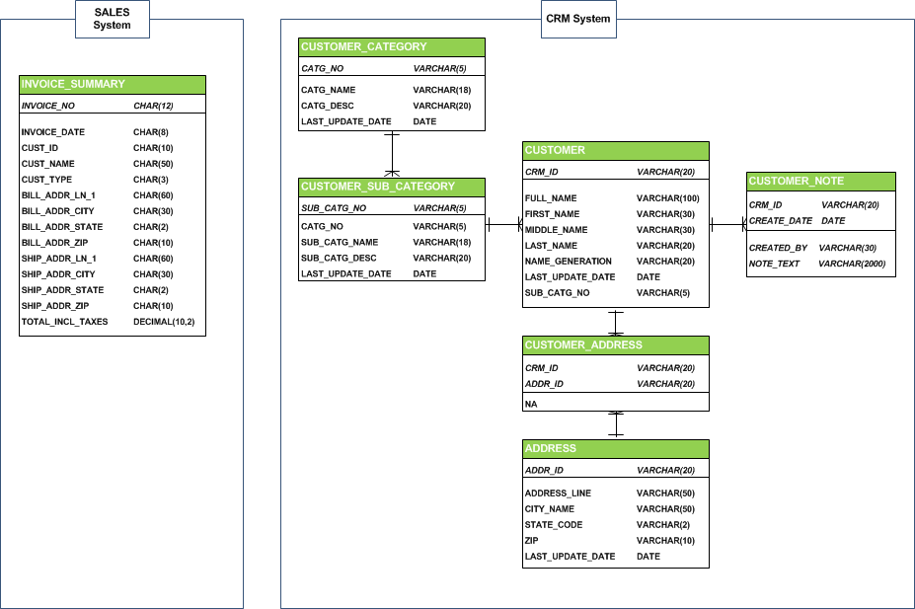
Source Systems
Source Systems used for this training

Slide 15
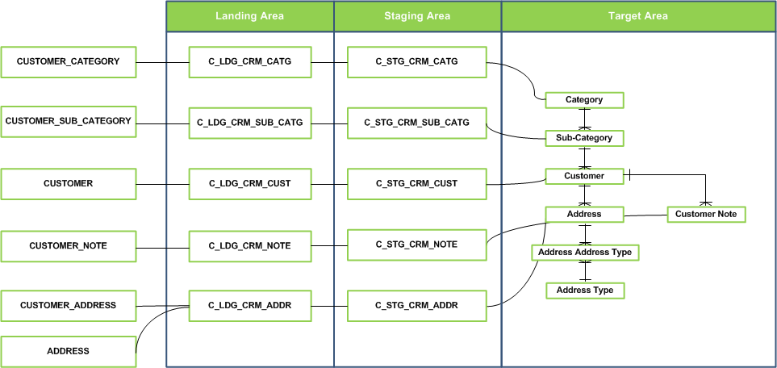
Source Systems
CRM System: High Level Data Flow

Slide 16
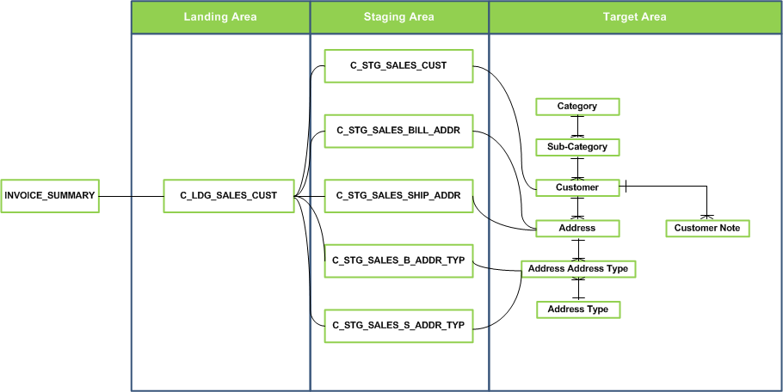
Source Systems
Sales System: High Level Data Flow

Slide 17
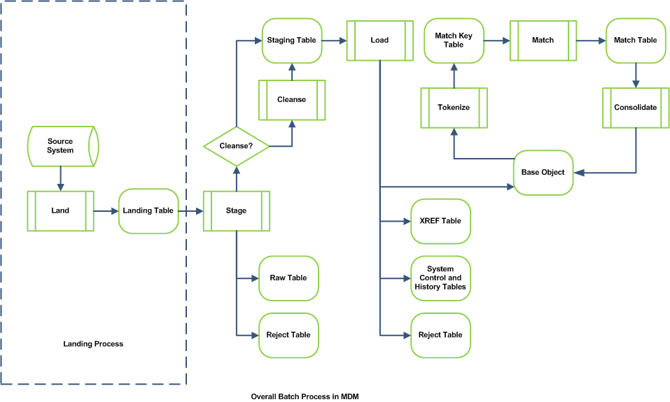
Landing Process

Slide 18
Landing Tables
Entry point of the source data into the MDM Hub
No constraints or referential integrity
Important columns in a landing table:
  Last Update Date – Date on which the record was last updated on the source system
  Primary Key Identifier column/s – A column or a combination of columns that would form the basis of a primary key
The mode by which source system load data into the landing tables is completely external to MDM Hub
Some general modes of loading data into the landing table are:
  ETL Process
  SQL Inserts
  Online System

Slide 19
Landing Tables
Contains Full Data Set Property – Specifies whether the landing table contains full data set from the source system or only updates
If selected, then TRUE
If not selected (default setting), then FALSE
Useful for the “Delta Detection” process during stage load.

Slide 20
Base Objects
Stores the central business entities – such as customers, accounts, or products
Represents the “best version of truth” for an entity
Provides functionality for matching and merging data
Built-in lineage (cross-references) and history
Supports Trust & Validation rules

Slide 21
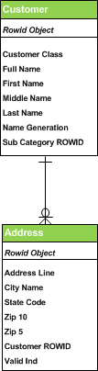
Base Objects
Unique key is ROWID_OBJECT
ROWID_OBJECT is generated and managed by MRM

Slide 22
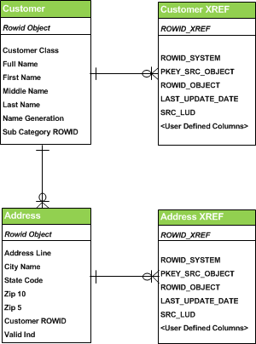
XREF Tables
Each Base Object has underlying cross-reference (XREF) table
XREF created and managed by MRM
XREF maintain source system lineage data

Slide 23
XREF Tables
Important columns of a XREF table:
  ROWID_XREF - Unique primary key of XREF table
  ROWID_SYSTEM - Unique identifier of the source system
  PKEY_SRC_OBJECT - Unique key from the corresponding stage table
  ROWID_OBJECT - Unique identifier of the base object record
  LAST_UPDATE_DATE - Date on which record was last updated in the XREF table
  SRC_LUD - Date on which record was last updated in the source system

Slide 24
Staging Table
Intermediate table between landing table and target table
Belongs to one specific source system
Staging table columns are selected sub-set of user-defined columns in target table
Important/mandatory columns in a stage table:
    LAST_UPDATE_DATE – Date on which record was last updated in the source system
    PKEY_SRC_OBJECT – Primary key from the source system
    SRC_ROWID – Database internal Rowid column

Slide 25
Staging Table
A staging table has one source
✓
Landing
Staging
✗
Landing
Staging
✓
Staging
Landing
Landing
Staging

Slide 26
Staging Table
A staging table has one target
✓
✗
Base Object
Staging
Base Object
Staging
Base Object
✓
Staging
Base Object
Staging

Slide 27
Topic 3: Stage Process

Slide 28
Objectives
Following are the objectives of this topic:
Configure Basic Mappings
Configure Cleanse Functions and Cleanse Lists
Configure Advanced Mappings
Configure Delta Detection and Audit Trail
Describe the Stage Process

Slide 29
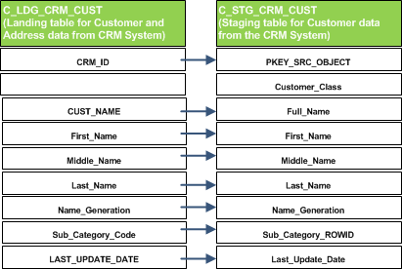
Basic Mappings
Mapping defines the movement of data from a landing table to a staging table
Basic mappings are simple copy-column mappings without any data standardization or change in the column values
A faster way to create a basic mapping in MDM is by using the “Auto Mapping” button that automatically maps landing and staging columns with the same name

Slide 30
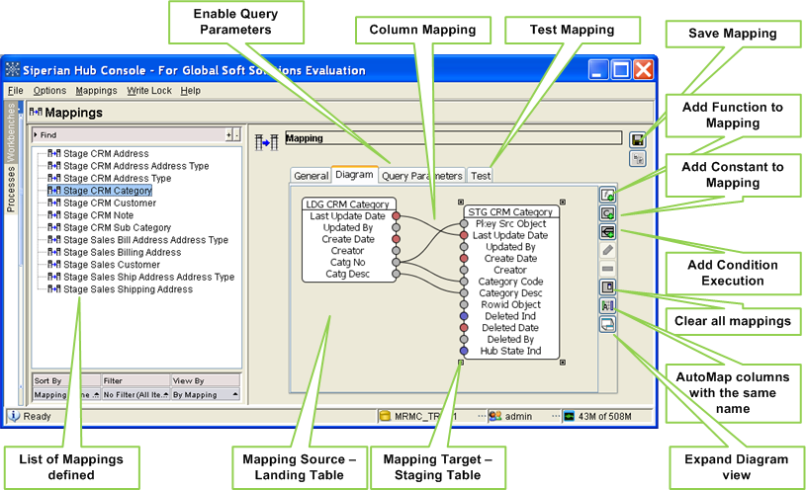
Demo – Mappings Tool

Slide 31
Mappings – Query Parameters
Query Parameters are optional parameters that allows users to influence how data is selected from landing tables for processing
Two types of query parameters are available
Enable Condition
  Stage process will select all the records in the landing table that meet the specified filter criteria
  Requires a SQL WHERE clause fragment to be specified as a filter
Enable Distinct
  Stage process will select only the distinct set of values of the mapped columns from the landing table

Slide 32
Mappings – Test Mappings
The Test tab in the mapping tool allows users to enter input values in the format of landing table and shows the resultant values that would be placed in staging table
Input Area represents landing table columns
Output Area represents staging table columns

Slide 33
Advanced Mappings
Advanced mappings support the various data cleansing and/or transformation logic required for cleaning the input source data
Functionality to add external data cleansing and address verification tools also like Trillium, Address Doctor, IDQ, etc.
A column map can include the following transformation options:
  Function
  Constant
  Conditional Execution Statements
  Combination of all the above

Slide 34
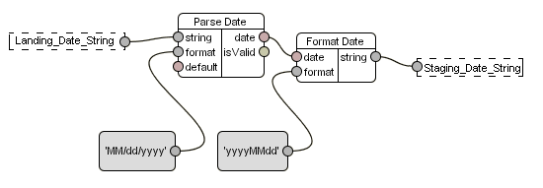
Advanced Mappings - Example
Source column in landing table
Inputs
Outputs
Target column in staging table
Example:
‘06/25/2005’
Reformatted to:
‘20050625’
Constant used to specify format of the date in the input string
Constant used to specify desired date format for the output string

Slide 35
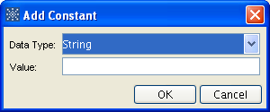
Constants
Can be Boolean, Date, Float, Integer, or String
Useful for providing default values to staging table columns
Useful for providing input values for different functions

Slide 36
Conditional Execution Component
Equivalent to a case statement
Allows different cleansing depending on an input value
Consists of a set of case values and a case graph for each case value
Each case graph contains the steps to perform when the input to the condition equals the case value

Slide 37
Functions
Functions are used for cleansing and transforming data in MDM
Each function has a set of Inputs and Outputs
An Input can be mapped from
  A landing table column
  A constant
  An output from another function
An Output can be mapped to
  A staging table column
  An input from another function
Types of Functions:
  Predefined Functions
  Cleanse Lists
  Cleanse Functions/Graph Functions

Slide 38
Pre-Defined Functions
Informatica MDM comes with a list of pre-defined function that could be used to perform various data transformation activities
Types of pre-defined functions:
  Data Conversion Functions: Coverts one data type to another. Examples – Format function converts Boolean, date, or integer to string
  Logic Functions: Performs logical comparisons and checks on different data types. Examples – Boolean AND, OR, and NOT functions, Is…Null functions
  Math Functions: Performs math operations on integer and decimal data types. Examples – Add, Subtract, Multiply, Divide, Ceiling, Floor function
  String Functions: Performs various transformation operations on string data types. Examples – Space, Whitespace, Case, Concatenate function
  Miscellaneous Functions: Other pre-defined functions. Examples – Now function, Read database function, Reject function

Slide 39
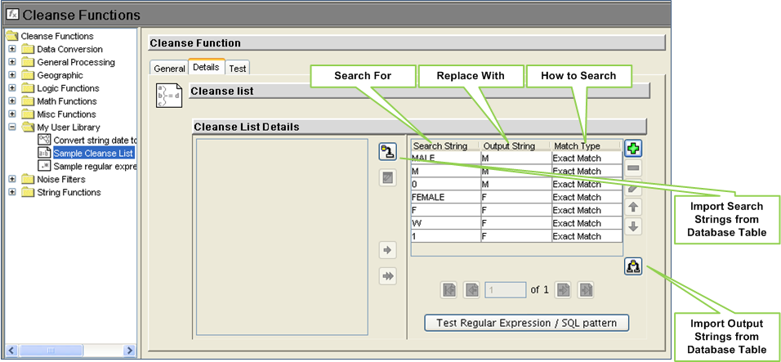
Cleanse List
A cleanse list is an user-defined list of search and replace values
Used for standardizing known string values, standardizing code values, and removing “noise” or punctuation from input strings

Slide 40
Cleanse List
Cleanse List Inputs
Cleanse List Outputs
Input String | Source system value
Search Type | Specifies how to compare the cleanse list items with the input string
Replace All Occurrences | Specifies whether to replace all substring in input string or just the first
Stop On Hit | Specifies whether to continue to process the rest of the cleanse list once an item has been found in the input string
Strip | This flag controls whether the matched value will be stripped from the input, rather than using the replace value
Default Value | Value to write out if none of the items are found in the input string
Output String | Output value of the cleanse list function
Matched | Last matched value of the cleanse list
Match Flag | Indicates whether a match was found in the cleanse list of not

Slide 41
Cleanse List
Cleanse List Input – searchType
ANYWHERE to find the items anywhere in the input
WORD to compare cleanse list items with words in the input
ENTIRE to compare cleanse list items with the entire input string
Default value is ENTIRE
Cleanse List Match String = Doug
Input String:
The Doug McDougal Group
searchType=ANYWHERE:
Found: 2
The Doug McDougal Group
searchType=WORD
Found: 1
The Doug McDougal Group
searchType=ENTIRE:
Found: 0
The Doug McDougal Group

Slide 42
Cleanse List
Cleanse List Input – replaceAllOccurrences
TRUE replaces all parts of input string that match an item in the cleanse list. If Strip is also TRUE, then all occurrences are removed
FALSE replaces first substring in the input string that matches an item in the cleanse list. If Strip is also TRUE, then only first occurrence is removed
Default value is TRUE
Cleanse List Match String = Doug; Replace With=BOB
searchType=“ANYWHERE”
Input String:
The Doug McDougal Group
replaceAllOccurrences=TRUE:
The BOB McBOBal Group
replaceAllOccurrences=FALSE:
The BOB McDougal Group

Slide 43
Cleanse List
Cleanse List Input – Strip
This input works together with the replaceAllOccurrences parameter to determine output
TRUE removes the matched value from the input string, ignoring the replace value
FALSE condition will replace the matched value with the replace value instead of removing it
Default value is FALSE
Cleanse List Match String = Doug; Replace With=BOB
searchType=“ANYWHERE”
Input String:
The Doug McDougal Group
Strip=TRUE; replaceAllOccurrences=TRUE:
The Mcal Group
Strip = TRUE; replaceAllOccurrences=FALSE:
The McDougal Group
Strip=FALSE; replaceAllOccurrences=TRUE:
The BOB McBOBal Group
Strip=FALSE; replaceAllOccurrences=FALSE:
The BOB McDougal Group

Slide 44
Cleanse List
Cleanse List Input – stopOnHit
TRUE: Stop processing cleanse list when a matching item is found
FALSE: Continue through the rest of the items in the cleanse list
Default value is TRUE
Cleanse List Match Strings:
Look for:
Replace with:
Doug
BOB
BOB
Jack
Group
Team
searchType=ANYWHERE; replaceAllOccurrences=FALSE
Input String:
The Doug McDougal Group
stopOnHit=TRUE:
The BOB McDougal Group
stopOnHit=FALSE:
The Jack McDougal Team

Slide 45
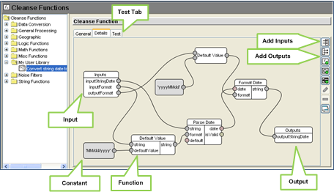
Cleanse Function
Group of functions, constants, cleanse lists and conditional execution components to perform a specific cleansing activity
User defined inputs and outputs

Slide 46
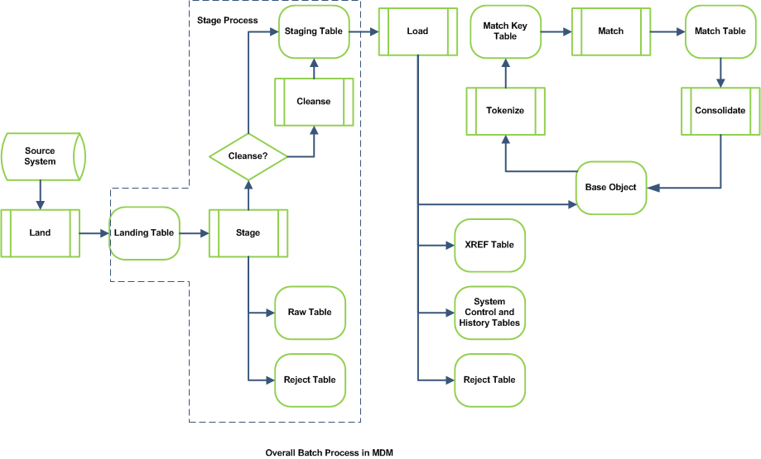
Stage Process

Slide 47
Stage Process
Data load from the landing tables into the source specific staging tables
Stage jobs execution is independent with respect to other stage jobs
Register
STAGE
job
Delta Detection
Cleansing
Maintain Raw History and PRL
End
STAGE
job
COMMIT

Slide 48
Stage Process
Delta Detection
Property of the Staging Table
Only available if the “Contains Full Data Set” landing table property is switched on
Process of identifying new and changed records from the source system by comparing the source system’s current data set with the previous data set
Deltas are determined by comparing landing table data with previous landing table data
Two options for determining deltas:
  On a change in date column (LAST_UPDATE_DATE) in the landing table
  On a change in any column other than the LAST_UPDATE_DATE

Slide 49
Stage Process
Previous Landing Table
Property of the Staging Table
A snapshot of the landing table columns and data from the end of the previous stage job
Used for Delta Detection
Can be used for Hard Delete Detection
Table name format: staging_table_name_PRL

Slide 50
Stage Process
Audit Trail / RAW Table
Property of the Staging table
This table stores a history of the raw data, as stored in the landing table at the start of the stage process
Audit trail retention period can be specified
Table name format: staging_table_name_RAW

Slide 51
Stage Process
Rejects
Rejects can occur in the Stage Process if:
  Data Conversion Error occurs
  Target Column size is small
  Duplicate primary keys in the data
  Reject function called from the mapping
Table name format: staging_table_name_REJ
The load process also uses the same reject table as the stage process

Slide 52
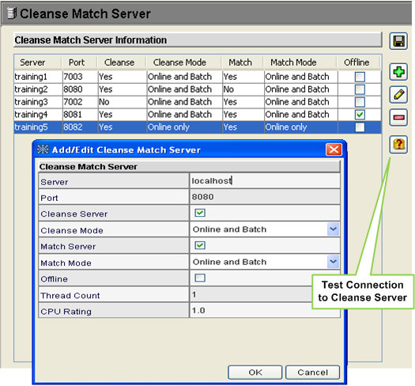
Process Server
Server for handling cleansing or matching requests from MRM
Informatica MDM provides functionality for registering multiple cleanse match servers
Servers can be cleanse only, match only, or both

