Slide 1
“A little less pedestrian”
Melbourne CBD pedestrian counts

Slide 2

Data
Data provided by the City of Melbourne website
Sensors placed around various places in the Melbourne CBD
Roughly 40 sensors, exact number changes over time
Counts number of pedestrians that walk pass
Counts summarised in 15 minute intervals over a few years

Slide 3
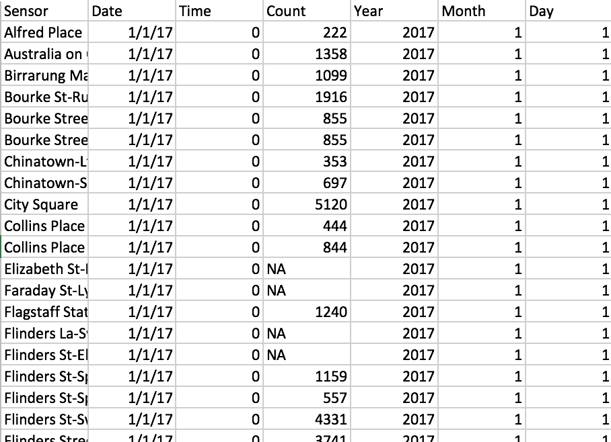
Data processing
Data provided in large CSV
Containing Sensor Name, Date, Month, Day, Time and Count
Values aggregated into hourly values
Incomplete values removed
Use only data from 2017

Slide 4
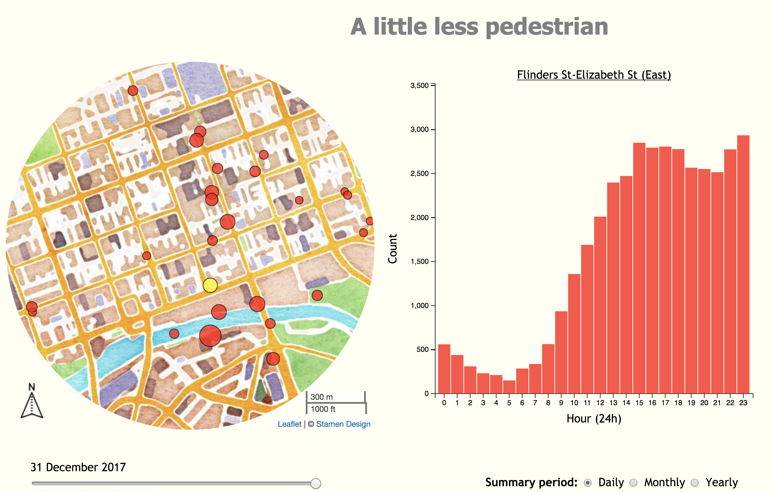
Data Visualisation Strategy
Two plots
Map with points showing the location of sensors
Point size determined by the total count on a specific day
Bar plot showing further summaries at specific sensors
Interactions
Sliding time selector to specify which day to plot
Clicking on sensors (points) on the map brings up related bar chart
Radio buttons to choose how to summarise bar chart

Slide 5
Demonstration

Slide 6
Applause
Source Data: http://www.pedestrian.melbourne.vic.gov.au/
Retrieved using rwalkr R package
Source Code: https://github.com/sa-lee/summerviz
*Only seems to work properly on Chrome and Firefox

