Slide 2


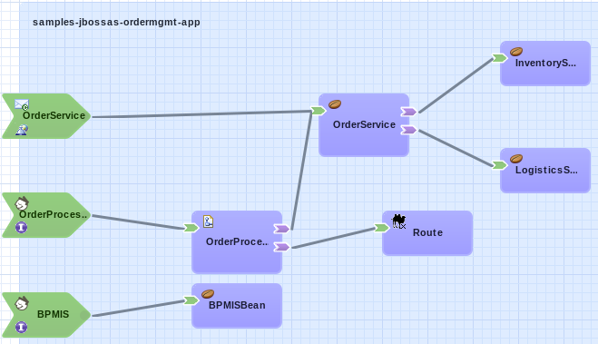



Inventory
System
Retailers
ACME Inc.
Integration Platform
Logistics
System
Mobile
Frontend

