Slide 1


Health and Insurance Data Analysis
Industrial Training/Institutional project
2024
Sarang Rajendra Jadhav
Sayu Softtech
Guide: Mr.Sagar Ingale

Slide 2
Introdunction:
Health and Insurance Data Analysis is Data Hub where analysis for Medicine and Insurance Policies data is done on Big Data platform .
At least 10% of the Healthcare insurance payments are attributed to fraudulent claims. Worldwide this is estimated to be a multi-billion dollar problem.
Fraudulent claims is not a novel problem but the complexity of the insurance frauds seems to be increasing exponentially making it difficult for the healthcare insurance companies to deal with them
Benefits:
• Integrated, Hadoop solution for the enterprise
• Faster time to deployment
• Automated, consistent, dependable deployment and management
• Simplified operation that can be quickly learned without systems administration experience

Slide 3








Project Flow
L1
L2
Primarytables
Final Transform,
applying business logic,
As per client requirement
Data Analyst
Historical Data
SQL
merge
Database
New Inserted and updated data
deltaTables
Daily Transactions
Hadoop Distributed File System
(HDFS)
L1=Staging Layer
L2=Datawarehouse Layer
EMR Cluster

Slide 4
Primarytables
Initial Load
SQL
Reference Tables:
ADDRESS
CITY
COUNTRY
DEPARTMENT
DISEASE
DOCTOR
E_ADDRESS
HOSPITAL
POLICY
STATE
TEST
In Real World Scenario,
There are 80 Transactional tables and 30 Reference tables. The initial bulk load will consist of 25-30 TB data. Incremental data would be 200 GB per day
Transactional Tables:
BILLING
CLAIM
FAMILY_DETAIL
PATIENT
STAFF

Slide 5
Project Flow
Primarytables
Final Transform,
applying business logic,
As per client requirement
Data Analyst
Initial Load
SQL
merge
Final Table
New Inserted and updated data
Database
deltaTables
Sqoop
Apache Hive
Hadoop Distributed File System
(HDFS)
EMR Cluster

Slide 6
Primarytables
Final Transform,
applying business logic,
As per client requirement
Final Table
COLUMNS
PATIENTINFO
PATIENTID bigint,
PATIENTFULLNAME STRING,
CONTACT STRING,
UID BIGINT,
ADDRESS STRING,
CREATIONDATE TIMESTAMP,
UPDATEDATE TIMESTAMP,
SOURCEQUERYTIME TIMESTAMP

Slide 7
ER Diagram:

Slide 8
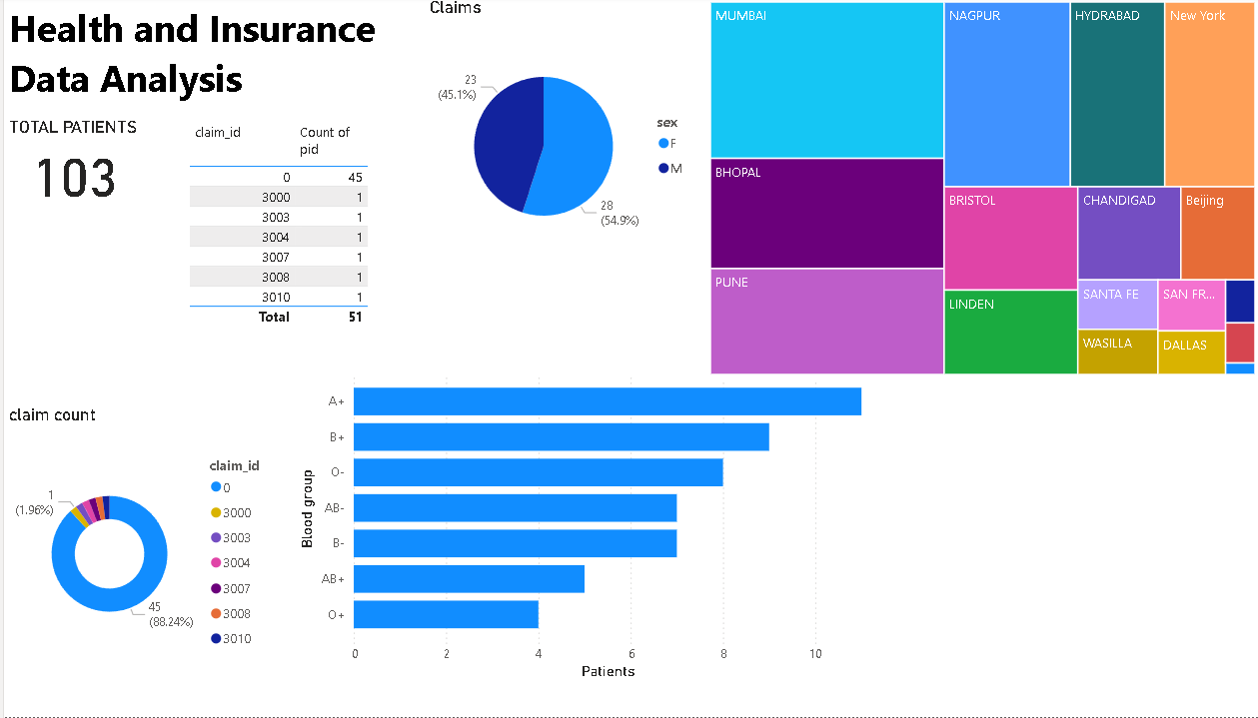
Sample Report

Slide 9
Q & A

Slide 10
Thank You

