Slide 1
K-means clustering

Slide 2
K-means overview
k-means clustering aims to partition n observations into k clusters in which each observation belongs to the cluster with the nearest mean, serving as a prototype of the cluster.

Slide 3
Steps involved...
Choose the number k of clusters
Select at random k points, the centroids (not necessarily from your dataset)
Assign each data point to the closest centroid, that forms k clusters
Compute and place the new centroid of each cluster
Reassign each data point to the new closest centroid.
If any reassignment took place, go to STEP 4,otherwise the model is ready.

Slide 4
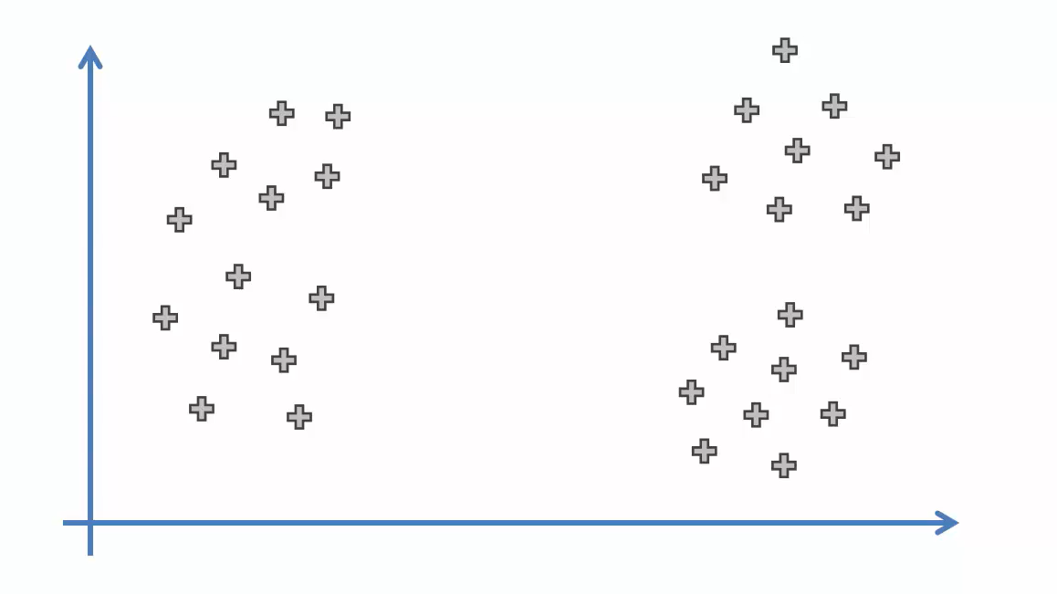
Choosing the right number of clusters

Slide 5
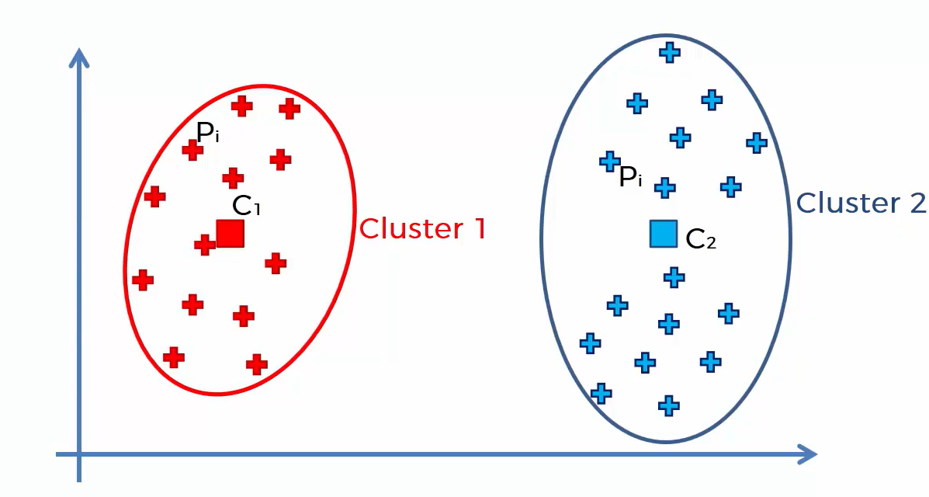
Choosing the right number of clusters

Slide 6
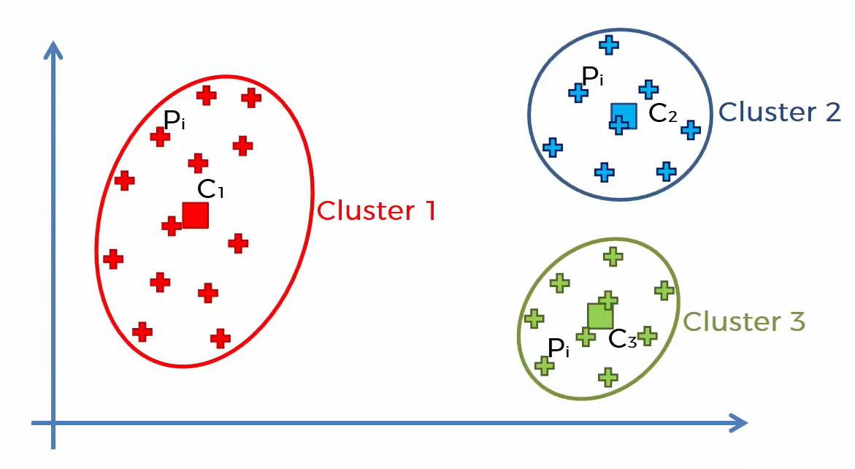
Choosing the right number of clusters

Slide 7
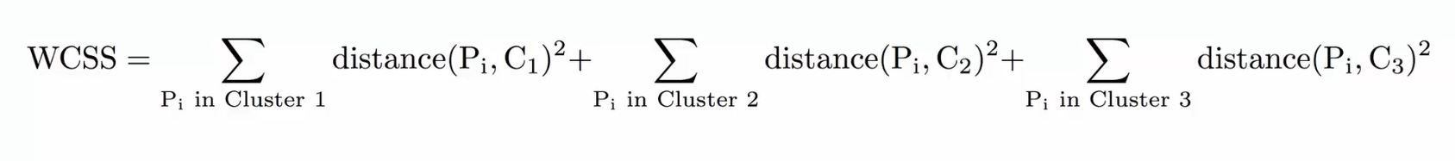
Choosing the right number of clusters

Slide 8
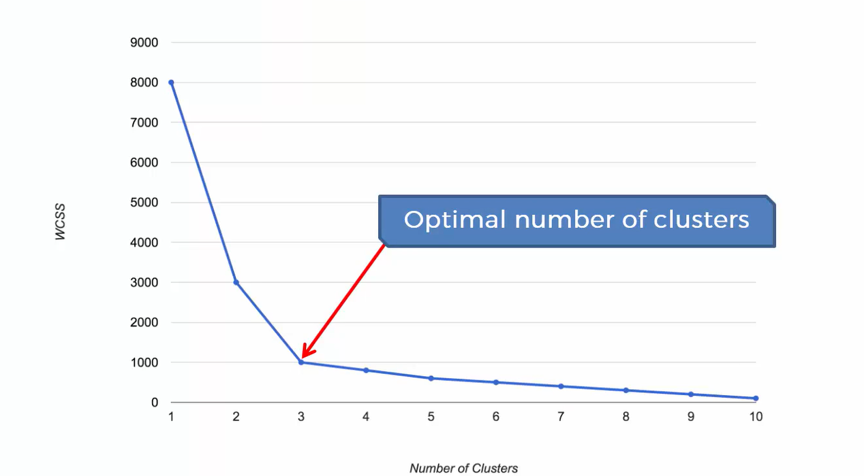
The Elbow Method

Slide 9
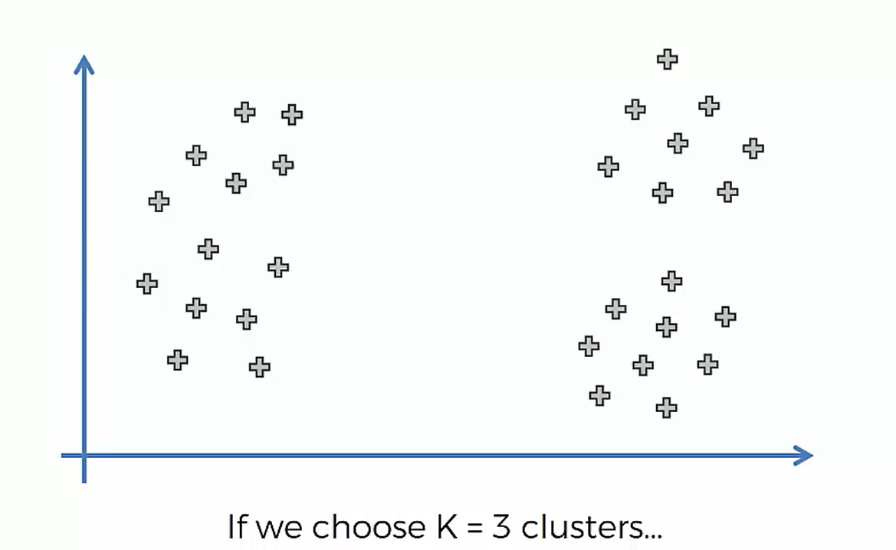
Issue one must be aware of…..

Slide 10
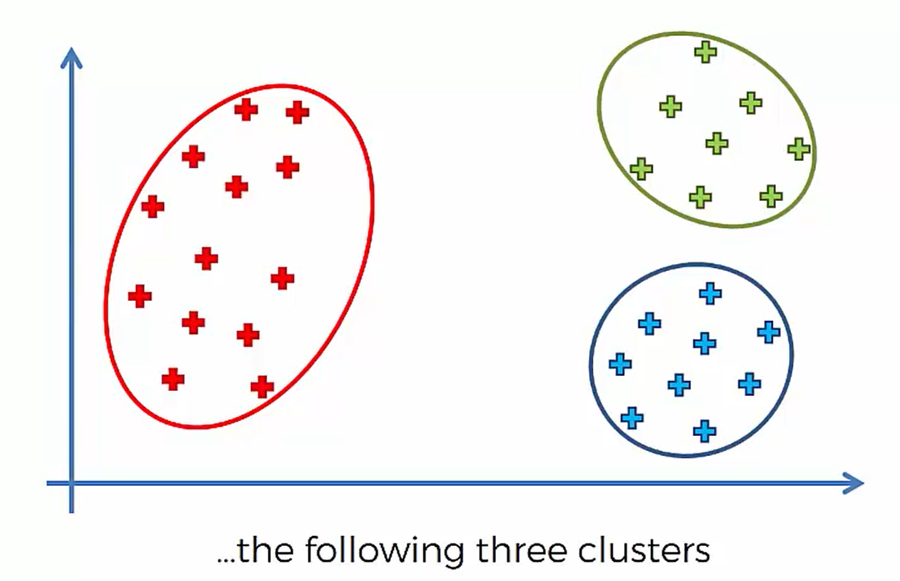
Issue one must be aware of

Slide 11
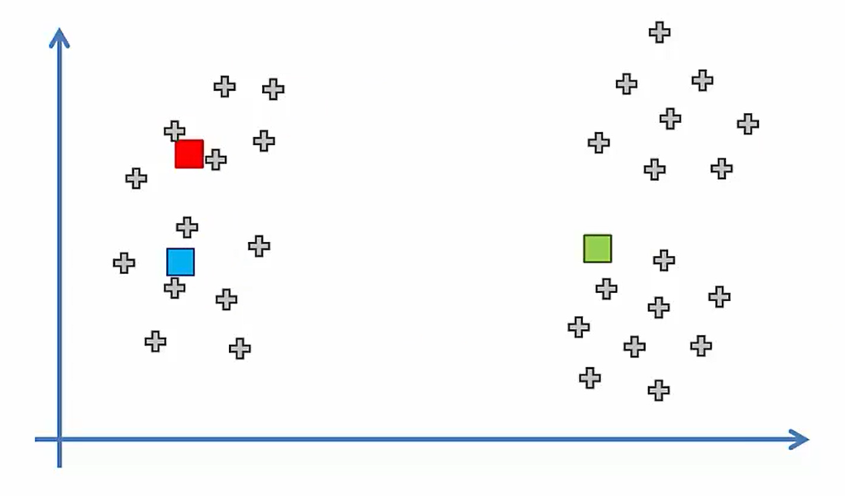
Random Initialization Trap

Slide 12
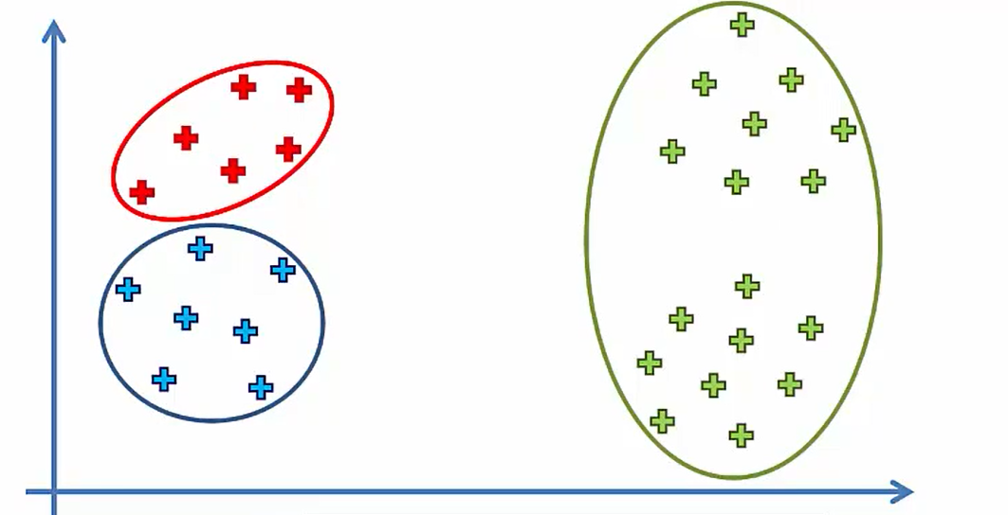
Random Initialization Trap

Slide 13
Some of the applications of k-means
Document Classification
Identifying Crime Localities
Customer Segmentation
Delivery Store Optimization
Call Record Detail Analysis
……..

