Slide 1
IP SECURITY

Slide 2
IP Security Overview
The standard Internet communication protocol is completely unprotected, allowing hosts to inspect or modify data in transit. Adding IPsec to the system will resolve this limitation by providing strong encryption, integrity, authentication and replay protection.

Slide 3
What Security Problem?
Today's Internet is primarily comprised of :
Public
Un-trusted
Unreliable IP networks

Slide 4
Internet Threats
Attack on data integrity
Identity spoofing
Replay attacks
Loss of privacy

Slide 5
IP SECURITY
IP-level security encompasses three functional areas:
Authentication
Confidentiality
Key management

Slide 6
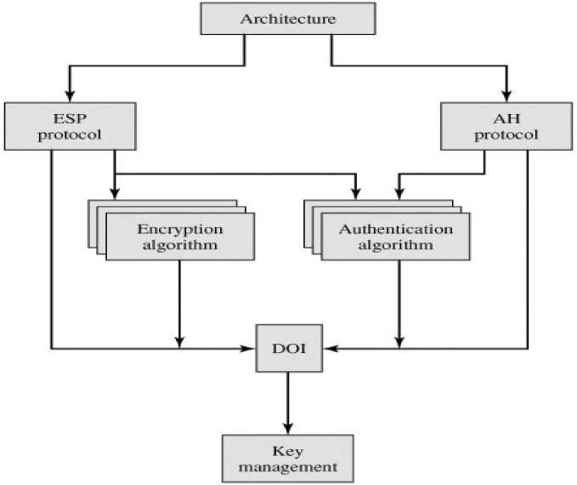
IPSec Document Overview

Slide 7
Security Associations
A one-way relationship between a sender and a receiver that affords security services to the traffic carried on it.
A security association is uniquely identified by three parameters:
Security Parameter Index (SPI)
IP Destination Address
Security Protocol Identifier

Slide 8
Security Association Parameters
Security Association Database defines the parameters associated with each SA. A security association is normally defined by the following parameters:
Security Parameter Index
Sequence Number Counter
Sequence Counter Overflow
Anti-Replay Window
AH Information
ESP Information
Lifetime of this Security Association
IPSec Protocol Mode
Path MTU

Slide 9
IPSec Modes of Operation
Both AH and ESP supports two modes of use:
Transport mode
Tunnel mode

Slide 10
Authentication Header
Provides support for data integrity and authentication of IP packets.
Authentication is based on the use of a message authentication code (MAC), hence the two parties must share a secret key.

Slide 11
Authentication Header
The Authentication Header consists of the following fields :
Next Header (8 bits): Identifies the type of header immediately following this header.
Payload Length (8 bits): Length of Authentication Header in 32-bit words, minus 2.
Reserved (16 bits): For future use.
Security Parameters Index (32 bits): Identifies a security association.
Sequence Number (32 bits): A monotonically increasing counter value.
Authentication Data (variable): A variable-length field (must be an integral number of 32-bit words) that contains the Integrity Check Value (ICV), or MAC.

Slide 12
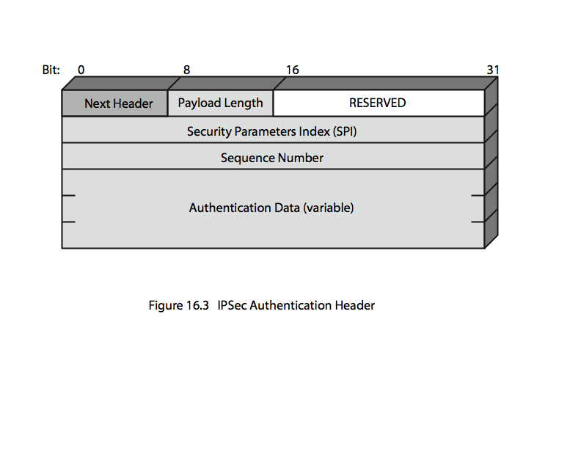
Authentication Header

Slide 13
Encapsulating Security Payload (ESP)
provides message content confidentiality
can optionally provide the same authentication services as AH
Because message authentication is provided by ESP, the use of AH is deprecated
supports range of ciphers, modes, padding
incl. DES, Triple-DES, etc
CBC & other modes
padding needed to fill blocksize, fields, for traffic flow

Slide 14
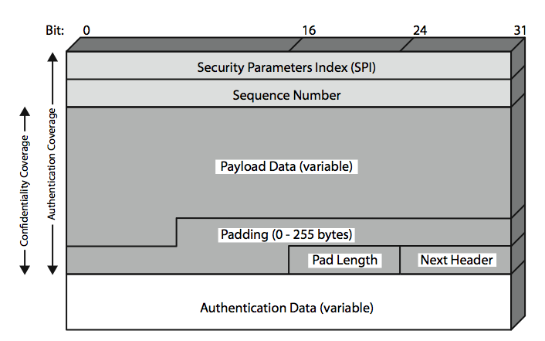
Encapsulating Security Payload

Slide 15
Encapsulating Security Payload
Security Parameters Index (32 bits): Identifies a security association.
Sequence Number (32 bits): A monotonically increasing counter value; this provides an anti-replay function.
Payload Data (variable): This is a transport-level segment (transport mode) or IP packet (tunnel mode) that is protected by encryption.
Padding (0–255 bytes): for various reasons.
Pad Length (8 bits): Indicates the number of pad bytes immediately preceding this field.
Next Header (8 bits): Identifies the type of data contained in the payload data field by identifying the first header in that payload
Integrity Check Value (variable): A variable-length field that contains the Integrity Check Value computed over the ESP packet minus the Authentication Data field.

Slide 16
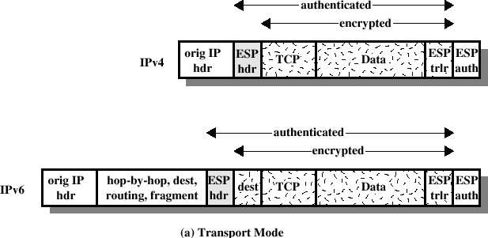
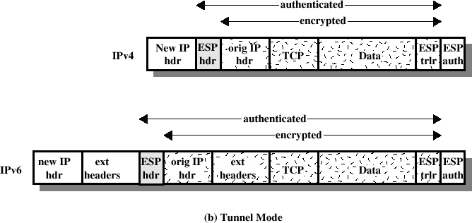
Transport vs Tunnel Mode ESP
Scope of ESP Encryption and Authentication

Slide 17
Anti-Replay Service
A replay attack is one in which an attacker obtains a copy of an authenticated packet and later transmits it to the intended destination. The receipt of duplicate, authenticated IP packets may disrupt service in some way or may have some other undesired consequence.
The Sequence Number field is designed to thwart such attacks.
When a new SA is established, the sender initializes a sequence number counter to 0.
If anti-replay is enabled (the default), the sender must not allow the sequence number to cycle past 2³² -1 back to zero. Otherwise, there would be multiple valid packets with the same sequence number. If the limit of 2 ³² -1 is reached, the sender should terminate this SA and negotiate a new SA with a new key.

Slide 18
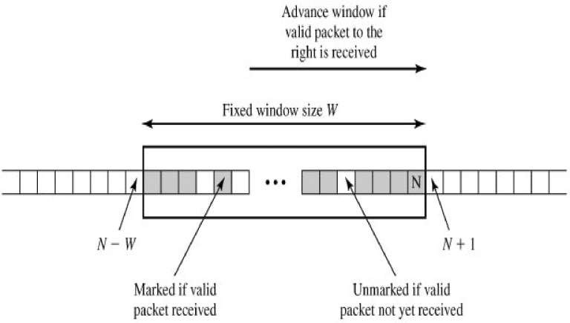
Anti-Replay Service

Slide 19
Key Management
handles key generation & distribution
typically need 2 pairs of keys
2 per direction for AH & ESP
manual key management
System administrator manually configures every system
automated key management
automated system for on demand creation of keys for SA’s in large systems
has Oakley & ISAKMP elements

Slide 20
THANK YOU

