Slide 1

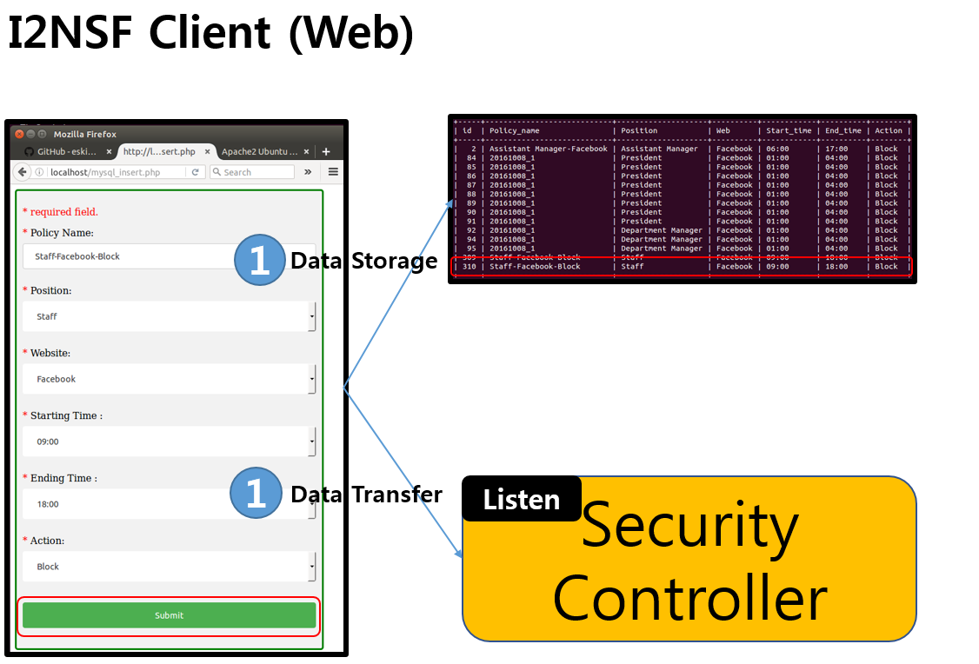
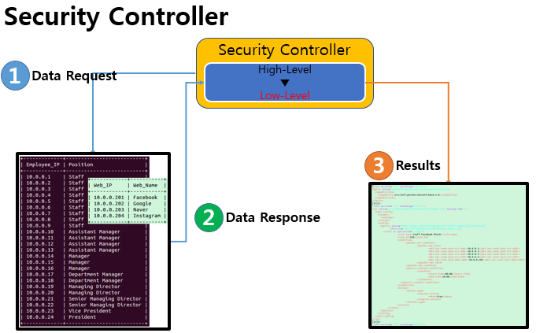
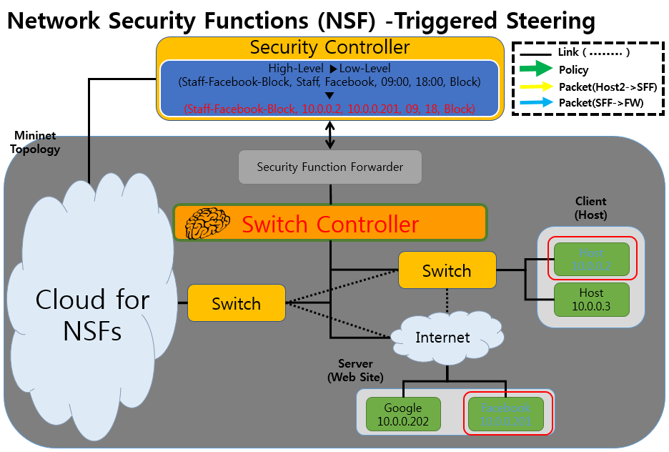



IETF I2NSF (Interface to Network Security Functions) Working Group: I2NSF Framework Project
Champions: Jaehoon Paul Jeong, Jinyong Tim Kim (SKKU), Jung-Soo Park (ETRI), and Tae-Jin Ahn (KT)
Where to get code
Github – Source code
https://github.com/kimjinyong/i2nsf-framework
USB – Source code & environment
Provided by USB Driver
What to pull down to set-up environment
OS : Ubuntu 14.04TL
Netconfd : 6.2 Version
Apache2 : 2.4.7 Version
MySQL : 14.14 Version
PHP : 5.5.9 Version
Mininet : 2.2.1 Version
OpenDaylight : Distribution-karaf-0.4.3-Beryllium-SR3
Manual for Operation Process
https://github.com/kimjinyong/i2nsf-framework/ README.txt
IETF 97 Hackathon
I2NSF Framework Project
Professors
Jaehoon (Paul) Jeong (Sungkyunkwan)
Hyoungshick Kim (Sungkyunkwan)
Hoon Ko (Sungkyunkwan)
Sangwon Hyun (Sungkyunkwan)
Collaborators
Jung-Soo Park (ETRI)
Tae-Jin Ahn (Korea Telecom)
Contents of Implementation
Firewall
DPI for VoIP-VoLTE Security Service
Mission
Firewall
Deletion of policy
Update of policy
Avoidance of the duplication of policy
VoIP-VoLTE Security Service
Deletion of policy
Update of policy
Avoidance of the duplication of policy
Students
Jinyong Tim Kim
Sanguk Woo
Daeyoung Hyun
Eunsoo Kim
Mahdi Daghmehchi Firoozjaei
Sanghak Oh
Yunsuk Yeo
Soyoung Kim

