Slide 1
Forecast Accelerator
Dashboards for Exploration and Model Evaluation
Large Scale Deployment

Slide 2
Introduction
Objective of this accelerator is to speed up the process of data exploration, model building and evaluation for time series based models. Hence, three components are developed during this current phase of work.
Dashboard for exploration of time series data
Codebase to deploy and run more than 100K time series models quickly on AWS
Dashboard for evaluating various models built

Slide 3

Forecast Accelerator – Phase I Summary - EDA Dashboard
Current work
Next Phase
Input file
Ability to upload file from local drive
Inputs:
User inputs to fetch time series granularity, DV, Time variable
User input for frequency of forecast, length of forecast
User input to browse and load data
Visualizations:
Univariate analysis
Time series Exploration (New, Active, Sparse, Seasonality, Outlier, Changepoint, Pareto Charts)
Multivariate plots for continuous variables
Option to flag outliers/data points to events
Model ready dataset creation:
Create model ready dataset based on user inputs
Deployment on AWS
Input file
Ability to upload file from S3
Inputs:
User inputs to correct variable types
User input option for aggregation metric of variables
User click to mention an experiment name and run models
Visualizations:
Multivariate plots to include categorical variables
More charts, eg: Line density
Deployment on AWS:
Ability to run faster with 100K+ series data
Ability to save and reload session info. based on timestamp and IP
Ability to run the models directly from EDA using a click
Current dashboard deployed at:
http://a873a4dfe9b2249c493389badc950b1-1549006211.us-east-1.elb.amazonaws.com/ts/eda/eda_dashboard

Slide 4
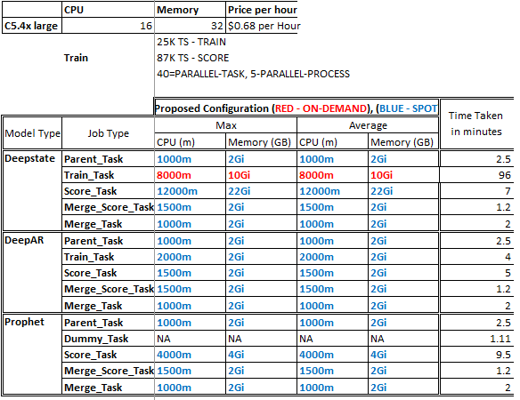
Forecast Accelerator – Phase I Summary – Scaling and Deployment
Current work
Configuration of nodes
Model building & scoring using single command from Jupyter notebook
Gluonts data format
Deepstate, DeepAR, Fbprophet
3 models in parallel (one hyper parameter combination for each of the models)
Automatic backend data generation for model monitoring dashboard
Handle 100K time series ~ 2.5GB data
All results stored in S3 buckets
Model progress view option using Airflow and Mlflow
Deployment on AWS
Automation of infrastructure creation and installation of airflow / Mlflow / other servers.
Next Phase
Automatic scaling of instance type based on model complexity, data size
Ability to save and retrieve models of different formats, currently gluonts format of saving models is incorporated

Slide 5
Forecast Accelerator – Phase I Summary – Deployment – Costs
Cost of one time scoring:
*Infrastructure cost for dashboard usage, S3 cost and other components
**Assuming one time scoring for month, where machines are switched on during 5 days of scoring week and switched off rest of the month.
^Based on AWS dynamic pricing - varies by time of the day and load
Cost of model building depends on number of models built and evaluated upon by scoring.
Cost of model build is very less compared to cost of scoring as the number of time series increases.
Cost Calculation Details:

Slide 6
Forecast Accelerator – Phase I Summary – Model Monitoring Dashboard
Current Work
Next Phase
Two tabs
Granular time series level views
Aggregated time series level views
Input file
Ability to fetch file from S3 using experiment name
Metrics
MAPE, WMAPE, MAD, Bias
Visualizations
Comparison across model runs
Metrics detailed distribution
Cross table of metrics
Chart to show Actual vs Predicted
confidence interval for forecast
Features Contribution to forecast
Filters to view the above
Hierarchy of time series
Model
Deployment on AWS
Input file
Ability to upload file from S3
Metrics
More metrics
Filters
Frequency of forecast (quarterly etc.)
Other hierarchy variables in the data
Outlier removal for metric calculations
Deployment on AWS:
Ability to run faster with 100K+ series data
Current dashboard deployed at:
http://a873a4dfe9b2249c493389badc950b1-1549006211.us-east-1.elb.amazonaws.com/ts/eval/eval_dashboard

Slide 7
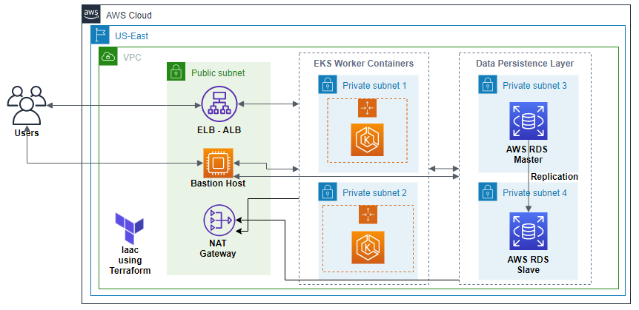
Deployment Architecture – AWS

Slide 8
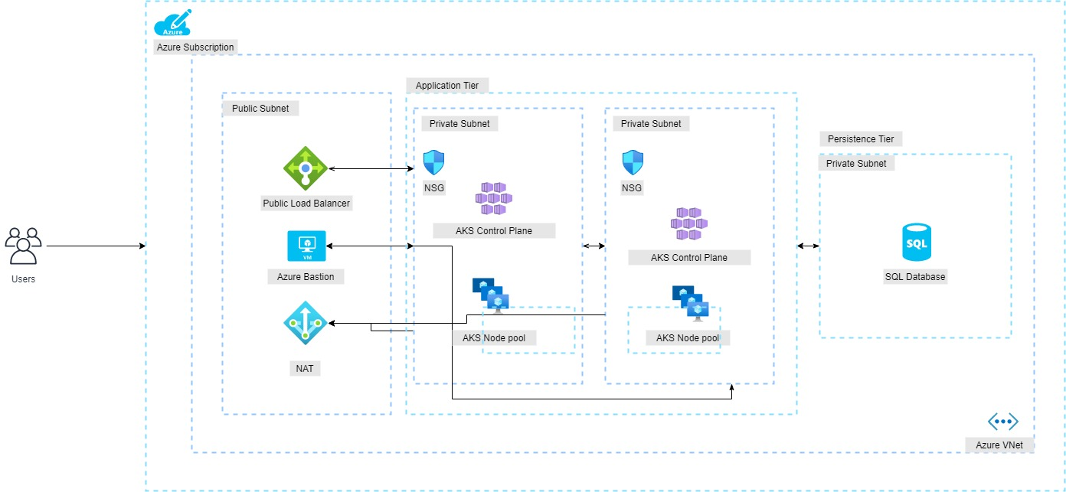
Deployment Architecture – Azure
Components used for AWS and Azure are similar with slight modifications (eg: SQL db in Azure vs RDS in AWS) .
Estimated effort to build the tool in Azure is 6-8 weeks.

Slide 9
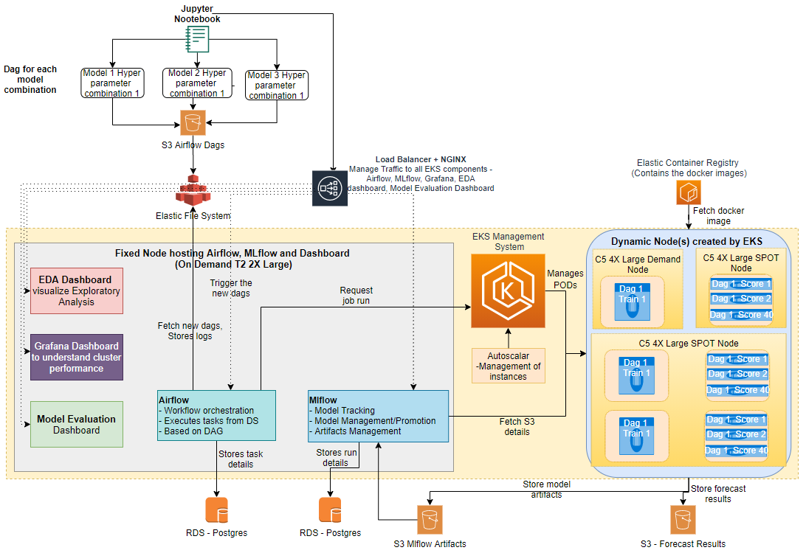
Deployment Architecture – AWS - Detailed

