Slide 1
Components of effective IPR reporting
August 2024
Notes:
Standard title slide

Slide 2
About this document
This document is intended as a helpful guide to illustrate data visualisation options which are proven to :
reduce the amount of time wasted by boards discussing insignificant changes in data
provide a clear focus on issues requiring board attention
An outline of recommended visualisations appear on subsequent slides along with a mock-up of one section of an Integrated Performance Report (IPR) for St Elsewhere NHS Trust
The final slide includes links to IPRs which utilise the formats outlined in this document

Slide 3
Key components of an effective IPR
Using statistical process control (SPC) charts as the basis for the IPR will provide the board with an accurate assessment of performance. SPC charts provide an understanding of whether a metric is improving, deteriorating or staying the same and whether targets can be achieved consistently, inconsistently or not at all. SPC charts provide much greater insight than RAG reports which have been traditionally used in the NHS to understand performance. Learn more in this BMJ Leader paper
It is helpful to utilise the same format of reporting for all sections of the IPR and to replicate this format at committee and care group/division level.
The Making Data Count team provide 90 minute board development sessions
More info
In addition, Making Data Count training (currently 10 modules) is available to all staff
More info
Contact the Making Data Count team if you have specific queries
Notes:
Plain slide with subhead and bullets

Slide 4
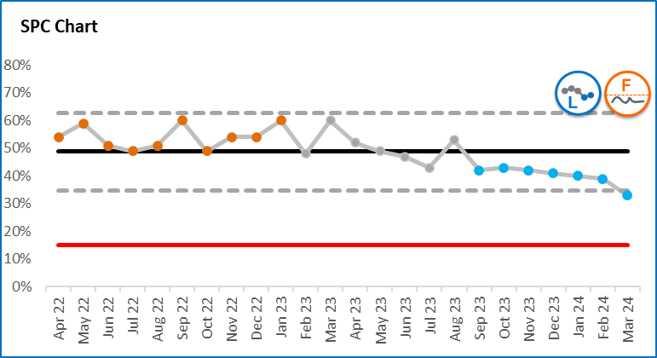
Interpreting SPC charts
A statistical process control (SPC) chart is a useful tool to help distinguish between signals (which should be reacted to) and noise (which should not as it is occurring randomly).
The following colour convention identifies important patterns evident within the SPC charts in this report.
Orange – there is a concerning pattern of data which needs to be investigated and improvement actions implemented;
Blue – there is a pattern of improvement which should be learnt from;
Grey – the pattern of variation is to be expected. The key question to be asked is whether the level of variation is acceptable.
The dotted lines on SPC charts (upper and lower process limits) describe the range of variation that can be expected.
Process limits are very helpful in understanding whether a target or standard (the red line) can be achieved always, never (as in this example) or sometimes.
SPC charts therefore describe not only the type of variation in data, but also provide an indication of the likelihood of achieving target.
Summary icons have been developed to provide an at-a-glance view. These are described on the following page.
Concerning variation
Expected variation
UPL
Average
LPL
Improving variation
Target
To be less than

Slide 5
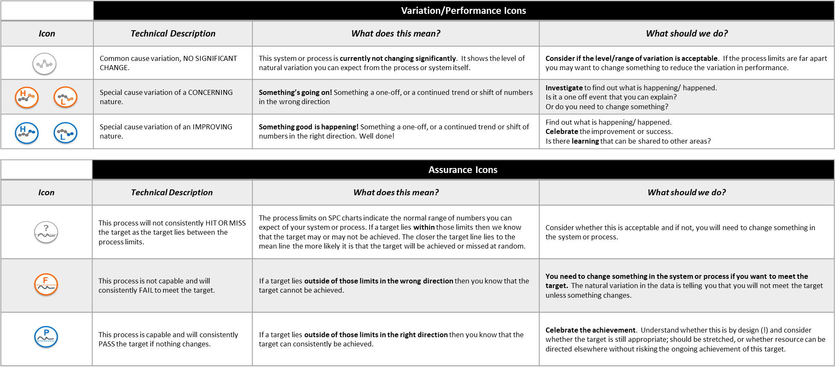
Interpreting summary icons
These icons provide a summary view of the important messages from SPC charts.

Slide 6
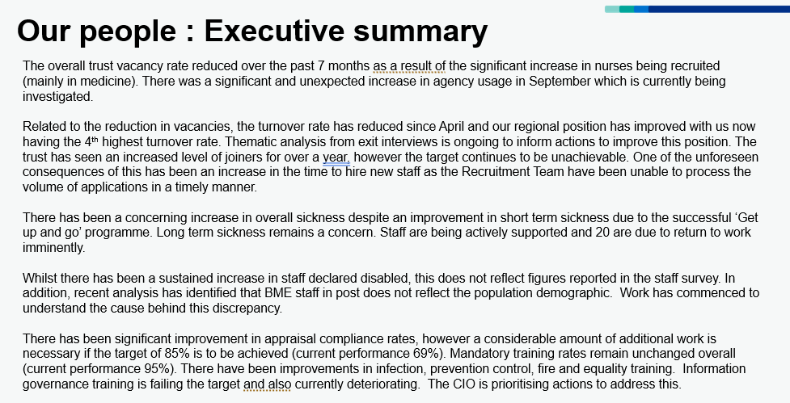
Executive summary
It is helpful to have a brief executive summary (1-2 pages) which draws attention to areas which the board needs to be sighted on. It is important that this summary is informed by the messages evidenced in the data.
It is recommended that the executive summary acknowledges areas where improvement is evident as well as areas of concern.
Board members will be keen to underlying causes for changes in performance highlighted within the Executive Summary. In addition, they will seek to understand key actions underway to address areas of concern.
Notes:
Plain slide with subhead and bullets

Slide 7
Matrix view
This matrix provides an ‘at a glance’ view of performance to focus board discussion
IMPROVING
NOT CHANGING
WORSENING
PASSING
HIT/MISS
FAILING
NO TARGET
Notes:
Plain slide with subhead and bullets

Slide 8
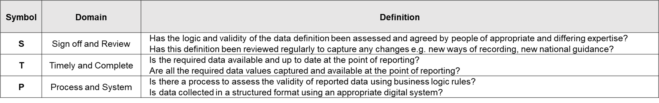
Icon summary
An icon summary can condense important information about a selection of metrics on one page
It can be helpful to provide an assessment of data quality for key metrics.
See below for key
Notes:
Plain slide with subhead and bullets

Slide 9
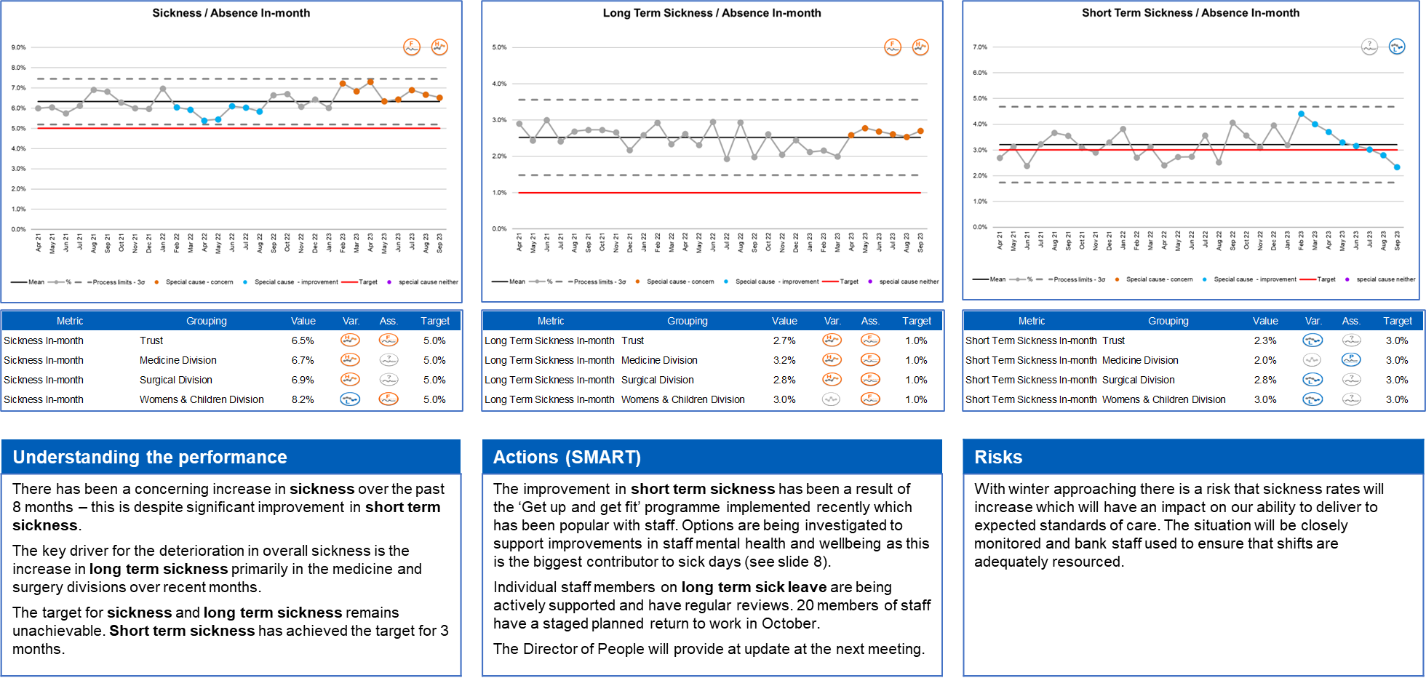
Inter-related charts
It is useful to group inter-related indicators and view SPC charts alongside each other
Icon summary breakdowns can provide a more granular view of aggregate data plotted in the SPC charts above
Supporting narrative should be structured and succinct
Notes:
Plain slide with subhead and bullets

Slide 10
Supporting narrative
It is important that supporting narrative describes important patterns in the data which indicate statistical change rather than referencing a change in 2 data points.
Narrative should also describe:
The underlying reasons for changes in performance
Actions underway to address areas of concern along with timescales for implementation and responsible officers
Key risks and mitigating actions
The causes for improvements in performance
It is helpful to provide narrative alongside SPC charts as this aids the ability to consider whether the described actions are appropriate and adequate.
Notes:
Plain slide with subhead and bullets

Slide 11
Integrated Performance Report Our People Data
St Elsewhere Best Practice IPR
NB This appendix contains a range of visualisations which are useful in guiding board level conversations. Trusts are encouraged to consider the most appropriate format for local use. It is recommended that once agreed, a consistent format and style is adopted for all sections of the IPR.

Slide 12

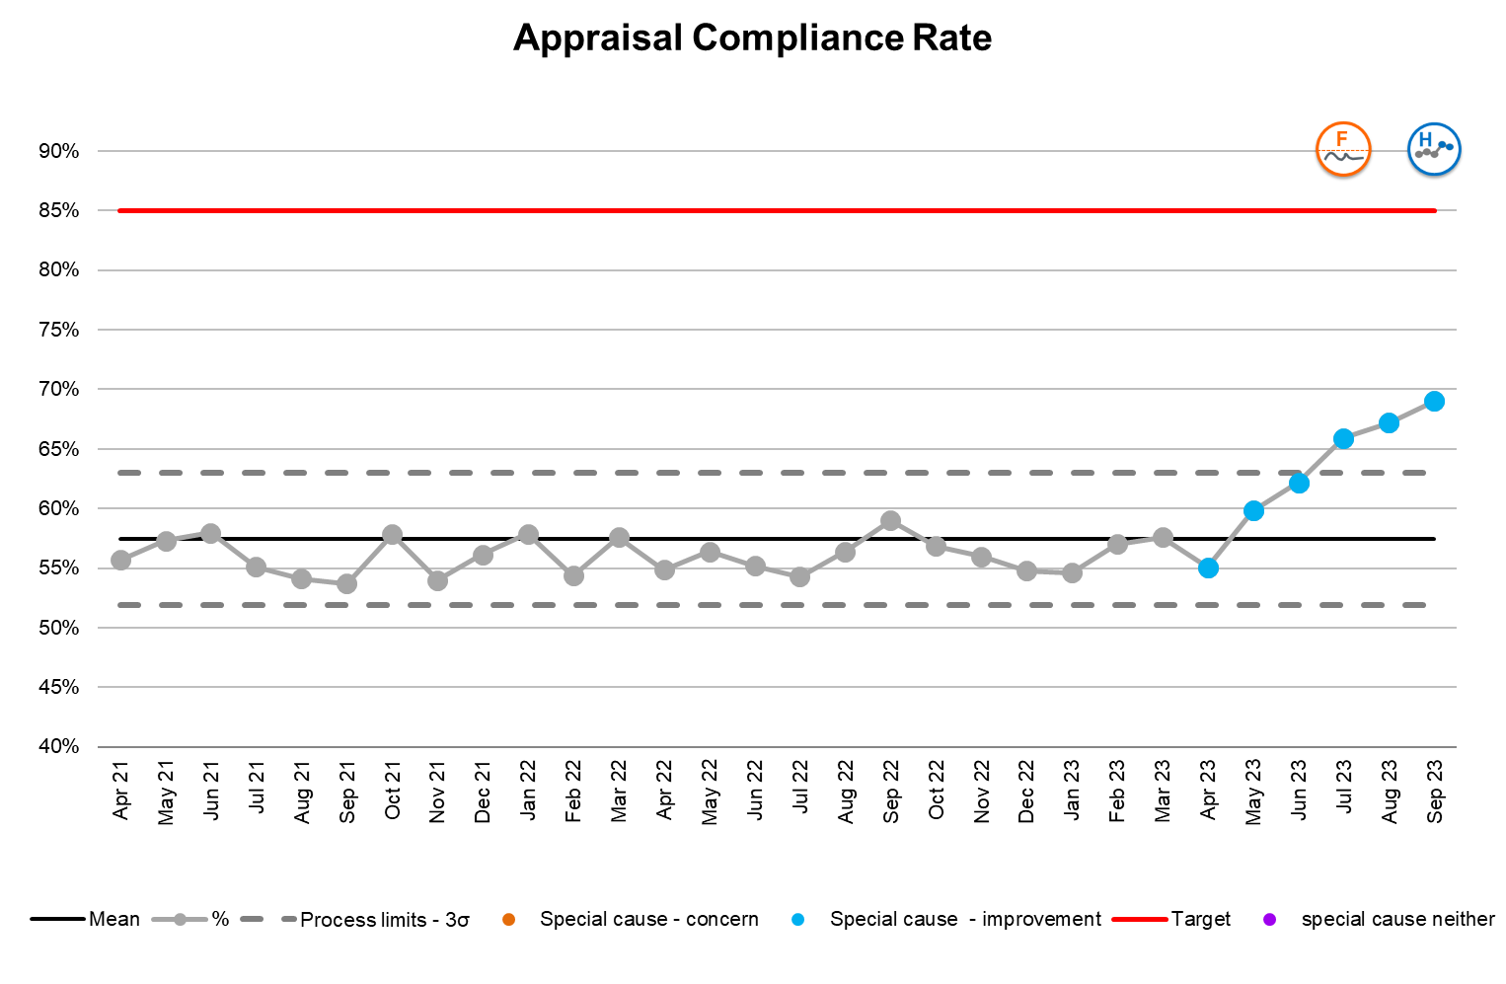
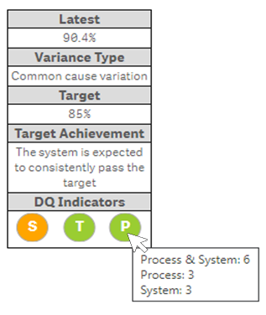
Assessing data quality
The indicator provides an effective visual aid to quickly provide analysis of the collection, review and quality of the data associated with the metric. Each metric is rated against the 3 domains in the table below and displayed alongside the SPC chart as in the below example.

Slide 13
Our people : Executive summary
The overall trust vacancy rate reduced over the past 7 months as a result of the significant increase in nurses being recruited (mainly in medicine). There was a significant and unexpected increase in agency usage in September which is currently being investigated.
Related to the reduction in vacancies, the turnover rate has reduced since April and our regional position has improved with us now having the 4th highest turnover rate. Thematic analysis from exit interviews is ongoing to inform actions to improve this position. The trust has seen an increased level of joiners for over a year, however the target continues to be unachievable. One of the unforeseen consequences of this has been an increase in the time to hire new staff as the Recruitment Team have been unable to process the volume of applications in a timely manner.
There has been a concerning increase in overall sickness despite an improvement in short term sickness due to the successful ‘Get up and go’ programme. Long term sickness remains a concern. Staff are being actively supported and 20 are due to return to work imminently.
Whilst there has been a sustained increase in staff declared disabled, this does not reflect figures reported in the staff survey. In addition, recent analysis has identified that BME staff in post does not reflect the population demographic. Work has commenced to understand the cause behind this discrepancy.
There has been significant improvement in appraisal compliance rates, however a considerable amount of additional work is necessary if the target of 85% is to be achieved (current performance 69%). Mandatory training rates remain unchanged overall (current performance 95%). There have been improvements in infection, prevention control, fire and equality training. Information governance training is failing the target and also currently deteriorating. The CIO is prioritising actions to address this.

Slide 14
Our people domain : matrix

Slide 15
Our people : staffing summary
Data quality assessment
A range of potential data quality issues have been identified with BME staff in post. These include delays in recording, the robustness of validity checks and the indicator definition. Resolving these issues is the top priority for the DQ Improvement Taskforce.
Given the discrepancy with staff survey figures, there are concerns with the process for validating the staff declared disabled data. Further investigation is currently underway.
Data quality assessment
A review is currently being undertaken to ensure short term sickness data consistently adheres to the agreed definition.

Slide 16
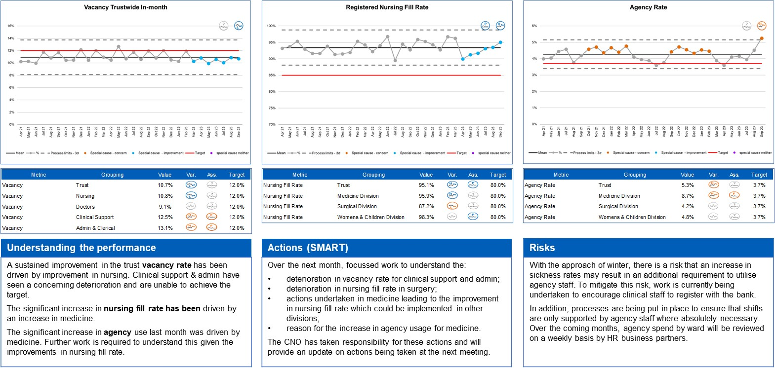
Our people : staffing

Slide 17
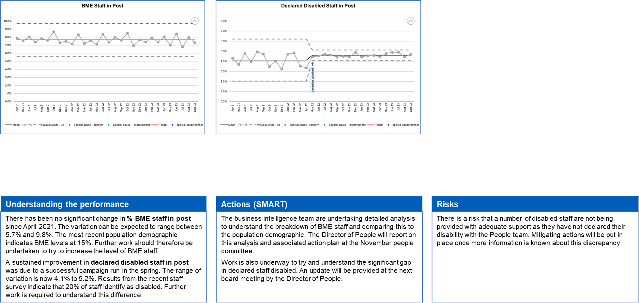
Our people : staffing

Slide 18
Our people : sickness and absence

Slide 19
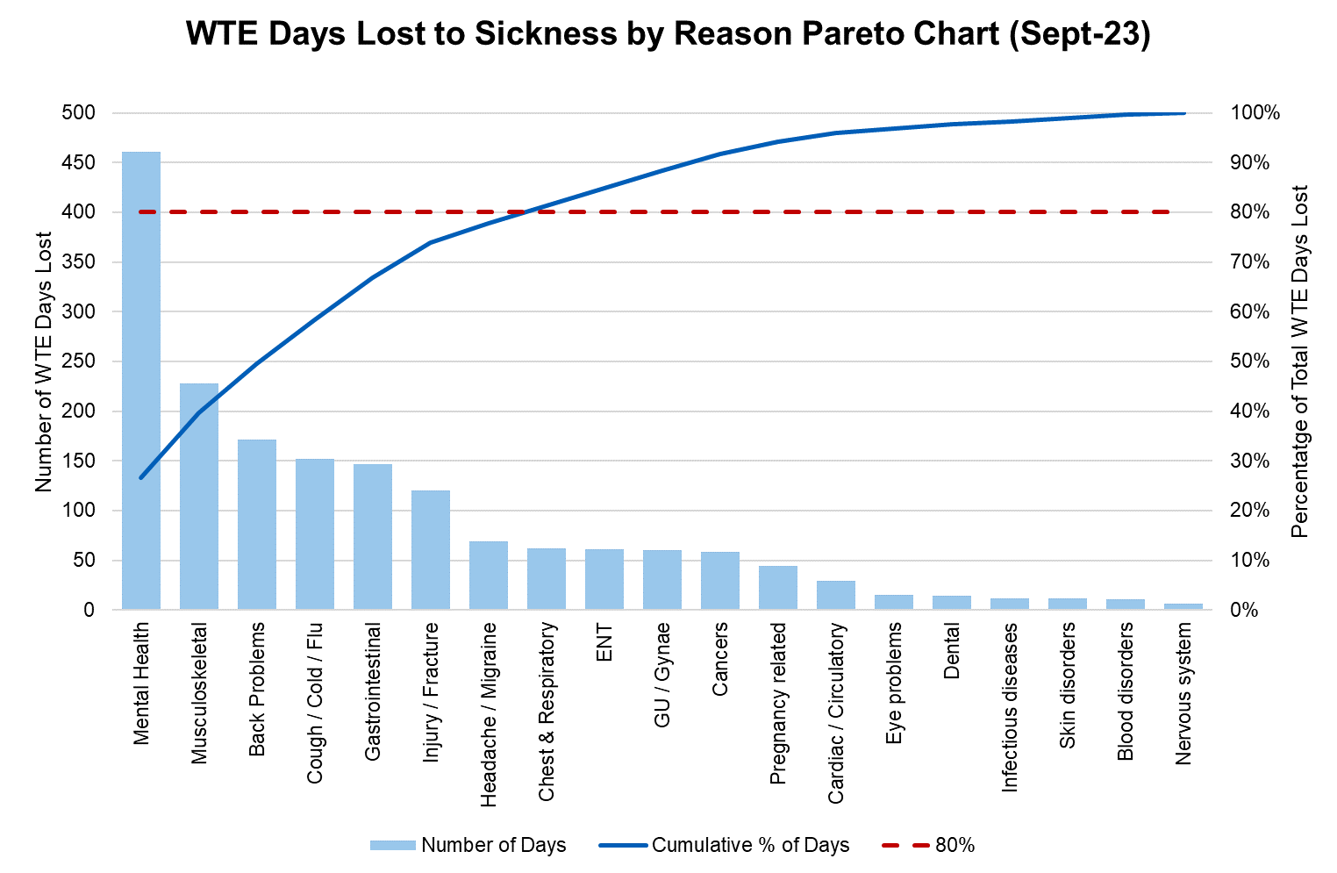
Sickness by category
Key Contributors
Mental Health Musculoskeletal Back Problems Cough / Cold / Flu Gastrointestinal Injury / Fracture Headache / Migraine

Slide 20
Our people : training and development summary
Data quality assessment
The time to hire data is currently held in a spreadsheet maintained by the Recruitment Team so the data is not easily accessible to the Business Intelligence team. A project has been established to record this data on the main HR system and at the same time ensuring that the validation processes and indicator definition are formalised and documented.
Data quality assessment
The mandatory training data is held in a separate database historically managed by the Development and Training team. This database is currently being transferred to the Business Intelligence team who will maintain it going forward.

Slide 21
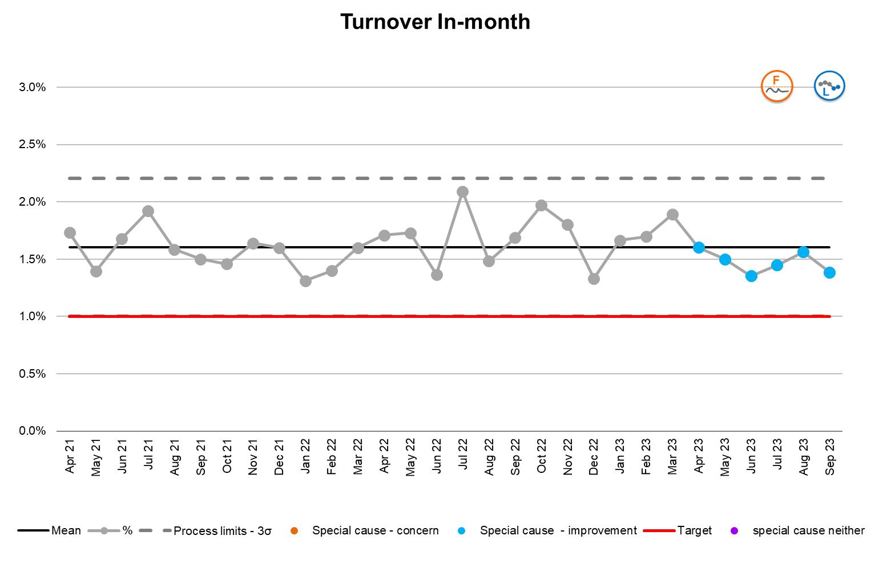
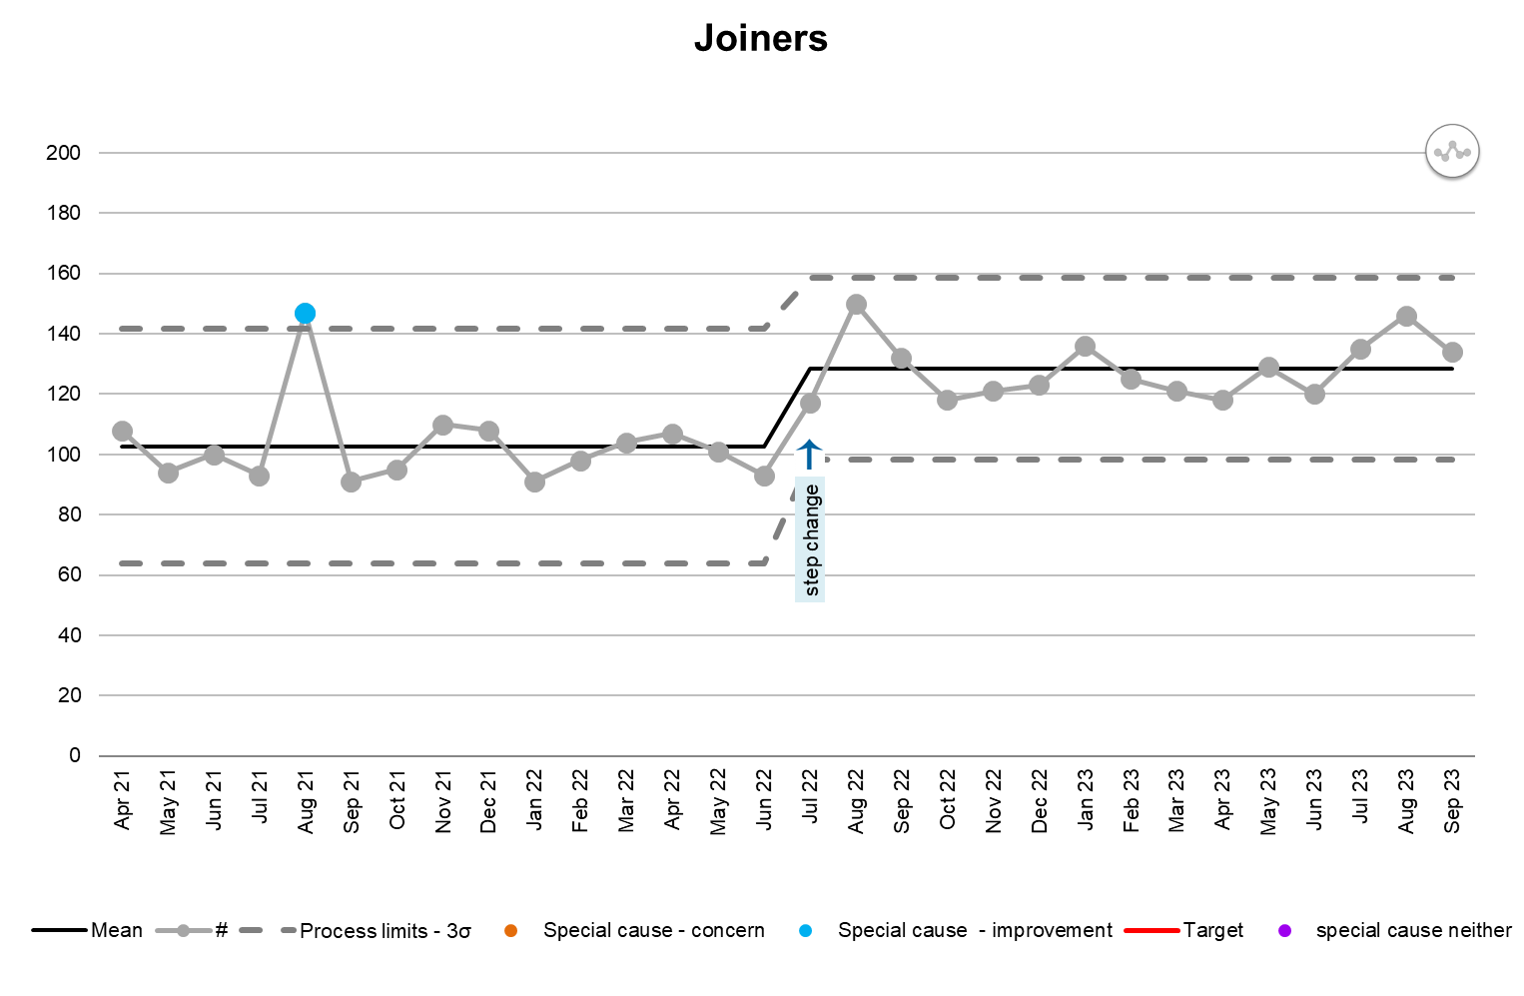
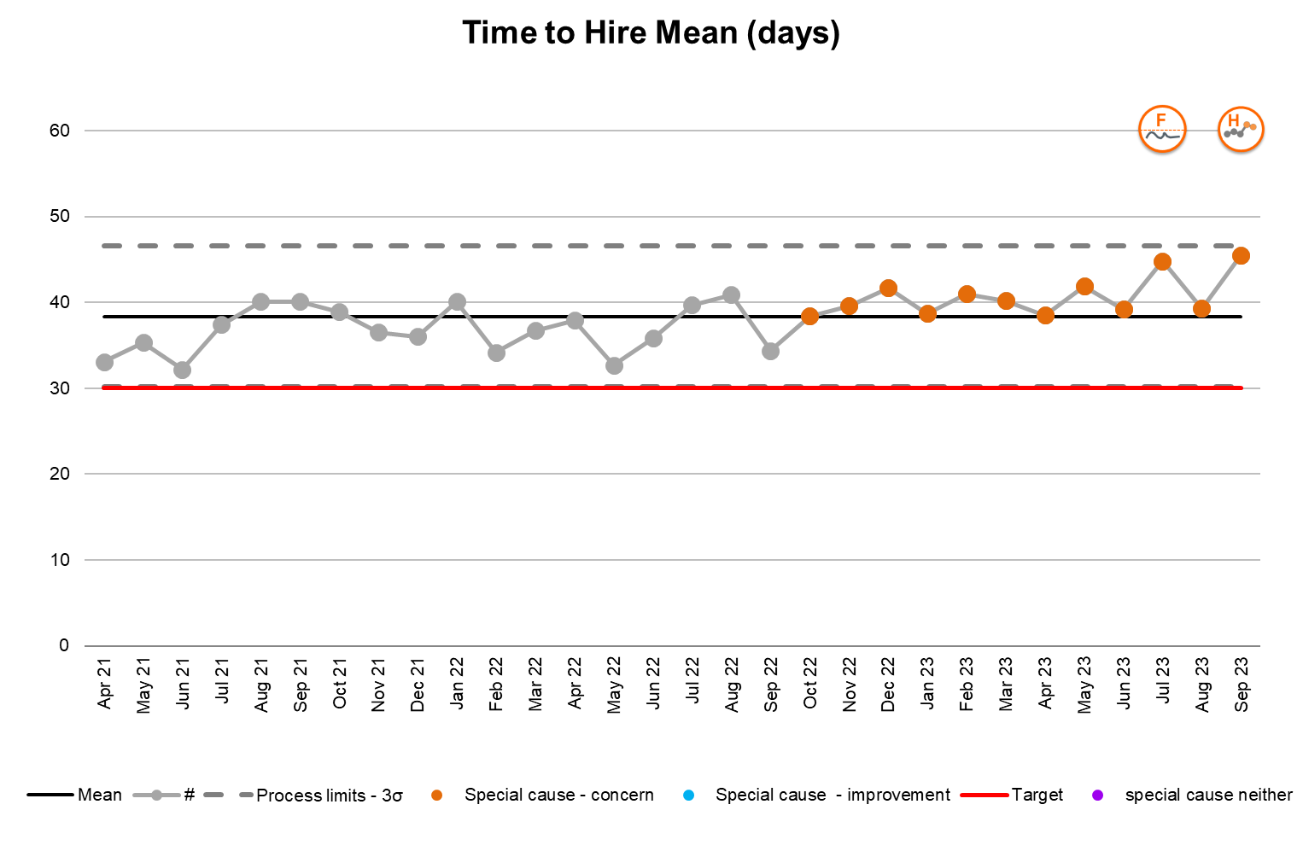
Our people : turnover and vacancies
Understanding the performance
There has been a reduction in staff turnover since April 2023. Current performance is 1.4% against a target of 1% so further work is necessary for the target to be achieved. The trust has the 4th highest rate compared to regional peers (best performance is 0.84%). There has been a significant and sustained increase in new joiners. Process limits have therefore been recalculated. There has been an associated decline in time to hire times as the Recruitment Team has been unable to process the necessary paperwork as quickly. The target cannot be achieved.
Actions (SMART)
The People Committee have tasked the workforce intelligence team to provide a further breakdown of data for all three measures. They will be considering this at the next committee meeting and provide any items for escalation to the November board. Process mapping is scheduled for mid October with the intention of implementing improved processes to reduce the time to hire time. It is hoped that improvement will be evidenced in the data by December.
Risks
None requiring consideration by the board.

Slide 22
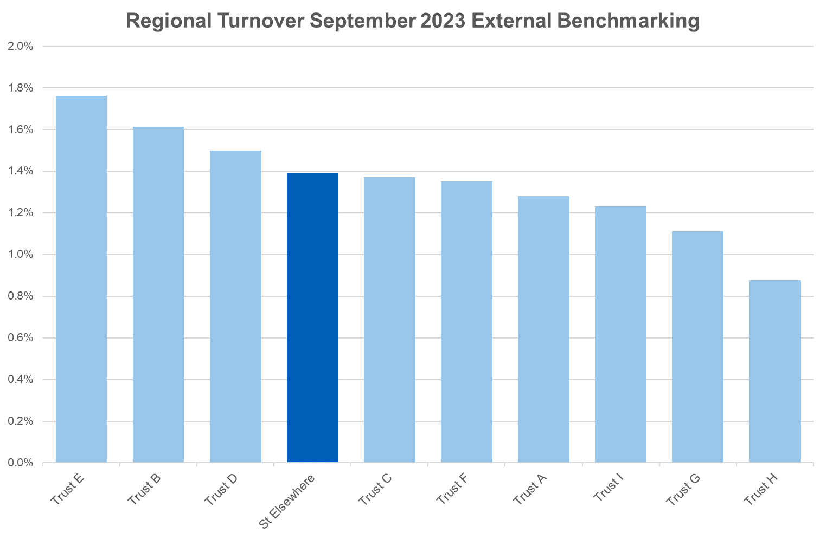
Our people : turnover regional benchmarking
Narrative
Trust performance has improved over the past 12 months when we had the highest turnover rate in the region. The Director of People will be implementing a range of additions over the coming year with the intention of improving this position further. The workforce intelligence team will provide an updated position to board quarterly.
Low is Good

Slide 23
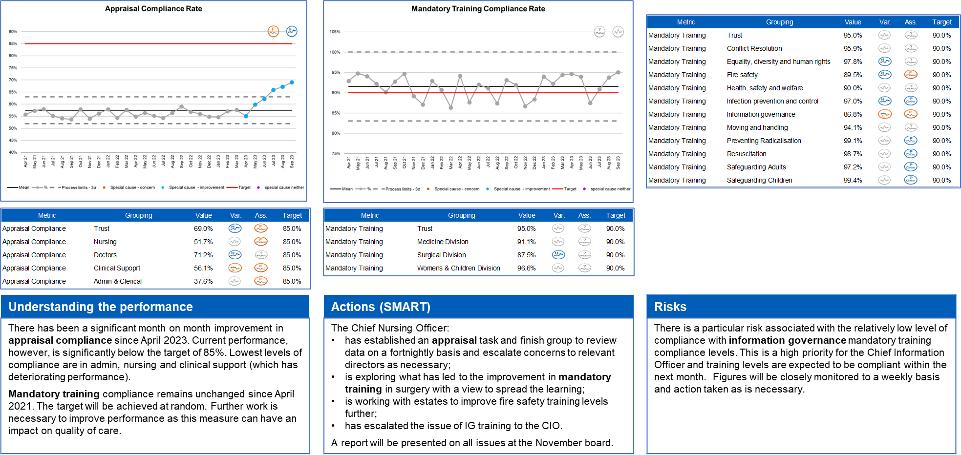
Our people : training and appraisal

Slide 24
Metric glossary and definitions
Metric | Improvement Direction | Definition | Methodology / Exclusions | Data Source
Number of WTE | Up
Registered nurse fill rate | Up
% Agency rate | Down
% BAME Staff in Post | Neither
% Trust staff who are declared disabled | Neither
% Sickness / absence in month | Down
% Long term sickness / absence | Down
Days lost per WTE mean | Down
% Turnover in month | Down
Number of leavers in month | Down
Number of joiners in month | Up
Time to hire in days mean | Down
% Vacancy in month | Down
% Appraisal compliance | Up
% Mandatory training compliance | Up
For local agreement and completion

Slide 25












Links to SPC based IPR documents
Here are some examples of IPR reports which utilise the components described within this document. Click on the logo to access each report
Notes:
Plain slide with subhead and bullets

