Slide 1

E-Fresh : Food Freshness Detector
Under the Guidance of
Dr . Suresh Dara , Professor
Department of Computer Science & Engineering
B V Raju Institute of Technology, Narsapur
Presented by
Sawan Dasari : 17211a0558
CH.Abhinav Goud : 17211a0547
B.Srikar Raju : 17211a0534
D. Rama Raghava Raju : 17211a0556

Slide 2
Abstract
Abstract
Introduction
Existing System
Proposed System
Software/Hardware Requirements
Architecture Model
Modules
UML Diagrams/ER Diagrams/Flow Charts
References
The food we consumes provide nourishment and gives energy to our body, it gives us the ability to do daily activities and help improves our health in direct as well as indirect ways. A healthy and fresh diet is the most important way to keep ourselves fit. The food items kept at room temperature undergo rapid bacterial growth and chemical changes in food. Taking unhealthy food leads to bad health, and can cause different food borne diseases. The purpose to use biosensor and electrical sensors is to determine the freshness of food. A smart system which can detect the freshness of household food like dairy items, meat, and fruits. The identification and selection of pH sensor and Gas sensor to develop a smart food freshness detector ensures the freshness of food and tells whether to eat it or bin it. An android application is developed to select the type of food to be checked.
Keywords: Food Freshness; pH Sensor ; Gas Sensor; Arduino Uno

Slide 3
Abstract
Introduction
Existing System
Proposed System
Software/Hardware Requirements
Architecture Model
Modules
UML Diagrams/ER Diagrams/Flow Charts
References
Introduction
The food we consume can affect in any form of contamination that may occur due to storage or chemical changes within the food. There are several viruses and bacteria that causes food contamination and leads to numerous food borne diseases, for example Norovirus a very contagious virus caused by contaminated food or water. About 351,000 people die of food poisoning globally every year.It is necessary to develop a system that can help people to identify the freshness of food or quality of food items. Our proposed system may give the good quality (freshness) management in food. It is based on electrical, and biosensors. Biosensors play a vital role to detect the bacterial contamination in food sample. Based on the combination of the sensor outputs quality of the food should be detected.

Slide 4
Abstract
Introduction
Existing System
Proposed System
Software/Hardware Requirements
Architecture Model
Modules
UML Diagrams/ER Diagrams/Flow Charts
References
Existing System
The manual method includes checking fruits and food items by human force i-e by color checking and by smelling but food checking are expensive, time consuming, and less efficient due to human errors and environmental effects.
A device called Food Sniffer is developed to check the freshness and quality of meat items like Beef, Chicken, and Fish. This device is only for meat items there is no development done for diary and fruits items.
Using Gas sensors that can detect spoilage of food by detecting ammonia and hydrogen sulp1hide. On spoilage of the food the light indicator changes to indicate that food is spoiled.

Slide 5
Abstract
Introduction
Existing System
Proposed System
Software/Hardware Requirements
Architecture Model
Modules
UML Diagrams/ER Diagrams/Flow Charts
References
Proposed System
The objectives of this device is to make an electronic device integrated with biosensors that can detect food spoilage. The use sensors that can measure different parameters of food like pH, moisture, and ethanol level.The block diagram below shows the model of device. The device consists of a microcontroller Arduino Uno, Bluetooth module, electrical and bio sensor like pH sensor, moisture sensor, and gas sensor. The food to be checked is attached to the corresponding sensor and the user can input from Android mobile application, the selection of food item from application gives command to Arduino Uno with communicating through Bluetooth module. The microcontroller take readings from the sensor and decide result with a predefined algorithm. The result is in the form of “Good to use” and “Not good to use” depending upon the food freshness level. The output is shown on a LCD.

Slide 6

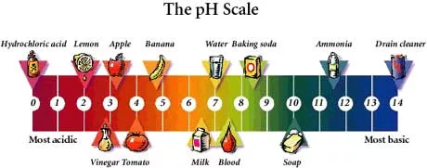
Abstract
Introduction
Existing System
Proposed System
Software/Hardware Requirements
Architecture Model
Modules
UML Diagrams/ER Diagrams/Flow Charts
References
Proposed System
FOR EXAMPLE :
Depending on the specific variety, the pH of apples may be between 3.2 and 4.0. Apples do contain acid -- which is reflected by this low pH .
Therefore, the apple is fresh when the pH value is in between 3.2 and 4.0. If the pH value is either higher- than 4.0 or less than 3.2 then it is not fresh.

Slide 7
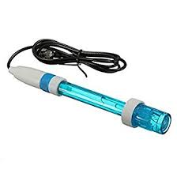
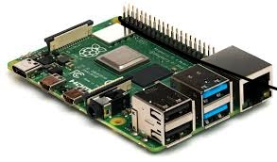
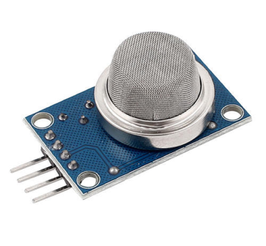
Abstract
Introduction
Existing System
Proposed System
Software/Hardware Requirements
Architecture Model
Modules
UML Diagrams/ER Diagrams/Flow Charts
References
Software/Hardware Requirements
SOFTWARE REQUIREMENTS :
Rasberry pi
C / C++
HARDWARE REQUIREMENTS :
pH sensor
Gas sensor
Rasberry pi
GAS SENSOR
PH SENSOR
RASBERRY PI
2/10

Slide 8
Architecture Model
Abstract
Introduction
Existing System
Proposed System
Software/Hardware Requirements
Architecture Model
Modules
UML Diagrams/ER Diagrams/Flow Charts
References

Slide 9
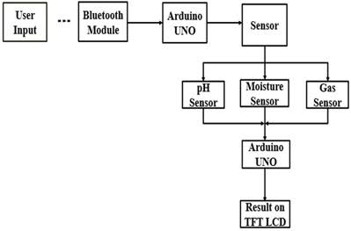
Modules
Abstract
Introduction
Existing System
Proposed System
Software/Hardware Requirements
Architecture Model
Modules
UML Diagrams/ER Diagrams/Flow Charts
References

Slide 10
UML Diagrams/ER Diagrams/Flow Charts
Abstract
Introduction
Existing System
Proposed System
Software/Hardware Requirements
Architecture Model
Modules
UML Diagrams/ER Diagrams/Flow Charts
References

Slide 11
Abstract
Introduction
Existing System
Proposed System
Software/Hardware Requirements
Architecture Model
Modules
UML Diagrams/ER Diagrams/Flow Charts
References
References
"Norovirus food poisoning", Foodborneillness.com,2018.[Online]. Available:http://www.foodborneillness.com/norovirus_food_poisonin g/. [Accessed: 28- Jun- 2018].
2. "http://time.com", Time, 2018. [Online]. Available: http://time.com/3768003/351000-people-die-of-food-poisoningglobally-every-year/. [Accessed: 28- Jun- 2018].
3. M. Omid, M. Khojastehnazhand, A. Tabatabaeefar, “Estimating volume and mass of fruit by image processing technique”, Volume 100, Issue 2, September 2010
4. J.W. Gardner, P.N. Bartlett, "A brief history of electronic noses ," Sens. & Actuators B 18–19 (1994) 211–220
5. US, "FOODsniffer", Myfoodsniffer.com, 2018. [Online]. Available: http://www.myfoodsniffer.com. [Accessed: 25- Jun- 2018].

Slide 12
Q and A?
?
THANK YOU

