Slide 1
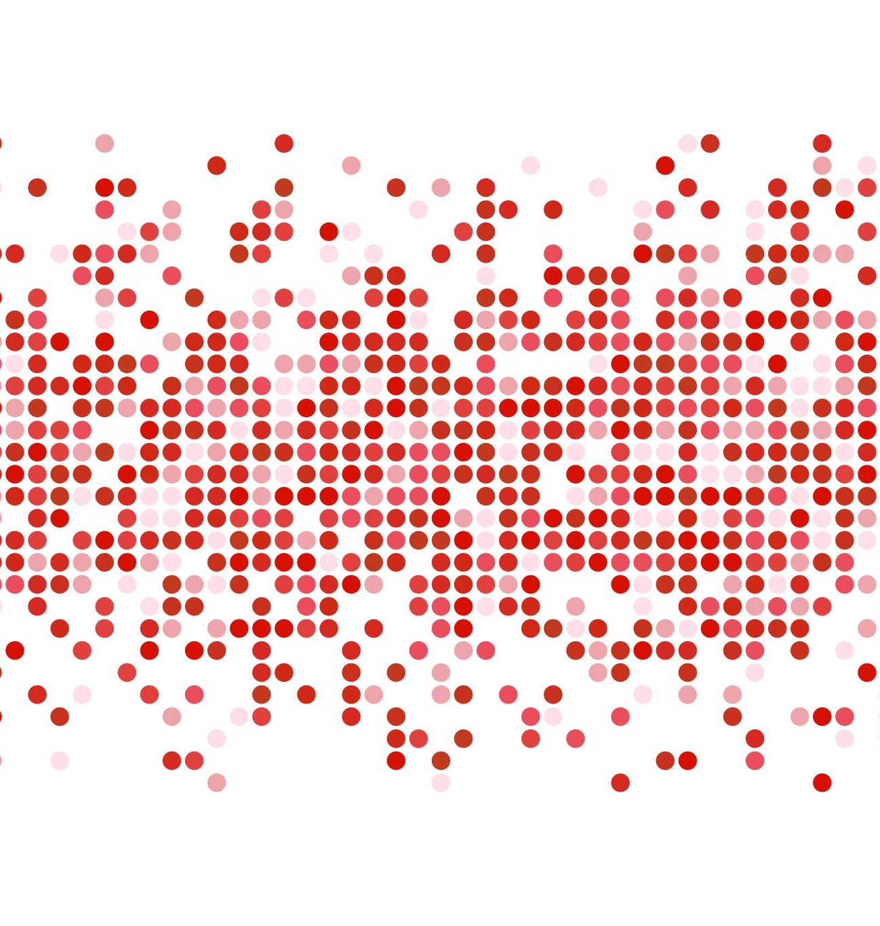
University of Trento Next Generation Networks Import and analyze online networking datasets
Ettore Saggiorato
Stiven Sharra
Prof. Fabrizio Granelli
Repository

Slide 2
GOAL
Build a software for automated processing and visualization of extracted information from online datasets
Build a Software for distinction of drones according to RCS measurments

Slide 3
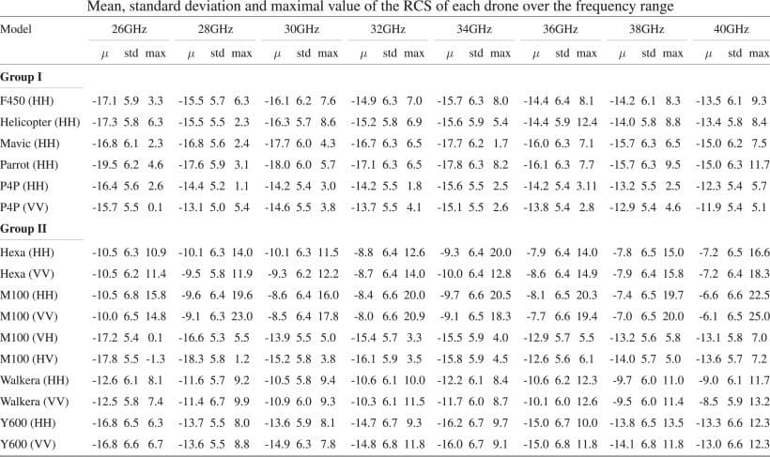
TABLE 2

Slide 4
INDICE

Slide 5
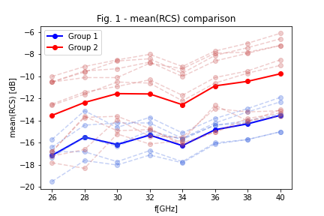
mean(RCS) comparison
mean(RCS) of group I and II are significantly different
mean(RCS) it grows increasing frequency, but it does not depend on the group or single drone
Therefore, it is not necessary to use ALL the frequencies in the statistical model, and we can limit ourselves to a few (see table 2 of the paper)

Slide 6
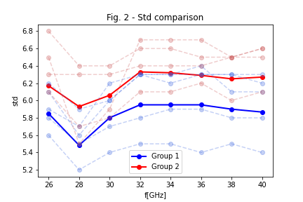
Std comparison
The Std does not depend on the drone or on the frequency
difference of an order of magnitude
we don't use it in the statistical model

Slide 7
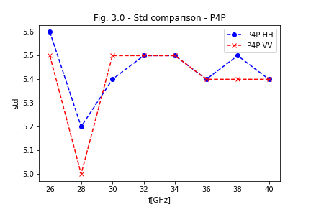
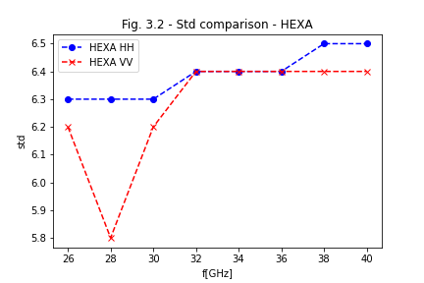
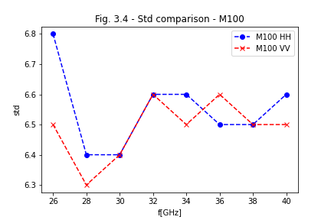
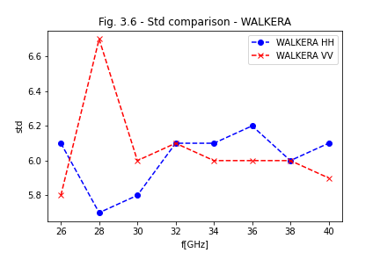
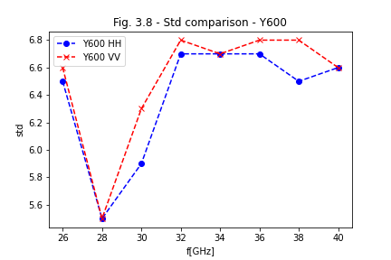
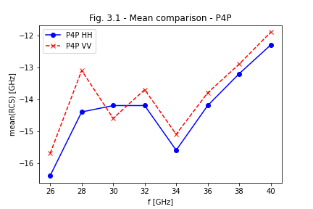
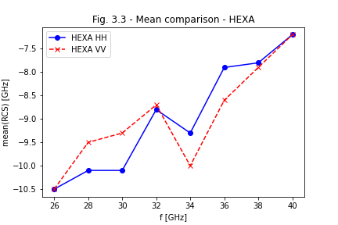
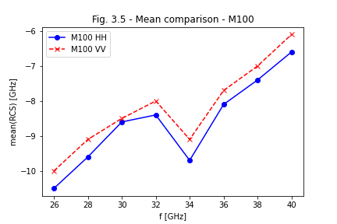
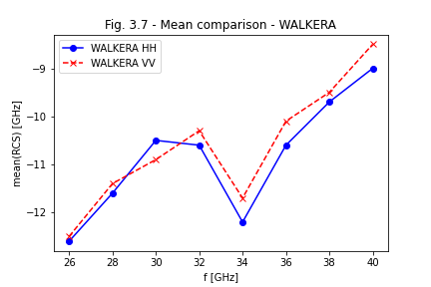
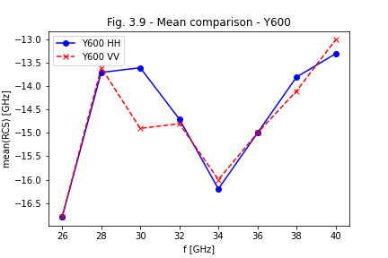
HH – VV comparison

Slide 8
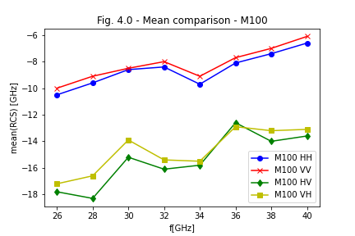
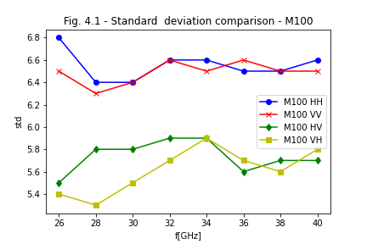
Cross - polarization
HV cross-polarizations give small RCS compared to HH and VV, mean and std are smaller.
HV’s std is offset from that of HH,
we don't use HV.

Slide 9
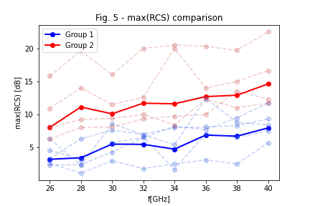
max(RCS) comparison
max(RCS) is used to distinguish groups and/or single drones

Slide 10
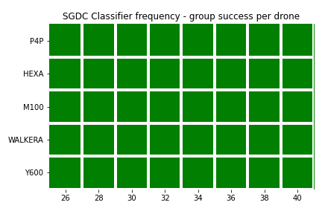
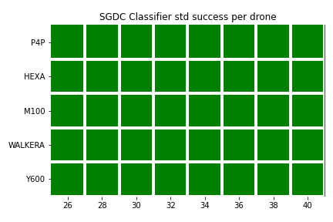
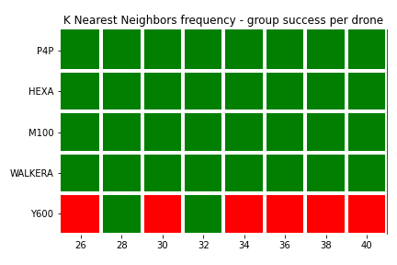
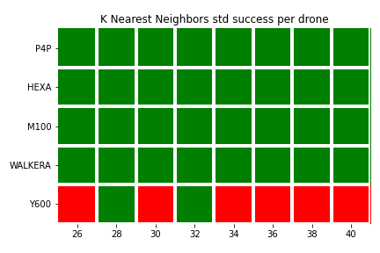
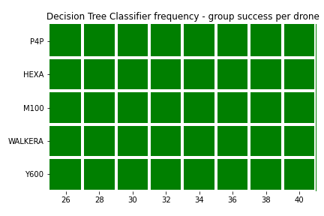
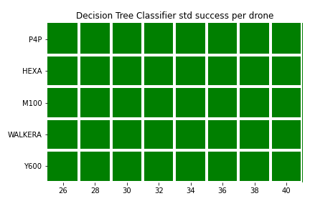
Classifiers - Groups
The std has very little influence on the results, so it can be excluded
 | NO Std |  | Std
 | HH | VV | HH | VV
SGDC | 1,0 | 1,0 | 1,0 | 1,0
KNN | 0,9 | 0,85 | 0,9 | 0,85
DTC | 1,0 | 1,0 | 1,0 | 1,0

Slide 11
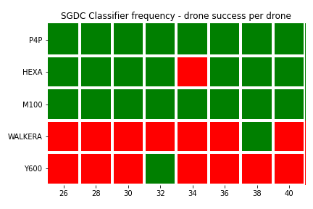
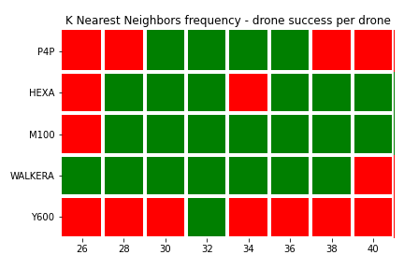
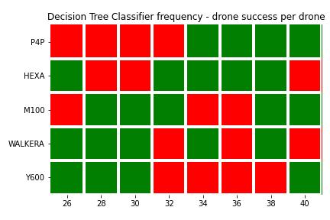
Classifiers - Drones
Score(HH): 0.55
Score(VV): 0.625
Score(HH): 0.48
Score(VV): 0.625
Score(HH): 1.0
Score(VV): 0.575

Slide 12
University of Trento Next Generation Networks Import and analyze online networking datasets
Ettore Saggiorato
Stiven Sharra
Prof. Fabrizio Granelli
Repository

