Slide 1

12C Remediator Tool
Topics covered in this session:
Tool Description
Benefits of using this tool
Working of the tool
Future Developments Planned

Slide 2
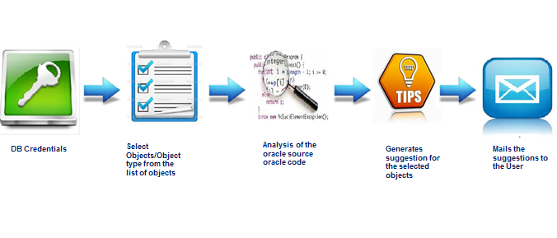
Tool Description
The tool generates a report containing the line number and portion of the code that can be enhanced. Currently the application can find enhancements in the code if the code is migrated from an older version of Oracle (Oracle 10g/11g) to a newer Oracle version (Oracle-12c)

Slide 3

Benefits of using this tool
Performance Improvement of the code
Removal of Depreciated Keyword
Effort Reduction in migrating the code to 12C version
Lets say a database schema has 100 objects and each object takes 30 mins for code analysis.
Also we assume that a database has 5 schemas.
Time Saving per database
Description | Hours | Resources | Cost | Currency
Total hours per database | 250 | 1 | 6750 | USD
Total hours per database by Using this tool | 5 | 1 | 135 | USD
Cost @Time saving By tool | 1.45 | 3 | 6615 | USD
Cost & Time Saving per Schema
Description | Hours | Resources | Cost | Currency
Average man Hrs | 50 | 1 | 1350 | USD
Average man Hrs by using this tool | 1 | 1 | 27 | USD
Cost @Time saving By tool | 49 | 1 | 1323 | USD
Cost Saving in a Project
Description | Cost(USD) | Resource
Cost of project for support | 6750 | 1
Cost Saving by this tool | 6615 | 1

Slide 4

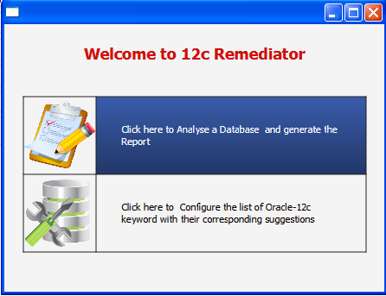
Working of the Tool
Loading & Home Screen

Slide 5
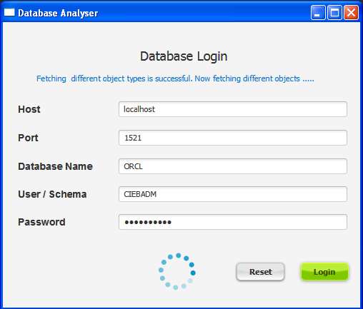
Database Login Screen

Slide 6
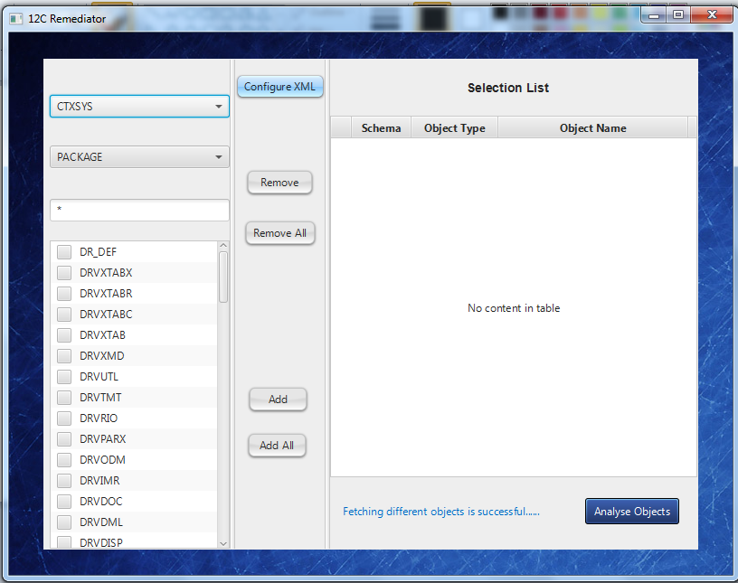
Home page Screen

Slide 7
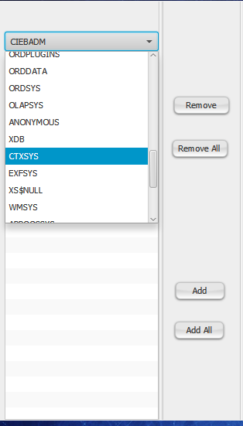
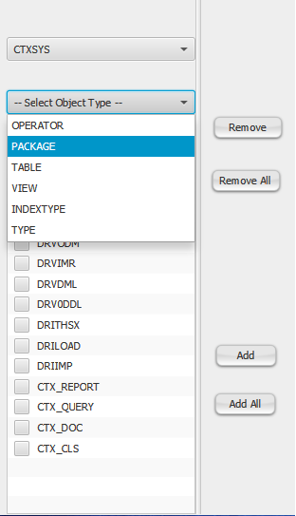
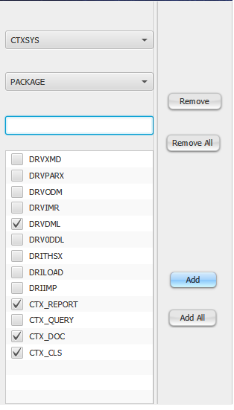
Selecting Schema Selecting Object Type Selecting Objects

Slide 8
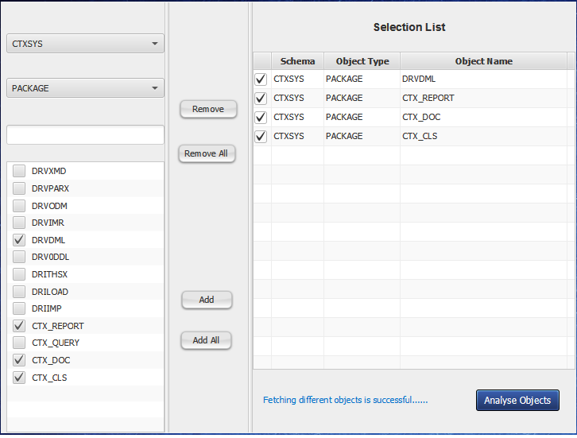
Adding the objects to the Analysis Table

Slide 9
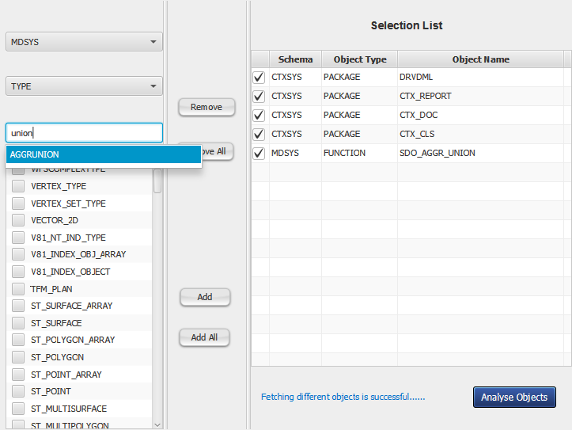
Benefits of Auto-Suggestion when the object list is big

Slide 10
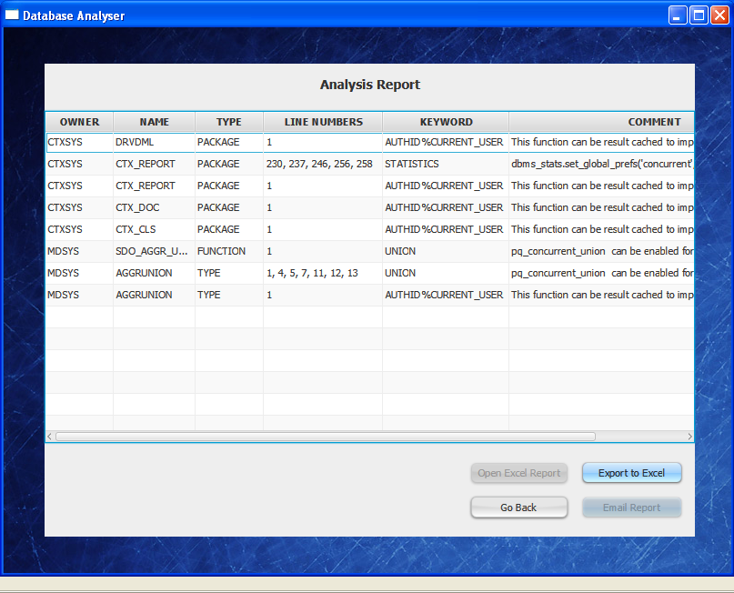
Analysis Report of the Selected Objects

Slide 11
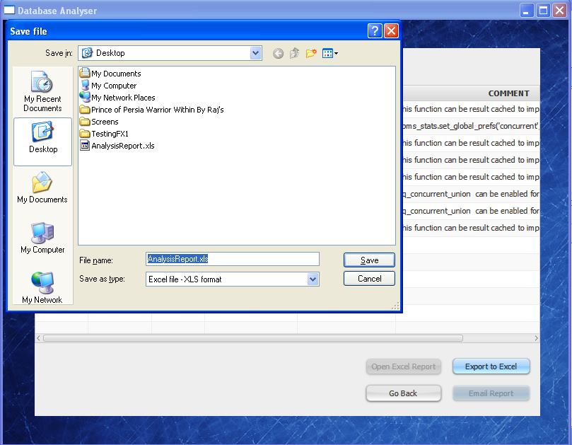
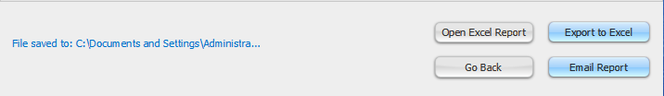
Generating Excel Report

Slide 12
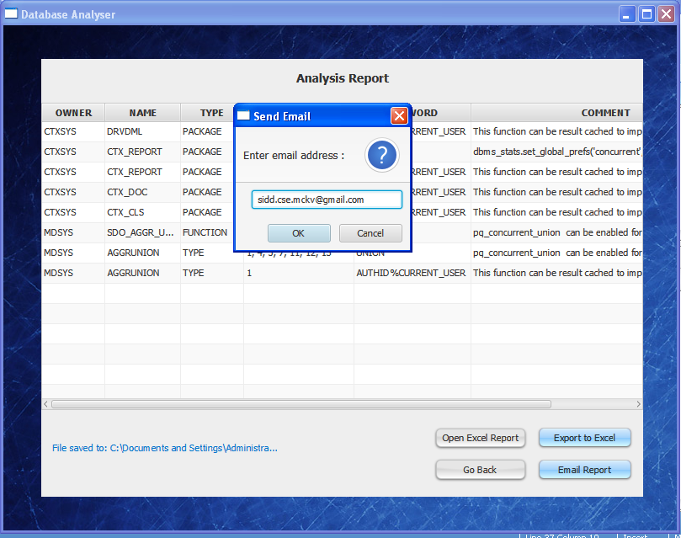
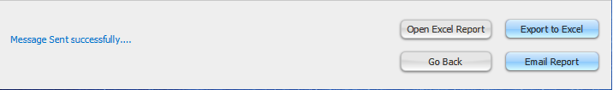
Sending the Analysis Report by Email

Slide 13
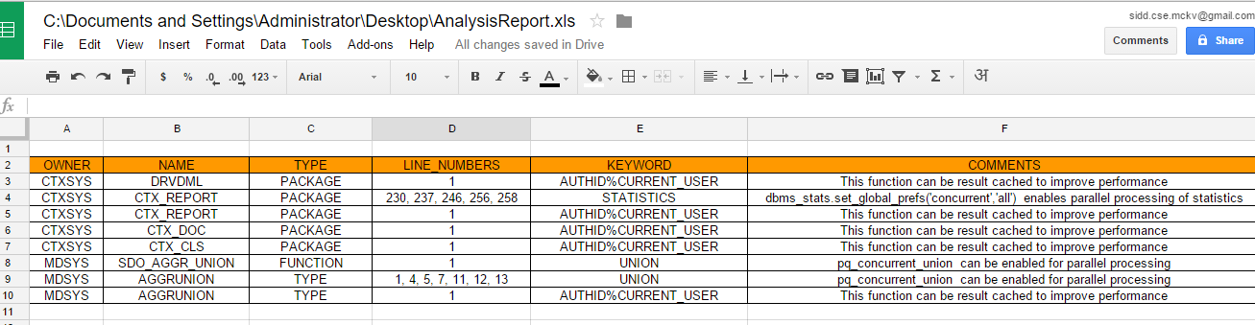
Analysis Report opened through Gmail

Slide 14
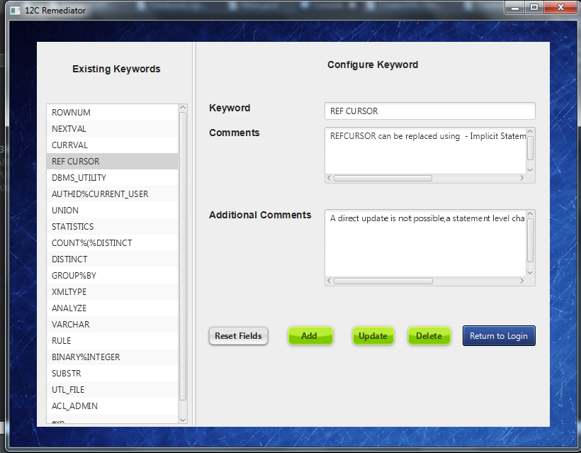
Configure Keywords Screen

Slide 15
Future Development Plans
Added support for Database like Microsoft SQL Server and IBM DB2
Automatic code conversion to Oracle 12C
Provision to compare Database Objects
Provide the Performance improvement summary directly of a Oracle 12C converted code

Slide 16

Thank you for your patience !!
Any questions ?
Notes:
In Slide Show mode, click the arrow to enter the PowerPoint Getting Started Center.

