Slide 1


WaLLe: Final Project AAMR
Sahil Arora
32953

Slide 2
Rough work
General intro in 2 lines
360 rotation
most profitable target
if stuck then see where is space and move there
retry for 4 times
at end of program go home

Slide 3
How is Everything Working ?
Uses a Navigation Stack with /move_base, /amcl, /map_server nodes.
Target points are published to /goal_publisher.
WallE uses /amcl_pose to get position and orientation.
Targets are sequentially published to move_base_action_client:
It computes Global and Local Path.
Publishes to velocity commands to /cmd_vel.
Local mapping checks for real-time obstacle range with provided sensors.

Slide 4
360° Rotation on start-up
WallE need to fully know its current positions before it starts for a target.
Calls a function to rotate 360° degree in 10 seconds --> Converged particle cloud.
Why: If this is not done it poses problem when robot is spawned very near to a goal point.

Slide 5
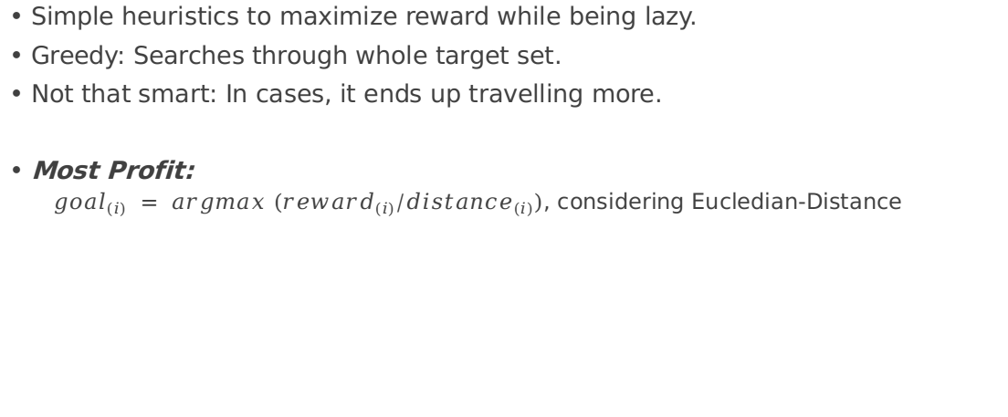
Where to go first?
Simple heuristics to maximize reward while being lazy.
Greedy: Searches through whole target set.
Not that smart: In cases, it ends up travelling more.
Most Profit:
${goal}_{(i)} = argmax ({reward}_{(i)}/{distance}_{(i)})$, considering Eucledian-Distance

Slide 6
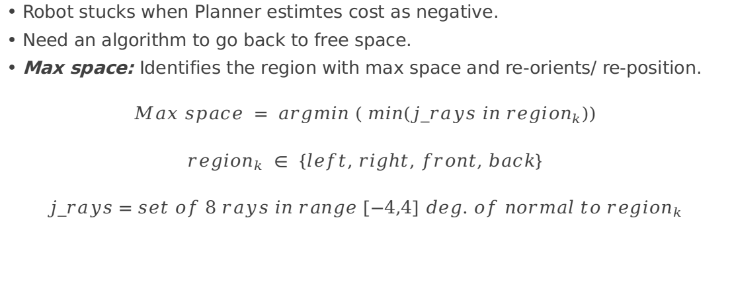
If I am stuck due to Planning inconsistency ?
Robot stucks when Planner estimtes cost as negative.
Need an algorithm to go back to free space.
Max space: Identifies the region with max space and re-orients/ re-position.
$$Max space = argmin ( min(j_rays in {region}_{k}))$$
$${region}_{k} ∈ \left\{left, right, front, back\right\}$$
$$j_rays=set of 8 rays in range [−4,4] deg. of normal to {region}_{k}$$

Slide 7
What if I am unable to reach the target ?
Keeps a time window of 10 seconds and checks displacement after the time interval.
if displacement < threshold, then append goal to later_goal
It may be because another robot was standing at goal.
Or due to inability of path planning.
After all points from all_target list are tried then goals from later_goal are retried at max 4 times.

Slide 8
Go home if tired !
After retry algorithm, Walle doesn‘t intend to block path for others.
It drives to origin(0,0) and asks:

