Slide 1
Caching and Concurrency
Alt-Tab W25: Sat Arora

Slide 2
Introduction
4A Computer Science
Past Experience: Product Backend @ Ramp, Infrastructure @ Matroid
Current Interests: Programming Performance, Running, Guitar

Slide 3
What is Concurrency?
“Concurrency means multiple computations are happening at the same time.”
Applications:
Multiple computers in a network
Multiple applications in one computer
Multiple processors in a computer
Without concurrency, your computer would wait for every operation. It’s thus essential for both performance and responsiveness.

Slide 4
Concurrency from the CPU
Thread: A unit of execution within a process.
Core: Runs one or more threads – an individual processing unit on a CPU chip.
Context Switching (key to concurrency!): Swapping out one thread for another to execute on the core.
Shared memory: Exists between multiple threads, also exists between multiple cores.

Slide 5

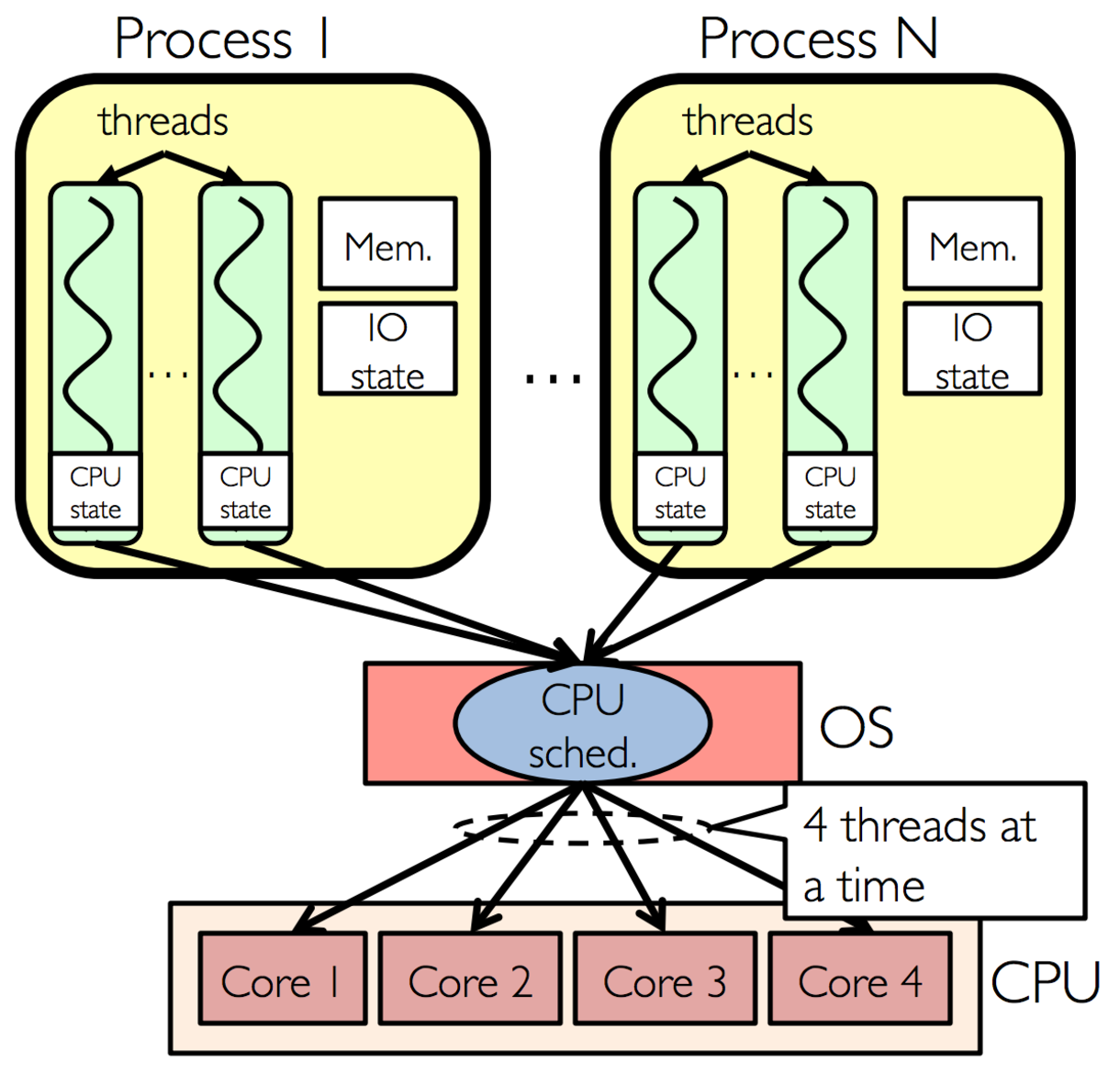
A diagram
Source: this medium article
The scheduler manages how threads from different processes are allocated and executed across the available cores

Slide 6
Concurrency is hard
Code is non-deterministic.
Example: Get 2 threads to increment the result of a counter
Issues with accessing critical sections.
Sections of code that only one thread should have access to at a time.
Deadlocking, race conditions, live lock, etc.
To make matters worse, ChatGPT isn’t that good at concurrent programs.

Slide 7

debugging concurrent code be like

Slide 8
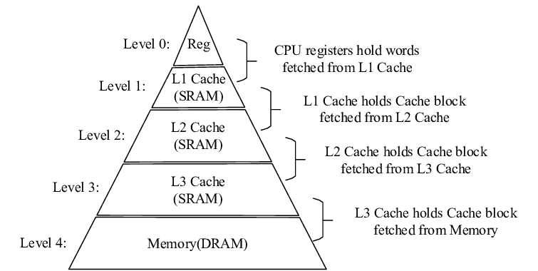
Cache
We have a fixed amount of cache. Wait, what is cache? Don’t confuse it with cash. I know they’re different because I’m running low on cash, but not cache.

Slide 9
What is caching?
Caching: The temporary storage of program data that have been previously used, that may need to be retrieved again shortly.
Controlled typically by the OS
Big advantage: Cache lives on the CPU, so access time is much faster than access time for memory (RAM), which is much faster than that of disk (SSD)
Typical Levels of cache: L1, L2, L3, Memory

Slide 10
Latencies of different cache layers
Layer | Approx. Latency | Relative Latency
L1 (private to each thread) | 0.5-1 ns | 1s
L2 (private to each core) | 3-10 ns | 5-20s
L3 (shared across all cores) | 10-20 ns | 40s
RAM | 100 ns | ~3 minutes
SSD | 50-150 µs | ~1.5 days

Slide 11
What can go wrong?
Typically, cache is divided into cache lines. If we need data, it tries to retrieve the entire cache line (it’s the smallest unit of transfer from memory)
If multiple variables live on the SAME cache line, and multiple threads try to write onto those cache lines, they invalidate it from other readers, causing a cache miss when the other thread tries to read/write to that cache line.
A cache miss means that the thread must reload the values from memory.
This is a phenomenon that we call false sharing.

Slide 12

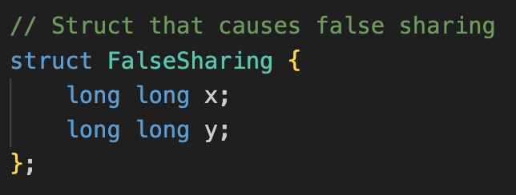
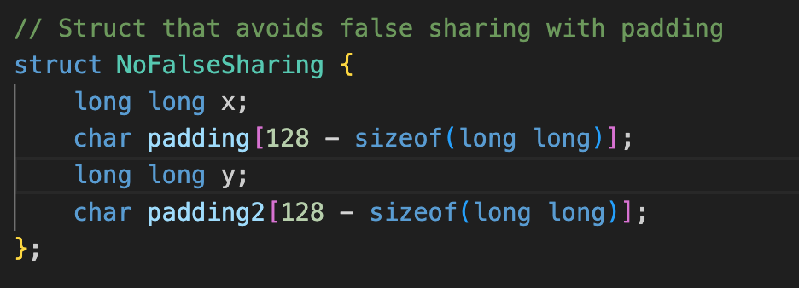
Sample Structures
An instance of the struct on top will put x and y on the same cache line.
Adding padding in between x and y will cause them to not be put on the same cache line.
What happens if we run a program on both of these? How do they compare?

Slide 13
Demo!
perf is a performance analysis tool that we can use to see how algorithms perform
perf stat is used for statistics, and can track certain events (specified by -e)
We want to look at statistics related to caching, and so our program is: perf stat -e cache-references,cache-misses [cmd]

Slide 14
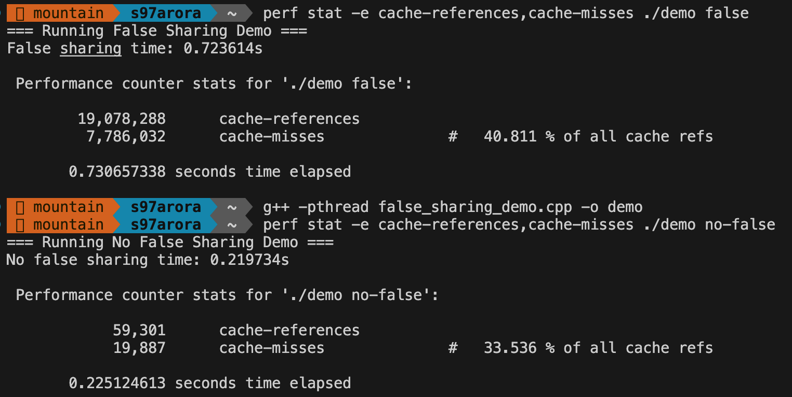
Results

Slide 15
What did we see?
By separating the cache lines that the two threads interact on, we allow them to always stay in their cache without getting booted off by the other thread.
This means that things that run in parallel should be on different cache lines?
Issues:
Padding takes more memory.
Threads that must share a variable will always have cache misses.
Depending on the mechanics of the machine that algorithms are being run on, you may not always see way less cache misses. An example of this is the adjacent line prefetcher.

Slide 16
Debrief
There’s a lot more to concurrency and caching than what we’ve discovered today – not everything is solved by just padding.
But, you hopefully have more of an idea with how small changes in how we write code can save a lot of CPU cycles, cache misses, etc.
The algorithms and possibilities for optimization are very specific to certain use cases, and are considered both when writing software and when designing hardware (Intel, AMD, etc.)

Slide 17
Recommended courses and Applications
CS 798: Advanced Research Topics [Multicore Programming]
Undergrads would have to override in…
CS 343: Concurrency
Graphics programming (CUDA) – relies heavily on parallel + concurrent execution
The Art of Multiprocessor Programming – a good book!
CS 350

