Slide 1



Data Security
Authorization

Slide 2
Access Control - Authorization

Slide 3
Gentle Reminder → Access Control
Two parts to access control
Authentication: Who goes there?
Determine whether access is allowed
Authenticate human to machine
Authenticate machine to machine
Authorization: Are you allowed to do that?
Once you have access, what can you do?
Enforces limits on actions
Note: Access control often used as synonym for authorization, but the right is both.

Slide 4
Authentication vs Authorization
Authentication ⎯ Who goes there?
Restrictions on who (or what) can access system
Authorization ⎯ Are you allowed to do that?
Restrictions on actions of authenticated users
Authorization is a form of access control
Authorization enforced by
Access control Matrix
Access Control Lists
Capabilities

Slide 5
Access control Matrix
This matrix contains all the relevant information needed by an operating system to make decisions about which users are allowed to do what with the various system resources.
UNIX-style notation, that is, x, r, and w stand for execute, read, and write privileges, respectively.
 | Objects
Subjects

Slide 6
Lampson’s Access Control Matrix
Subjects (users) index the rows
Objects (resources) index the columns
Accounting
program
Accounting
data
Insurance
data
Payroll
data
OS
rx | rx | r | --- | ---
rx | rx | r | rw | rw
rwx | rwx | r | rw | rw
rx | rx | rw | rw | rw
Bob
Alice
Sam
Accounting
program

Slide 7
Are You Allowed to Do That?
Access control matrix has all relevant info
But how to manage a large access control (AC) matrix?
Could be 1000’s of users, 1000’s of resources
Then AC matrix with 1,000,000’s of entries
Need to check this matrix before access to any resource is allowed
Hopelessly inefficient

Slide 8
Access Control Lists (ACLs)
ACL: store access control matrix by column
How can do what on this resource (subject).
Example: ACL for insurance data is in blue
Accounting
program
Accounting
data
Insurance
data
Payroll
data
OS
rx | rx | r | --- | ---
rx | rx | r | rw | rw
rwx | rwx | r | rw | rw
rx | rx | rw | rw | rw
Bob
Alice
Sam
Accounting
program

Slide 9
Capabilities (or C-Lists)
Store access control matrix by row
What can a specific user do.
Example: Capability for Alice is in red
Accounting
program
Accounting
data
Insurance
data
Payroll
data
OS
rx | rx | r | --- | ---
rx | rx | r | rw | rw
rwx | rwx | r | rw | rw
rx | rx | rw | rw | rw
Bob
Alice
Sam
Accounting
program

Slide 10
ACLs vs Capabilities
r
---
r
r
w
rw
Alice
file1
Alice
file1
w
r
---
---
r
r
Bob
file2
Bob
file2
rw
r
r
r
---
r
Fred
file3
Fred
file3
Access Control List
Capability
Note that arrows point in opposite directions!
With ACLs, still need to associate users to files

Slide 11
Confused Deputy
Two resources
Compiler and BILL file (billing info)
Compiler can write file BILL
Alice can invoke compiler with a debug filename
Alice not allowed to write to BILL
Access control matrix
Compiler
BILL
x | ---
rx | rw
Alice
Compiler

Slide 12
Confused Deputy
With ACLs, it's more difficult (but not impossible) to avoid the confused deputy.
In contrast, with capabilities it's relatively easy to prevent this problem, since capabilities are easily delegated, while ACLs are not.
In a capabilities-based system, when Alice invokes the compiler, she can simply give her C-list to the compiler.
The compiler then consults Alice's C-list when checking privileges before attempting to create the debug file.
Since Alice does not have the privilege to overwrite BILL, the situation in following Figure can be avoided.

Slide 13

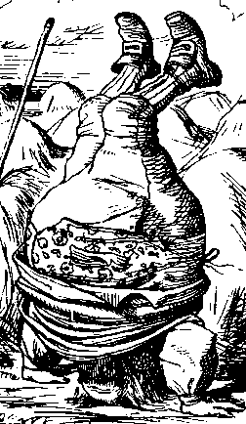
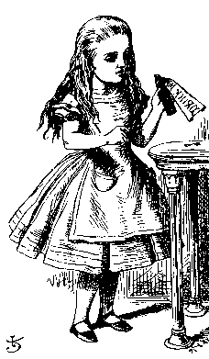
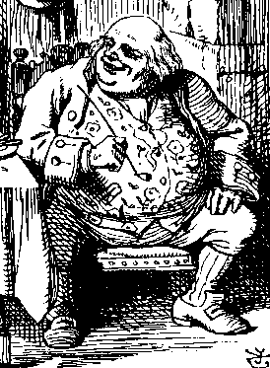
ACL’s and Confused Deputy
debug
BILL
filename BILL
Compiler
Alice
BILL
Compiler is deputy acting on behalf of Alice
Compiler is confused
Alice is not allowed to write BILL
Compiler has confused its rights with Alice’s

Slide 14
Confused Deputy
Compiler acting for Alice is confused
There has been a separation of authority from the purpose for which it is used
With ACLs, difficult to avoid this problem
With Capabilities, easier to prevent problem
Must maintain association between authority and intended purpose
Capabilities make it easy to delegate authority

Slide 15
ACLs vs Capabilities
ACLs
Good when users manage their own files
Protection is data-oriented
Easy to change rights to a resource
Capabilities
Easy to delegate
Easy to add/delete users
Easier to avoid the confused deputy
More difficult to implement

Slide 16
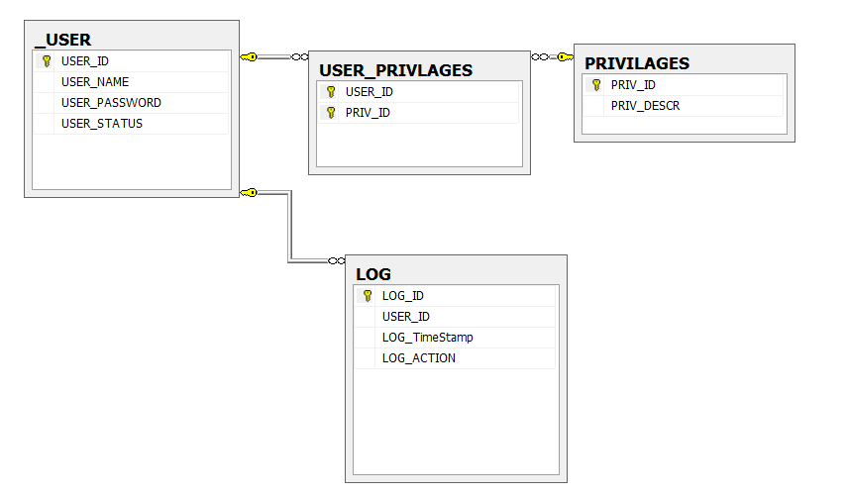
Implementing Privileges

Slide 17
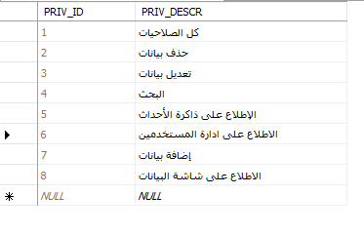
PRIVILAGES

Slide 18
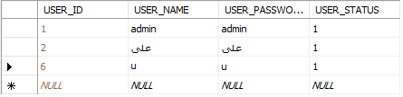
_user

Slide 19
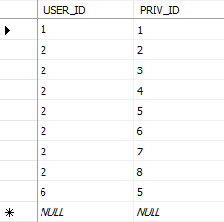
USER_PRIVLAGES

Slide 20
Can you obtain ACL and c-list from Database?

Slide 21
CAPTCHA

Slide 22
Turing Test
Proposed by Alan Turing in 1950
Human asks questions to one other human and one computer (without seeing either)
The goal is to distinguish the human from the computer
If human questioner cannot distinguish the human from the computer responder, the computer passes the test
No computer can pass this today

Slide 23
CAPTCHA
CAPTCHA ⎯ Completely Automated Public Turing test to tell Computers and Humans Apart
Automated ⎯ test is generated and scored by a computer program
Public ⎯ program and data are public
Turing test to tell… ⎯ humans can pass the test, but machines cannot pass the test
Why we need it ?

Slide 24
CAPTCHA Paradox
“…CAPTCHA is a program that can generate and grade tests that it itself cannot pass…”
“…much like some professors…” LOL
Paradox ⎯ computer creates and scores test that it cannot pass!
CAPTCHA used to restrict access to resources to humans (no computers)
CAPTCHA useful for access control

Slide 25
CAPTCHA Uses?
Original motivation: automated “bots” to vote for best CS school !!
Free email services ⎯ spammers used bots sign up for 1000’s of email accounts
CAPTCHA employed so only humans can get accts
Sites that do not want to be automatically indexed by search engines
HTML tag only says “please do not index me”
CAPTCHA would force human intervention

Slide 26
CAPTCHA: Rules of the Game
Must be easy for most humans to pass
Must be difficult or impossible for machines to pass
Desirable to have different CAPTCHAs in case some person cannot pass one type
Blind person could not pass visual test, etc.

Slide 27

Do CAPTCHAs Exist?
Test: Find 2 words in the following
Easy for most humans
Difficult for computers (OCR problem)

Slide 28
CAPTCHAs
Current types of CAPTCHAs
Visual
Like previous example
Many others
Audio
Distorted words or music

Slide 29
CAPTCHA’s and AI
Computer recognition of distorted text is a challenging AI problem
But humans can solve this problem
Same is true of distorted sound
Humans also good at solving this
Hackers who break such a CAPTCHA have solved a hard AI problem
Putting hacker’s effort to good use!
May be other ways to defeat CAPTCHAs…

Slide 30
Beyond the 1950s: The Modern Context Is the Turing Test Still "Unpassable"?
The Reality Shift: While the original slide says "No computer can pass," modern Large Language Models (LLMs) have blurred this line.
The Goal Change: We are no longer asking "Can a machine talk?" but "Can a machine reason?"
Key Example: * Old AI (ELIZA): Could only parrot back phrases.
Modern AI: Can explain a complex SQL join or write a poem in the style of a specific author, making it nearly indistinguishable from a human in a chat.
Chatting to solve problems !!

Slide 31
Current Milestones (2024-2026) Passing the "Blind Test" in Everyday Life
Natural Conversations: AI now handles nuances like sarcasm, cultural slang, and emotional empathy.
Case Study: Google Duplex & Virtual Assistants
Example: An AI calling a hair salon to book an appointment. The receptionist doesn't realize they are talking to a bot because the AI adds "umms" and "ahhs" to sound human.
Professional Domains: AI passing Bar Exams (Law) and Medical Licensing Exams with scores higher than 90% of humans.

Slide 32
The Future: A New "Turing Test"? Headline: Moving Toward AGI (Artificial General Intelligence)
Visual & Physical Turing Test: Can a humanoid robot move and react in a crowded room without being identified as a machine?
The Multimodal Test:
Current AI: Can "see" an image, "hear" your voice, and "write" code simultaneously.
The Ultimate Question for Students:
If a machine helps you develop a system like "Dahab" or "Control Lite" from scratch, does it matter if it has a "soul" as long as the logic is flawless?

Slide 33

Firewalls

Slide 34


Firewalls
Internal
network
Internet
Firewall
Firewall must determine what to let into internal network and/or what to let out
Access control for the network

Slide 35
Firewall as Secretary
A firewall is like a secretary
To meet with an executive
First contact the secretary
Secretary decides if meeting is reasonable
Secretary filters out many requests
You want to meet chair of CS department?
Secretary does some filtering
You want to meet President of EGYPT?
Secretary does lots of filtering!

Slide 36
Firewall Terminology
No standard terminology
Types of firewalls
Packet filter ⎯ works at network layer
Stateful packet filter ⎯ transport layer
Application proxy ⎯ application layer
Personal firewall ⎯ for single user, home network, etc.

Slide 37
Packet Filter
Operates at network layer
Can filters based on
Source IP address
Destination IP address
Source Port
Destination Port
application
transport
network
link
physical

Slide 38
Packet Filter
Advantage
Speed
Disadvantages
No state
Cannot see TCP connections
Blind to application data
application
transport
network
link
physical

Slide 39
TCP ACK Scan
Attacker sends packet with ACK bit set, without prior 3-way handshake
Violates TCP/IP protocol
ACK packet pass thru packet filter firewall
Appears to be part of an ongoing connection
RST sent by recipient of such packet
Attacker scans for open ports thru firewall

Slide 40



TCP ACK Scan
ACK dest port 1207
ACK dest port 1208
ACK dest port 1209
Trudy
RST
Internal
Network
Packet
Filter
Attacker knows port 1209 open thru firewall
A stateful packet filter can prevent this (next)
Since ACK scans not part of established connections

Slide 41
Stateful Packet Filter
Adds state to packet filter
Operates at transport layer
Remembers TCP connections and flag bits
Can even remember UDP packets (e.g., DNS requests)
application
transport
network
link
physical

Slide 42
Stateful Packet Filter
application
transport
network
link
physical
Advantages
Can do everything a packet filter can do plus...
Keep track of ongoing connections
Disadvantages
Cannot see application data
Slower than packet filtering

Slide 43
Application Proxy
A proxy is something that acts on your behalf
Application proxy looks at incoming application data
Verifies that data is safe before letting it in
application
transport
network
link
physical

Slide 44
Application Proxy
Advantages
Complete view of connections and applications data
Filter bad data at application layer (viruses, Word macros)
Disadvantage
Speed
application
transport
network
link
physical

Slide 45
Application Proxy
Creates a new packet before sending it thru to internal network
Attacker must talk to proxy and convince it to forward message
Proxy has complete view of connection
Prevents some attacks stateful packet filter cannot

Slide 46
Personal Firewall
To protect one user or home network
Can use any of the methods
Packet filter
Stateful packet filter
Application proxy

Slide 47





Firewalls and Defense in Depth
Example security architecture
FTP server
WWW server
DNS server
Intranet with
Personal
Firewalls
Packet
Filter
Application
Proxy
Internet

Slide 48
Thank U

