Slide 1

Emerging Market Bond
VIX-Driven Trading Strategy
Can fear signals be a reliable predictor for EM bond price movements?

Slide 2
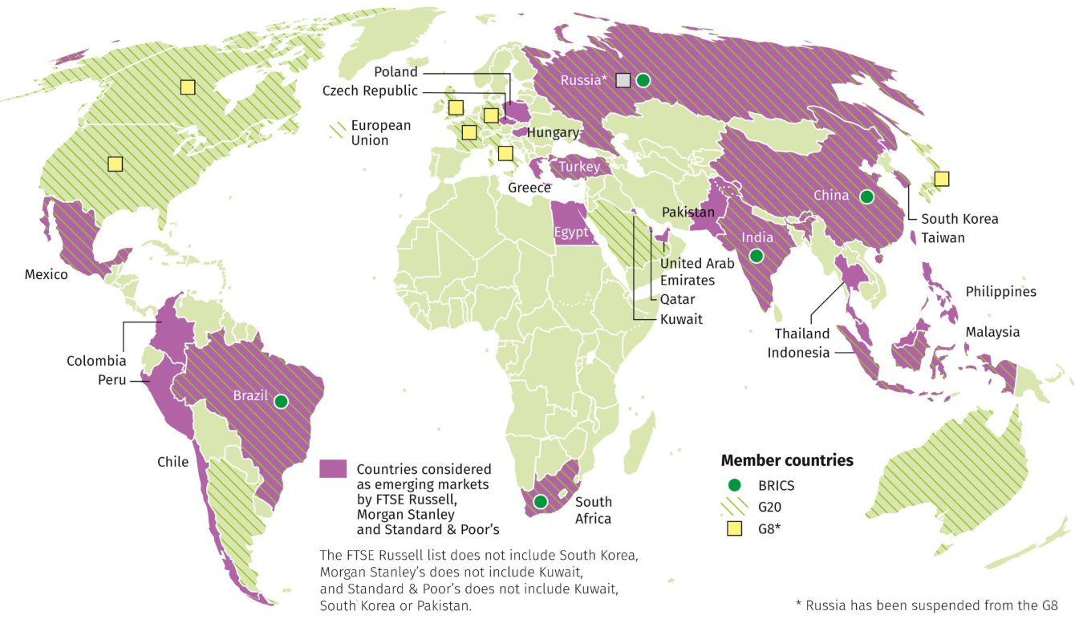
OVERVIEW
What Are Emerging Market Bonds
01
Bonds issued by less stable but developing countries like Turkey, Brazil, and Indonesia
02
Riskier than US Treasury bonds due to a variety of factors (political/economic/social)
03
We study the JP Morgan EMB Index: a fund that tracks a basket of EM bonds

Slide 3
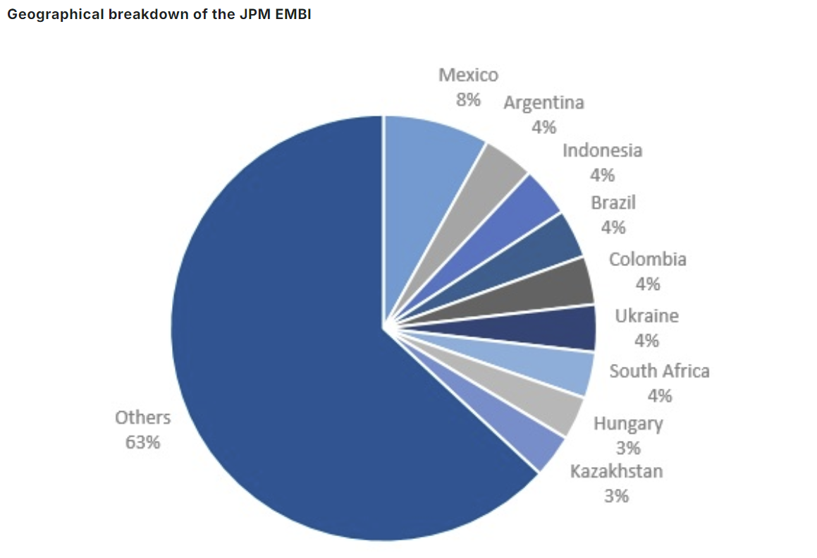
OVERVIEW
Composition: JPMorgan EMBI GD Index
The index provides exposure to liquid, US dollar-denominated emerging market sovereign debt.
The following graph shows some, but not all of the countries’ bonds that make up its portfolio.

Slide 4
OUR PITCH
Our Research Question
Can we predict when EM bonds recover after a flight-to-safety panic, and how can we profit from it?
We Tested 3 Fear Signals
We Tested 3 Models
Delta (Change in) VIX
Cboe Volatility Index tracks forward expectations of volatility in the US market
First Model - Delta VIX Only
We used a one-factor model with only continuous changes in VIX to predict EMB returns
Delta Credit Spreads
The credit spread index we used tracks the difference between US treasuries and BBB investment-grade US credit
Second Model - All 3 Signals
We used a three-factor model continuously trading on changes in oil prices, VIX, and credit spreads
Oil Prices
Crude oil futures track the price of oil
Third Model - VIX Threshold
Our last model only traded in discrete windows when the VIX spiked above certain level in order to filter for high-impact shocks

Slide 5
Model 1
Single Factor OLS

Slide 6
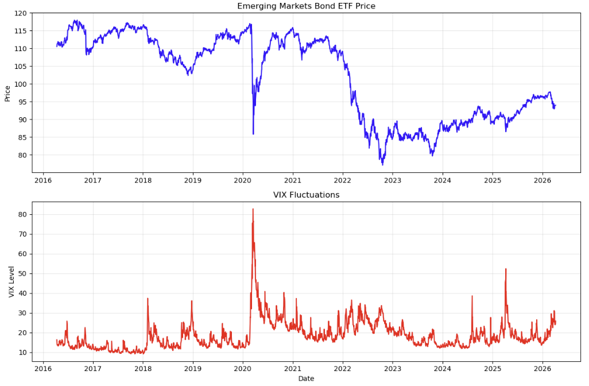
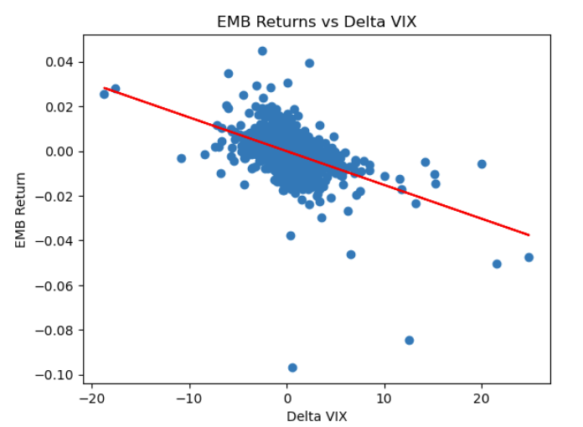
Model 1 - INTRO
Why Use VIX As Our Independent Variable

Slide 7
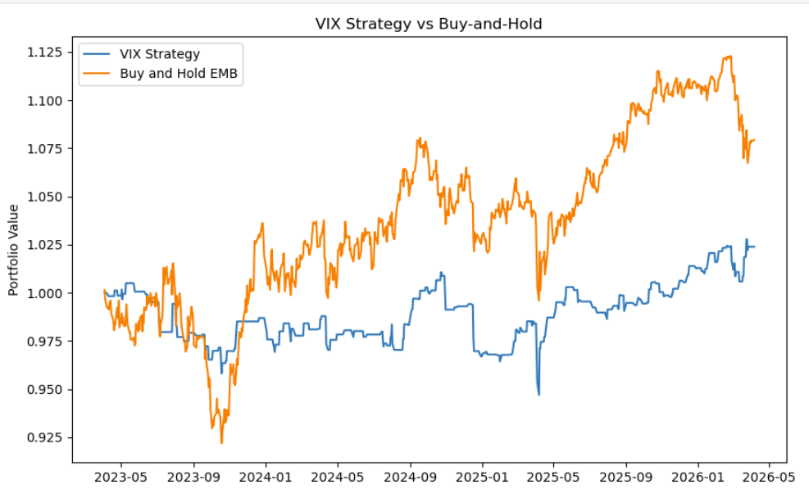
MODEL 1 - INTRO
Model 1: Setup & Results
ŷ = -0.0001 + 0.0003 · ΔVIX(t) + ε(t)
Methodology
Bivariate OLS regression: Δ VIX (today) → EMB return (tomorrow)
70% train / 30% test on daily data 2016–2026
Predicts t+1 returns — eliminates look-ahead bias
Strongest single predictor: ΔVIX (corr = −0.47 same day)
On the right, we tested this strategy versus a traditional buy-and-hold
Key Insight — Sign Reversal
Correlation is negative (−0.47) but regression coefficient is positive (+0.0003). Why? Correlation is same-day panic. Regression predicts next day — when fear subsides, prices bounce back.

Slide 8
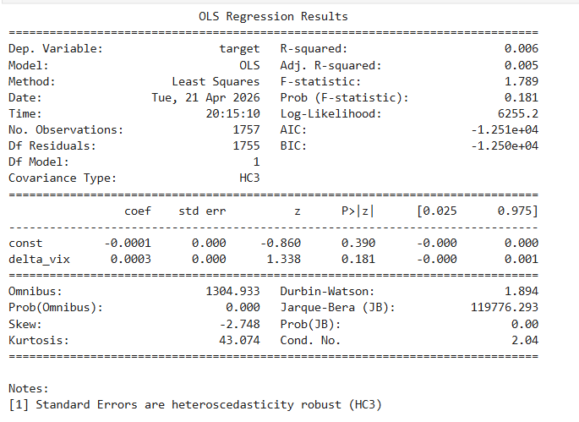
MODEL 1 - RESULTS
Model 1 (continued)
+0.0003
0.01
Δ VIX Coefficient
P-Value
-1.01%
0.013
Test R-Squared
Sharpe Ratio
Negative Test R² (-1.01%) is standard in financial return prediction because of high noise in daily EMB returns. The key finding is that Δ VIX is statistically significant and directionally correct for short-term reversals.

Slide 9
Model 2
All Three Signals

Slide 10

MODEL 2 - SELECTION
Why Also Use Oil or Δ Credit Spreads?
Δ Credit Spreads
Measures default probability and US investment climate.
Widening Spreads: Indicates increasing risk and worsening financial conditions.
Return Impact: Clear link between positive change in spreads (widening) and a reduction in EMB returns.
Oil Returns
Major commodity export for EMB nations.
Return Impact: Sudden spikes in oil may signify massive geopolitical volatility.
One Complication: Slow longer-term rises in the price may signify a stronger economy and currency for exporting countries.
By focusing on the delta (change) of these variables, we capture the momentum and shock factors essential for predicting short-term emerging market bond performance.

Slide 11
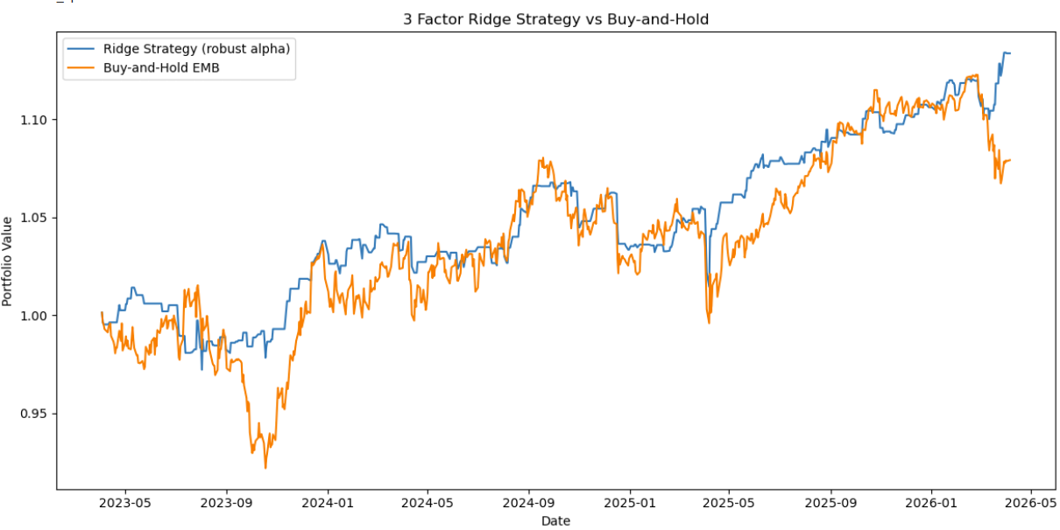
MODEL 2 - INTRO
Model 2: Setup & Results
Methodology
Using 3 factors to predict EMB Returns, and we have 2 choices: long (only invest today if predicting EMB return tomorrow is positive) or stay out (do nothing)
Corrected for heteroskedasticity by using HC3 (Heteroskedacity-Consistent standard errors type 3) - helps provide more reliable p-values by ensuring outliers don't make your p-values look smaller
The test R-Squared decreased from -0.0101 (for delta_vix only) to -0.0149 → this means the multivariate model became less accurate in predicting EMB returns
We plotted the cumulative returns of our strategy and compared it to a buy and hold strategy
Negative Test R² (-1.01%) is standard in financial return prediction because of high noise in daily EMB returns. The key finding is that Δ VIX is statistically significant and directionally correct for short-term reversals.

Slide 12
MODEL 2 - 3 FACTOR MODEL
Model 2: 3 Factor Model (Ridge)
3 Factor Model (Ridge) - Delta Vix, Delta Credit Spreads, & Oil Returns
0.000245
0.000512
Oil Return Coefficient
Delta VIX
Test R-Squared = -0.0149
Train R-Squared = 0.00749
Sharpe Ratio = 0.0562
0.000160
-0.000141
Delta Spread
Constant
Equation: ŷ = 0.000245 * (oil_return) + 0.000512 * (delta_vix) + 0.000160 * (delta_spread) - 0.000141

Slide 13
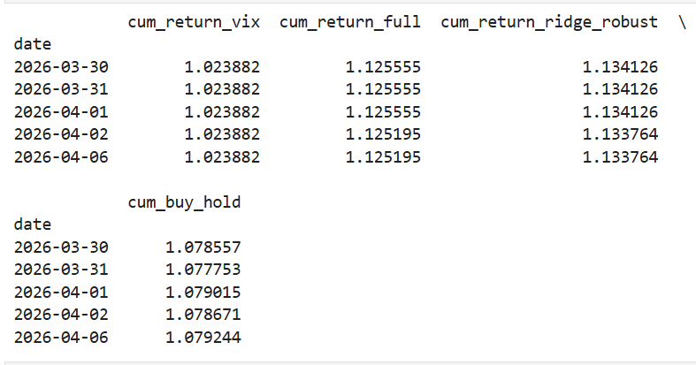
MODEL 2 - RESULTS
Ending returns comparing Model 1 and Model 2
All strategies started off with $1. The following table shows how much we end up with at the end of the 30% testing data period.
1 factor model (delta_vix only) → Portfolio value ≈ 1.024 → so 2.4% return
3 factor model (ridge) → Portfolio value ≈ 1.134 → so 13.4% return
Buy & Hold strategy → Portfolio value ≈ 1.079 → so 7.9% return

Slide 14
MODEL 2 - MULTI-FACTOR OLS
3-Factor Model
EMB Return_t+1 = α + β₁·ΔVIX_t + β₂·ΔSpread_t + β₃·Oil_Return_t + ε
What Improved
The Problem: Multicollinearity
Used HC3 heteroskedasticity correction for more reliable p-values
Strategy: go long tomorrow if predicted EMB return > 0, else stay out
Sharpe ratio: ~0.053 (model 3) vs 0.40–0.75 (model 2)
Δ VIX and Δ Credit Spread are 0.46 correlated — shared signal
Condition number = 84 (>30 = very high multicollinearity)
Result: none of the 3 predictors are individually significant
More variables did not improve prediction — double-counting noise
Fix: Ridge regression adds penalty term to shrink correlated predictors
Strategy vs Buy-and-Hold
3-factor strategy ends at 1.134× vs buy-and-hold at 1.08×
Sep 2023: strategy protected capital when buy-and-hold crashed
Strategy consistently hovers at or above buy-and-hold
Lesson: adding correlated predictors inflates the condition number and destroys individual significance, even when R² marginally improves.

Slide 15
DATA
Dataset & Feature Engineering
2016–2026
2,500+
33
70 / 30
Date Range
Daily Observations
Features Built
Train / Test Split
Variable | Constructed As | Role | Intuition
em_return (Y) | log(EMBt / EMBt-1) | Dependent variable | What we predict and trade
Δ VIX (X₁) | log(VIX_t) − log(VIX_t-1) × 100 | Primary predictor | Δ in levels; fear spike detector
Δ Credit Spread (X₂) | Spreadt − Spreadt-1 | Risk premium proxy | Δ in levels; increased risk off climate
Oil Return (X₃) | log(OIL_t / OIL_t-1) | Global risk appetite | Δ in levels; increased macro uncertainty
Returns used for prices (oil, EMB); first differences used for non-prices (VIX, spreads). Eliminates look-ahead bias by predicting t+1 returns using t predictors.

Slide 16
DATA - CORRELATIONS
How the Variables Move Together
On the SAME day: when fear spikes, investors panic-sell EMBs. This is a contemporaneous reaction, not a prediction.
Δ VIX vs EMB Return
−0.47 (Strong Negative)
Higher credit spreads = more market stress = investors dump risky EM bonds on the same day they see spreads widen.
Δ Credit Spread vs EMB
−0.35 (Moderate Negative)
Rising oil = healthy global economy = more risk appetite. But the relationship is noisy since geopolitical volatility increases prices.
Oil Return vs EMB Return
+0.24 (Weak Positive)
PROBLEM: Two of our predictors are highly correlated with each other; they explain the same variation in EMB returns.
Δ VIX vs Δ Credit Spread
+0.46 (⚠ Multicollinearity)
Important: correlations are same-day (time t) relationships which is good for understanding reactions, but NOT as good for predicting future returns.

Slide 17
Model 3
Threshold Analysis

Slide 18
MARKET CONTEXT
The Core Trade Thesis
Flight-to-Safety Thesis
VIX Spikes (top 20%)
▼
Mean-reversion trade: fear overshoots → prices snap back → we capture the bounce.
Since the VIX is noisy, we measure fear by examining statistically significant VIX spikes
Panic → Sell EM Bonds
▼
Prices Overshoot Downward
▼
Fear Subsides (~Day 74)
▼
Mean Reversion ↑ Profit

Slide 19

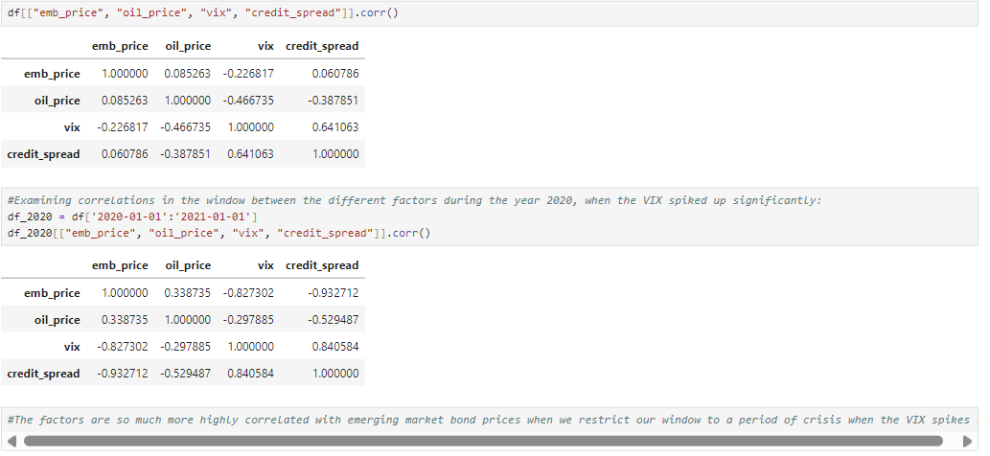
MODEL 3
Context for Our Model
Strategic Shift to VIX Spikes
Since the continuous trading models weren’t as successful as hoped, we thought that it could be better to only trade on large and significant VIX spikes, spikes that signify important shocks driven largely by macro.
Examining the two side-by-side correlation matrices, we see that when we only look at VIX spikes that are significantly above average, price movements in the ensuing 240 day windows are significantly more negatively correlated with VIX than before.
Logically, it seems that when the VIX spikes up, emerging markets must see their bond prices crash after bad news.
Correlation Matrix Across All Data
Correlation Matrix Across Restricted Data
Two Key Questions Remain:
In most periods with high instability, do bond prices bottom out and recover?
If there is a clear rebound, how do we time it?

Slide 20
MODEL 3 — EVENT THRESHOLD MODEL
Our Approach to Answering the 2 Questions
1
2
3
4
5
Detect VIX
Spikes
>80th pct
(140 raw)
Decluster VIX spikes
20-days between each other
(78 final spikes)
Track EMB
240 days
after each
spike
Map trough
& recovery
timing
patterns through stats
Build rule
from median
observed
patterns

Slide 21
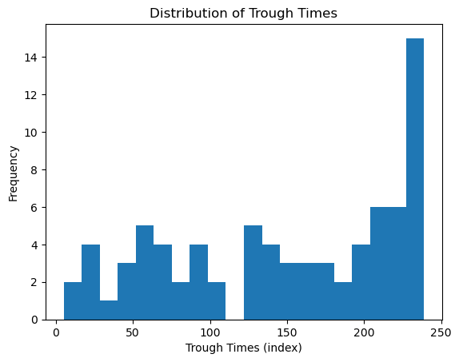
MODEL 3 — TROUGH TIMING
Question 1: Do Prices Bottom Out?
74 days
157 days
73.3 days
Median trough for fast news-driven declines
Median trough for all windows, fast and slow
Standard deviation of all trough times, fast and slow
Why do Trough Times Follow a Bimodal Distribution?
Fast clusters (40–100 days): Indicate sharp risk and news shocks (e.g. COVID, Aug 2024 carry unwind)
Slow clusters (180–240 days): Indicate structural shocks, which are prolonged rate cycles and harder to navigate
We should target FAST clusters, which requires at least a 5% drawdown by day 74
Days from VIX spike to EMB trough
Since the standard deviation of faster troughs is 40 days, we cannot predict the exact trough day. Our strategy uses a fixed 74-day entry as a disciplined rule rather than chasing the bottom.

Slide 22
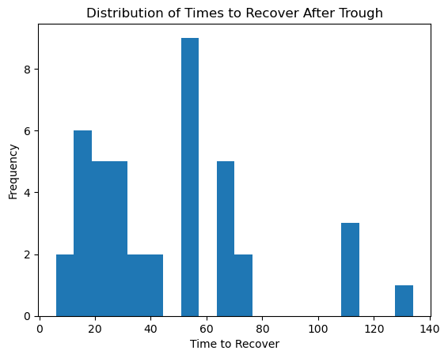
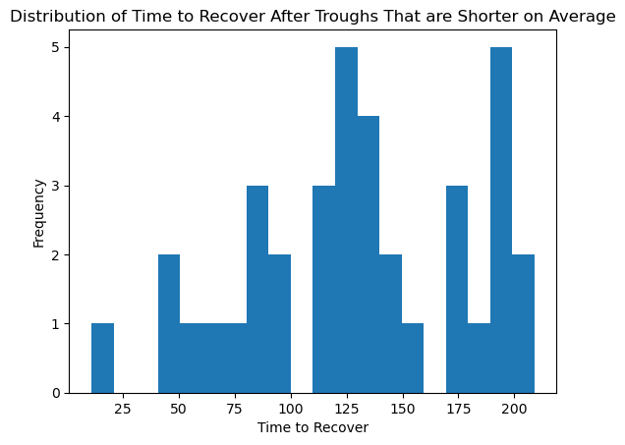
MODEL 3 — RECOVERY TIMING
Question 2: How Quickly Do Prices Bounce Back?
This measures all 42 recovering events
Sample of Fast-trough only (trough < day 150)
42 / 78
46%
128 days
37/39
Events recover meaningfully, when we analyze all troughs
Events that never recovered
Median: trough → recovery
(Only for short-term troughs)
Short-term events that Recover Meaningfully

Slide 23
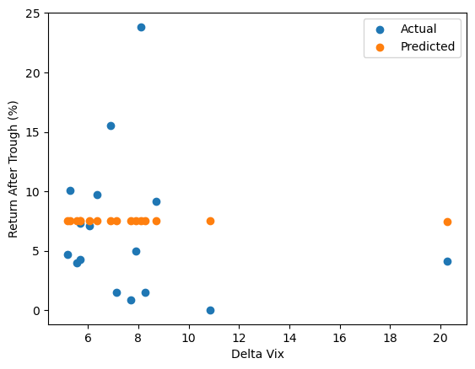
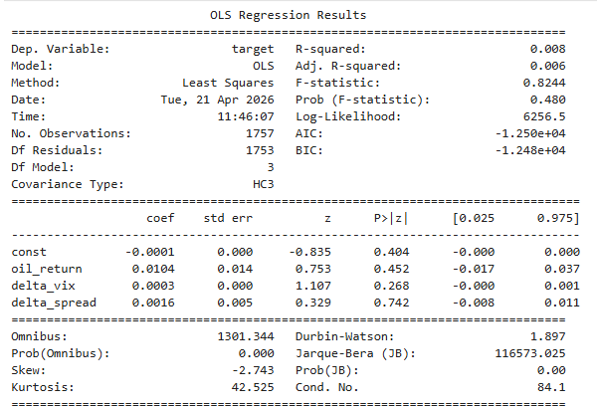
MODEL 3 — OLS ON TROUGH RETURNS
Does VIX Spike Size Predict Return Size?
Actual vs Predicted return (OLS, ΔVix predictor)
Return After Trough vs Δ VIX magnitude
≈ 0
0.956
7.58%
R-squared (OLS on returns)
ΔVIX coefficient (p-value)
Intercept (const)
No predictive power
Not significant
p < 0.001 — significant
Key insight: VIX spike SIZE is irrelevant to return size once the threshold is met. Being in the trade at all (after any top-20% spike) earns ~7.6% on average as shown by the intercept. Our trading rule will thus just be based on the presence of spikes and not on the size of them after our threshold js met.

Slide 24
MODEL 3 — BACKTEST & SHARPE RATIO
Trading Rule and Final Performance
5.15%
2.44%
8.76%
Median return / trade
Mean return / trade
Std deviation / trade
ENTER
Day 74 post-spike only if EMB has fallen by more than 5% and prices are still not accelerating down
Sharpe Ratio Calculation
EXIT
Day 202 post-spike, holding for 128 days since that’s the median recovery time for early troughs
Hold period: Day 74 → 202 = 128 trading days
Rf per trade: 5.25% × (128÷252) = 2.67%
Excess return (median): 5.15% − 2.67% = 2.49%
Annualization: × √(252÷128) = × 1.403
0.40
0.75
Sharpe (median)
Sharpe (mean)

Slide 25
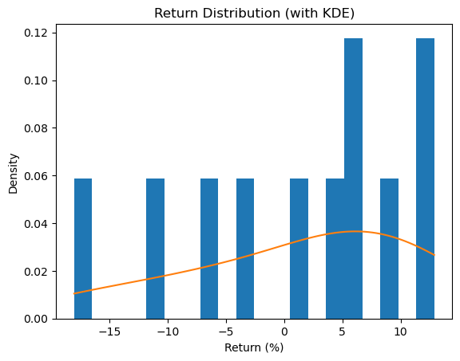
MODEL 3 — RETURN DISTRIBUTION
What Does the Return Profile Look Like?
Upside
Clustering
A massive % of positive gains are concentrated around each other
Left
Skew
Mean < Median → Fat left tail
Loss
Rate
24% of trades lose money
Return distribution with KDE (filtered strategy, price returns only)
The left skew represents a danger even though most returns are clustered around a healthy 5%-10%. In rare events where we time the bottom incorrectly or assume we’re trading on news instead of realy structural issues, we can lose upwards of 10-15%. This shows that more components need to be made in our model to account for this.

Slide 26
MODEL COMPARISON
Overview of the Three Models
Model 1
OLS (1-factor)
Model 3
Threshold
Model 2
OLS (3-factor)
Approach
Regression
Event study + rule
Regression
Signal
Δ VIX
Top 20% VIX spikes
Δ VIX + Spreads + Oil
Prediction
Tomorrow's return
Trough timing
Tomorrow's return
Key Stat
p = 0.01 ✓
54% recovery rate
Condition Number = 84
R²
0.6%
N/A (event study)
0.8%
Sharpe
N/A
0.40–0.75
0.053
Best Feature
Stat. significance
Real backtest trades
Beats buy-and-hold
Limitation
Single factor
46% Windows Fail or Need Long-Term Recoveries
Multicollinearity

Slide 27



RISKS & LIMITATIONS
Key Risks in the Trade & Limitations in the Models
46% of Events Don't Recover Meaningfully
Rates Shock vs Risk Shock
Nearly half of VIX spikes don’t produce a meaningful price recovery within a 240-day window. This impacts models 1 and 2 since they don’t attempt to filter out less impactful spikes.
The model treats all VIX spikes identically. Fed rate hikes hurt EM bonds permanently. Pure panic recovers. These have to be separated further.
OLS Assumptions are Violated, Meaning We Can’t Conclusively Prove Correlation
Spike Size Irrelevant
Autocorrelation, heteroskedasticity, and fat tails are all present in the first two models. HC3 helps but doesn't fully solve the problem.
ΔVIX magnitude predicts nothing about return size (Test R²≈0). Signal is binary, you either see a big spike cross the threshold or you don't.
We Didn’t Hedge FX Risk
Yield Excluded from Backtest
Even though our index avoids direct risk, a rising dollar greatly impacts the ability of countries to repay their debt. Additionally, if you hold a basket of EM bonds, you would have direct FX risk exposure, which you’d need to pay a premium to hedge against.
Coupon income, from holding bonds, is NOT counted. Real P&L is materially higher, with Sharpe ratios near or above 1.0 in the threshold model once yield is included.

Slide 28
MODEL 1 & 2 — OLS ASSUMPTIONS
OLS Assumptions Are Violated in Practice
Autocorrelation (1,2, & 3)
Heteroskedasticity (1, 2)
If model underpredicts during a crash, it also underpredicts the next day. Crises cluster and errors are not independent over time.
Volatility clustering: tiny errors in calm markets, massive errors during crises. Error variance is NOT constant over time.
Normal Residuals (1,2,3)
Multicollinearity (2)
Financial data has fat tails (high kurtosis > 3). Extreme events happen far more often than a normal distribution predicts.
Δ VIX and Δ Credit Spread are 0.46 correlated. They share explanatory power, inflating standard errors in multi-factor models.
Kurtosis reference: Normal distribution has a kurtosis of 3. Financial data has kurtosis levels typically around 5–15+, meaning extreme moves are far more common than OLS assumes.

Slide 29




What's Next?
Four directions to could make the model materially more powerful
Logistic Regression
Overlay DXY & UST Yields with VIX
This effectively combines the multifactor and threshold models
It would recognize longer-term structural shocks that would keep the price of EM bonds depressed.
From there we could isolate pure headline shocks (which would recover earlier).
Using a machine learning model, we could predict the probability of recovery per VIX spike. From there, we could only enter trades when the probability > 60%.
One key advantage is that it’d filter out the 46% fail rate.
Regime Splitting
Trade Individual Bonds Instead
The recoveries in high-VIX spikes (>25) vs moderate-VIX spikes are fundamentally different
It seems that higher VIX spikes leave longer impressions and cause price movements to be more choppy.
Bifurcating our model could improve signal quality further.
One limitation in trading the EMB Index is that we lose out on returns due to diversification
Since the index combines bonds that have different sensitivities to news & capital outflows, the patterns we talked about could be diluted
The next step is to construct a bond portfolio from geopolitically sensitive countries like Turkey.

Slide 30

Thank You
Questions?
78
54%
5.15%
0.40–0.75
VIX Spike Events
Recovery Rate
Median Return
Sharpe Ratio

