Slide 1
Engineering Graduate Salary Prediction with Machine Learning
Sagar Biswas
MSDS 422-DL Section 55
June 7, 2026

Slide 2
Executive Summary
Machine learning techniques can help universities identify key predictors of post-graduate outcomes and proactively support students before they graduate.
Purpose
Predicting post-graduate salary outcomes with student data
Linear regression, Ridge regression, Random Forest, Gradient Boosting
Models used
Gradient Boosting
Best model
Quantitative score, Academic consistency, English score, Programming score
Top predictors

Slide 3
Research Objectives
Universities are always facing pressure to improve employment outcomes for graduates. However, outcomes are only known after students have already graduated, making it difficult to proactively influence outcomes while students are enrolled.
Key questions:
Can salary outcomes be predicted before graduation?
Which predictors are associated with higher salaries?
Can schools identify students who need assistance and take action?

Slide 4
Business Value
Employment outcomes for graduates, like salary, impact a university’s reputation, rankings, recruitment, and employer relations. Understanding which factors influence salary and being able to make predictions would allow universities to identify students at risk of less desirable outcomes and take proactive steps to improve their outcomes.
Student Data
Machine Learning
Salary Prediction
Early Intervention
Improved Outcomes

Slide 5
Data Overview
This analysis uses the Kaggle dataset Engineering Graduate Salary Prediction. The dataset is sourced from ‘Aspiring Minds Research’, which captures salary and education information for engineering graduates from universities in India.
Predictors
2998 graduates
Sample size
College Tier
Academic Scores
# of universities
1173 universities
Specialization
Personality Scores
Rupees (₹)
Salary currency

Slide 6
Data Preparation
Preprocessing steps:
Dropped identifiers from dataset.
Regrouped Specialization and Degree to avoid sparse levels.
Replaced null and invalid values with median.
Log-transformed salary to address extreme values and improve model stability.
Engineered features for academic consistency and growth.
Raw Data
Data Cleaning
Feature Engineering
Apply Pipeline
Modeling

Slide 7
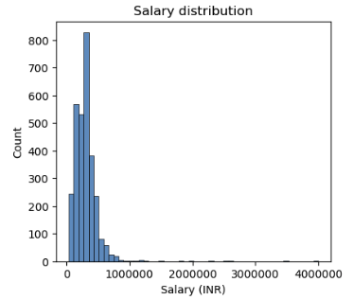
Salary Overview
Average salary: ₹305,174
Median salary: ₹300,000
Salaries ranged from ₹35,000 to ₹4,000,000.
Most graduates were near median salary, with 2.6% of graduates receiving substantially higher salaries over ₹655,000.

Slide 8
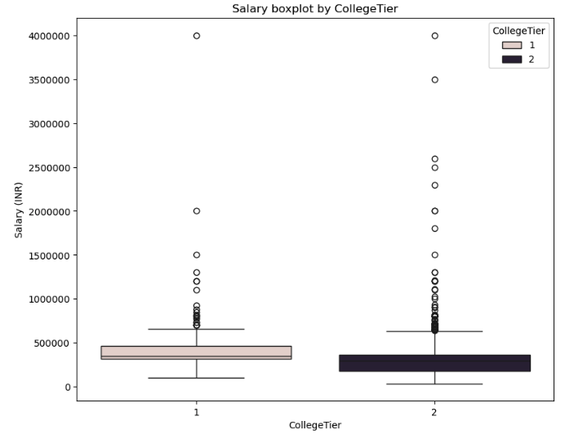
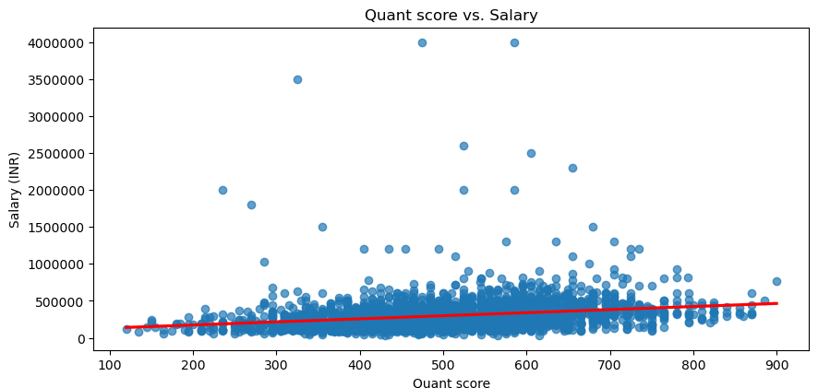
Exploring Features Associated with Salary
The median salary and salary range for Tier 1 college graduates is higher than Tier 2.
There is a moderate positive correlation between Quantitative test score and salary.

Slide 9
Methodology
Approach
Developed regression and tree-based machine learning models.
Linear regression, Ridge regression, Random Forest, and Gradient Boosting
Cross-validation: Trained models on 80% of data and predicted salary on remaining 20% for validation.
Model performance was evaluated on prediction accuracy and explanatory power.
Prepared Data
Validation Split
Fit Models
Predict Salary
Evaluate

Slide 10
Tools and Technology
Environment
Jupyter Notebook
Programming Language
Python
Data Analysis
Pandas, NumPy
Data Visualization
Matplotlib, Seaborn
Machine Learning
SciKit-learn
Hardware
Google Colab Cloud

Slide 11
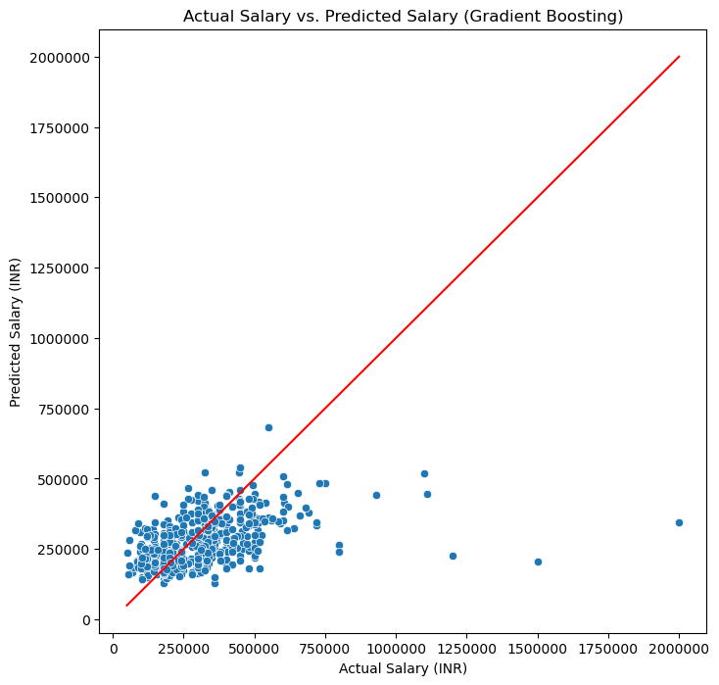
Model Performance
Models capture some patterns in salary outcomes, but much of the variation remains unexplained.
A more robust dataset or additional features could improve predictive performance.
Gradient Boosting displayed strongest predictive power and lowest error.

Slide 12
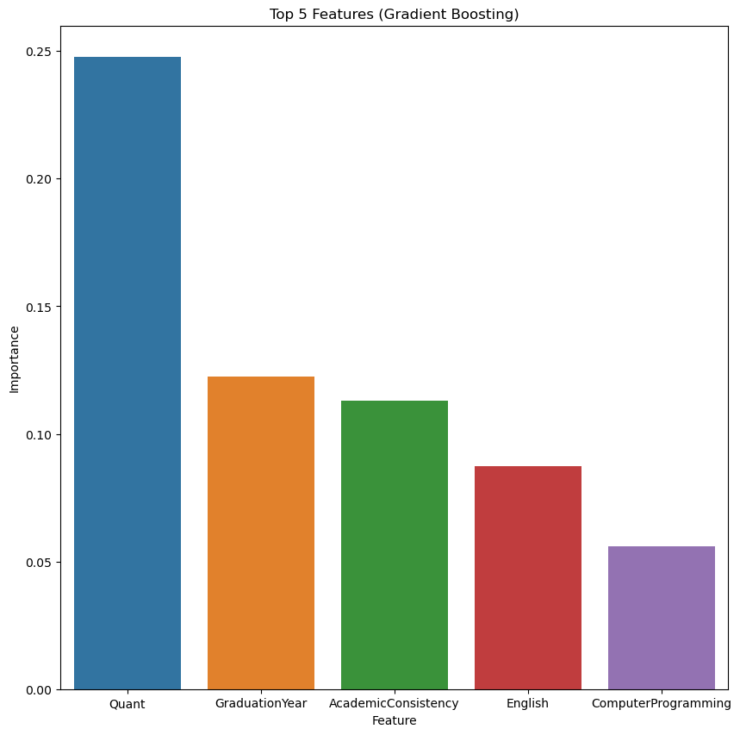
Gradient Boosting: Top Predictors
Quantitative score is the most influential factor for salary outcomes.
Consistent academic performance from grade 10 through college was more important than any single academic measure.

Slide 13
Findings & Conclusions
Predicting salary is possible, but it is multi-faceted.
The models only explained a portion of salary variation. Other factors like internship experience likely contribute as well.
Quantitative skills and consistency matter.
Students with high quantitative scores tended to earn higher salaries. Investing in quantitative training for students could improve overall salary outcomes.
Academic consistency emerged as an important salary predictor. Lower college GPA compared to high school grades can be an indicator that intervention is needed.
Communication is high-impact.
English scores were associated with higher salaries. This is a skill that employers are looking for, so proficiency in it can be emphasized at the university level.
Quantitative skills and consistency matter

Slide 14
Deployment Strategy
Automatically pull data from university sources and apply preprocessing.
Fit machine learning model and predict salaries on a schedule.
Dashboard to help staff identify students in need of support.
Early intervention.
Retrain model when new salary outcomes are available.
Student Data
Automated Pipeline
Salary Predictions with ML
Administrator Dashboard
Action

Slide 15
Future Work
Capturing more predictors and using a larger sample will improve model performance and generalize better to other countries and disciplines.
Obtaining data on additional post-graduation outcomes such as job placement and career progression will provide additional insights to universities.
Applying deep learning techniques such as artificial neural networks can improve prediction accuracy.

Slide 16
References
Manish KC. “Engineering Graduate Salary Prediction Dataset.” Kaggle. https://www.kaggle.com/datasets/manishkc06/engineering-graduate-salary-prediction.
Dataset derived from Aspiring Minds Employment Outcomes study

