Slide 1
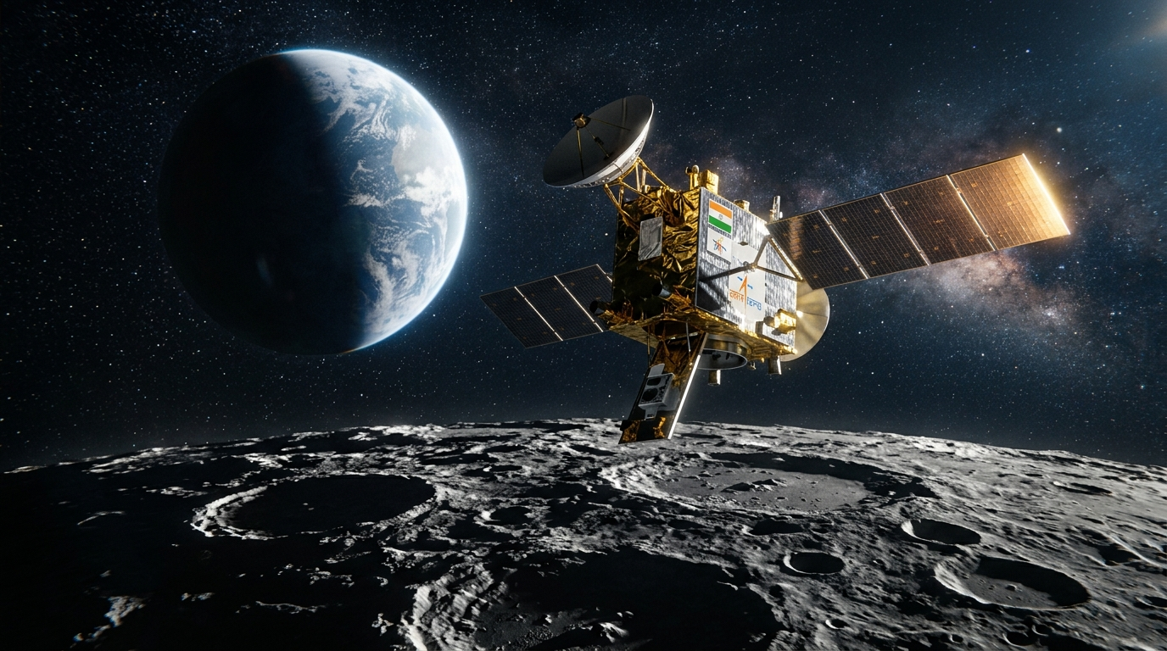
SIH 2026 · PS 26166 · ISRO
LunarAlign
Sun-Sweep Atlas & Trust Router for Multi-Modal Lunar Image Correspondence
Team Selenographers
Multi-modal, Sun angle & scale invariant image correspondence using Chandrayaan-2 optical images
Python
OpenCV
Kornia
LightGlue
LoFTR
MINIMA
Streamlit
github.com/saBBy-is/SunSweepAtlas

Slide 2
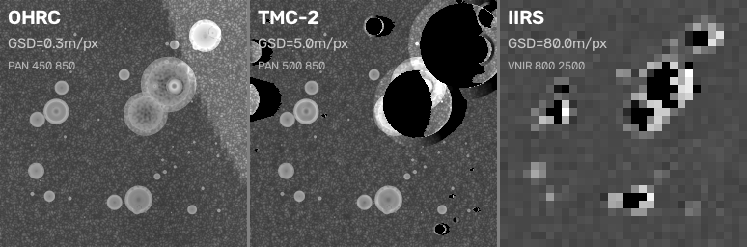
THE PROBLEM
Why Lunar Image Matching Fails
☀ Sun Angle Variation
🛰 Multi-Sensor Scale Gap
Shadows cover 21% of pixels at 10° elevation
vs only 2.9% at 40° elevation
NCC (Normalized Cross-Correlation) drops to:
+0.56 at grazing sun (el 10°)
−0.54 at 180° azimuth flip
−0.62 at grazing + flip (worst case)
→ Same terrain looks completely different under
different illumination — SIFT finds 0 correct!
Chandrayaan-2 carries 3 very different sensors:
OHRC → 0.3 m/px · PAN 450–850 nm
TMC-2 → 5.0 m/px · PAN 500–850 nm
IIRS → 80 m/px · VNIR+SWIR 800–5000 nm
Scale ratios between sensor pairs:
OHRC ↔ TMC-2 : 17× → Moderate
TMC-2 ↔ IIRS : 16× → Moderate
OHRC ↔ IIRS : 267× → Extreme 🔴
Same terrain rendered at 3 sensor resolutions — fine craters vanish at coarse GSD

Slide 3
OUR SOLUTION
Sun-Sweep Atlas & Trust Router Pipeline
1
LOLA DEM
Terrain
2
Sun-Sweep
Renderer
3
6-Matcher
Sweep
4
60-Cell
Atlas
5
Trust
Router
Synthetic lunar
surface from LOLA
elevation data
→
512×512 px renders
at 10 sun geometries
(5 Δaz × 2 el)
→
SIFT, ORB, LoFTR
SP+LightGlue
ALIKED+LG, MINIMA
→
Per-cell success rate
+ grid error + match
count → CSV
→
GREEN ≥85%
AMBER 40–85%
RED <40% → REFUSE
🔒 SHA-256 Pinned Simulator
🧪 Negative Control Built-In
Renders are hash-locked — no post-hoc tuning possible
Mismatched terrain correctly refused by SIFT (18 < 20 match floor)
⚠ MINIMA False Positive Caught
📊 Pre-Committed Criteria
71 matches, 22 RANSAC inliers — but 114.9 px error vs ground truth!
max_grid_error < 3.0 px AND min_correct ≥ 20 — locked BEFORE sweep

Slide 4
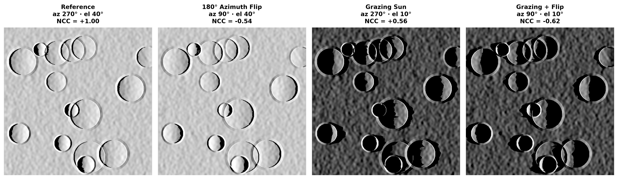
VISUAL PROOF
Sun Angle Destroys Pixel Correlation
Reference
180° Flip
Grazing Sun
Grazing + Flip
az 270° · el 40°
az 90° · el 40°
az 270° · el 10°
az 90° · el 10°
NCC = +1.00
NCC = −0.54
NCC = +0.56
NCC = −0.62
0% shadow delta
Shadows swap sides
21% shadow coverage
Worst-case scenario
All renders: 512×512 px · 20 m/px · SHA-256 pinned simulator (eb05f65...)

Slide 5
RESULTS — SINGLE SENSOR
60-Cell Matcher Atlas (Verified from atlas.csv)
Matcher
Δ0° / 10°
Δ0° / 40°
Δ45° / 10°
Δ45° / 40°
Δ90° / 10°
Δ90° / 40°
Δ135° / 10°
Δ135° / 40°
Δ180° / 10°
Δ180° / 40°
SIFT
✓ 55
✓ 318
✗ 0
✗ 1
✗ 0
✗ 0
✗ 0
✗ 0
✗ 0
✗ 0
ORB
✓ 114
✓ 2080
✗ 5
✗ 27
✗ 0
✗ 0
✗ 0
✗ 0
✗ 1
✗ 0
LoFTR
✓ 2948
✓ 3600
✓ 318
✓ 2080
✓ 59
✓ 217
✗ 7
✗ 80
✗ 70
✗ 263
SP+LG
✓ 1012
✓ 1871
✓ 445
✓ 749
✓ 93
✓ 298
✗ 56
✓ 148
✓ 169
✗ 267
ALIKED
✓ 383
✓ 829
✗ 0
✗ 0
✗ 0
✗ 0
✗ 0
✗ 0
✗ 0
✗ 0
MINIMA
✓ 1014
✓ 1868
✓ 737
✓ 952
✓ 754
✓ 849
✓ 797
✓ 868
✓ 966
✓ 1031
Success = grid_error < 3.0 px AND correct_matches ≥ 20 | ✓ = success cell | Number = correct matches | MINIMA: 10/10 cells succeeded

Slide 6
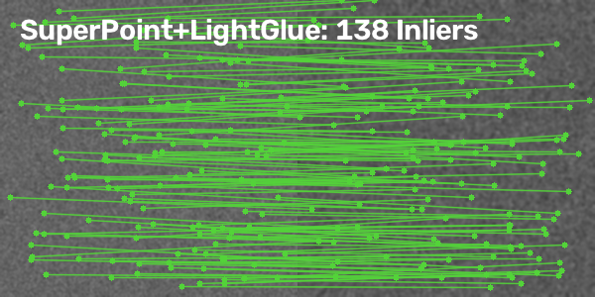
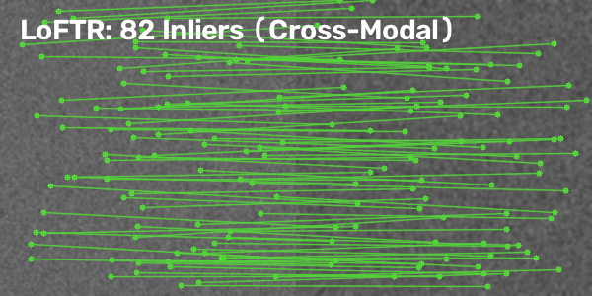
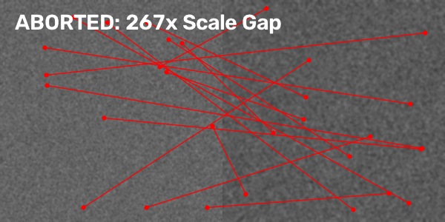
CROSS-SENSOR MATCHING
Multi-Modal Feature Matching Results
SuperPoint+LightGlue: 138 Inliers
(OHRC ↔ TMC-2, 17× scale)
LoFTR: 82 Inliers (Cross-Modal)
(TMC-2 ↔ IIRS, 16× scale)
ABORTED: 267× Scale Gap
(OHRC ↔ IIRS — Trust: RED)
Classical Matchers (SIFT, ORB)
0 matches across ALL 60 cross-sensor cells
0% success rate — complete failure
Resolution mismatch destroys feature detection
Trust Router Decision Logic
OHRC↔TMC-2 (17×): Route to neural matcher
TMC-2↔IIRS (16×): Route to neural matcher
OHRC↔IIRS (267×): REFUSE to match → RED 🔴

Slide 7
LIVE DEMO
Trust Router & Interactive Dashboard
🟢 GREEN
🟡 AMBER
🔴 RED
≥ 85% Atlas Success
40–85% Atlas Success
< 40% Atlas Success
Safe to use — any matcher works
Classical SIFT sufficient
Use with caution
Route to neural matcher (LoFTR/MINIMA)
REFUSE to match
False match risk too high
Streamlit Dashboard Features
☀ 3D Sun Hemisphere
📊 Heatmaps
🤖 Trust Router
Interactive Plotly sky dome — drag to rotate, see sun position
Per-matcher success rate across all 10 sun geometries
Select angle + sensor pair → instant best-matcher recommendation
📈 3D Surface Plot
🛰 Live PDS4 Demo
📋 Raw Data
Rotatable success-rate landscape across Δaz × el grid
Upload real ISRO PDS4 XML → live trust routing result
Full atlas.csv table — every number verifiable
Launch: streamlit run dashboard.py → http://localhost:8501

Slide 8
REPRODUCIBILITY & INTEGRITY
Every Number is Verifiable
🔐 SHA-256 Simulator Pinning
📋 Pre-Committed Success Criteria
sun_sim_v2.py (eb05f65...) and synth_dem.py (841ba17...) hashed at startup.
Any modification to renderer → pipeline refuses to run.
config.yaml locked at commit 7b459d3 BEFORE any sweep ran.
max_grid_error < 3.0 px AND min_correct_matches ≥ 20.
🔄 Deterministic Outputs
🧪 Negative Control
Same (matcher, az, el) cell → bit-for-bit identical results.
Verified on both SIFT and MINIMA back-to-back runs.
Mismatched terrain (seed=42 vs seed=9999): SIFT correctly refused (18 < 20).
MINIMA false positive caught: 22 RANSAC inliers but 114.9 px error!
📊 CSV Source of Truth
🚫 Audit Trail
atlas.csv (60 rows) — every number derived from script output.
No manual edits. No rounding in favorable direction.
AGENT_CONTEXT.md documents ALL previously fabricated numbers.
Stale PDF explicitly marked. Every correction traceable to git commit.

Slide 9
TECHNOLOGY STACK
6 State-of-the-Art Matchers + Full Pipeline
Classical
SIFT
2/10
Classical
ORB
2/10
Transformer
LoFTR
6/10
Scale-invariant keypoints
Good baseline, fails at
large sun angle deltas
Fast binary features
High match count but
low precision under Δaz
Dense pixel matching
Strong at moderate Δaz
Fails at 135°+ delta
Deep Learning
SP+LightGlue
7/10
Deep Learning
ALIKED+LG
2/10
Foundation
MINIMA
10/10
SuperPoint features +
adaptive matching
7/10 cells succeeded
Deformable keypoints
Excellent at Δaz=0 but
collapses beyond 45°
Foundation model matcher
10/10 illumination cells
Best overall performer

Slide 10
CONCLUSION & FUTURE WORK
We verify every fit and refuse what can't be verified.
✅ 60-cell single-sensor atlas — 6 matchers × 10 sun geometries
✅ Cross-sensor pipeline — OHRC, TMC-2, IIRS at native GSDs
✅ MINIMA: 10/10 illumination cells succeeded (best performer)
✅ Trust Router with RED/AMBER/GREEN traffic light system
✅ SHA-256 pinned simulator — tamper-proof reproducibility
✅ Negative control proves even MINIMA can be confidently wrong
✅ Interactive Streamlit dashboard — ready for live demo
NEXT STEPS
🔮 Integrate real Chandrayaan-2 OHRC/TMC-2 data from PRADAN archive
🔮 Ground-truth-free rejection for MINIMA false positives
🔮 Multi-matcher consensus voting for cross-validation
Team Selenographers · SIH 2026 · PS 26166 · ISRO · github.com/saBBy-is/SunSweepAtlas

