Slide 1


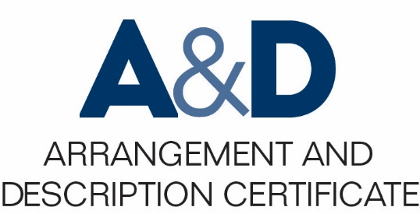
Describing Archives: A Content Standard Workshop Series Video 1
What Is Archival Description
Presenter: Laura Romans
Date
©2016 Society of American Archivists

Slide 2
What Is Archival Description
Learning Objectives:
Define archival description
Identify examples of good archival description
Understand the role of description in the use of archives

Slide 3
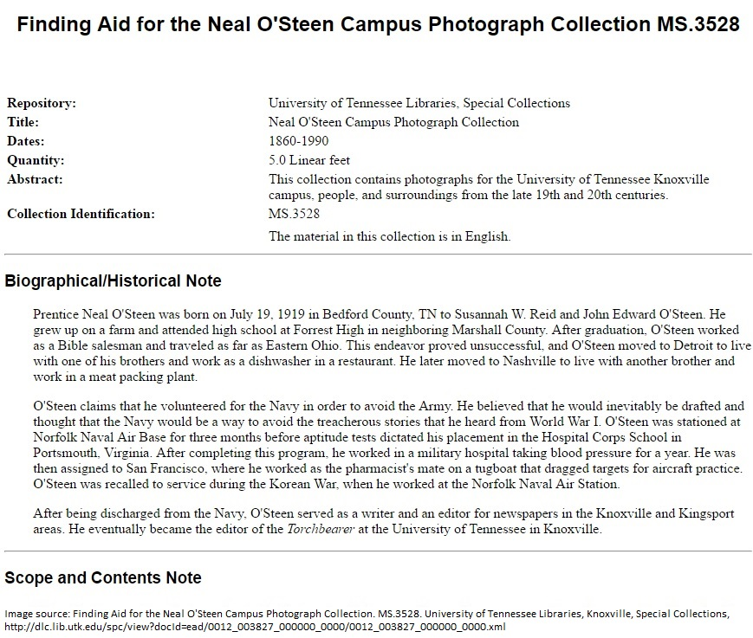
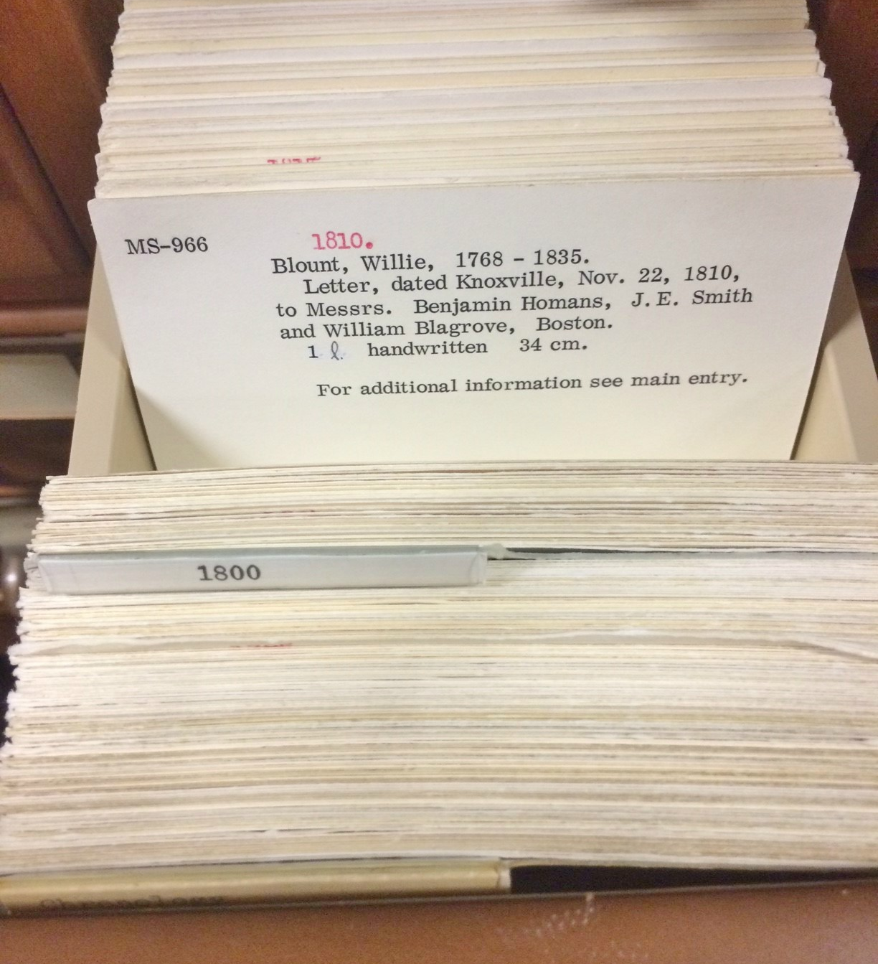
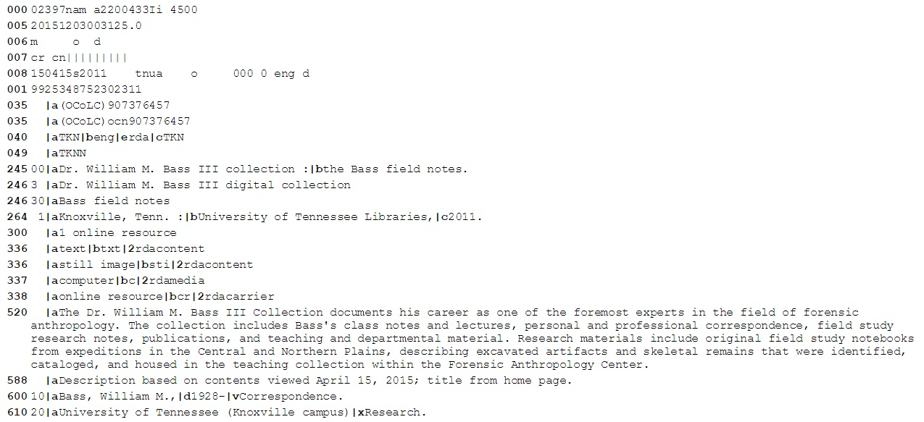
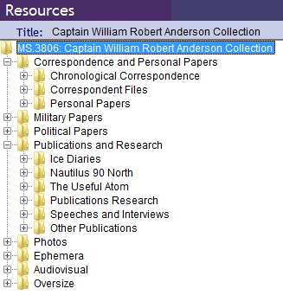

Slide 4
Archival description is not only a product but is the encompassing process by which we create representations and explanations of records.

Slide 5
Archival Description:
“the process of analyzing, organizing, and recording details about the formal elements of a record or collection of records, such as creator, title, dates, extent, and contents, to facilitate the work’s identifications, management, and understanding”
– Society of American Archivists’ A Glossary of Archival and Records Terminology

Slide 6
Archival description is unique and complex.
Records have value in content but also as evidence of creators and contexts that produced them
Description focuses on intellectually-significant groups of material
Level of detail will depend on records as well as needs of the institution and users

Slide 7
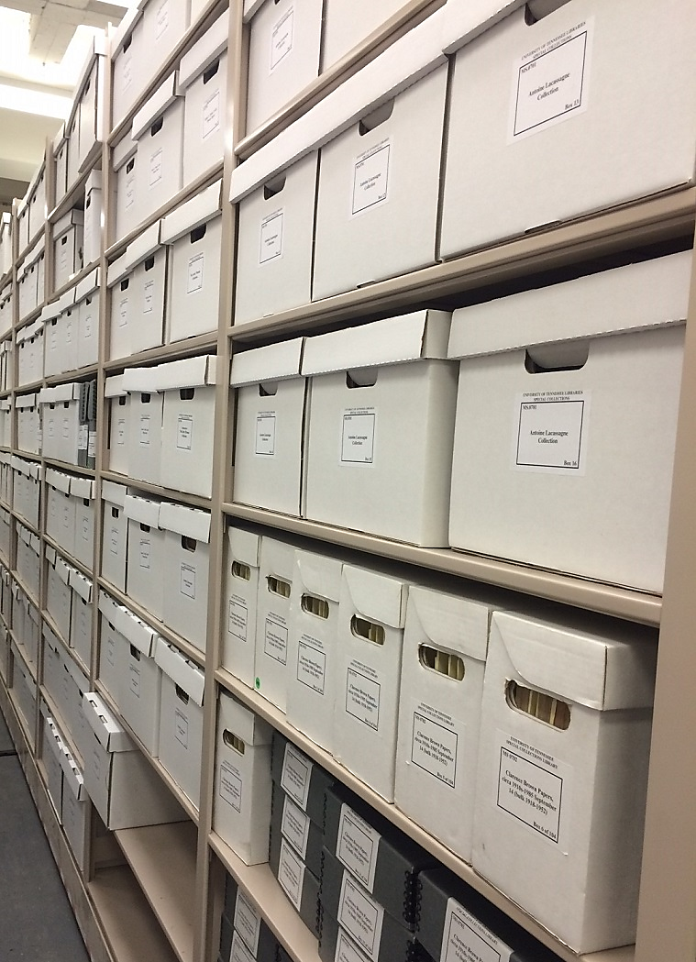
Archival description is mostly constituted by information about material’s stated content and physical attributes.

Slide 8
Archival description includes contextual information.
Essential to the understanding of archival records’ authenticity and reliability
Examples of contextual information:
Biographical narratives or organizational histories
Further detail on historical context in which records were created
Details about how records were maintained over time
Includes archivists’ interventions

Slide 9
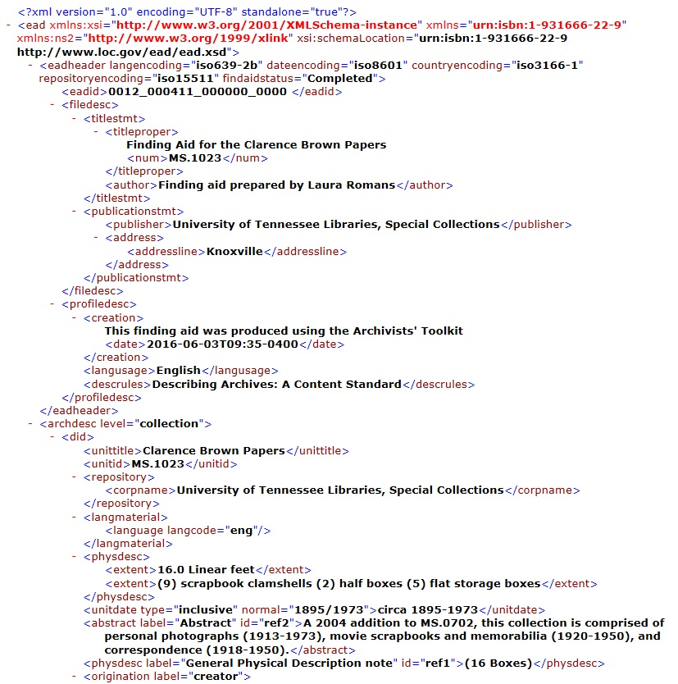
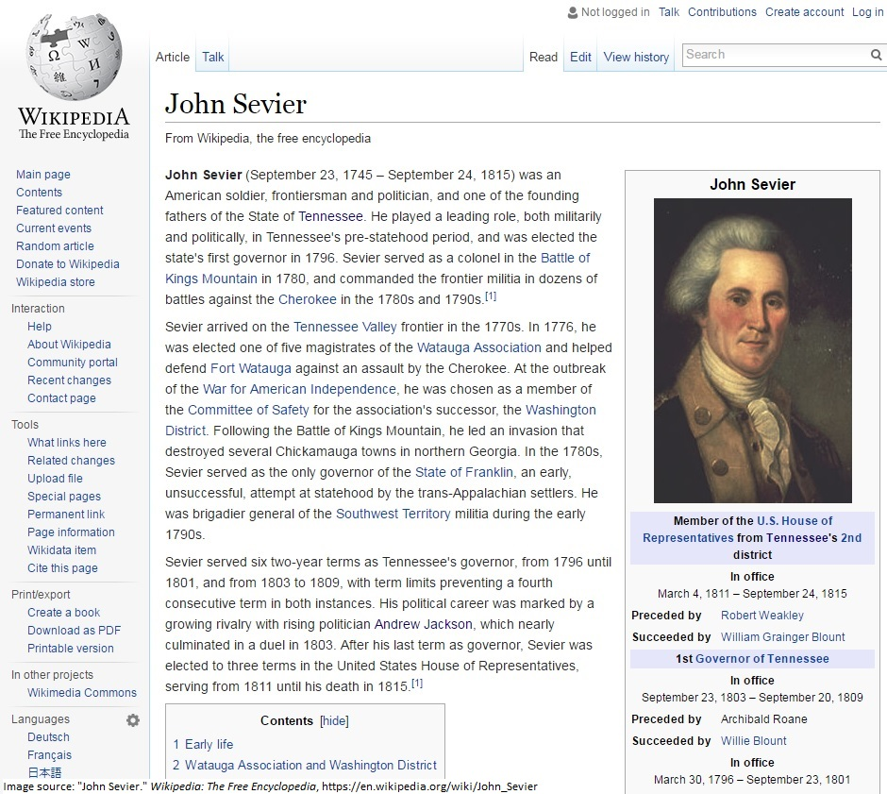
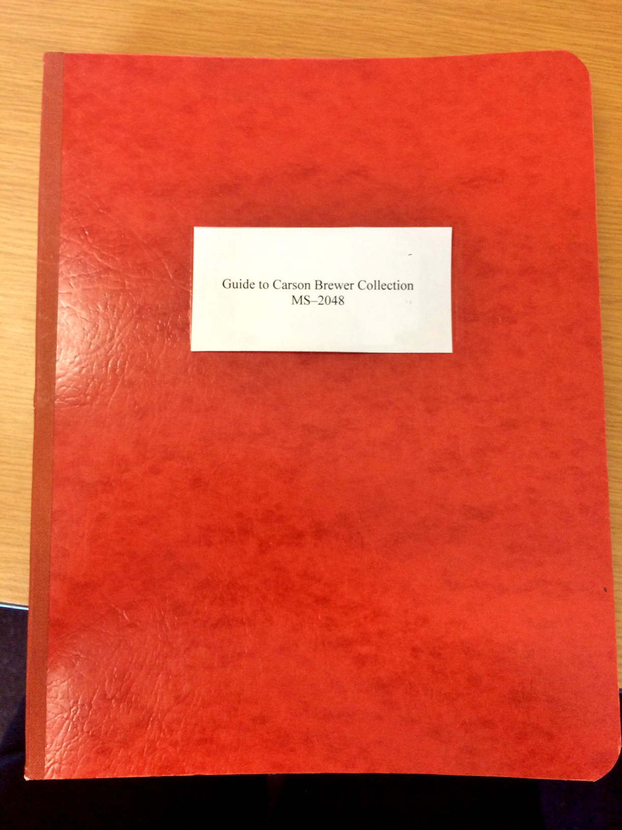
Final Product
Discovery tools will look different at each institution
Will depend on needs of users and institution as well as nature of records

Slide 10
Archival description is iterative.
Description can and should be re-used and revised
Outputs are endlessly flexible and responsive

Slide 11
Purposes of Archival Description
Facilitates access
Improves collection management
Description is the bridge between acquisition and use!

Slide 12
Archival Description
Process of explaining content, structure, and context of archival records
Facilitates access to archival records so users may engage with them in meaningful ways

Slide 13
Resources:
Thanks for listening!
Millar, Laura A. Archives: Principles and Practices. New York: Neal-Schuman Publishers, Inc., 2010.
Pearce-Moses, Richard. A Glossary of Archival and Records Terminology. Chicago: Society of American Archivists, 2005.
Roe, Kathleen D. Arranging & Describing Archives & Manuscripts. Chicago: Society of American Archivists, 2005.
Yeo, Geoffrey. “Debates about Description.” In Currents of Archival Thinking, edited by Terry Eastwood and Heather MacNeil, 89-114. Santa Barbara: Libraries Unlimited, 2010.
All images courtesy Laura Romans except where noted.

