Slide 1



Describing Archives: A Content Standard Workshop Series Video 2
Principles of Archival Description
Presenter: Sarah Bost
©2016 Society of American Archivists
Notes:
Slide 1

Slide 2
Learning Objectives
Understand the basic tenets of archival arrangement and description.
Be able to apply these tenets in various archival situations.
Notes:
Slide 2

Slide 3

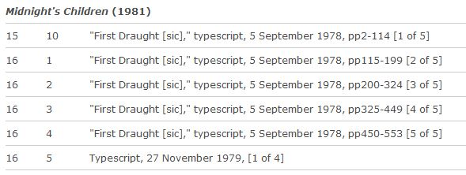
Principle 1: Unique characteristics
Excerpt from finding aid for the Salman Rusdie papers
Notes:
Slide 3

Slide 4

Principle 2: Respect des fonds
Notes:
Slide 4

Slide 5
Principle 2: Respect des fonds
Original
Order
Notes:
Slide 4

Slide 6
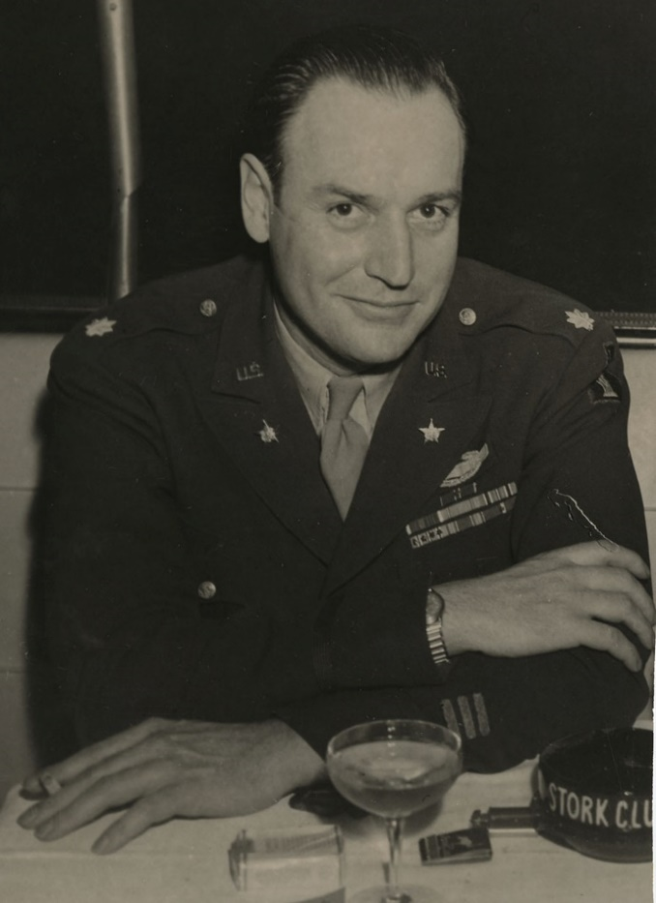
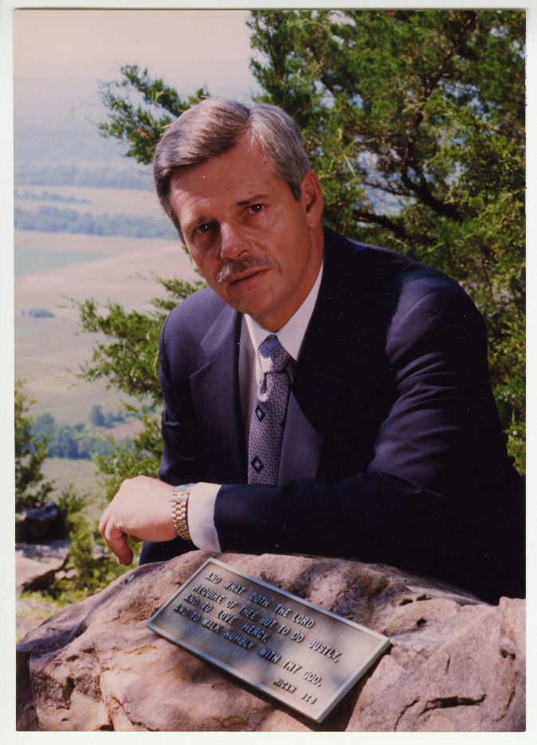
Principle 2: Respect des fonds
Winthrop Rockefeller
Winthrop Paul Rockefeller
Notes:
Slide 5

Slide 7
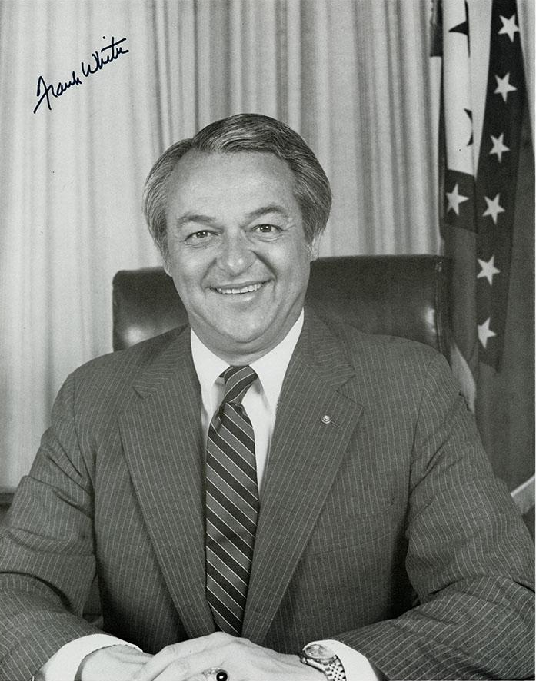
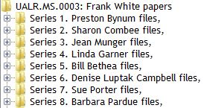
Principle 2: Respect des fonds
Series list for the Frank White papers
Frank White
Notes:
Slide 6

Slide 8
Principle 3: Identification of groupings
Fruit
Grapes
Pears
Red
Green
Bosc
Anjou
Bartlett
Example of hierarchical groupings
Notes:
Slide 7

Slide 9

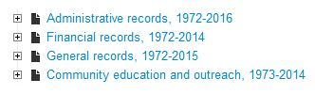
Principle 3: Identification of groupings
Notes:
Slide 8

Slide 10
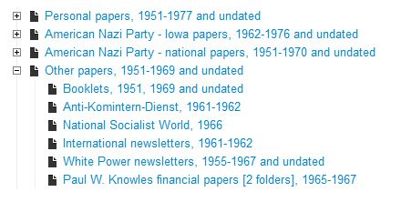
Principle 3: Identification of groupings
Excerpt from John Robert Bishop finding aid
Notes:
Slide 8

Slide 11
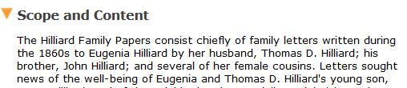
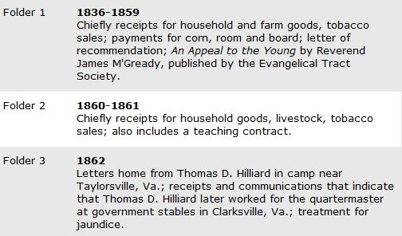
Principle 4: Description reflects arrangement
Notes:
Slide 8

Slide 12
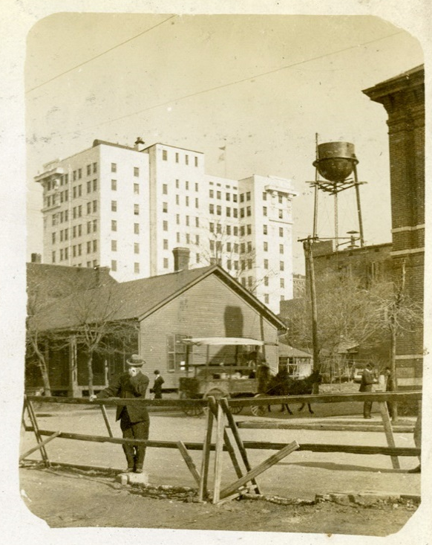
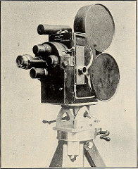
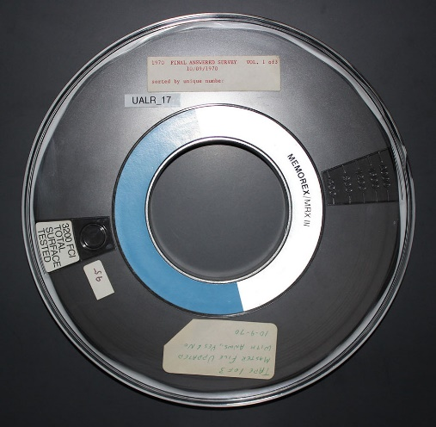
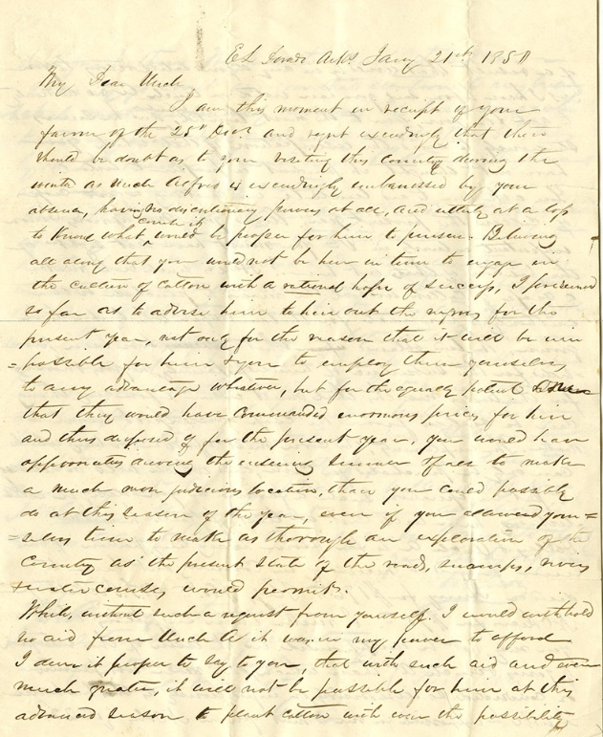

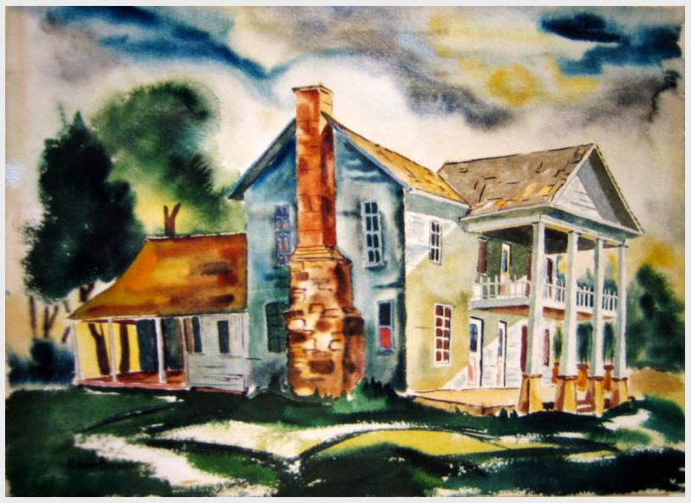

Principle 5: Applicable to all formats
Notes:
Slide 9

Slide 13

Principle 6: Applicable to all sources
Notes:
Slide 10

Slide 14
Principle 7: Outputs and levels of detail
Principle 7
Principle 7.1
Principle 7.2
Principle 7.3
Notes:
Slide 11

Slide 15
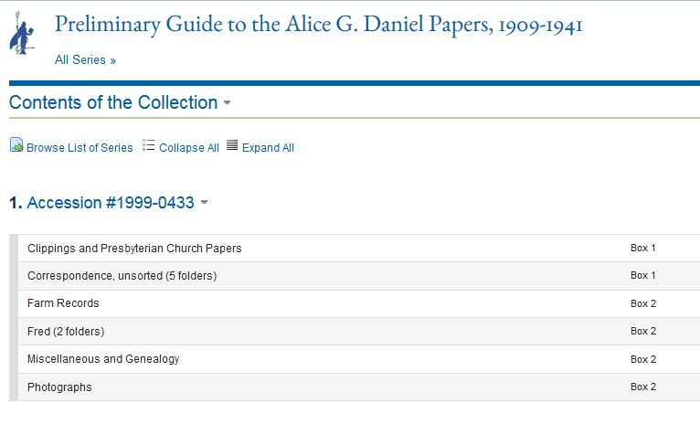
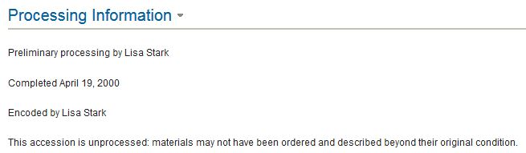
Principle 7.1: Levels of description & arrangement correspond
Notes:
Slide 12

Slide 16
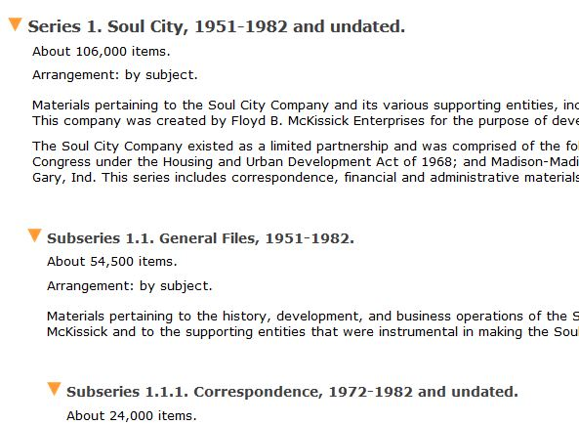
Principle 7.2: Relationships between levels of description must be clear
Notes:
Slide 13

Slide 17
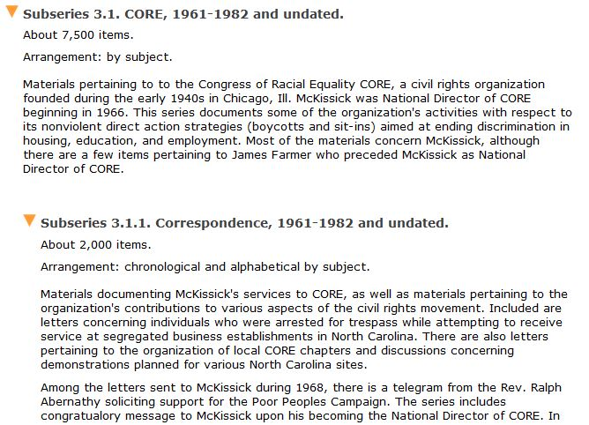
Principle 7.3: Appropriate information at each level of description
Notes:
Slide 14

Slide 18
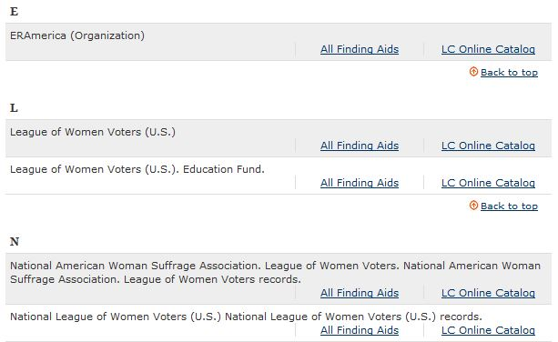

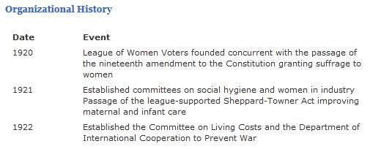
Principle 8: Creators must be described
Notes:
Slide 15

Slide 19
Conclusion
Arrangement
Description
Notes:
Slide 16

