Slide 1


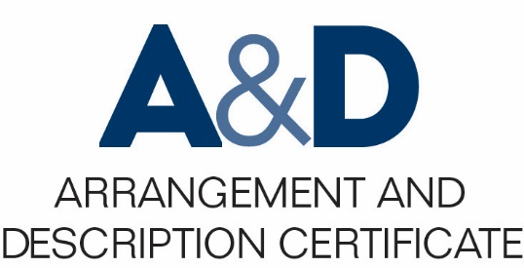
Describing Archives: A Content Standard Workshop Series Video 3
What is a content standard?
Presenter: Sue Luftschein
Additional content by Jennifer Mitchell
August 2016
©2016 Society of American Archivists

Slide 2
Learning Objectives
Understand the definition of a content standard, the purpose of a content standard and what such a standard can contribute to an archival descriptive program.
Articulate some of the problems that content standards, specifically DACS, can address and resolve.
Understand the relationship and differences between content standards and encoding standards.

Slide 3
What is a content standard?
A data content standard is a set of formal rules that specify information content to promote consistency and clarity.
Data content standards provide guidelines on what kind of data to include. For example, DACS requires the inclusion of a title and also provides guidance for how that title should be derived and expressed.

Slide 4
Why is it useful to use a content standard?
Content standards like DACS provide institutions with a way to consistently achieve intellectual control.
Content standards are often used in association with other types of standards, such as structure or value standards.
The use of companion standards allows for interoperability.
Use of DACS promotes consistency and clarity across access points, such as titles or names of creators.

Slide 5
What kinds of issues does using a content standard resolve?
Iteration: DACS can and should be used throughout the archival enterprise as the archivist learns more about the collection.

Slide 6
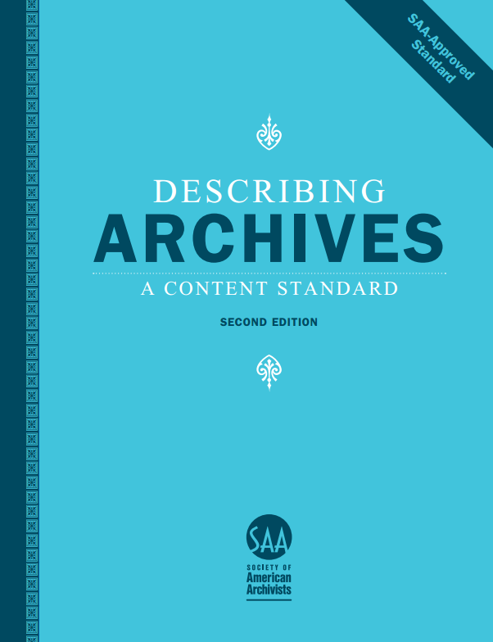
What kinds of issues does using a content standard resolve?
Output neutrality
Library catalog record
Finding aid
Wikipedia article
Digital object metadata record

Slide 7
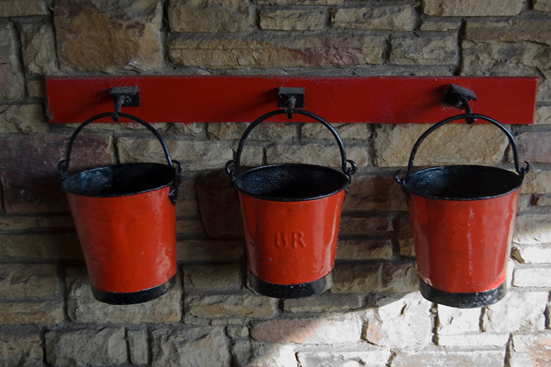
Content Standard vs. Encoding Standard
Encoding standards tell you what the buckets are
Content standards tell you what to put into the buckets
Paul Harrop, http://www.geograph.org.uk/photo/2666296

Slide 8



Encoding standard = Data Structure Standard

Slide 9


Content standard = DACS, RDA, CCO

