Slide 1

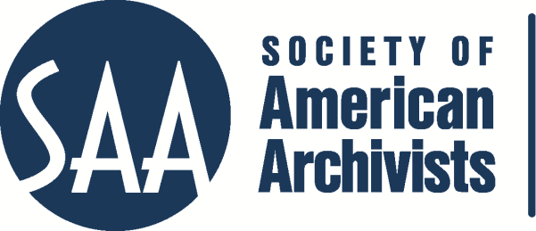
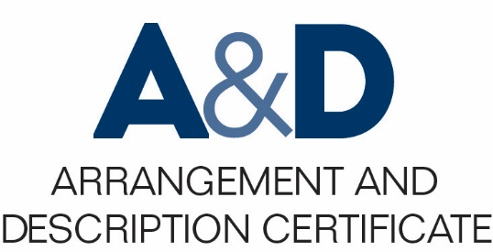
Describing Archives: A Content Standard Workshop Series Video 4
Crosswalking DACS
Crosswalking DACS
Presenter:
Amelia W. Holmes
©2016 Society of American Archivists

Slide 2
Learning
Learning Objectives
Be able to crosswalk between DACS and a variety of other standards.
Understand why interoperating between various standards is important in the work of archivists.

Slide 3
What is Crosswalking?
“a mapping of the elements, semantics, and syntax from one metadata schema to those of another” (NISO, 2004)
Schema 1
Element A
Element B
Element C
Schema 2
Element X
Element Y
Element Z

Slide 4
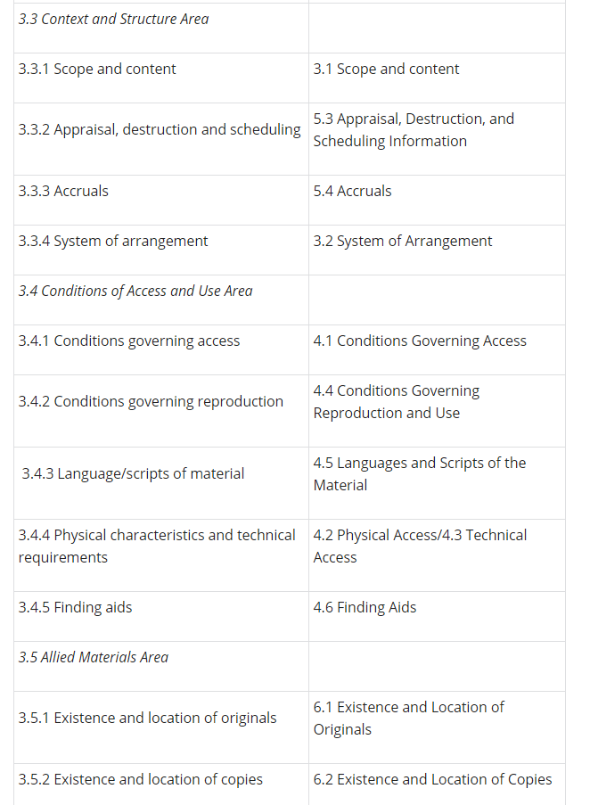
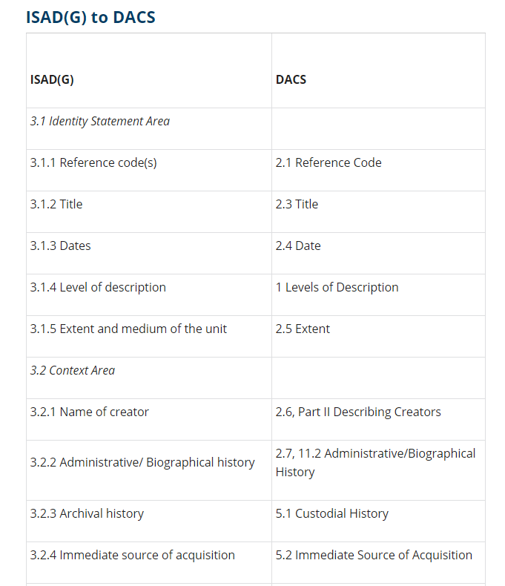
DACS and ISAD(G)

Slide 5
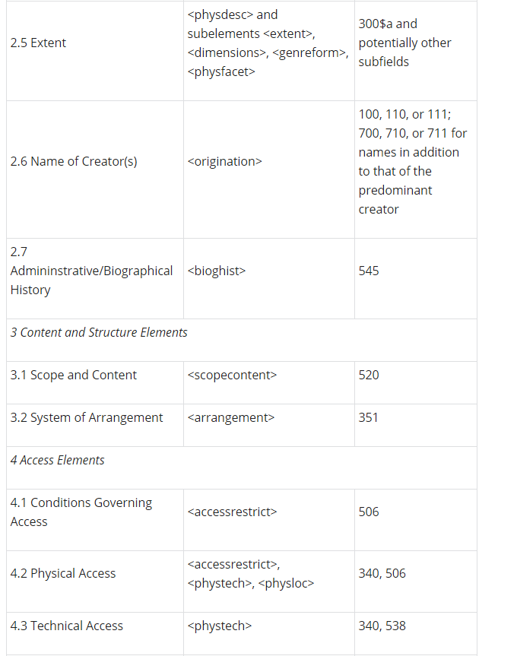
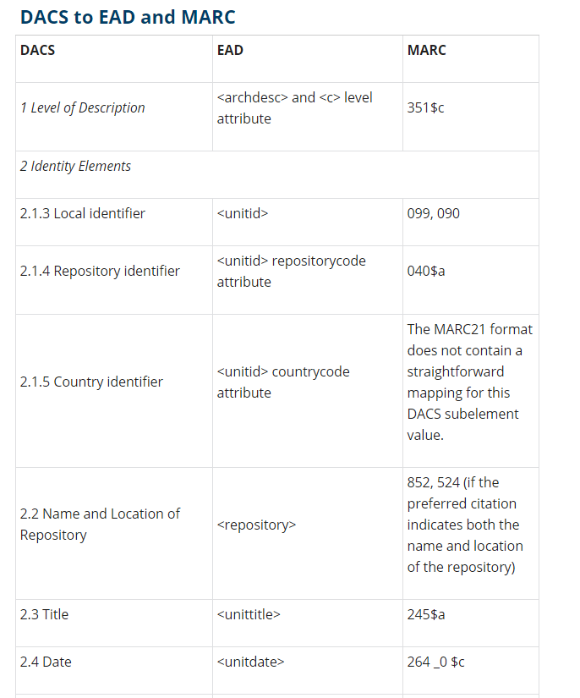
EAD, MARC, and DACS

Slide 6
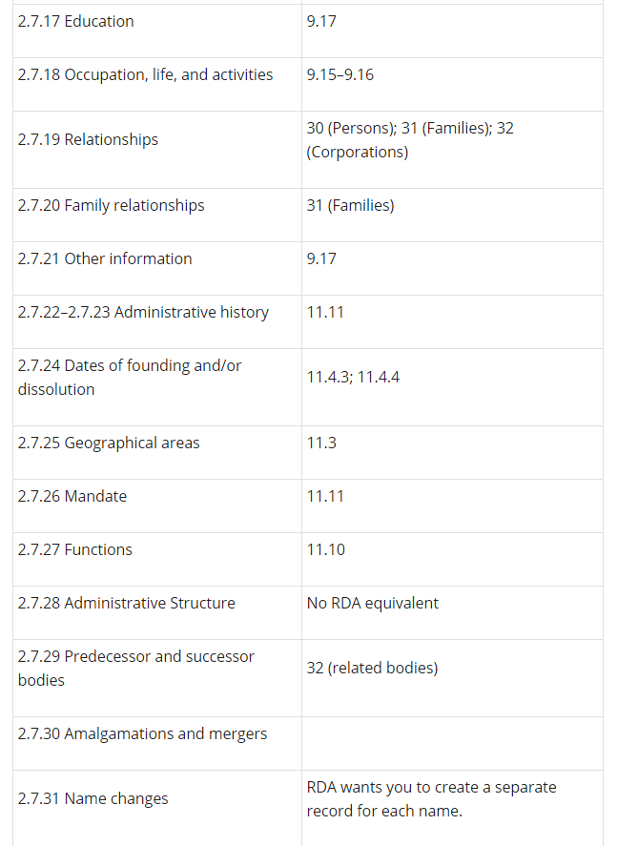
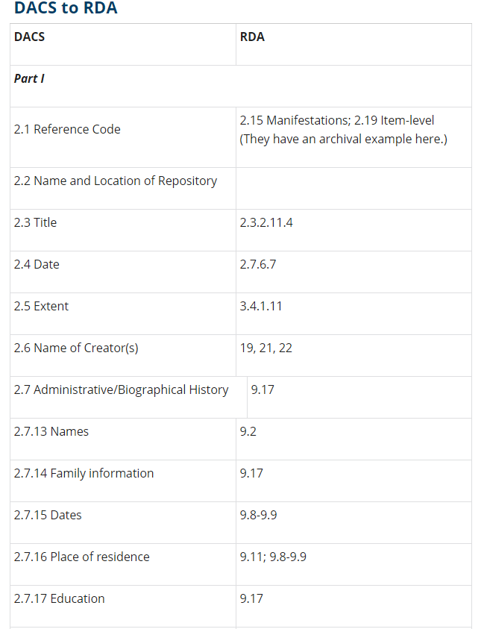
RDA and DACS

Slide 7
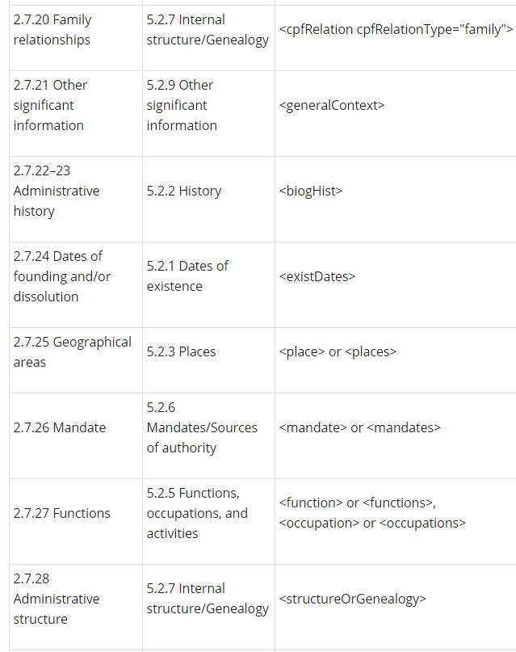
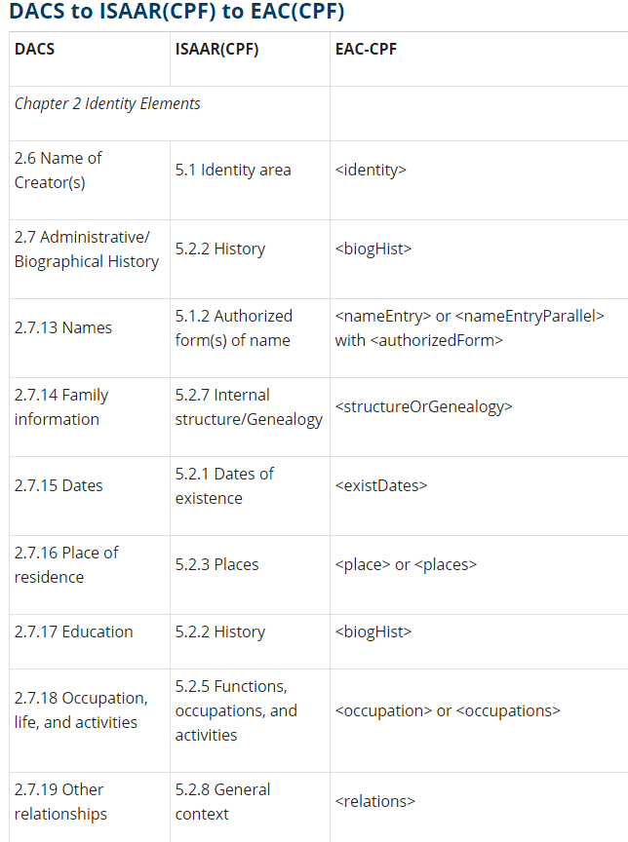
ISAAR (CPF), EAC-CPF, and DACS

Slide 8
Conclusion
Appendix C: Crosswalks

