Slide 1


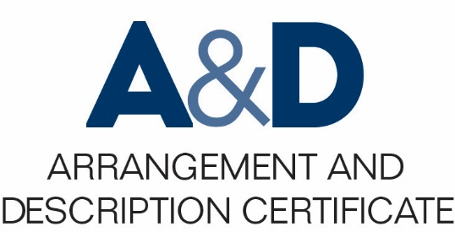
Describing Archives: A Content Standard Workshop Series Video 5
Single- and Multilevel Description
Presenter: Sue Luftschein
Additional material by Jennifer Mitchell
August 2016
©2016 Society of American Archivists
Notes:
Slide 1

Slide 2
Learning Objectives
Understand the differences between single- and multilevel archival description.
Understand the concepts of required, optimum, and added value elements and what it means for a description to be DACS-compliant.
Notes:
Slide 2

Slide 3
Single-level and multi-level description
Single-level description
Collection Only
Multilevel description
Collection
Series
Folder
Notes:
Slide 2

Slide 4
Single-level description
Collection
Record Group
Fonds
or
or
or
Series
Folder
Item
or
or
Notes:
Slide 2

Slide 5
Multi-level description
Collection
Series
Folder
Item
Notes:
Slide 2

Slide 6
Single-level and multi-level description
Single-level description = flat
Multilevel description = hierarchical
Notes:
Slide 2

Slide 7
Single-level description examples
Preliminary accession record
MARC 21 record in a library catalog not linked to other MARC 21 records
Wikipedia article that describes archival materials at a single level
Notes:
Slide 2

Slide 8
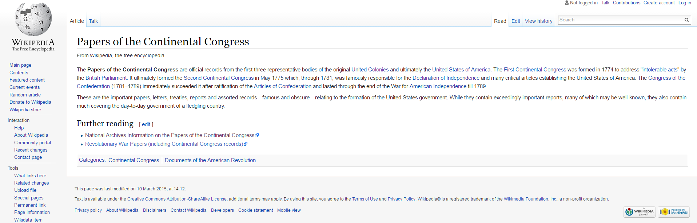
Single-level description example: Wikipedia
screenshot captured from https://en.wikipedia.org/wiki/Papers_of_the_Continental_Congress on 2016-07-13
Notes:
Slide 2

Slide 9
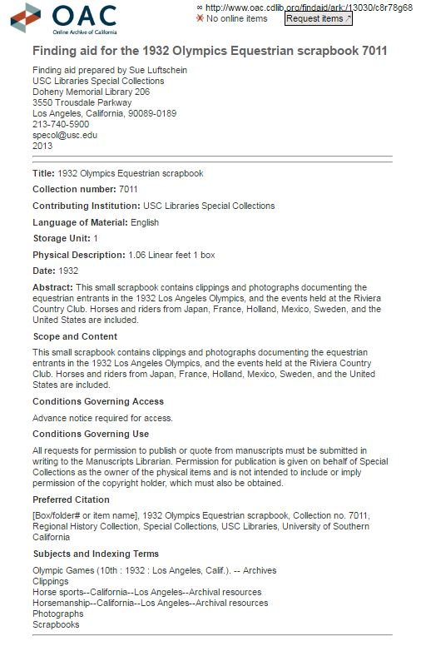
Single-level description
example:
Finding aid
Notes:
Slide 2

Slide 10
Multilevel description examples
Preliminary collection inventory or register
Full collection inventory or register
Multiple linked MARC 21 records
Notes:
Slide 2

Slide 11
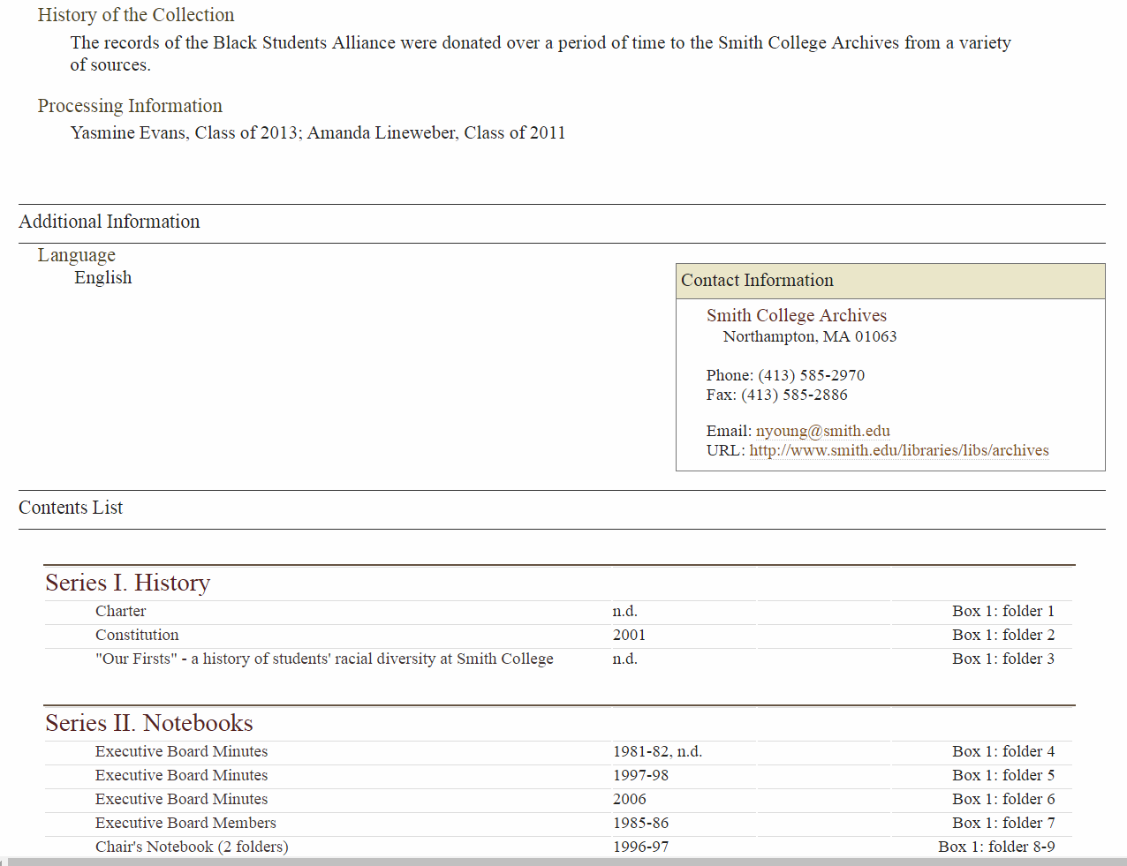
Multilevel example: Smith College Archives
screenshot captured from http://asteria.fivecolleges.edu/findaids/smitharchives/manosca308.html on 2016-07-13
Notes:
Slide 2

Slide 12
Required, Optimum, and Added-value elements
Required elements = minimum amount of information necessary for description to be DACS-compliant
Optimum elements = recommended when appropriate
Added-value elements may be of greater or lesser use, or sometimes inapplicable, depending on the particular descriptive work being done
Notes:
Slide 2

Slide 13
Conclusion
Archival material can be described at many different levels
DACS prescribes required, optimum, and added-value elements for both single- and multi-level description
Archival description, either single- or multi-level, must contain at least the required elements to be considered DACS-compliant
Notes:
Slide 2

