Slide 1


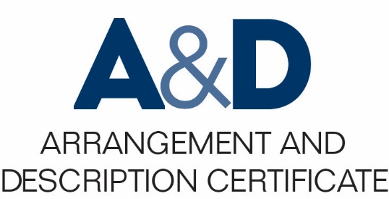
Describing Archives: A Content Standard Workshop Series Video 6
How DACS came to be and continues to adapt
Presenter:
Chris Marino
August 2016
©2016 Society of American Archivists

Slide 2
Learning Objectives:
How DACS came to be and continues to adapt
How DACS relates to other descriptive standards

Slide 3
Paradigm
Shift
1980s
Tech Adv.
Thru 1990s
DACS

Slide 4
PARADIGM SHIFT 1980s
Products
Of
Description
(MARC records)
Intellectual
Process underlying
Description

Slide 5
Internet
and XML
EAD
APPM
Paradigm
Shift

Slide 6

1994
ISAD(G)
Babycoverart.jpg

Slide 7
I
ISAD (G) 26 Elements
Identity Statement
Context
Content and Structure
Condition of Access and Use
Allied Materials
Note
Description Control

Slide 8
I
1996 ISAAR (CPF) 27 Elements
Identity
Description
Relationships
Control

Slide 9
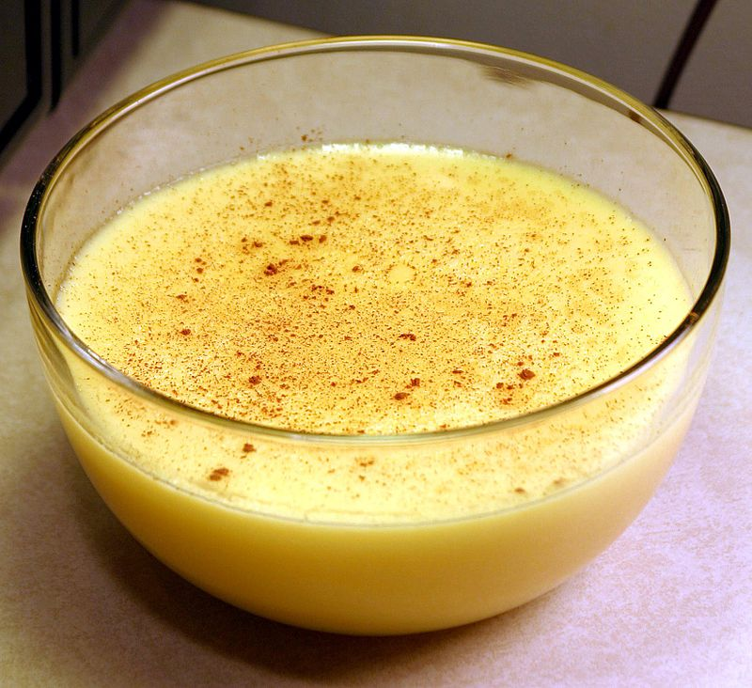
CUSTARD
Standard to replace APPM
Function in accordance with ISAD(G) and ISAAR(CPF)
Applicable to all types and levels of description
https://en.wikipedia.org/wiki/Custard#/media/File:Custard.jpg

Slide 10
TS-DACS and the 2013 Revision
Part III of DACS “Forms of Names” was removed
Part II of DACS was reworked to more closely align with ISAAR(CPF)
DACS was revised in response to feedback from the archival community to permit local naming conventions for digital/electronic records
TS-DACS created a companion website filled with more extensive examples

Slide 11
Things to remember...
DACS is an output neutral standard
Enables archival collections to be more accessible and places value on the intellectual component of processing
It is an ever changing standard that was and continues to be created by and for Archivists

Slide 12

Thanks for listening, and be sure to check out the rest of the videos in the Society of American Archivists series on DACS to become an archival description pro!
https://commons.wikimedia.org/wiki/File:Believe_Tour_12,_2012.jpg

