Slide 1


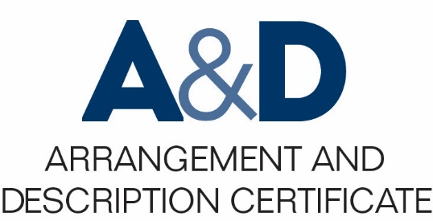
Describing Archives: A Content Standard Workshop Series Video 7
A Blitz through the Elements in Part I
Presenter: Tal Hurwitz
Date: 7/13/2016
©2016 Society of American Archivists

Slide 2
DACS Elements
Flexible
Applicable to dissimilar item types
Scalable
Useable with collections of any size
Interoperable
Output-neutral
Collaborative approach to current standards
Facilitates institutional exchanges

Slide 3
Required, Optimum, and Added Value Elements
DACS Required Elements
2.1
2.2
2.3
2.4
2.5
2.6
3.1
4.1
4.5
Reference Code
Name and Location of Repository
Title
Date
Extent
Name of Creator(s) (If Known)
Scope and Content
Conditions Governing Access
Languages and Scripts of the Material
DACS Online: http://bit.do/dacsonline

Slide 4
Element Categories
2
3
4
5
6
7
8
1
Identity Elements
Conditions of Access and Use Elements
Content and Structure Elements
Acquisition and Appraisal Elements
Related Materials Elements
Notes Element
Description Control Element
Levels of Description

Slide 5
Reference Code (2.1)
The single most important identifier in tracking your items.
Typically an alphanumeric sequence.
Identifiers are repeatable.
Includes a local reference code (2.1.3), a standardized three letter code for your repository (2.1.4), and a standardized county code (2.1.5)
2 Identity Elements
2.1.3 Local Identifier | 8Je.011
2.1.4 Repository Identifier | HCSS
2.1.5 Country Identifier | US

Slide 6
Name and Location of Repository (2.2)
The repository currently responsible for the storage of archival materials.
This includes the whole name of the repository (2.2.2), any parent bodies, the location (2.2.3), and optionally, the associated address.
2 Identity Elements
2.2.2 Name of Repository | Historical Center for Semantic Studies
2.2.3 Location of Repository | Historical Center for Semantic Studies. 239 East 42nd Street, New York, NY, 12231. (212) 867-5309.

Slide 7
Title (2.3)
Names the item or group of items as concisely as possible.
Formal title: A clear pre-existing title.
Devised title: A brief statement usually composed of a creator name and material type.
Devised titles are more common and are left to the archivist’s discretion.
2 Identity Elements
2.3 Title | Franklin Barais film collection

Slide 8
Date (2.4)
Can refer to many different types of “date.”
Be clear about which type of date you’re referring to.
Be consistent.
2 Identity Elements
2.4 Date | 1952-1993, bulk 1971-1991

Slide 9
Extent (2.5)
Describes the quantity and material types of items.
Quantity is described a unit of measurement.
Specificity in this field is important to guide researchers.
2 Identity Elements
2.5 Extent | Approximately 1250 slides, 350 medium-format photographic negatives, 200 medium-format photographic positives

Slide 10
Name of Creator(s) (2.6)
The primary entities associated with archival materials.
Typically refers to entities responsible for items.
2 Identity Elements
2.6 Name of Creator(s) | Barais, Franklin, 1930-2001

Slide 11
Scope and Content (3.1)
Usually the most extensive required field in a DACS record.
Provides information about and activities related to materials.
Details are recommended.
3 Content and Structure Elements
3.1 Scope and Content | These slides, negatives, and positives are primarily documentation of the Barais Collection of Oceanic Art, currently housed by various public and private repositories. The Barais Collection includes sculptures, figurines, statues, and other artifacts and realia documented by Franklin Barais and collected by his father between the period of 1856-1901, broadly in the geographical region of Oceania. The majority of slides are Kodachrome and were used in presentations. All photographic transparencies are medium-format film, and include studio image capture of individual artifacts and documentation of conservation treatments in action.

Slide 12
Conditions Governing Access (4.1)
Provides stipulations by which users are allowed access.
The access policy should be as clear as possible.
Include details regarding restrictions as appropriate.
4 Access Elements
4.1 Conditions Governing Access | Appointment required for in-house access. No other restrictions apply. For further information, contact the Archives Officer of the Historical Center for Semantic Studies at (212) 867-5309 or archives@hcss.org.

Slide 13
Language and Scripts of the Material (4.5)
The language in which a collection is composed.
Indicate mixed-language collections or items.
Indicate the lack of linguistic content if none exists.
4 Access Elements
4.5 Languages and Scripts of the Material | Image collection. All attached notes are written in English.

Slide 14
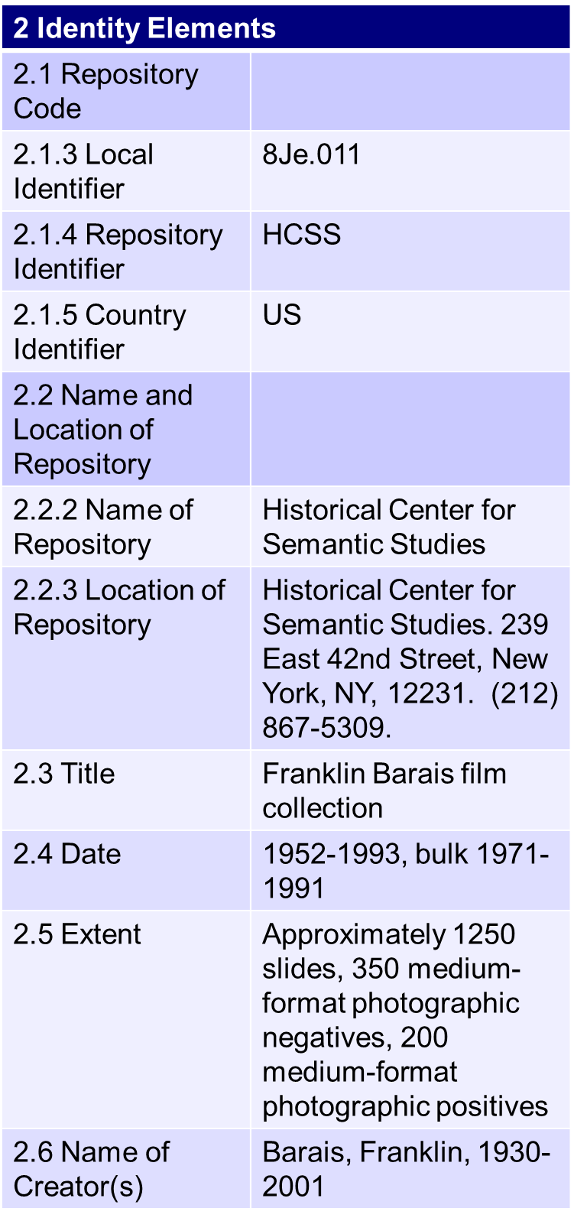
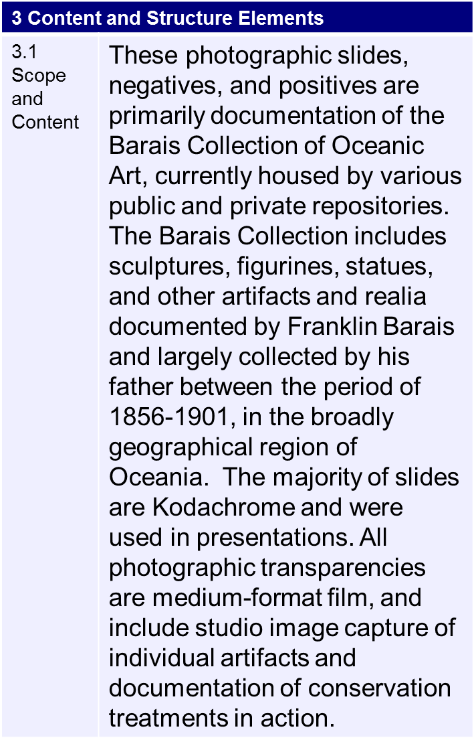
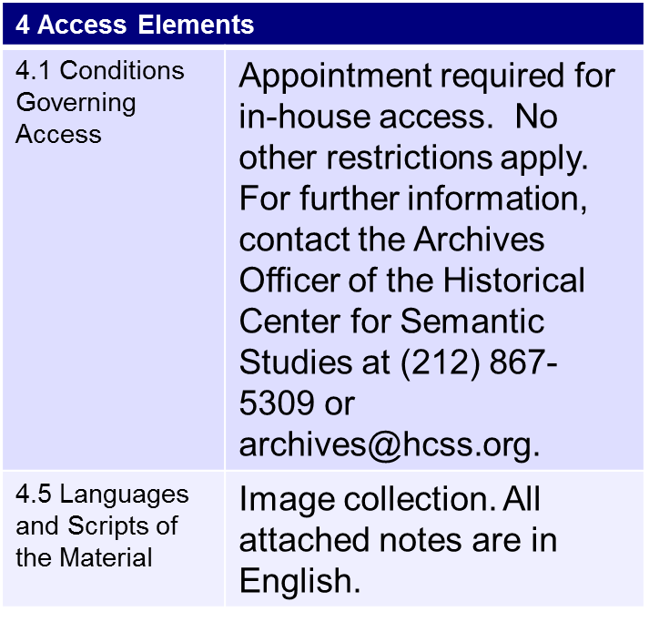
Authority Record Sample
DACS Online: http://bit.do/dacsonline

Slide 15
Conclusion
Thank you!
Get in touch: tal.hurwitz@gmail.com
Acknowledgements:
Thanks to the TS-DACS team for their editorial acumen and continuous assistance, and to Ami Ronnberg, Director, National ARAS, for her generous contribution of time to allow me to assemble this material.

