Slide 1



Describing Archives: A Content Standard Workshop Series Video 10
Archival Description in Archival Authority Records
Presenter:
Anneliese Warhank, C.A.
©2016 Society of American Archivists

Slide 2

Institution
Name of Creator

Slide 3
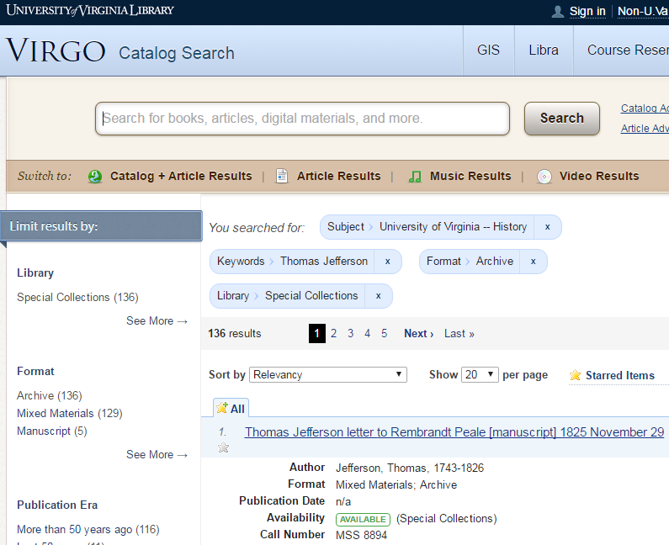
Different Institution
Same Creator
Notes:
3

Slide 4
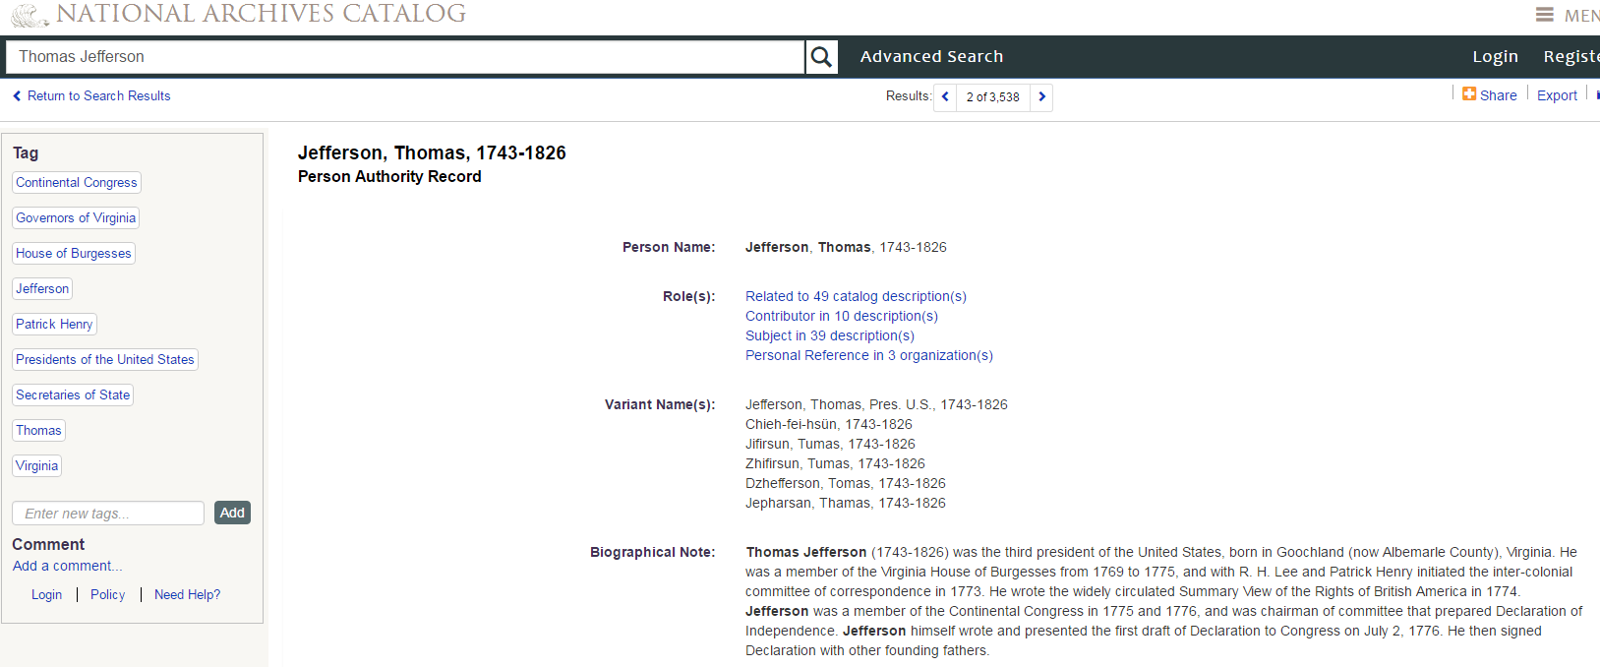
Notes:
4

Slide 5
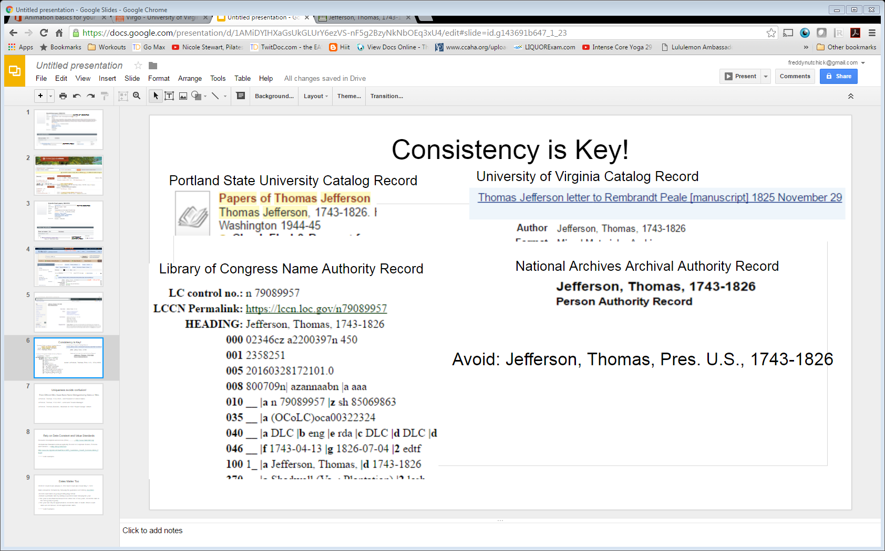
Consistency is Key!
(Add in Variant Names Element)

Slide 6
Uniqueness Avoids Confusion!
Three Different Men, Exact Same Name Distinguished by Dates or Titles
Jefferson, Thomas, 1743-1826
3rd President of the United States
Jefferson, Thomas, 1732-1807
Actor and Theater Manager
Jefferson, Thomas (Bassist)
Musician on the 1992 “Bryan Savage” Album
Notes:
*

Slide 7
Rely on Data Content and Value Standards for Names…
Library of Congress Name Authority Files (LCNAF)
http://id.loc.gov/authorities/names.html
International Standard Archival Authority Record for Corporate Bodies, Persons and Families (ISAAR[CPF])
http://bit.ly/1XKE5eh
Resource Description and Access (RDA)
http://www.rdatoolkit.org/
Notes:
7

Slide 8
…and Dates.
01/05/12 could mean January 5, 2015, but it could also mean May 1, 1912.
Dates should be formatted by following the guidelines set forth by ISO 8601
-Record exact dates in [year][month][day] format.
1743 April 13
-Indicate a probable date by adding a question mark
following the year.
1625?
-If the year is uncertain but known to be either one of two years, record the date in the form [year] or [year].
1501 or 1507
-If the year can only be approximated, record the date in the form approximately [year].
Approximately 1945 January
Notes:
8

Slide 9
Minimum DACS Element Required
There are four required elements when describing the creators of archival material one must use to comply with ISAAR[CPF] guidelines. These elements must convey standardized information about the creators being described.
-Authorized form of name (see 10.1)
-Type of entity (see 10.2)
-Dates of existence (see 11.1)
-Authority record identifier (see 13.2)
Notes:
9

Slide 10
Form of Name (Section 10) Example for Montana Power Co.
Authorized Form of the Name (10.1): Montana Power Company
Type of Entity (10.2): Corporation
Variant Names (10.3): Butte Electric & Power Company
Identifiers for Corporate Bodies (10.4): mtbup (MARC Code List for Organizations)
Notes:
10

Slide 11
Text or Code, Up to You
Type of Entity (10.2)
MARC 21 Records Code Examples
100 0# $a Huffman, L.A. Person
100 3# $a McArthur (Family: McArthur, Duncan, 1796-1864) Family
110 2# Museum of Natural Science (Jackson, Miss.) Corporate Body
EAC-CPF Encoding Examples
<entityType>person</entityType>
<entityType>family</entityType>
<entityType>corporateBody</entityType>
Plain Text Example
Type of Entity: Person
Notes:
11

Slide 12
Dates of Existence (11.1)
Examples
Record floruit (period of activity) dates, when specific dates cannot be established.
1841-1874 (active)
Record years or centuries in which corporations were active.
19th century (date of establishment)
Record significant dates associated with families.
1945 (date of termination)
Notes:
12

Slide 13
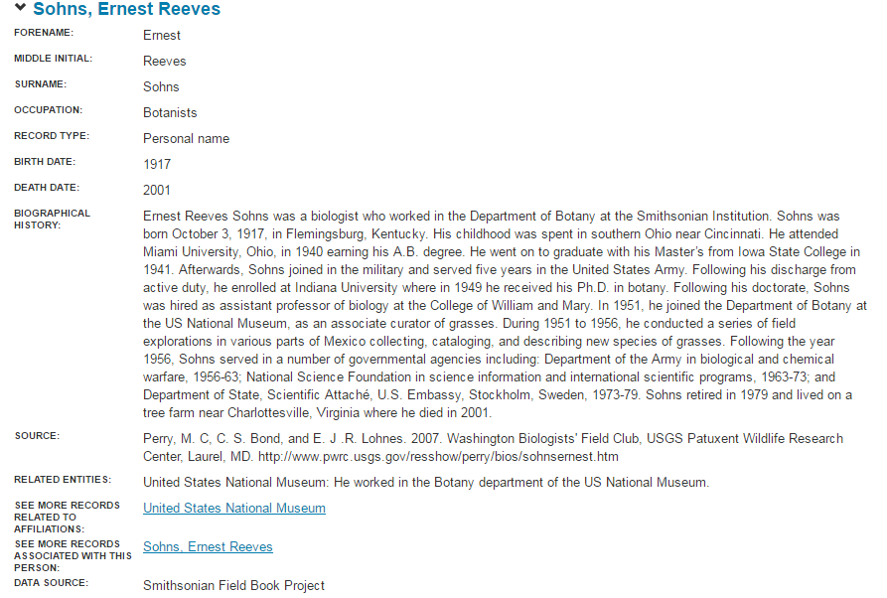
Description of Person, Family, or Corporate Body (Section 11)
Source: Smithsonian
Notes:
13

Slide 14
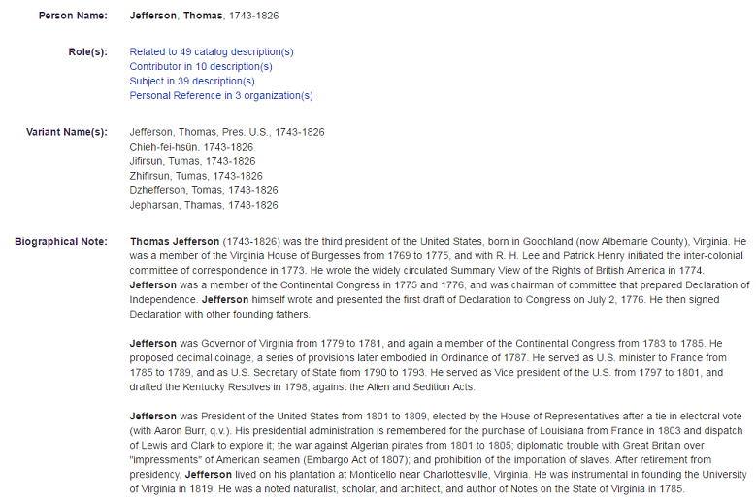
Tie It All Together
Historical Summary (11.2) serves as a description of the creator (identified and recorded in the previous element) in narrative format
Include dates when possible
Notes:
14

Slide 15
Places (11.3)
Plain Text Example
Washing County, Kan. (location of headquarters)
MARC 21 Records Code Example
370 bb $e Paris, France $s 1776 $t 1785
EAC-CPF Encoding Example <place> <placeRole>Residence</placeRole> <placeEntry vocabularySource=“lcsh”>Prickley Pear Creek Valley (Mont.)</placeEntry> <dateRange> <fromDate standardDate=“1504”>1865</fromDate> <toDate standardDate=“1905”>1905</toDate> </dateRange> </place>
Notes:
15

Slide 16
Legal Status (11.4)
Plain Text Example
Public limited company
EAC-CPF Example
<legalStatus> <term>Private limited liability company</term> <dateRange> <fromDate standardDate="1941">1941</fromDate> <toDate standardDate="1948">1948</toDate> </dateRange> </legalStatus>
Notes:
16

Slide 17
Functions, Occupations, and Activities (11.5)
For persons focus on occupations or activities.
Artists (occupation; from Index terms for Occupations in Archival and Manuscript Collections)
Civil rights workers (occupation; from LCSH)
For corporate bodies focus on functions.
Mining engineering (function; from LCSH)
Zoning (function; from Art & Architecture Thesaurus)

Slide 18
Mandates/Source of Authority (11.6) Corporate Bodies only
Plain Text Example
United States. Aviation and Transportation Security Act (from LC Name
Authority File)
EAC-CPF Example
<mandate> <dateRange> <fromDate standardDate="1919">1919</fromDate> <toDate standardDate="1925">1925</toDate> </dateRange> <citation>Minnesota. Executive Session Laws 1919 c49</citation> </mandate>
Notes:
18

Slide 19
Internal Structure/Genealogy (11.7)
For corporate bodies, record administrative structure, other corporate bodies that control or are controlled by entity.
Big Heart Pet Brands began as the pet food division of Del Monte Foods in 2006. In 2014 Del Monte Pacific Limited completed the purchase of Del Monte’s consumer food business. The remaining company consisted of the pet food division and was renamed Big Heart Pet Brands. In 2015 J.M. Smucker Company announced the acquisition of Big Heart Pet Brands.
For Persons or families, record family structure.
In 1873 Nickolas Kessler married Louisa Ebert, who was born June 15, 1849, in Williamsburg, New York, the daughter of G. Ebert, a German immigrant. The couple had three children: Charles N. (born July 9, 1874), Frederick E. (born in 1876), and Mathilda. Louisa died on December 18, 1880.
Notes:
19

Slide 20
Related Persons, Families, and Corporate Bodies (Section 12) Example Minnesota Dept. of Game and Fish
Names/Identifiers of Related Corporate Bodies, Persons, or Families (12.1): Minnesota. Division of Game and Fish
n 79066215 (LC authority record control #)
Types of Related Entity (12.2): Corporate Body
Nature of Relationship (12.3): Temporal
Can also record relationship using codes or text or in a narrative.
Dates of Relationship (12.4): 1931 (date of succession)
Notes:
20

Slide 21
Thanks for listening!
Next up:
Video 11: Elements in Part II of Describing Archives: A Content Standard

