Slide 1


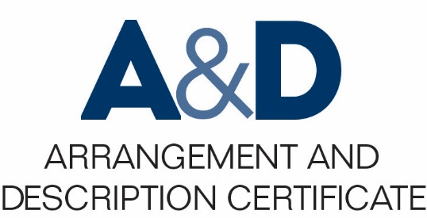
Describing Archives: A Content Standard Workshop Series Video 11
Elements in Part II
Presenter: Tal Hurwitz
Date: 7/12/2016
©2016 Society of American Archivists

Slide 2
Authority Records
Authority records present the context in which archival materials were created.
Authority records focus on information about the creation, assembly, and use of materials being described.
Traditional authority records are “embedded,” or included in the material descriptions.
DACS provides an alternative system of “linked” authority records, which are independent records connected to archival descriptions. This approach has many benefits.

Slide 3
Required and Added Value Elements
DACS Required Elements
10.1
10.2
11.1
13.2
Authorized Form of Name
Type of Entity
Dates of Existence
Authority Record Identifier

Slide 4
Categories of Authority Records
10
Description of Person, Family, or Corporate Body
12
13
14
Form of the Name
11
Related Corporate Bodies, Persons, and Families
Authority Record Management
Related Archival Materials and Other Resources

Slide 5
Authorized Form of Name (10.1)
The standardized form of a particular name.
Create this using standardized vocabulary and remain strictly consistent.
Where possible, DACS recommends Library of Congress Authority standards.
10 Form of the Name
10.1 Authorized Form of Name | Barais, Franklin (1930-2001).

Slide 6
Type of Entity (10.2)
Indicate the nature of the type of entity named in the authority record.
This can be a corporate body, a person, or a family.
10 Form of the Name
10.2 Type of Entity | Person

Slide 7
Dates of Existence (11.1)
Refers to the entity being described.
Include dates relevant to the subject.
Use different dates for a person (e.g. birth, death) than for a family (date founded, dates active) or a company (establishment, dissolution).
11 Description of Person, Family, or Corporate Body
11.1.2 Dates of Existence | 1930 December 4-2001 March 26

Slide 8
Authority Record Identifier (13.2)
Unique identifier for the authority record.
Either internally formulated, based on a system like the Library of Congress Authorities, or assigned by an external organization such as NARA.
13 Authority Record Management
13.2 Authority Record Identifier | bafr12041930.001

Slide 9
Authority Record Sample
10 Form of the Name
10.1 Authorized Form of Name | Barais, Franklin (1930-2001).
10.2 Type of Entity | Person
11 Description of Person, Family, or Corporate Body
11.1.2 Dates of Existence | 1930 December 4-2001 March 26
13 Authority Record Management
13.2 Authority Record Identifier | bafr12041930.001
DACS Online: http://bit.do/dacsonline

Slide 10
Conclusion
Thank you!
Get in touch: tal.hurwitz@gmail.com
Acknowledgements:
Thanks to the TS-DACS team for their editorial acumen and continuous assistance, and to Ami Ronnberg, Director, National ARAS, for her generous contribution of time to allow me to assemble this material.

