Slide 1

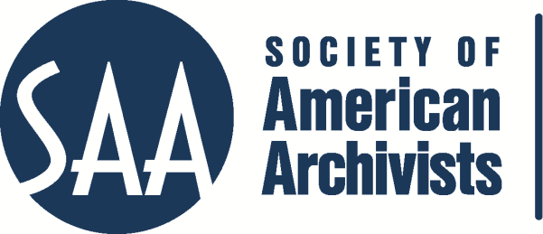
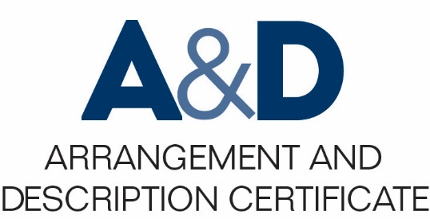
Describing Archives: A Content Standard Workshop Series Video 13
Relationships between Authorities and Archival Materials
Presenter: Katrina Windon
©2016 Society of American Archivists
Notes:
Hello, my name is Katrina Windon and I am a Photograph Archivist at the University of Nevada, Reno. Welcome to the thirteenth video in the Society of American Archivists instructional video series on Describing Archives: A Content Standard.
For those of you in the SAA’s Arrangement and Description Program, this tutorial is part of the required course on Describing Archives: A Content Standard. More information on the certificate program and requirements may be found at archivists.org.
In this video we will be going over the relationships between authorities and archival materials. Once this video is over, you should understand how to use reference authority records to standardize aspects of archival description and make certain collections metadata more easily harvested and shared. This video is free and available to anyone who wants to learn more about DACS, but if you sign up to take the DACS workshop for credit, you will be responsible for understanding this content, and there will be a quiz to test your understanding.
1

Slide 2
Archival Content Standards
ISAAR(CPF), Section 6
DACS Part II, Ch. 14
“Archival authority records are created primarily to document the context of records creation. To make this documentation useful it is necessary to link the authority records to descriptions of records. Archival authority records can also be linked to other relevant information resources.”
(ISAAR (CPF): International Standard Archival Authority Record for Corporate Bodies, Persons and Families, 2nd Edition. 2011.
http://www.icacds.org.uk/eng/ISAAR%28CPF%292ed.pdf)
“While authority records are created to document the context in which archival materials were created, it is also desirable to associate them with descriptions of the materials themselves and with other, external data that provides additional information about the entity described in the record. These connections may be electronic links within an archival information system between the authority record and associated descriptions or links to external files such as online biographical databases.” (Describing Archives: A Content Standard, 2nd Edition, 2013. http://www2.archivists.org/standards/DACS/part_II/chapter_14)
Notes:
As both DACS and ISAAR(CPF) note, authority records are vital tools for documenting the context of an archival record’s creation, but they’re most effective when they’re associated with the relevant archival records, and with each other.
Why use authority records—and why use others’ authority records, whenever possible? It reduces duplication of labor, and increases the opportunity for interoperability across consortiums and content aggregators like SNAC and ArchiveGrid.

Slide 3
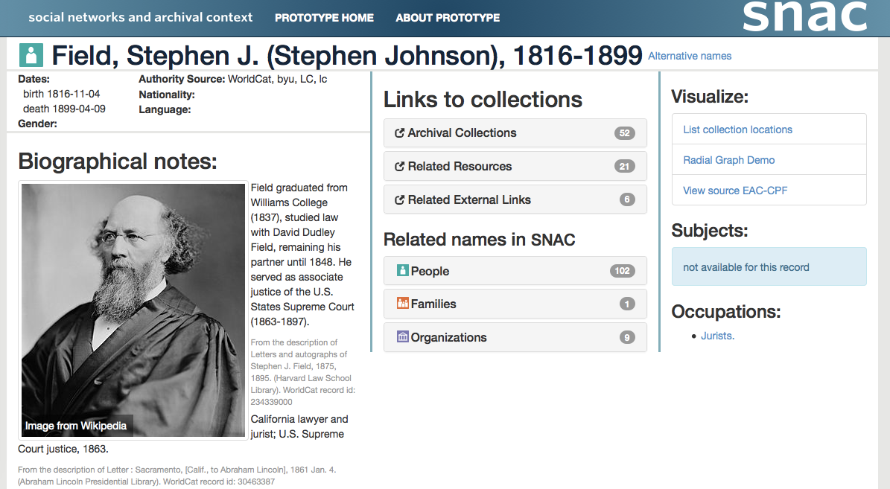
Creating connections between collections
(http://socialarchive.iath.virginia.edu/ark:/99166/w62n5c7k)
Notes:
A stand-alone authority record is a stub of a Wikipedia entry; linked to archival records and related authority records, it becomes part of a larger story, one that can be shared amongst repositories through tools like the Social Networks and Archival Context (SNAC) project.
3

Slide 4
Entity Relationship Types
Hierarchical
Temporal
Family
Associative
Notes:
Archival records can be created and influenced by a wide variety of people, organizations, and other agents. The exact nature of an entity’s relationship to a record may vary, and for a researcher it’s important to know whether the entity created the record, is related to the record, translated the record, or something else entirely. In order to ensure consistency in this area of archival description, several content standards and controlled vocabularies exist, some within larger standards and ontologies.
ISAAR(CPF), which DACS complies with and EAC-CPF supports, provides a framework for the description of the relationships between authorities and archival resources, and between authorities themselves.
ISAAR(CPF) entity relationship types may be described using an existing standard or by using one of four provided categories: Hierarchical, Temporal, Family, or Associative. These standardized categories can then be expounded upon in free-form description. DACS suggests using the same standardized categories developed by ISAAR(CPF) or using another vocabulary or standard, which should then be specified. Narrative description is also an option in DACS.
4

Slide 5
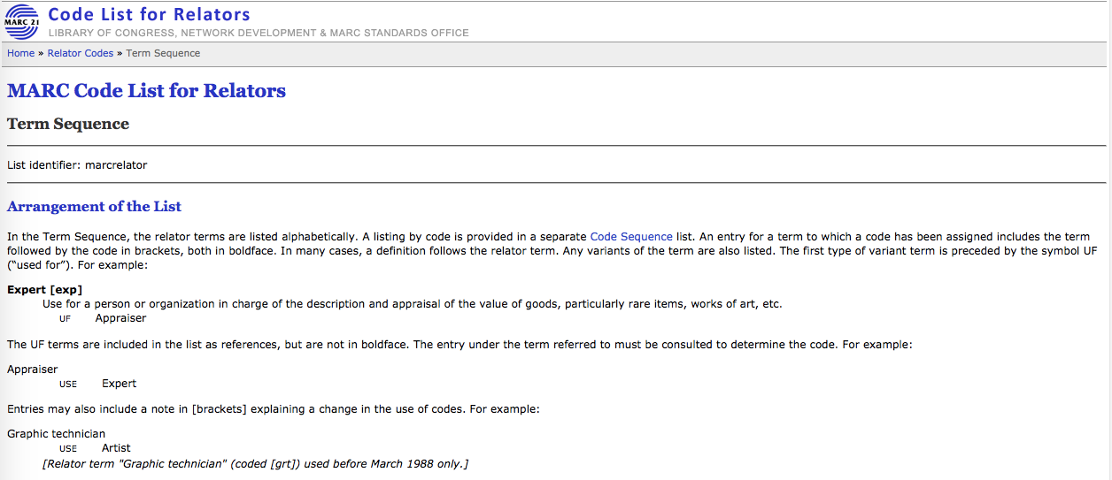
Describing the Entity-Record Relationship
MARC Code List for Relators
SCoRO
Art and Architecture Thesaurus- Agents facet
https://www.loc.gov/marc/relators/relaterm.html
Notes:
DACS doesn’t prescribe any one vocabulary or standard for relator terms, but there are many options. For entity-record relationship description, the MARC Code List for Relators is one of the most commonly used, and has been endorsed by the DCMI (Dublin Core Metadata Initiative).
Another possible vocabulary source is SCoRO, the Scholarly Contributions and Roles Ontology, which was designed for authors and publishers and could be a good fit for archivists working with institutional repositories. Other ontologies exist for other specialized data types, like the Agents facet of the Art and Architecture Thesaurus, which is the authority for the Creator Role element of the Categories for the Description of Works of Art (CDWA) standard, and is useful for art objects and museum collections.
These vocabularies may not always seem to be an exact fit for your collection needs—but DACS allows for narrative description to supplement controlled vocabulary terms when needed, and since most of the existing ontologies were designed to be as flexible as possible, this should meet most repository needs.

Slide 6
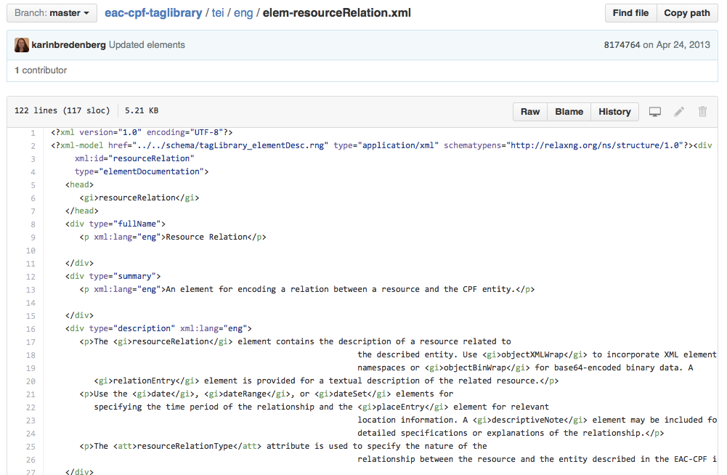
(https://github.com/SAA-SDT/eac-cpf-taglibrary/blob/master/tei/eng/elem-resourceRelation.xml)
Encoding the Entity-Record Relationship
Notes:
Once you have a completed authority record (or have found an existing authority record via LCAN, VIAF, ULAN, or another name authority) and you’ve selected a controlled vocabulary to describe the record relationships, it’s just a matter of linking the authority record to an archival record or to a related local authority record. Where this information is entered will depend on the metadata standard you’re following.
In EAC-CPF, a related entity can be described within a <cpfRelation> tag; a related resource expressed within a <resourceRelation> tag; or a related function within a <functionRelation> tag.
In an EAD record, information about the entity-record relationship is expressed in the <origination> tag, within which the label element can be used to express the general category (such as “Creator”) and the role element to express a more specific relator type (such as “Photographer”).
In Dublin Core metadata, entity-record relator information typically goes within the contributor element, and is further refined if necessary by using MARC relator terms; some institutions may instead use the creator element for this purpose.
Or, as DACS notes, these connections can even be expressed in print-based authority files, though that considerably limits the interoperability and usability of the records.
*

Slide 7
Thanks for listening!
Notes:
When implemented following professional standards, linking between authority records, archival records, and other resources can both provide a fuller context about the records’ creation and create a multitude of new access points to records—enhancing both discovery and understanding.
Thanks for listening, and be sure to check out the rest of the videos in the Society of American Archivists series on DACS to become an archival description pro!
7

