Slide 1

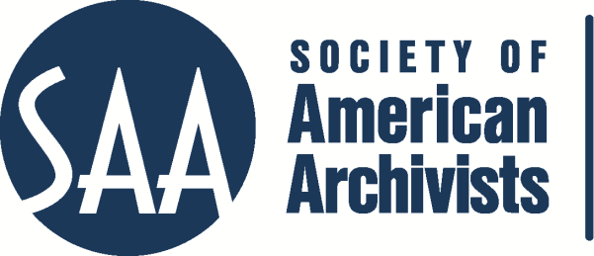
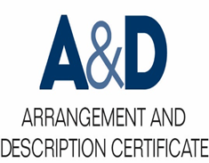
Describing Archives: A Content Standard Workshop Series Video 9
What are Archival Authority Records?
Presenter: Emily Gonzalez
©2016 Society of American Archivists

Slide 2
What are archival authority records?
Learning Outcomes:
Identify an archival authority record and its most important components
Know the differences between archival authority records and library (bibliographic) authority records
Learn the benefits of using archival authority records in your collections
See how to display authority records

Slide 3
YOUR INSTRUCTOR:
Emily Gonzalez, Archivist at the Cambridge Historical Commission

Slide 4

Archival authority records
Principle 8 in the DACS Statement of Principles: The creators of archival materials, as well as the materials themselves, must be described.
How?
Finding Aid
Materials
Creators
Archival Authority Record
Creators

Slide 5
What IS an archival authority record? According to DACS…
The archival authority record is a description of a personal, family, or corporate entity associated with a body of archival materials, typically where that name is used as an access point to a description of those records.
It gives us additional information and context to fully understand the creation and use of archival materials being described.

Slide 6
Details, details…
The archival authority record:
Identifies and describes a person, corporate body, or family (“entity”) associated with the archival materials
Documents relationships between these entities and the archival materials
May control the form of the name locally
Relies on consistency and uniqueness

Slide 7
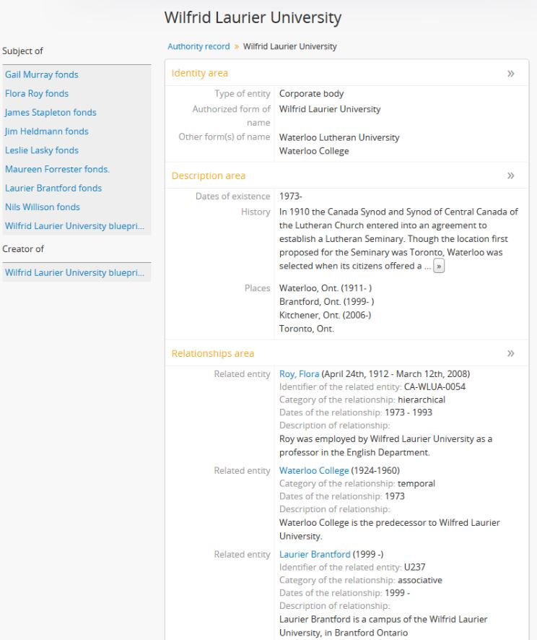
Source: https://www.accesstomemory.org/es/docs/2.2/_images/authority-record-example.png

Slide 8
What is required in an archival authority record?
4 types of information:
Identity (Name)
Description
Relationships
Control

Slide 9
Identity (Name)
Authoritative, standardized form of the name and any variant names
Create an authority record for each person, family, corporate body associated with the creation of archival materials
Ex.
Child, Julia
Or
Child, Lydia Maria, 1802-1880
Or
<corpname>New England Confectionary Company</corpname>
You can also indicate what kind of entity this is through codes or text. See above for an EAD encoding example of a corporate entity.

Slide 10
Description
The history and activities of the entity being described in the archival material (and is the subject of the authority record)
Administrative or biographical history
Ex.
Freddie Mercury, born Farrokh Bulsara on September 5, 1946, was a British singer, songwriter and record producer, known as the lead vocalist and co-principal songwriter of the rock band Queen. [Biography continues…]

Slide 11
Relationships resources
Relationships of the entity to other entities and information
Includes earlier names or other forms of names.
Ex.
Mercury, Freddie
Related name: Queen (Musical Group)

Slide 12
Control
Documentation of how authority record was created and maintained
Ex.
Authority record identifier (local):
01-0010205
Or
Rules/Conventions:
DACS
Or
Dates:
Created 15 June 2016. Revised 21 June 2016.
Or
A title/identifier of related resources:
A biography of Alexander Hamilton is available at http://www.pbs.org/wgbh/amex/duel/peopleevents/pande06.html

Slide 13
Why is the authority record useful?
Captures useful information about creators
Maintains in a separate system of authority records
Linked records

Slide 14
Archival authority record vs. Library (bibliographic) authority record
Contextual information
Detailed relationships model
Bounding of entities

Slide 15
Advantages of creating archival authority records
Reduce duplication and error
Document relationships
Access
Reduce maintenance
Record-creation context
Complex entity identification (i.e. name changes)
Data exchange

Slide 16
Where are archival authority records found?
Electronically: OPAC, finding aids
Paper-based
Shelf lists
Print finding aids or guides
Card catalogs

Slide 17
Next up:
What does archival description look like in archival authority records?
Notes:
Thanks for listening, and be sure to check out the rest of the videos in the Society of American Archivists series on DACS to become an archival description pro!

