Slide 1

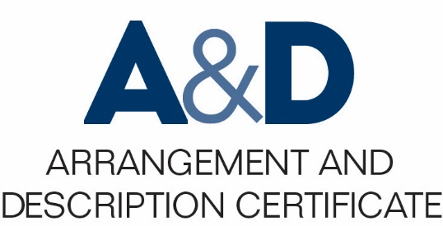
Relationships between authorities
Presenter:
Maristella Feustle
Date
©2016 Society of American Archivists

Slide 2
Your instructor:
Music Special Collections Librarian, University of North Texas Music Library
Master of Music, jazz guitar; Master of Library Science
Notes:
_________________________________________________________________
_________________________________________________________________
_________________________________________________________________
_________________________________________________________________
_________________________________________________________________
_________________________________________________________________

Slide 3
Overview / objectives
Major authority standards
Why they are important
How the unique needs of our profession inform archival authorities
Connections between authority standards
Notes:
*

Slide 4
“An Essential Activity”
DACS principles 1 and 8
ISAAR-CPF calls authority work an “essential activity” for three reasons:
Describe the creator(s)
Control creation / access points
Show relationships between creators

Slide 5
DACS Part II in context
ISAD(G)
ISAAR-CPF
EAC-CPF
DACS Part II and EAC-CPF have a common ancestor in ISAAR-CPF.

Slide 6
EAC-CPF: Implementations
The potential of XML-based frameworks
The SNAC project

Slide 7
More standards
Library of Congress
MADS
VIAF
ISNI
ORCID, ResearcherID, Digital Author Identifier, Lattes Platform

Slide 8
But why?
The human element of archival collections
Making connections across collections, institutions, and creators
Better service to our users
Broadening context, enabling discovery

Slide 9
Thank you!
Maristella.Feustle@unt.edu
Twitter: @MFeustle

